Slide 1
Exility
An approach to prospect, propose, deliver and maintain transaction processing applications
Notes:
(Slide should not be shown first. Provide the following explanation before displaying the slide)
Today, an organization that needs an application takes one of the following two approaches.
1. Buy license for a packaged standard(?) package (like ERP, CRM…). It costs them a one-time license fee, and a yearly fee. Vendor provides the Software in CDs on as-is-how-is basis. Customer uses implementation specialists to customize it to their needs, as well as maintaining it.
2. Engage service provider to develop a custom application for the organization.
Both the approaches have advantages and issues. While vendors push the advantages, customers are ultimately unhappy with either, as the issues start cropping-up as the implementation progresses, (or many a times, it does not progress). Customers have come t accept these issues as ‘inevitable’ in software industry.
Exility provides an alternate approach that aims to offer the advantages of the above two models while minimizing the associated risk. Exility is the foundation of Exilant’s business strategy. We propose to use this new business paradigm to offer compelling solutions to our customers.
Details of the business model is beyond the scope of this training. This training is on Exility-tech, the technology behind the business model.

Slide 2
Exility-tech
Technology that enables the Exility business model
Delivers the promise that the sales team makes
Achieves very high levels of productivity due to which we make money even after writing an attractive commercial proposal
Notes:
During this training, we focus only on the technology aspects behind Exility.
We should be clear about the objectives of Exility-tech. It is not a framework that we sell in the market. It is not a ‘generic’ tool for S/W development. It is very highly focused on the objectives as prescribed by the Exility Business Model. Most important of all, it is meant for ‘transaction processing system”

Slide 3
Review of Current Technologies
Application Architectures
  Client-server
    thick-client
    thin-client
    Rich-client , poor-server!!!
  Tiers
  Service Oriented Architecture
Notes:
Let us build some context.

Slide 4
Review of Current Technologies
Current Platforms
  .net
  Java
  LAMP
  Oracle Forms

Slide 5
What about Exility?
Client-server
Multi-tier
Java as well as .net
Standard Browser based client
AJAX
Notes:
Exility is not a framework, and as such does not enforce any specific deployment architecture. It actually provides lots of flexibility for deployment. However, it very strongly encourages, and many a times enforces, good software engineering priciples.
As of now, Exility is used in the above mentioned scenarios.

Slide 6
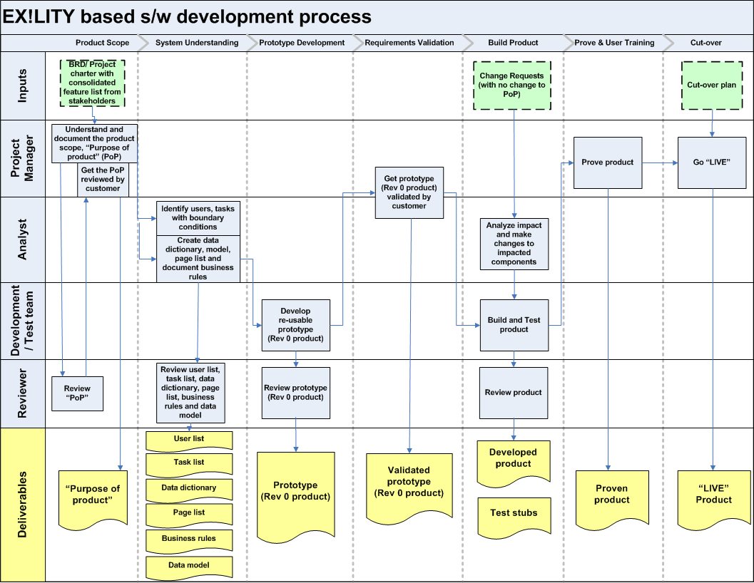
Notes:
This slide is to highlight the fact that the development process is different from the traditional approach.
We have to make separate presentation on process. That has to be used before asking the trainees to start the project.

Slide 7
Building Blocks – Data Element
Identified by unique name
Label
Data type
Enumerated values
Documentation
Grouped for convenience
Naming convention is CRITICAL
Collected into Data Dictionary
Notes:
Exility is used for developing data processing applications. Data is central here. Data is to be understood and modeled the way business users understand it. Exility requires you to create a dictionary of all such data elements in an application. Most data elements represent some business data, but event the data elements created by designers for internal use are also part of the data dictionary.

Slide 8
Transaction Processing Applications
Database
Business rules
Pages/screens
Reports
Interfaces
Batch processes
Notes:
A transaction processing application S/W has database at its center. In fact, data bases live much longer than the application S/W that is first written around that. S/W will become obsolete and gets re-written/replaces. But the data base lives on, it may be just about migrated to a new RDBMS. Data base is a corporate asset, and most of the time, the application S/W sooner or (than) later becomes a liability..
So Exility-tech models the entire application around database. It also emphasizes that the UI should be ‘de-coupled’ from server, so that it can catch-up with the changing times independent of the server. Similarly, server can have its own life-cycle independent of the client.
You will know how these are implemented without any hype in Exility.

Slide 9
Building Blocks – Data Type
Based on basic data type
  Integral
  Decimal
  Text
  Date (and time)
  Boolean
Project specific, and not fixed
Additional constraints
  Max/min value or length
  Days before/after today for date
  Pattern or regular expression
Notes:
Project defines its data types. Data types must be defined based on business needs, and should be named accordingly. E.g. text15 is not a good name. shortDescription, partNumber, id, amount, quantity are some good dataType names.
It is CRITICAL to have the right set of data types in a project. Too many or too few data types reduce flexibility during maintenance phase.
If the RDBMS chosen for the project allows the concept of user defined data types, then it would be ideal to reuse the same set. This will avoid any mismatch between the lengths of texts on the client and on the server. (For example, if the client allows more characters for a text field than the max characters defined in the database, a run-time error occurs)

Slide 10
Data Dictionary
Vocabulary of the application
In its initial stages of evolution
Consists of groups
Group has data elements
A project can choose its naming convention
  Names unique across groups (recommended)
  Names unique within a group
    Names should always be qualified (prefixed)
Notes:
Is a repository of every data element name used in the application. Exility enforces that any field, parameter or column name that is used anywhere in the application, either in the client or on the server, MUST be defined in the data base. This provides a central place to document all the data elements in the application. It also ensures consistency by avoiding duplicate entries.
As of now, data dictionary is just a ‘collection’ of all of them. Though it has the concept of ‘group’, the group is used only for organizing data elements in manageable and meaningful clusters.
In the future, we plan to use Data Dictionary to define all aspects of data organization, including the tables and views of the RDBMS model behind it. It will also be used to implement business logic in consistent manner.
(Show an example in VS and explain all the attributes)

Slide 11
Building Blocks – Field/Parameter
Instance of a data element
Name is the pointer to data dictionary
  Can override name to a local name
Can override label
Possible to use a different name and map it to a data element
Notes:
Any component of a transaction processing system will be full of variables/fields/parameters. Exility insists that you use only the names defined in the data dictionary. That provides excellent automatic documentation.
However, if it is not meaningful to define some local variables into the data dictionary, then programmer has the flexibility to have her own name, but it should be mapped to a data element in the data dictionary.

Slide 12
Building Blocks – List, Grid
List
  Like an array
  field that can have more than one values.
  All values are of the same data type
Grid
  Like a table
    Rows and columns
    Each row is ‘regular’
      Has all the columns
        No merge/break
      No mix of header/detail rows
  First row has column names
  Column names are from data dictionary
Notes:
Other than the simple field, Exility uses two data structures.
List is an ‘array’ of values for a name. Grid is a ‘collection’ of lists. However, it is easier to think of grid as a table. The order of column is not important by default. Exility uses names of columns rather than the index of the column. (however, there are some cases where a programmer can override this behavior and use column index instead)
No project has used list so far!!

Slide 13
Building Blocks – Messages
Message is identified by its id
Has severity
  ignore, info, warning, error
Text is provided with possible place holders for run time formatting
Allows multi-lingual implementation
Common between server and client
Notes:
Programmers should not hard code messages any where in the components. Instead an entry is to be made in the messages file, and the id is to be used. This allows multi-lingual implementation. Also, the severity of message can be site specific. Components detect a condition, and raise the corresponding message. A given site may change an error to warning etc..
Message text may contain ‘@1’ etc.. As place holders. Values are passed to these at run time. A meaningful message is formatted using these at run time.

Slide 14
Exility Architecture
Right Client – Right Server
  Very strict division of labor
Client
  Renders data
  Responds to user actions
  Gets input from users
  Handles navigation
Server
  All business logic
  Data storage and retrieval
Notes:
Exility enforces a simple client-server architecture.
We used to have ‘terminals’. A terminal typically had fixed number of rows and columns with fixed fonts.
All it could do was to display text characters, possibly in color and some decoration (bold/underline..)
An ‘intelligent terminal’ like 3270 terminal could ‘paint’ a form with enterable areas.
Online applications that used such terminals were monolithic.
Next generation of applications used PCs as clients. They typically used the computing power of PC to carry out not only validations, but also large part of business logic. Most applications used fat-clients, in that the server was used more like a data base server.
Then came the web era. Applications took a U turn, and started using PC as a terminal again. A typical asp/jsp based application was worse than the old Cobol code. Initial web designers resorted to monolithic programs in asp/jsp. This was a severe set back to the industry (during the .com boom)
J2EE changed the scenario. New breed of influential architects started professing multi-tier architectures. Theoretical purity gained importance. Architects talked about logical layers and allowed physical implementation across computers. Typically, the edge of the client tier was the browser (HTML client) with couple of layers implemented on the server to realize ‘client-tier’. (J2EE architecture with Struts, or JSF are examples.)
We propose a simple client-server architecture. This completely different from anything you would have seen. If you know any architecture well, please do not try to compare. Just understand this from scratch. Try to do the comparison only after we are done with training.

Slide 15
Contract between Client and Server
Service List
  A menu of services
A service
  may require data input from client
  returns status, data and messages (if any)
Text based protocol – like HTTP
Notes:
Exility views the application primarily from users’ perspective. Users see pages (forms).
[ In Exility, every transaction has a user. Batch programs, as traditionally known, are considered to be for a special user called ‘Clock’. Similarly, other applications are considered to be users..]
With this view, the application is visualized in terms of the client first. Client design results in a set of services that it requires to complete its job. A request from the client to the server for a specific service is called a ‘service’.
We will discuss service in details later, but a simple example will help here.
viewCustomer page requires the user to type a customerId and shows the details of that customer. This page requires a service, say getCustomerDetails. Client will send the id typed by the user, and expects the server to give twenty three attributes of the customer (Why 23? I like that number☺)
In this case getCustomer is a service that is agreed between the client and the server where the client is expected to supply the id and the server returns the details. Of course, server returns a message and error status if no customer is found with the supplied id)

