Slide 1

Data Visualization WORKSHOP using Tableau
Raghu Kalyan Anna
PSG COLLEGE OF TECHNOLOGY

Slide 2
Agenda
Github Integration
Business Intelligence (BI)
BI and DS Magic Quadrants
Data Visualization Principles
Popular Data Visualization Tools
Tableau
Tableau Hands On
References

Slide 3
Github Integration
Latest version of this presentation will be available in Github
Along with PPT; Tableau session setup document and Handout with Answers are available here.

Slide 4
What is BI?
Business intelligence (BI) is a set of theories, methodologies, architectures, and technologies that transform raw data into meaningful and useful information for business purposes. [Gnosis]
Business intelligence (BI) is an umbrella term that includes the applications, infrastructure and tools, and best practices that enable access to and analysis of information to improve and optimize decisions and performance.
[Gartner]

Slide 5
What is BI? Contd..
A set of methodologies, processes, architectures, and technologies that leverage the output of information management processes for analysis, reporting, performance management, and information delivery. [Forrester]
Business Intelligence (BI) comprises the strategies and technologies used by enterprises for the data analysis of business information. BI technologies provide historical, current and predictive views of business operations. [Wikipedia]

Slide 6
Steps in BI
Data from different systems
Data Repository
Reports
Data discovery capabilities

Slide 7
A word about Gartner
Gartner is the world's leading information technology research and advisory company.
“We deliver the technology-related insight necessary for our clients to make the right decisions, every day” [Gartner]

Slide 8
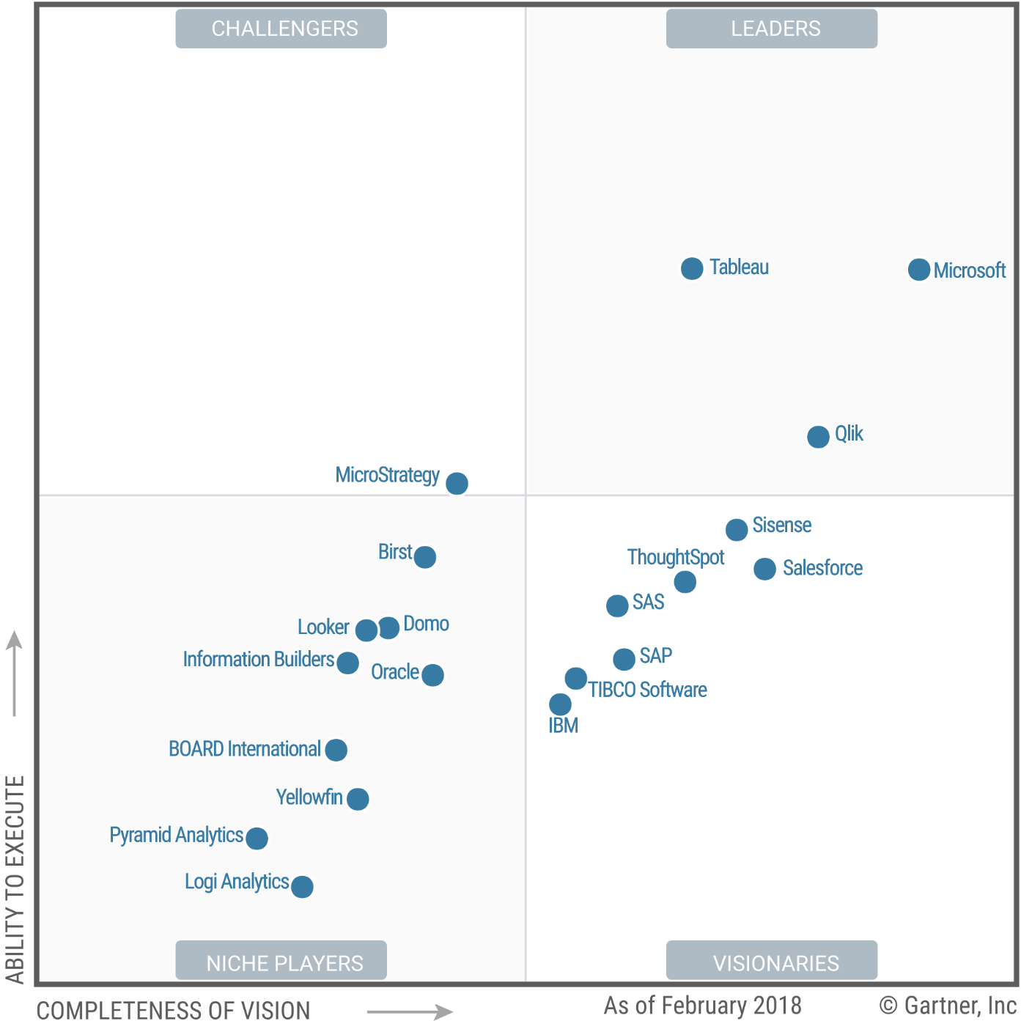
Gartner’s BI Magic Quadrant
Source: Gartner (February 2018)

Slide 9
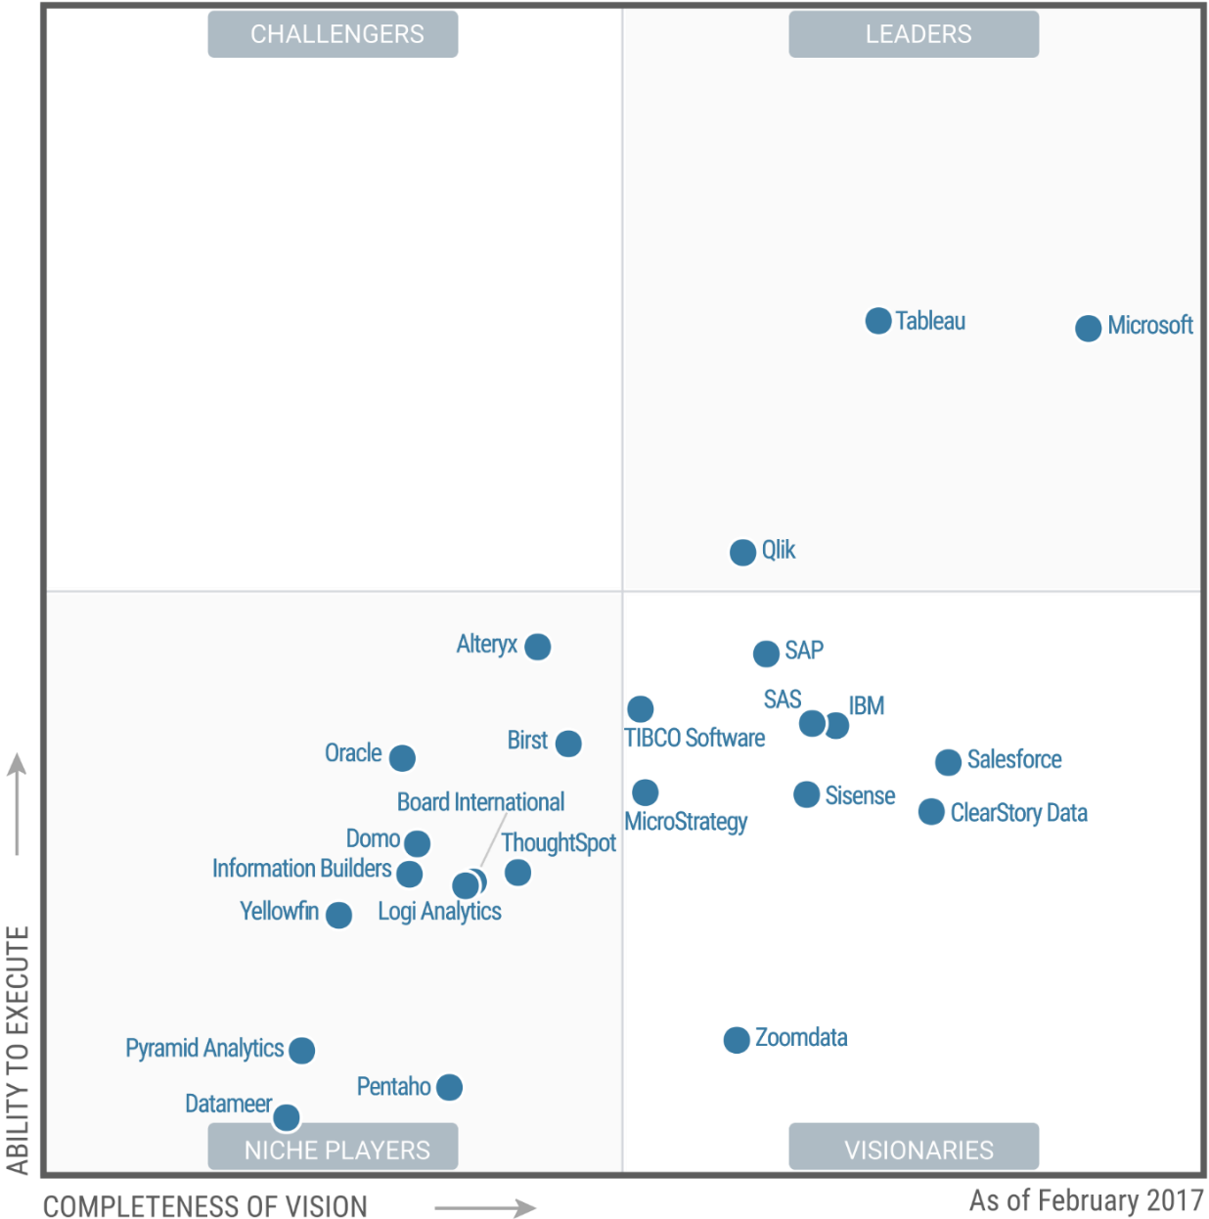
Gartner’s BI Magic Quadrant
Source: Gartner (February 2017)

Slide 10
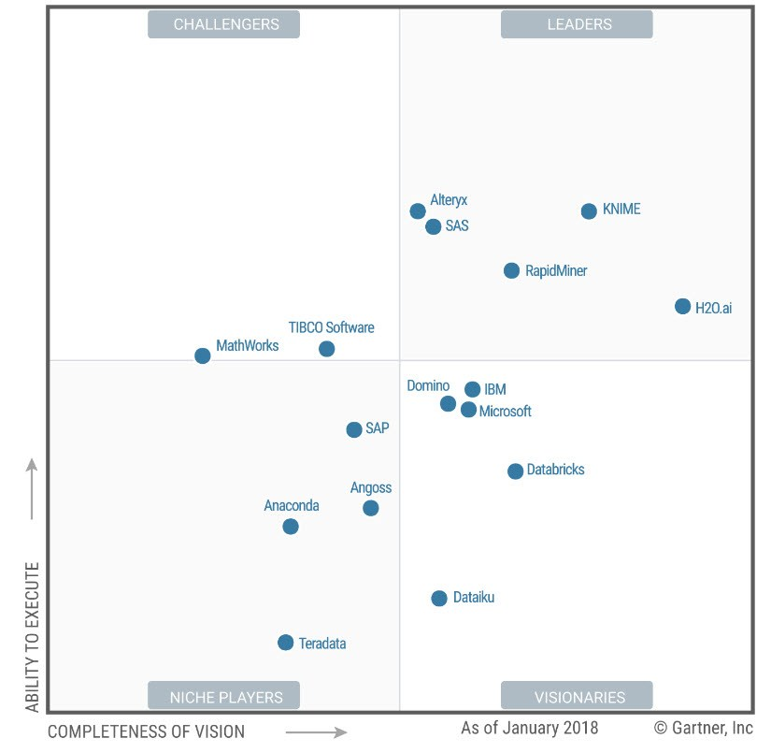
Gartner’s Data Science Magic Quadrant
Source: Gartner (January 2018)

Slide 11
Data Visualization Principles
Edward Tufte’s Principles
  Graphical Excellence
  Design Aesthetics
  Book: THE VISUAL DISPLAY OF QUANTITATIVE INFORMATION
Gestalt’s principles for Data Visualization. Also known as Gestalt laws of Grouping.
Notes:
https://www.quora.com/What-are-the-major-reasons-for-adoption-of-Tableau-over-other-data-visualization-tools

Slide 12
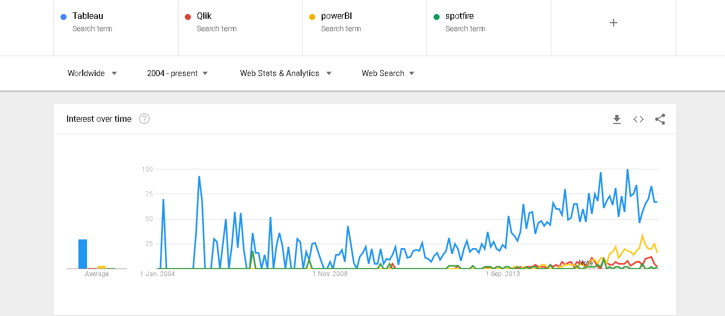
Tableau vs Others
Source: Google Trends

Slide 13
Tableau Illustration
Tableau Public Earth Quake Story
  Public Illustration
  Step-by-Step Example of Above. For later practice
Notes:
https://www.quora.com/What-are-the-major-reasons-for-adoption-of-Tableau-over-other-data-visualization-tools

Slide 14
Tableau Features
Ease of Use
Connectivity with multiple data sources
Flexibility
Better visualization
Statistical Analysis
Maps and Licensing
Notes:
https://www.quora.com/What-are-the-major-reasons-for-adoption-of-Tableau-over-other-data-visualization-tools

Slide 15
Tableau Integrations
Tableau Javascript API – excellent integration with D3
Tableau with R and Python using
  SCRIPT_BOOL
  SCRIPT_STR
  SCRIPT_INT
Notes:
https://www.quora.com/What-are-the-major-reasons-for-adoption-of-Tableau-over-other-data-visualization-tools

Slide 16
Dimensions and Measures
Dimension
  Independent variable
  Discrete
  Also known as Categorical field
Example:- Month, Date

Slide 17
Dimensions and Measures Contd..
Measure
  Dependent variable
  Aggregated field
  Continuous
  Also known as Metrics.
Example:- Profit (in numbers)

Slide 18
Tableau Products
Tableau Desktop – Develop and share
Tableau Server – Enterprise level Web
Tableau Online – BI in the cloud
Tableau Reader – Free and only to view
Tableau Public – Free, publish interactive online
Tableau Desktop for Students – Starts with 1 year free subscription
Notes:
Tableau Desktop – Develop Dashboards and share thru other means
Tableau Server – Enterprise level Web based Tableau Software. Share.
Tableau Online – Hosted version of Server
Tableau Reader – Free and only to view
Tableau Public – Free, similar to Desktop. Can be shared only in public cloud
Tableau Desktop for Students – Starts with 1 year free subscription

Slide 19
Tableau Data Types
Boolean – True or False
Whole Numbers – 200 or 30
Decimal Numbers – 12.4
Date/timestamp – Feb 1 2018 12:00 PM
Text/String – Conference, IEEE
Geographic Values – Country or Region Name

Slide 20
Tableau Usage
Connect to data
Analyze data thru UI
Create Visualization and Share

Slide 21
Tableau Menus
File Menu
Data Menu
Worksheet Menu
Dashboard Menu
Story Menu
Analysis Menu

Slide 22
Tableau Menus Contd..
Map Menu
Format Menu
Server Menu
Notes:
File menu
This Menu is used to create new Tableau workbook and open existing workbooks from both local system and Tableau server. The important features in this menu are:
Workbook Locale to set the language to be used in the report.
Paste Sheets to paste a sheet into the current workbook which is copied from another workbook.
Export Packaged Workbook option is used to create a packaged workbook which will be shared with other users.
Data Menu
This Menu is used to create new data source to fetch the data for analysis and visualization. It also allows you to replace or upgrade existing data source.
The important features in this menu are as follows:
New Data Source to see all the types of connections available and choose from it.
Refresh All Extracts to refresh the data form source.
Edit Relationships option is used to define the fields in more than one data source for linking.
Worksheet menu
This Menu is used to create new worksheet along with various display features like showing the title and captions etc.
The important features in this menu are as follows:
Show summary to see the summary of the data used in the worksheet like count etc..
Tooltip to show the tooltip when hovering above various data fields.
Run Update option is used to update the worksheet data or filters used.
Dashboard menu
This Menu is used to create a new dashboard along with various display features like showing the title and exporting the image etc..
The important features in this menu are as follows:
Format is used to set the layout in terms of colours and sections of the dashboard.
Actions to link the dashboard sheets to external URLS or other sheets.
Export Image option is used to export an image of the Dashboard.
Story Menu
This Menu is used to create a new story which has many sheets or dashboards with related data.
The important features in this menu are as follows:
Format is used to set the layout in terms of colours and sections of the story.
Run Update to update the story with latest data form source.
Export Image option is used to export an image of the story.
Analysis Menu
This Menu is used for analyzing the data present in the sheet. Tableau provides many out of box features like calculating the percentage and doing a forecast etc..
The important features in this menu are as follows:
Forecast to show a forecast based on available data.
Trend Lines to show the trend line for s series of data.
Create calculated Field option is used to create additional fields based on certain calculation on existing fields.
Map Menu
This Menu is used for building map views in Tableau. You can assign geographic roles to fields in your data.
The important features in this menu are as follows:
Map Layers to hide and show map layers, such as street names and country borders, and add data layers.
Geocoding to create new geographic roles and assign them to the geographic fields in your data.
Format Menu
This Menu is used for applying the various formatting options to enhance the look and feel of the dashboards created. It provides features like borders, colours, alignment of text etc..
The important features in this menu are as follows:
Borders to apply borders to fields displayed in the report.
Title and caption to assign a Title and caption to the reports.
Cell Size to customize the size of the cells displaying the data.
Workbook Theme to apply theme to the entire workbook.
Server Menu
Server Menu is used to login to the Tableau server if you have access and publish your results to be used by others. It is also used to access the workbooks published by others.
The important features in this menu are as follows:
Publish Workbook to publish the workbook in the server to be used by others.
Publish Data source to publish the source data used in the workbook.
Create User filters to create filters on the worksheet to be applied by various users when the access the report.

Slide 23
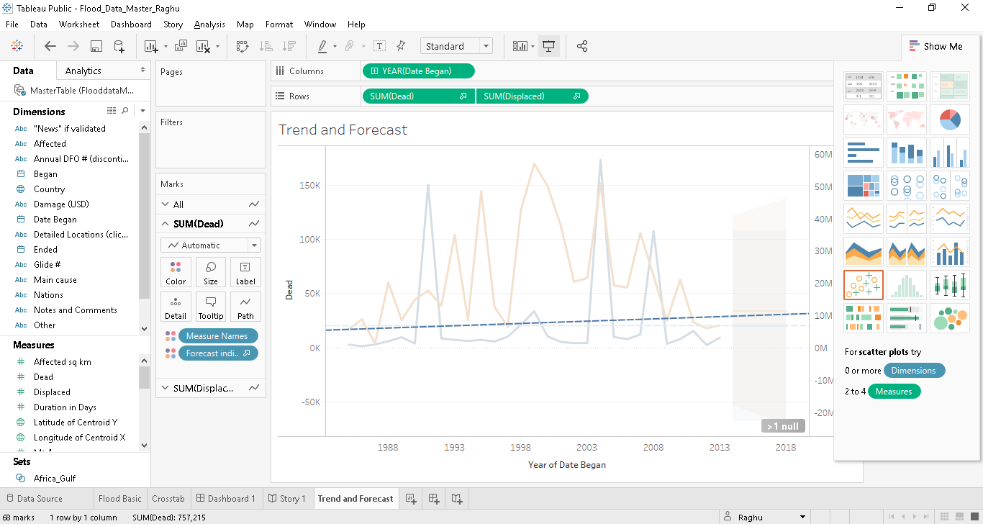
Tableau Public

Slide 24
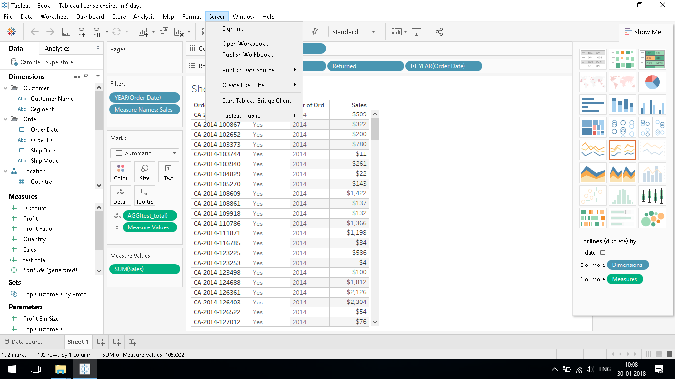
Tableau Desktop Professional

Slide 25
Tableau Visualizations
Visualization Type | Purpose
Bar Graph | Dimension is continuous
Line Graph | Continuous Dimensions
Dual Axis Graph | Two Measures together
Geographical Graph | Plot Measures on a Map
Area Graph – Dual Axes | Better comparison for Measures
Heat Map | Variations across Categories
Tree Map | Represent quantity in nested rectangles

Slide 26
Distributing and Publishing
Images and PDFs are static. No Data.
Workbooks
  Shared using Tableau Desktop or Reader
  Published using Tableau Server or Online
  Data refresh using schedule or live connection
  Accessed thru web browser or Mobile App
Packaged Workbooks
Non-packaged Workbooks
Notes:
Images and PDFs do not contain the underlying data and are static, both for any interactivity and for data updates because they’re simply snapshots taken at a particular time.
Workbooks, either packaged to contain the data or not, can be shared with others who have Tableau Reader or Tableau Desktop. Tableau Reader can view and interact with workbooks. Tableau Desktop can view and edit workbooks. Packaged workbooks may contain the underlying data and are not encrypted. Non-packaged workbooks require the recipient to have access to the same data source as they do not contain the data themselves.
Workbooks can also be published to Tableau Online or Tableau Server. These workbooks are secure, fully interactive, and can be scheduled to have data refreshes or maintain a live connection to the data source Published workbooks can be accessed via any major web browser as well as on mobile devices with the native Tableau App.

Slide 27
Tableau Hands On

Slide 28
Getting Started
Tableau Account
Data Sources or workbooks downloaded
Software installed – Any of
  Tableau Public
  Tableau Desktop
  Tableau Desktop for Students

Slide 29
Saving and Publishing Data Sources
Save Locally
Publish to a Tableau Server or Tableau Online

Slide 30
Hands On Demo
Using the Data, create basic charts
Sets, Filters, Cross Database Joins
Trend Lines, Forecasting
Dashboard and Story
Maps, Calculations, Integrate with R
Publish to Tableau Online, if account is ready

Slide 31
Sets, Filters
Session Exercise
Any Data Set from provided list
Create a Filter
Create a Set and label it
Notes:
https://www.tableau.com/learn/tutorials/on-demand/creating-sets?product=tableau_desktop&version=10.5&topic=visual_analytics
https://www.tableau.com/learn/tutorials/on-demand/working-sets?product=tableau_desktop&version=10.5&topic=visual_analytics

Slide 32
Cross-Database Join
Session Exercise
Using Sample Superstore Orders and Returns tables
Create a Join – Inner or Left or Right
Notes:
https://www.tableau.com/learn/tutorials/on-demand/cross-database-joins?product=tableau_desktop&version=10.5&topic=connecting_data

Slide 33
Data Blending
Session Exercise
Using Tableau datasets – Coffee chain and Office City
What kind of Join is this ?
Notes:
https://www.tableau.com/learn/tutorials/on-demand/cross-database-joins?product=tableau_desktop&version=10.5&topic=connecting_data

Slide 34
Trend Lines, Forecasting
Session Exercise
Any existing Dataset
Create Trend Line, Forecast from Analysis Pane
Exponential smoothing used internally for Forecast
Use Linear option for Trend Line
Notes:
https://www.tableau.com/learn/tutorials/on-demand/cross-database-joins?product=tableau_desktop&version=10.5&topic=connecting_data

Slide 35
Dashboard and Story Points
Session Exercise
Illustrate using Tableau Public Earthquake workbook
Create additional Dashboard and Story
Notes:
https://www.tableau.com/learn/tutorials/on-demand/cross-database-joins?product=tableau_desktop&version=10.5&topic=connecting_data

Slide 36
R integration
Session Exercise
Rstudio, Rconsole, Rserve library
Table calculation to execute script using R
Notes:
https://www.tableau.com/learn/tutorials/on-demand/cross-database-joins?product=tableau_desktop&version=10.5&topic=connecting_data

Slide 37
References
Gartner BI reports 2018 Reprint
Gartner BI reports 2017 Reprint
Edward Tufte and Gestalt Laws
http://www.jenunderwood.com/
Edureka Blog for Tableau
Tableau Learning

