Slide 1
The paper in one table
Stranski–Totomanow conjecture: the first crystal to nucleate is the one with the lowest barrier. Oppositely charged colloids (T* = 1, κσ = 6) are used to test it.
# | Experiment | What forms | Barrier / rate | What it tells us
1 | Brute-force MC, p* = 15 | nothing in 3×10⁶ cycles | nucleation far too rare | a rare-event method (FFS) is needed
2 | FFS, MC without swaps, p* = 15 (dr 0.01 for the initial flux, 0.04 for branching) | disordered fcc critical nucleus ≈ 120 | high barrier (≈ 31–32 kT) low rate | the nucleus that forms is not the cheapest one
3 | FFS with 20% swaps, p* = 15 | CsCl critical nucleus ≈ 65 | low barrier (≈ 20–22 kT) high rate | with swaps the lowest-barrier crystal wins
4 | Brute-force MC, p* = 18, no swaps THIS WORK | disordered fcc | no numbers given | same outcome as row 2, without FFS
5 | Brute-force MC, p* = 18, with swaps | CsCl | no numbers given | same swap effect as row 3
Take-home: without swaps, small nuclei cannot rearrange their charge arrangement, so they are not in local equilibrium and the conjecture fails. Swaps restore that equilibrium and CsCl appears.
Barriers are read from the paper’s umbrella-sampling figure (N = 8000), approximate. Source: Sanz, Valeriani, Frenkel, Dijkstra, Phys. Rev. Lett. 99, 055501 (2007).

Slide 2
What I built, and why p* = 18
The paper gives no numbers at p* = 18, so this is a test of a new working code and a qualitative comparison.
The code
1. No working code at the start.
2. Found the NpT Monte Carlo case study of Frenkel and Smit, Understanding Molecular Simulation (Lennard-Jones).
3. Changed it to signed hard-core Yukawa colloids: two charge types, hard-core rejection.
4. Added trajectory output, so runs can be viewed in OVITO.
 | Value | Why
System | N = 1000 (500 +, 500 −), T* = 1, p* = 18, κσ = 6, rc = 3.5σ | paper’s system size and state point; p* = 18 is the paper’s brute-force case
Run | 3×10⁶ cycles, no swaps; 1 cycle = 1000 displacement + 1 volume move | same length as the paper’s p* = 15 brute-force test
Step size dr | 0.01 and 0.04 (two separate runs) | the two values the paper uses in its FFS runs at p* = 15
Volume step | vmax = 0.0005 | not given in the paper; tuned to about 20% volume acceptance
Start | validated liquid (density 1.037, no crystal by PTM or CNA) | a brute-force run needs a clean liquid start
Why brute force at p* = 18
The paper says nucleation is likely enough there that no FFS is needed, so a plain run is a direct test of the new code. The paper gives no cluster size, time or step size at p* = 18.
What I contributed
• working Yukawa NpT Monte Carlo code with trajectory output
• validated liquid starting point (500:500, no overlaps, no crystal)
• tuned volume step; frozen, reproducible run workflow

Slide 3
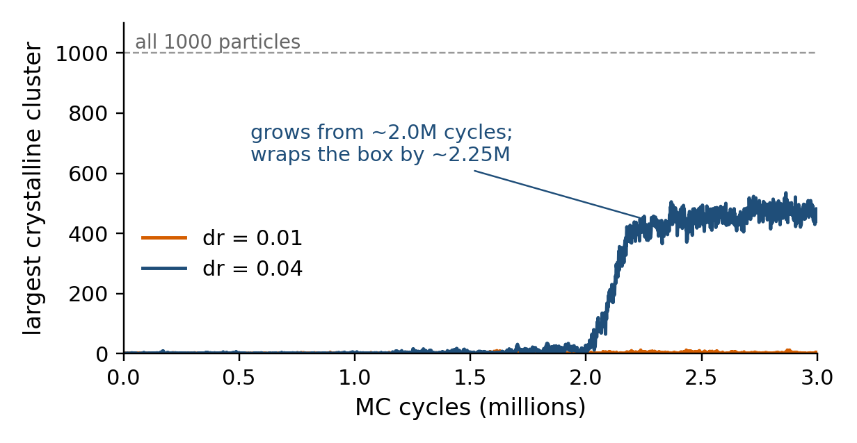
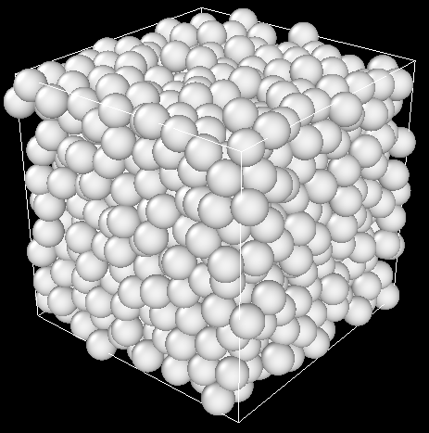
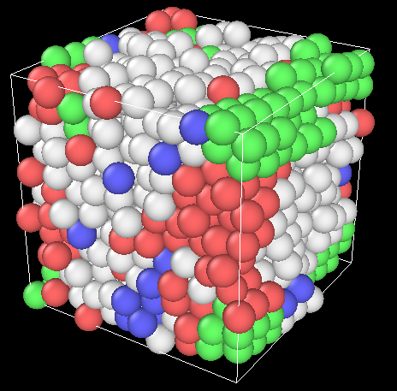
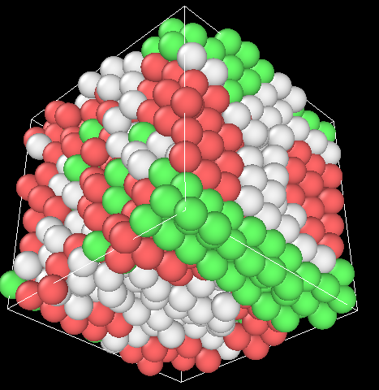
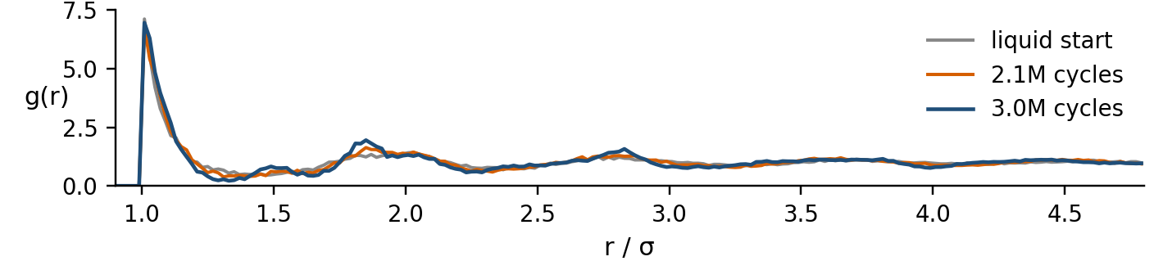
What came out at p* = 18
Liquid start
2.1×10⁶ cycles
3.0×10⁶ cycles
no crystalline particles
largest cluster: 193
largest cluster: 440
CNA colours: green fcc, red hcp, blue bcc, white other. dr = 0.04 run.
At 3.0×10⁶ cycles (dr = 0.04)
146 fcc, 294 hcp, 8 bcc, 552 other. No CsCl signal.
Opposite-charge neighbours: 0.58 in the crystal, 0.60 in the liquid (random mixing: 0.50).
Reading
Close-packed crystal (fcc and hcp, almost no bcc) with no extra charge order, in line with the paper’s no-swap result. dr = 0.01 stayed liquid. The crystal fills the 1000-particle box, so quote the nucleation time (about 2×10⁶ cycles), not the size.
Next (Maybe)
• add a swap move: CsCl is expected
• more seeds and a larger system, to see an isolated nucleus
• compare g(r) with the paper’s cluster g(r)
• FFS at p* = 15, the link to infRETIS

