Slide 1
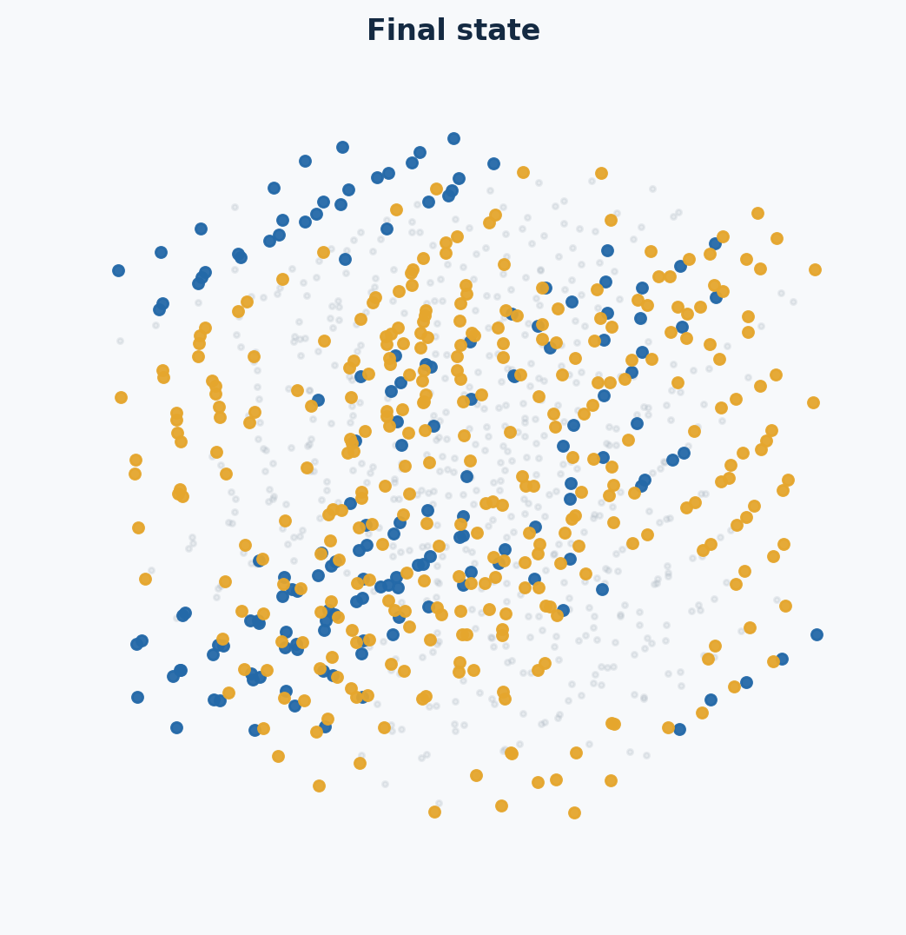
RECONSTRUCTING
CRYSTAL NUCLEATION
No-swap MC–NpT simulations
of an oppositely charged Yukawa mixture
T* = 1
p* = 18
N = 1000
Paper benchmark → controlled reconstruction → persistent close-packed growth
01

Slide 2
SCIENTIFIC MOTIVATION
The question is kinetic—not only thermodynamic
LIQUID
DISORDERED
CLOSE-PACKED
CHARGE-ORDERED
CsCl-LIKE
Local fluctuations
create small ordered domains
→
or
FCC/HCP-like packing
fast local route
requires structural +
charge reorganization
Which structure is reached
within the available time?
Conceptual summary based on Sanz et al., PRL 99, 055501 (2007).
02

Slide 3
PAPER BENCHMARK
What the paper actually established
• Binary 50:50 mixture of oppositely charged hard-core Yukawa particles.
• N = 1000, κσ = 6, T* = 1; disordered FCC competes with charge-ordered CsCl.
• At p* = 15, no spontaneous event appeared in 3 × 10⁶ ordinary MC cycles.
• Forward Flux Sampling generated rare reactive trajectories; the growing nuclei were compact and FCC-like.
• Operational critical size at p* = 15: n ≈ 120 ± 15.
IMPORTANT DISTINCTION
3 million cycles without
spontaneous nucleation
applies to p* = 15
FFS samples rare pathways; it does not prescribe their crystal structure.
Sanz, Valeriani, Frenkel & Dijkstra, Phys. Rev. Lett. 99, 055501 (2007), DOI 10.1103/PhysRevLett.99.055501.
03

Slide 4
STATE-POINT CHOICE
Why move to p* = 18?
p* = 15
p* = 18
Rare event
FFS needed
Higher postcritical probability
Direct kinetic MC is feasible
The paper reports the same no-swap phenomenology at p* = 18:
a substitutionally disordered FCC lattice forms.
The paper does not report the exact number of p* = 18 cycles or the brute-force displacement size.
04

Slide 5
EXPERIMENTAL DESIGN
Our reconstruction isolates one controlled difference
• Reconstruct only the no-swap, brute-force p* = 18 experiment.
• Preserve N, composition, T*, p*, interaction, cutoff, and MC–NpT ensemble.
• Start both trajectories from one byte-identical validated liquid.
• Compare dr = 0.01 and dr = 0.04 because the paper does not specify dr for its p* = 18 brute-force run.
TRIAL A
dr = 0.01
TRIAL B
dr = 0.04
Controlled comparison—not a claim that either dr is uniquely specified by the paper.
05

Slide 6
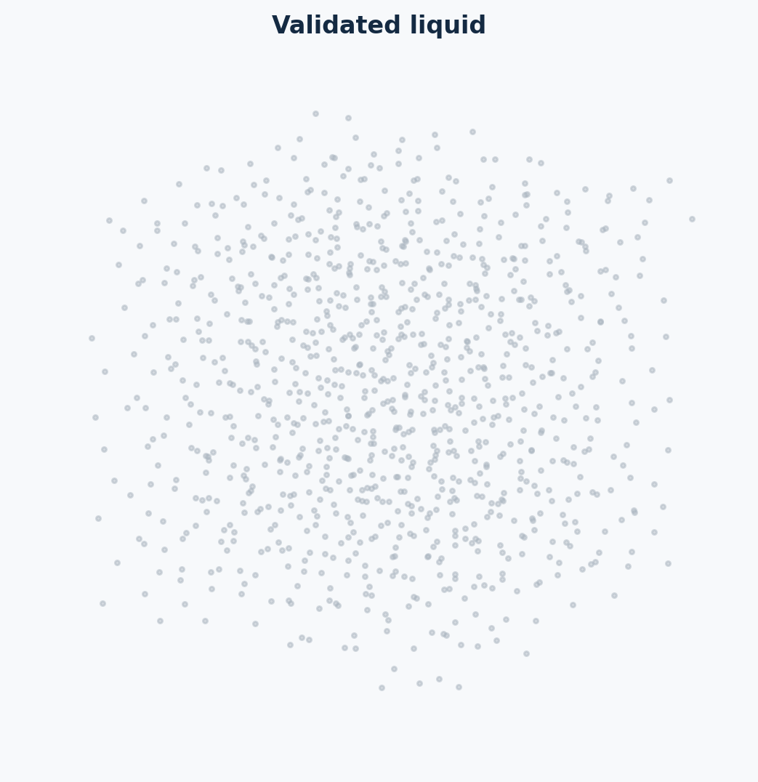
PARENT-STATE VALIDATION
Production began from a validated metastable liquid
ρ
η
1.03708
0.54301
overlaps
PTM crystal
0
0
CNA-BCC
max S(hkl)
1 isolated
2.03
No single classifier carried the argument
Validated parent: common/validated_parent_N1000_T1_P18.res; SHA-256 begins 7e406f2b…
06

Slide 7
SIMULATION PROTOCOL
From liquid preparation to structural evidence
01
02
03
04
05
06
Prepare liquid
→
Validate parent
→
Tune & pilot
→
Smoke test
→
Production
→
Analyse
earlier p* = 18 history
geometry + PTM/CNA + S(k)
acceptance + volume moves
segment chaining + hashes
12 × 250k cycles
thermo + connected domains
Every segment records parameters, input lineage, seed, hashes, completion state, and move statistics.
07

Slide 8
CONTROLLED TRIALS
Two trajectories; one deliberately changed parameter
CONTROL
dr = 0.01
dr = 0.04
Maximum displacement
0.01
0.04
Particles / composition
1000 / 50:50
1000 / 50:50
T* / p*
1 / 18
1 / 18
κσ / cutoff
6 / 3.5σ
6 / 3.5σ
Volume step vmax
0.0005
0.0005
Swap moves
none
none
Production
3M cycles
3M cycles
The branches use different random-number sequences; replicate seeds are still needed for causal inference.
08

Slide 9
RUN SCALE
The production campaign was large and auditable
3,000,000
12 × 250,000
1,000 + ~1
MC cycles per trajectory
chained production segments
particle + volume trials / cycle
dr = 0.01
3.000B
2.600B
2.999M
642.7k
86.66% / 21.43%
particle attempts
accepted
volume attempts
accepted
particle / volume
dr = 0.04
3.000B
1.723B
3.000M
657.8k
57.44% / 21.92%
particle attempts
accepted
volume attempts
accepted
particle / volume
Totals summed from the final accounting row of all 12 production segments in each branch.
09

Slide 10
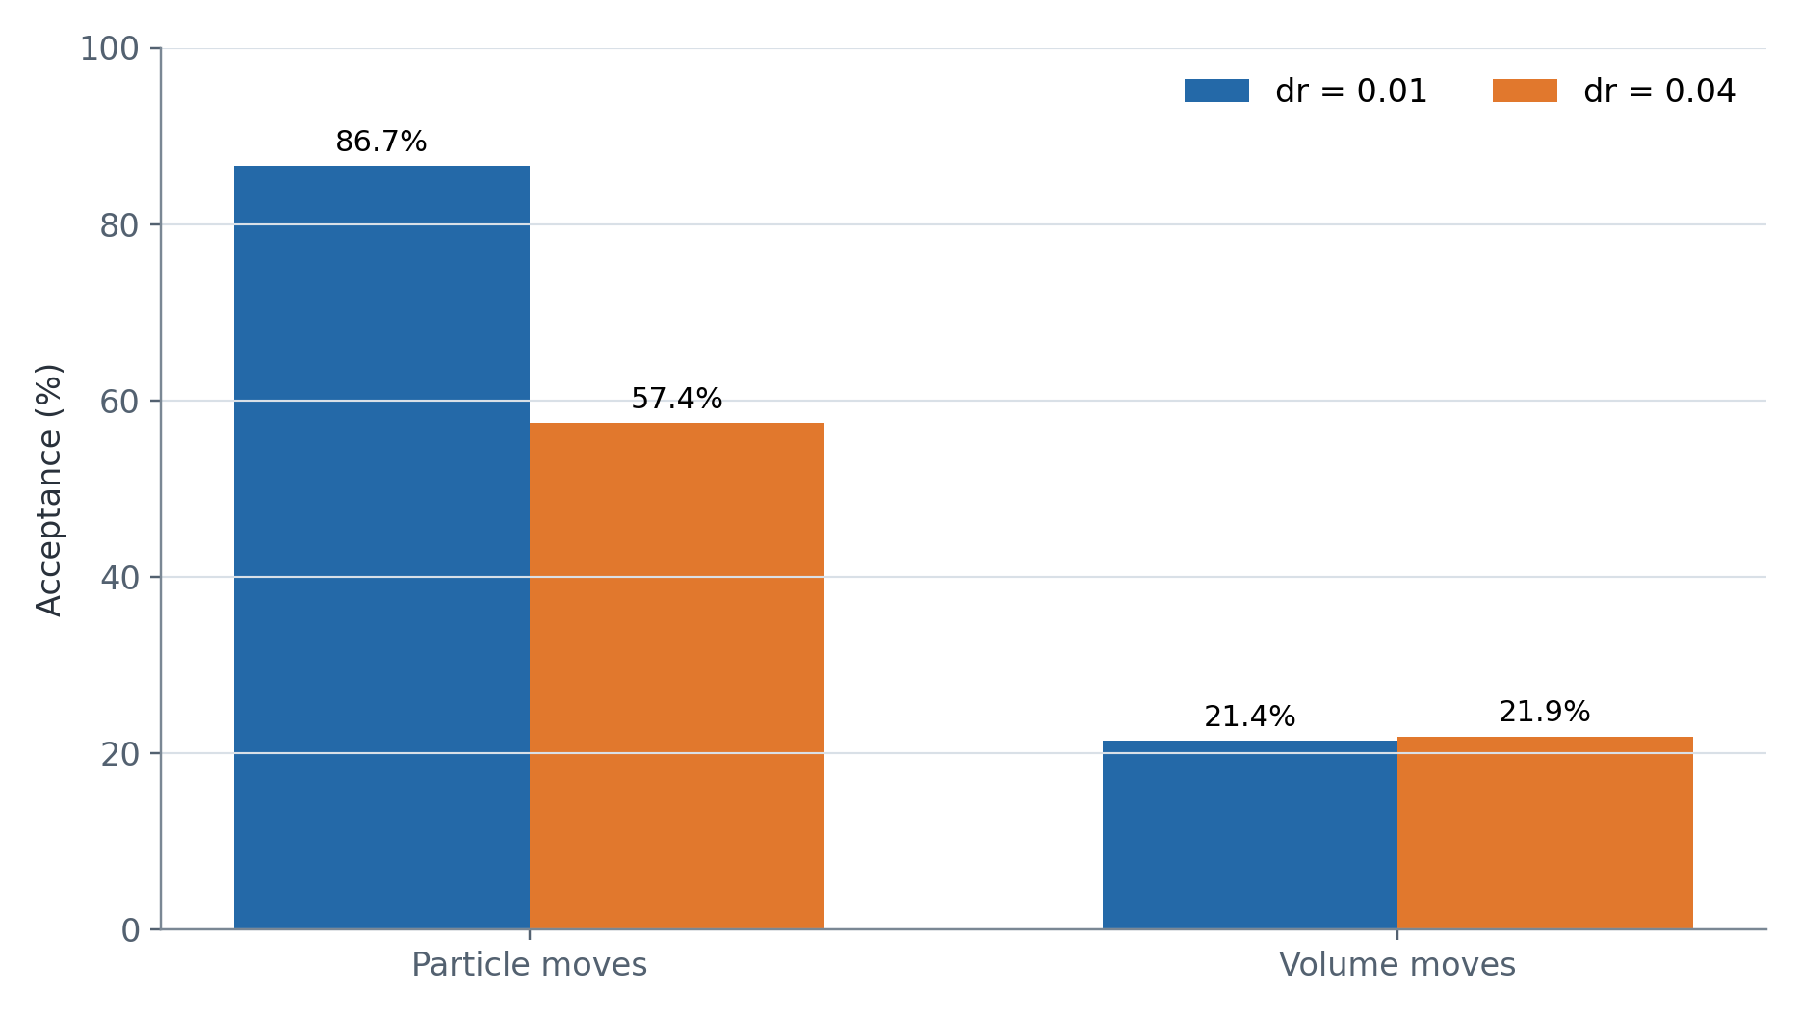
MOVE STATISTICS
The larger displacement lowers particle acceptance
86.7%
particle acceptance
dr = 0.01
57.4%
particle acceptance
dr = 0.04
Volume acceptance remains similar (~22%), so the later structural contrast is not explained by a frozen volume mover.
10

Slide 11
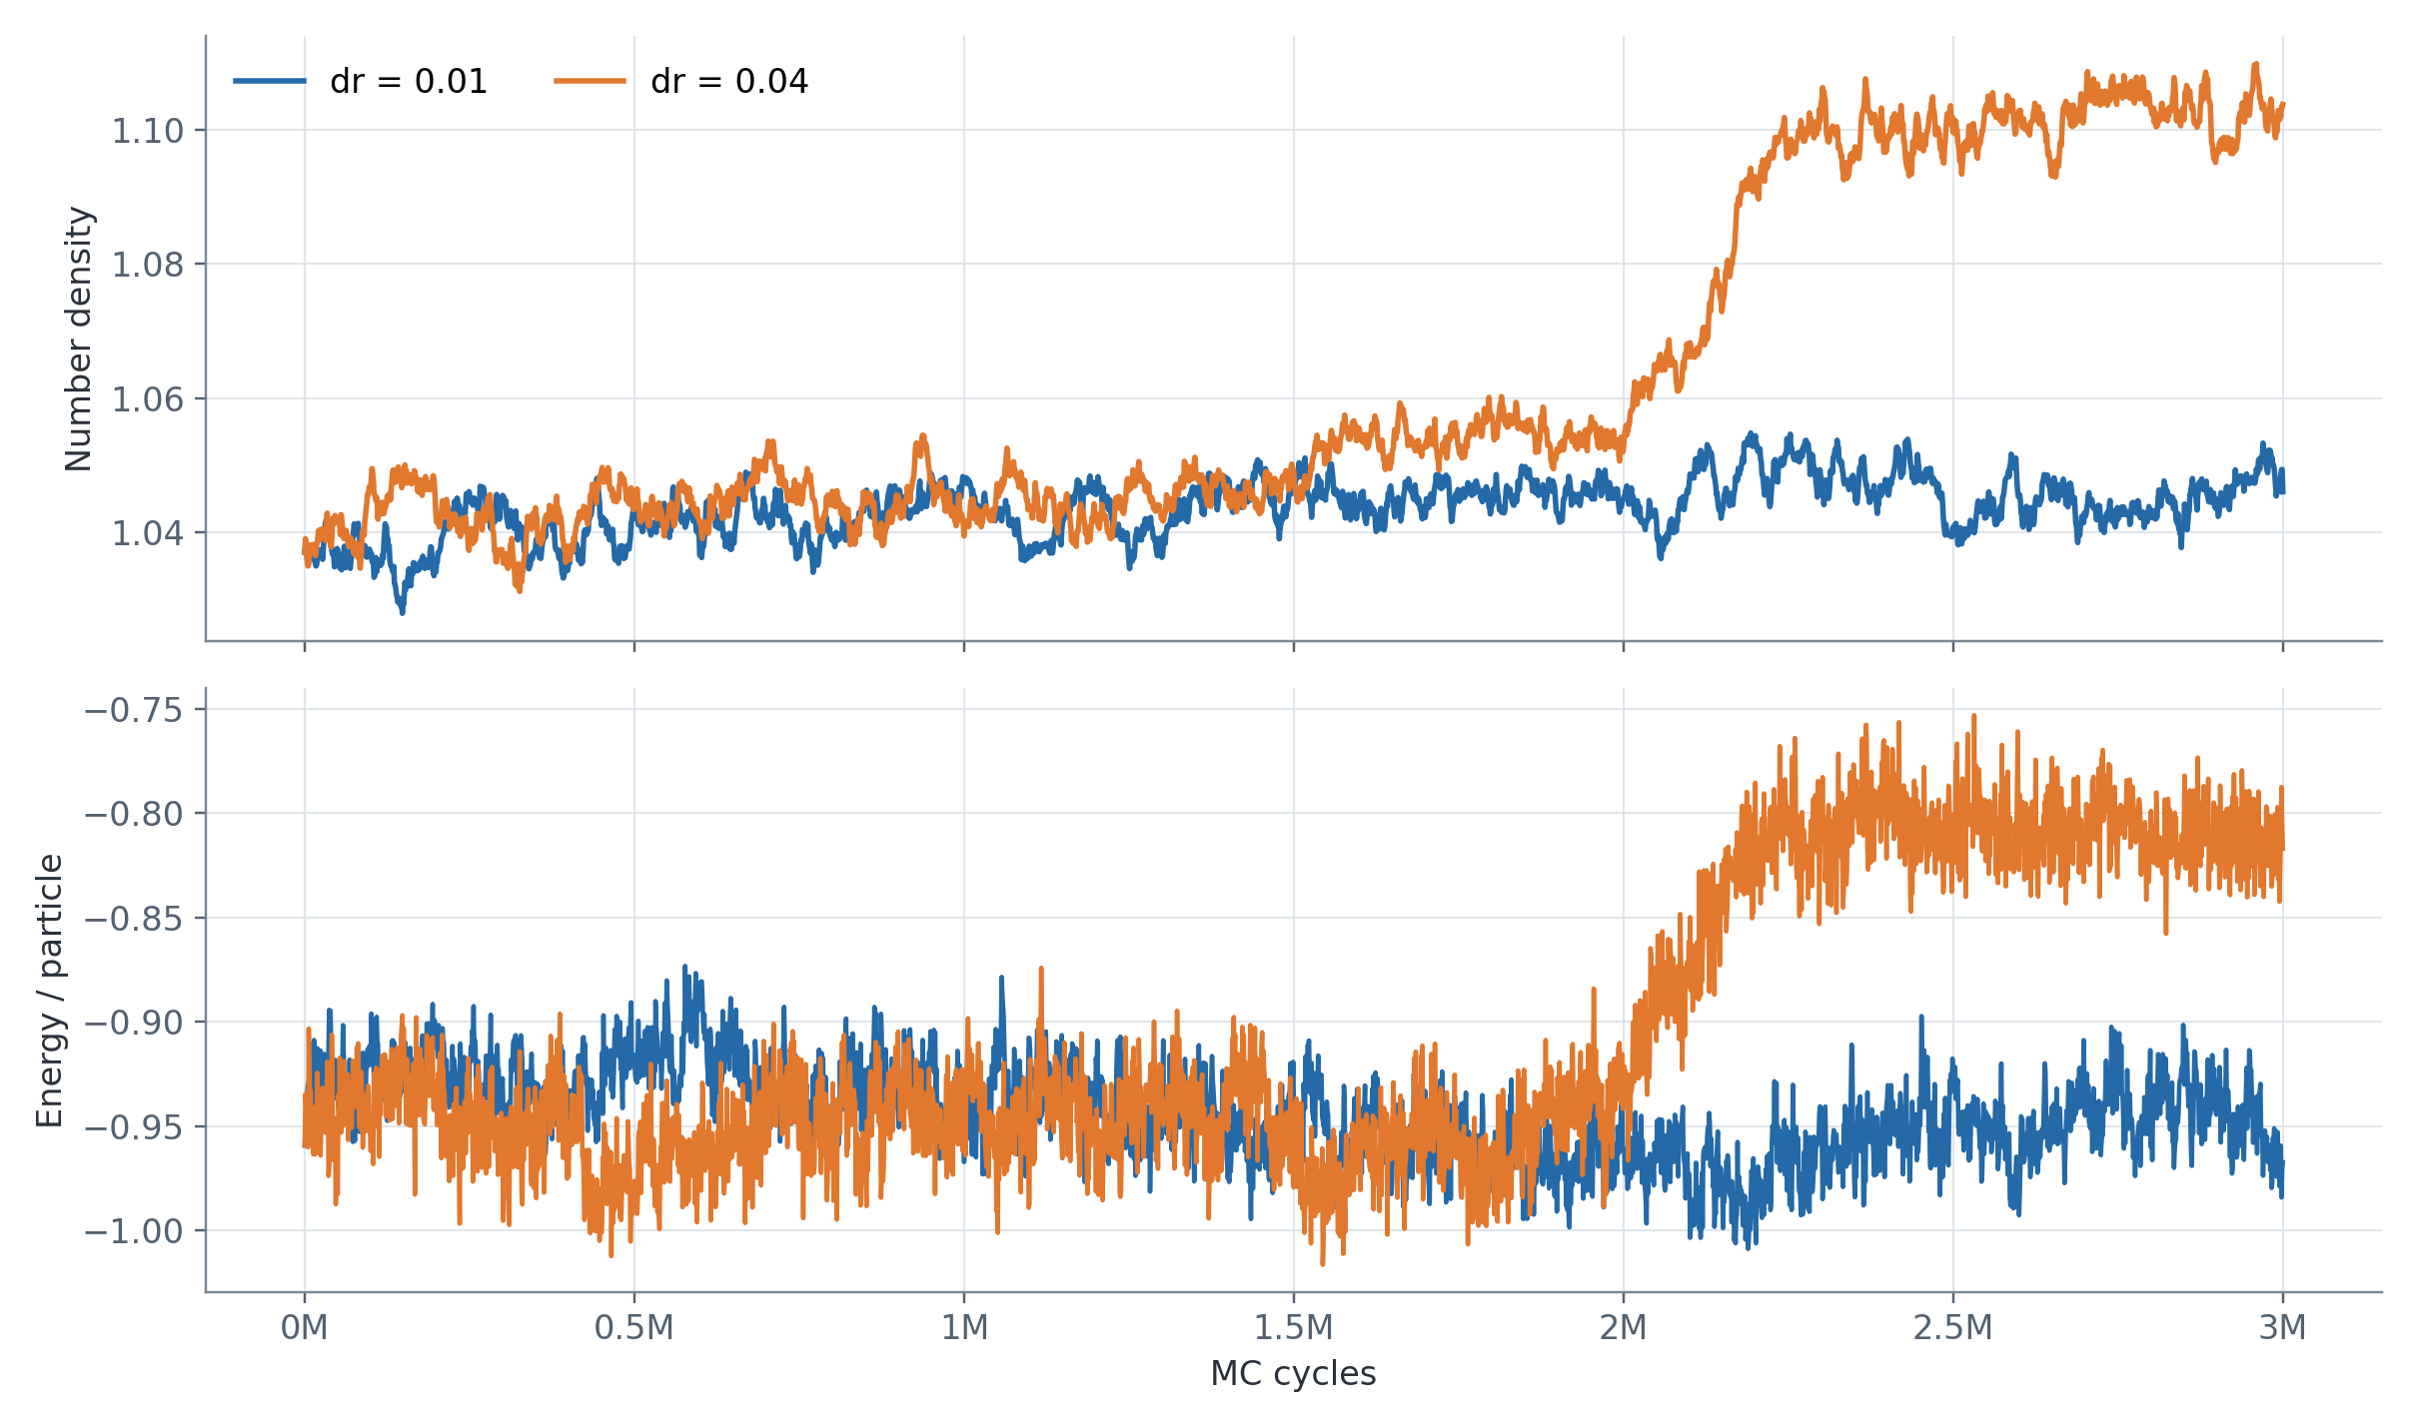
THERMODYNAMIC EVOLUTION
Only dr = 0.04 enters a distinct late-time regime
dr = 0.01
late 500k mean
ρ = 1.04468
E/N = −0.94660
dr = 0.04
late 500k mean
ρ = 1.10217
E/N = −0.80909
Thermodynamics tells us something changed—not what structure formed.
11

Slide 12
STRUCTURAL ANALYSIS
Connected persistence turns labels into evidence
1
2
3
4
PTM
Adaptive CNA
Connectivity
Persistence
local FCC/HCP labels
independent classifier
neighbors within 1.45σ
track the largest domain
500 crystalline labels scattered through the box ≠ one connected domain of 500 particles
Agreement between PTM and CNA guards against a one-classifier artifact.
12

Slide 13
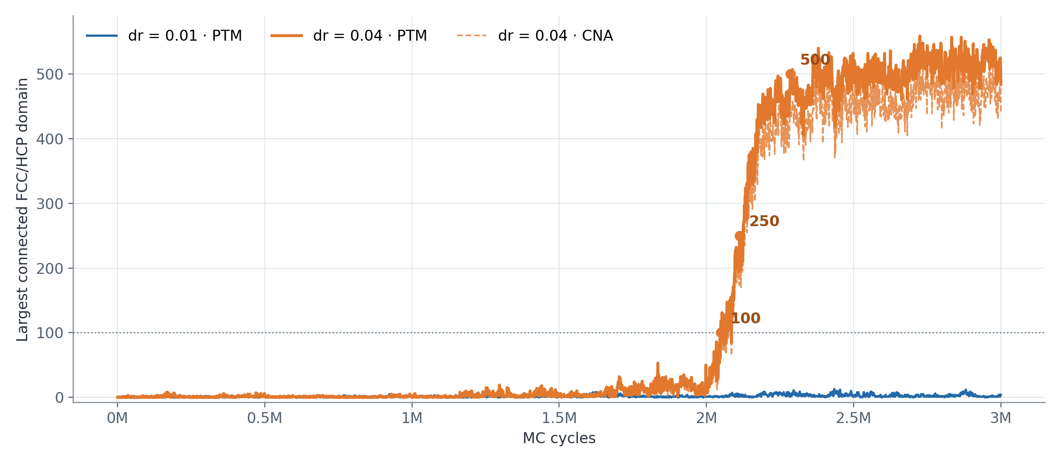
CLUSTER EVOLUTION
Persistent close-packed growth appears only for dr = 0.04
dr = 0.01
max PTM 13
final PTM 4
late mean 2.6
dr = 0.04
max PTM 559
final PTM 484
late mean 509
Threshold crossings are first saved frames, not exact nucleation or commitment times.
13

Slide 14
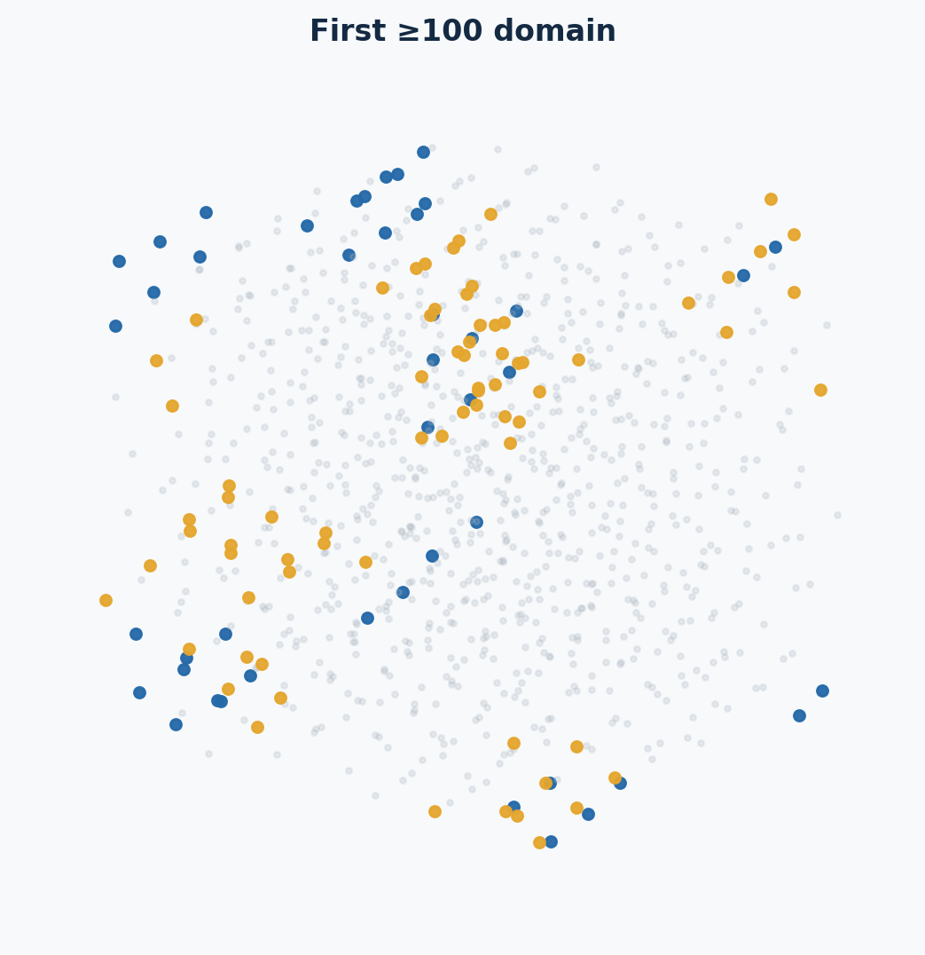
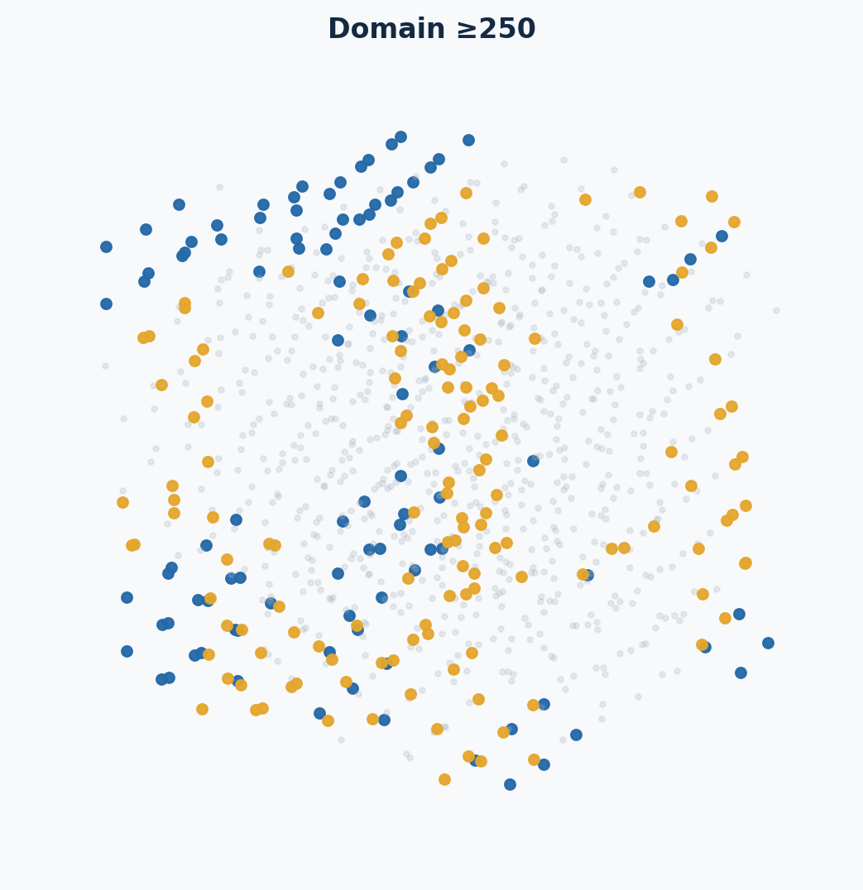
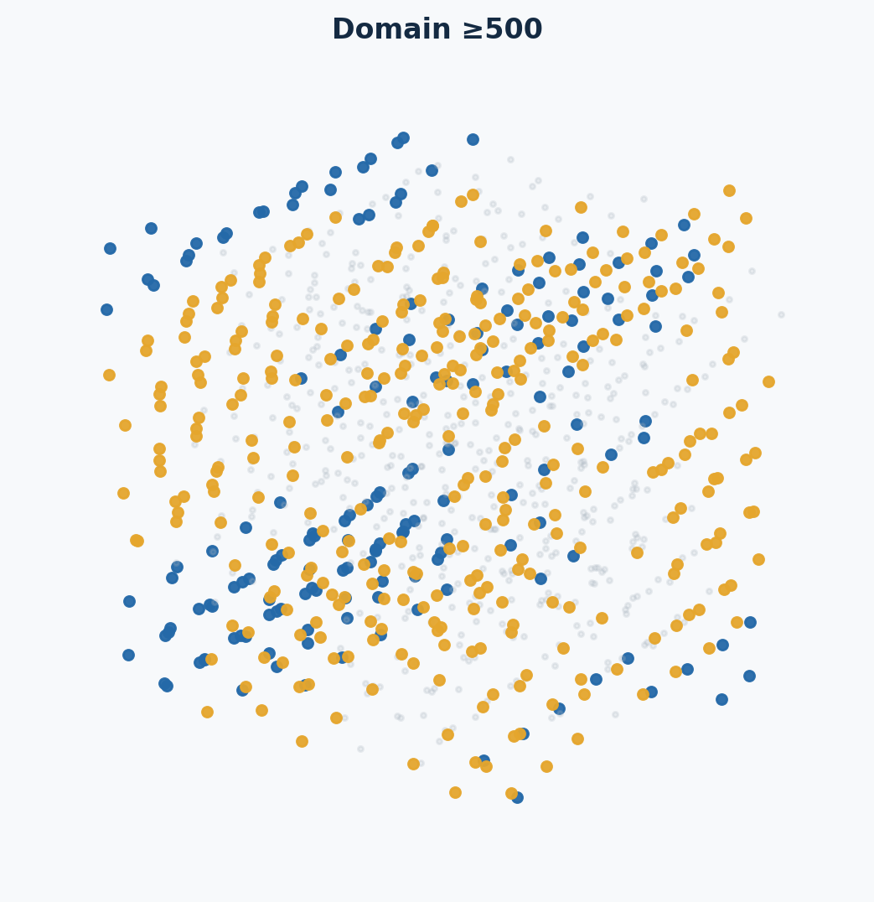
STRUCTURAL SNAPSHOTS · DR = 0.04
The domain grows, connects, and survives
largest domain: 0
largest domain: 118
largest domain: 252
largest domain: 501
largest domain: 484
Gray: liquid/other Blue: FCC in largest domain Gold: HCP in largest domain
Connectivity—not merely the number of colored particles—is the central visual test.
PTM classification with RMSD cutoff 0.10; connected FCC/HCP domain cutoff 1.45σ.
14

Slide 15
PERSISTENCE & STRUCTURE
The two independent classifiers tell the same story
FINAL dr = 0.04 STATE
PERSISTENCE TEST
PTM connected domain 484
CNA connected domain 440
501 / 501
frames in the final 500k window
have PTM and CNA domains > 100
PTM composition
160 FCC + 324 HCP
Interpretation: persistent close-packed crystalline growth, with FCC/HCP mixing consistent with stacking faults.
15

Slide 16
CONCLUSION
What we can say—and what comes next
SUPPORTED
NOT YET SUPPORTED
• Both branches began from the same validated liquid.
• dr = 0.04 developed a large, persistent close-packed domain after ~2.05M cycles.
• dr = 0.01 remained liquid-like through 3M cycles.
• The no-swap outcome is qualitatively consistent with the paper’s FCC-like kinetic pathway.
• An exact nucleation time.
• A nucleation rate.
• A universal causal effect of dr.
• A pure bulk FCC phase.
Next: multiple seeds + intermediate dr values + longer trajectories
16

