Slide 1
STRUCTURAL ANALYSIS
Connected persistence turns labels into evidence
1
2
3
4
PTM
Adaptive CNA
Connectivity
Persistence
local FCC/HCP labels
independent classifier
neighbors within 1.45σ
track the largest domain
500 crystalline labels scattered through the box ≠ one connected domain of 500 particles
Agreement between PTM and CNA guards against a one-classifier artifact.
12

Slide 2
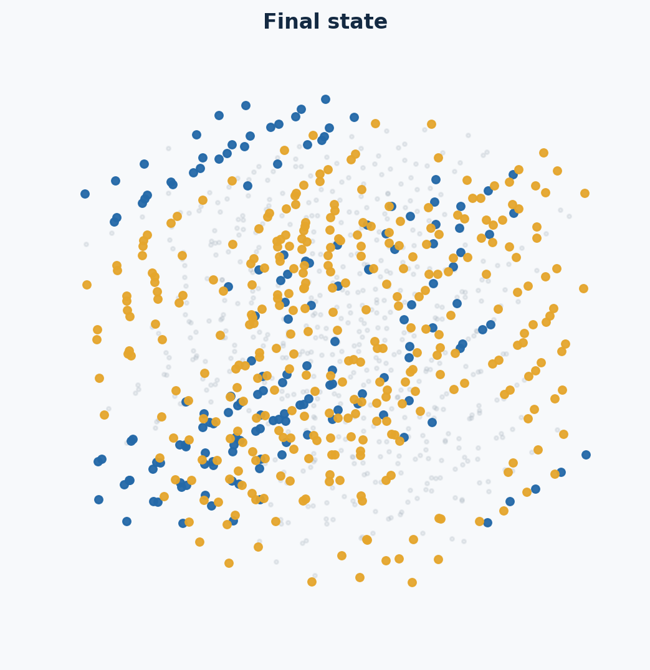
RECONSTRUCTING
CRYSTAL NUCLEATION
No-swap MC–NpT simulations
of an oppositely charged Yukawa mixture
T* = 1
p* = 18
N = 1000
Paper benchmark → controlled reconstruction → persistent close-packed growth
01

Slide 3
EXPERIMENTAL DESIGN
Our reconstruction isolates one controlled difference
• Reconstruct only the no-swap, brute-force p* = 18 experiment.
• Preserve N, composition, T*, p*, interaction, cutoff, and MC–NpT ensemble.
• Start both trajectories from a validated liquid state.
• Compare dr = 0.01 and dr = 0.04 at p* = 18 brute-force run.
TRIAL A
dr = 0.01
TRIAL B
dr = 0.04
Controlled comparison—not a claim that either dr is uniquely specified by the paper.
05

Slide 4
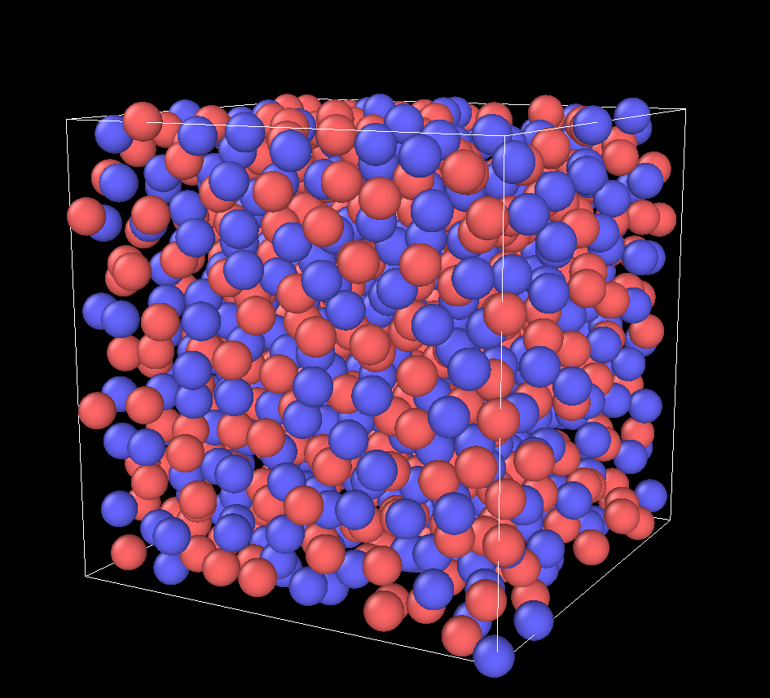
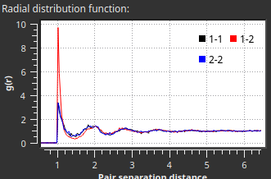
PARENT-STATE VALIDATION
Production began from a validated metastable liquid
ρ
η
1.03708
0.54301
overlaps
PTM crystal
0
0
CNA-BCC
max S(hkl)
1 isolated
2.03
No single classifier carried the argument
Validated parent: common/validated_parent_N1000_T1_P18.res; SHA-256 begins 7e406f2b…
06

Slide 5
CONTROLLED TRIALS
Two trajectories; one deliberately changed parameter
CONTROL
dr = 0.01
dr = 0.04
Maximum displacement
0.01
0.04
Particles / composition
1000 / 50:50
1000 / 50:50
T* / p*
1 / 18
1 / 18
κσ / cutoff
6 / 3.5σ
6 / 3.5σ
Volume step vmax
0.0005
0.0005
Swap moves
none
none
Production
3M cycles
3M cycles
The branches use different random-number sequences; replicate seeds are still needed for causal inference.
08

Slide 6
RUN SCALE
The production campaign was large and auditable
3,000,000
12 × 250,000
1,000 + ~1
MC cycles per trajectory
chained production segments
particle + volume trials / cycle
dr = 0.01
3.000B
2.600B
2.999M
642.7k
86.66% / 21.43%
particle attempts
accepted
volume attempts
accepted
particle / volume
dr = 0.04
3.000B
1.723B
3.000M
657.8k
57.44% / 21.92%
particle attempts
accepted
volume attempts
accepted
particle / volume
Totals summed from the final accounting row of all 12 production segments in each branch.
09

Slide 7
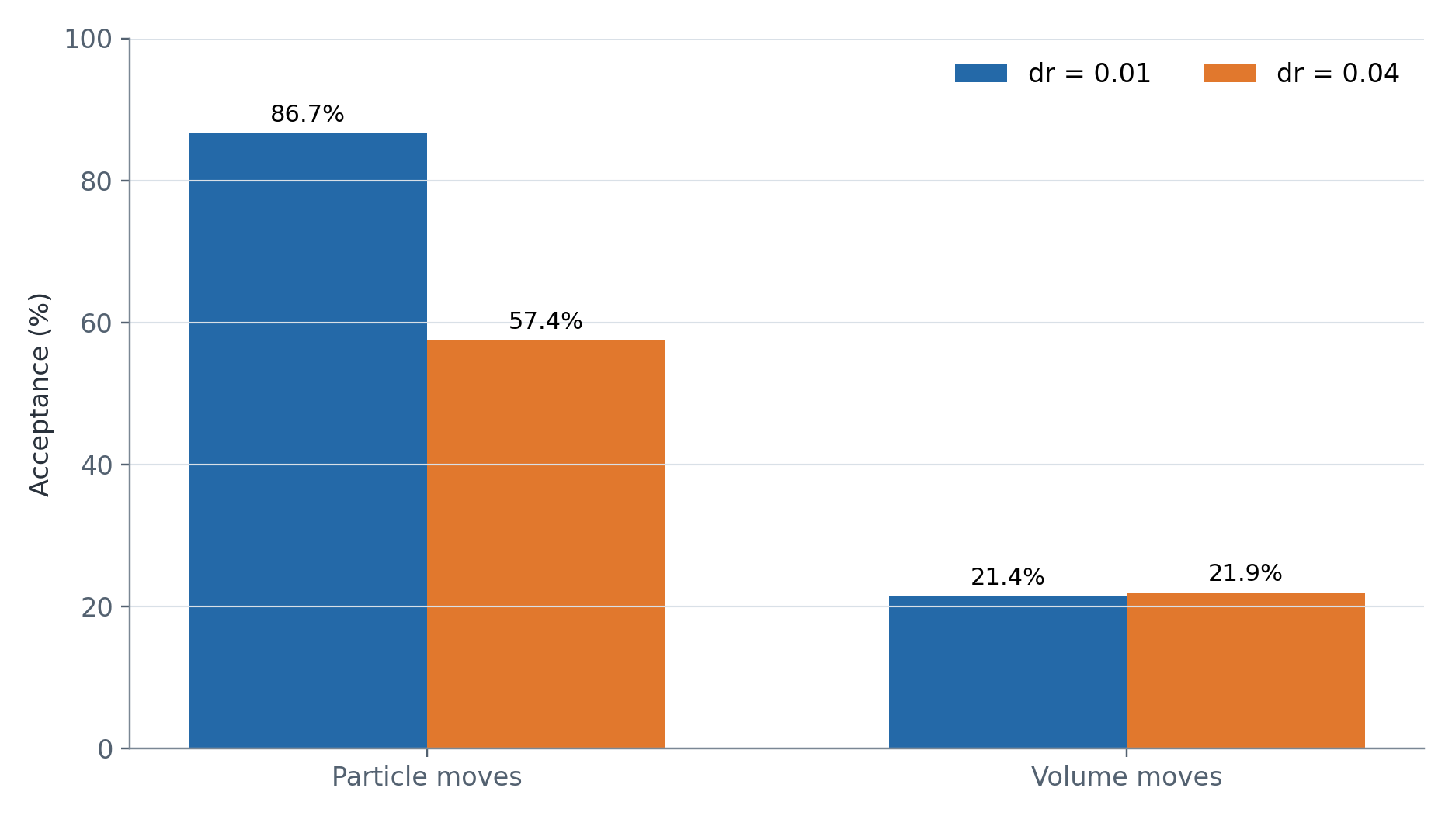
MOVE STATISTICS
The larger displacement lowers particle acceptance
86.7%
particle acceptance
dr = 0.01
57.4%
particle acceptance
dr = 0.04
Volume acceptance remains similar (~22%), so the later structural contrast is not explained by a frozen volume mover.
10

Slide 8
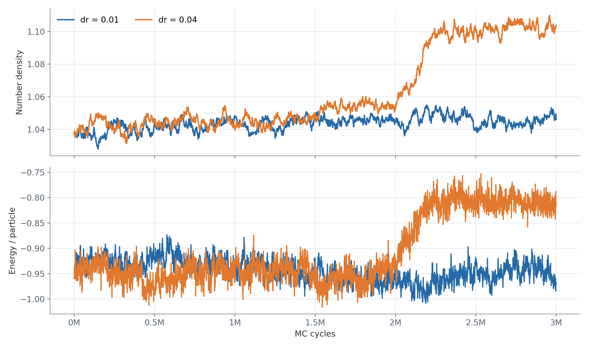
THERMODYNAMIC EVOLUTION
Only dr = 0.04 enters a distinct late-time regime
dr = 0.01
late 500k mean
ρ = 1.04468
E/N = −0.94660
dr = 0.04
late 500k mean
ρ = 1.10217
E/N = −0.80909
Thermodynamics tells us something changed—not what structure formed.
11

Slide 9
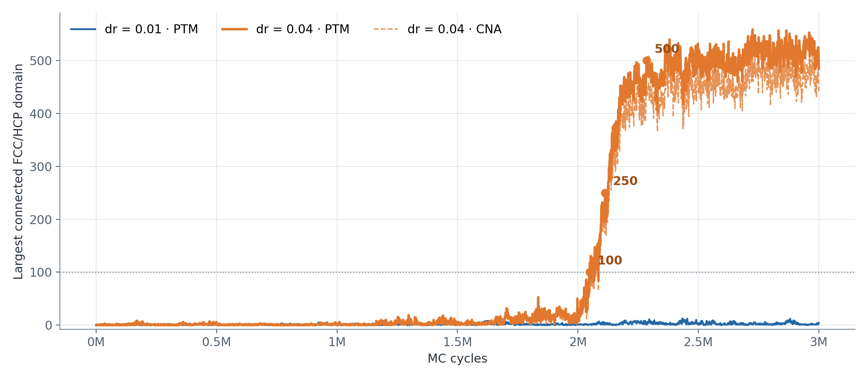
CLUSTER EVOLUTION
Persistent close-packed growth appears only for dr = 0.04
dr = 0.01
max PTM 13
final PTM 4
late mean 2.6
dr = 0.04
max PTM 559
final PTM 484
late mean 509
Threshold crossings are first saved frames, not exact nucleation or commitment times.
13

Slide 10
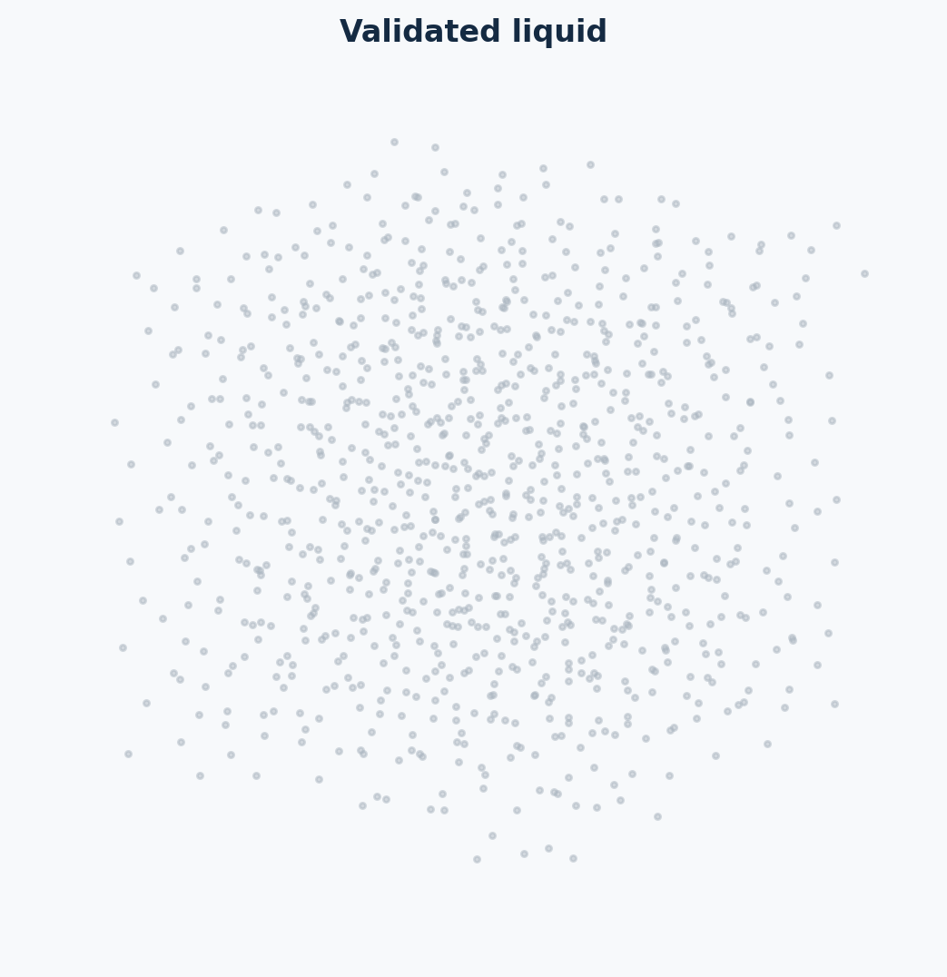
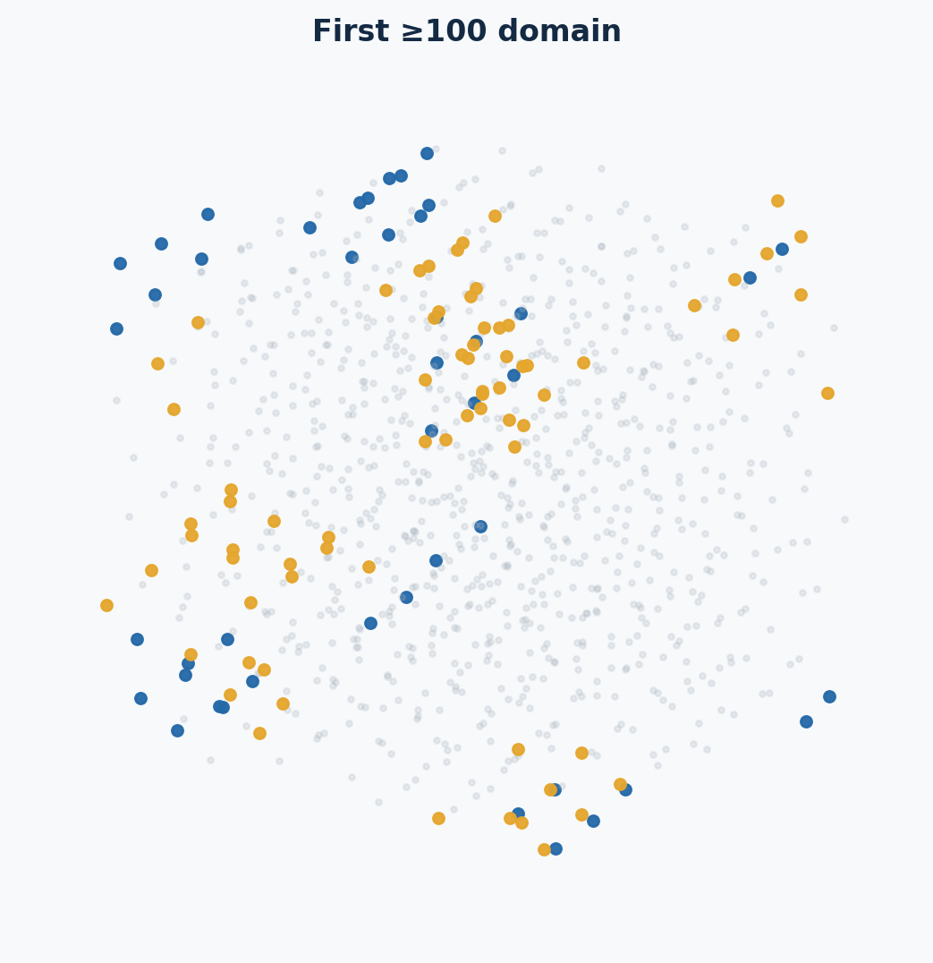
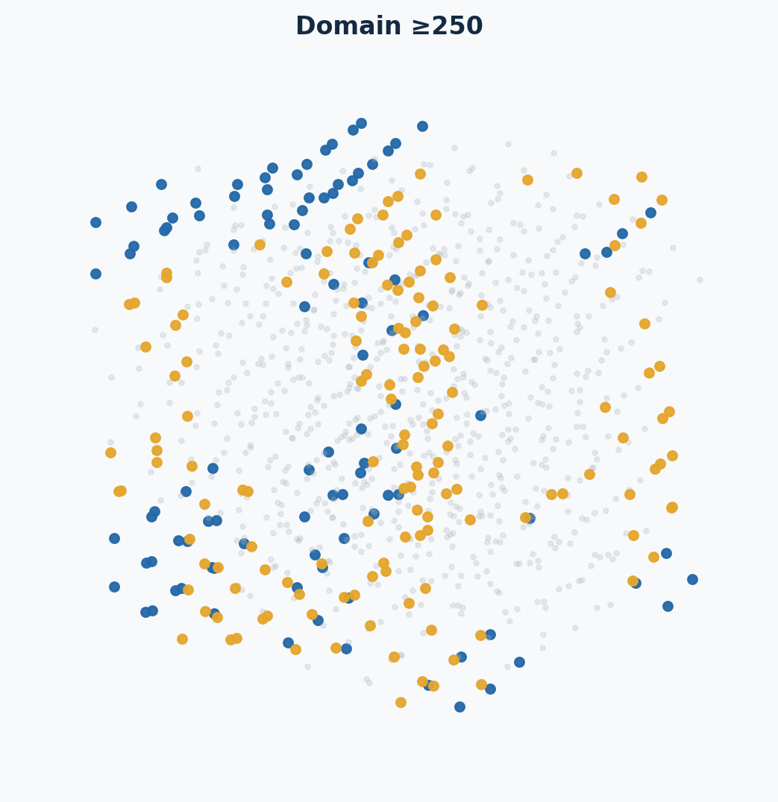
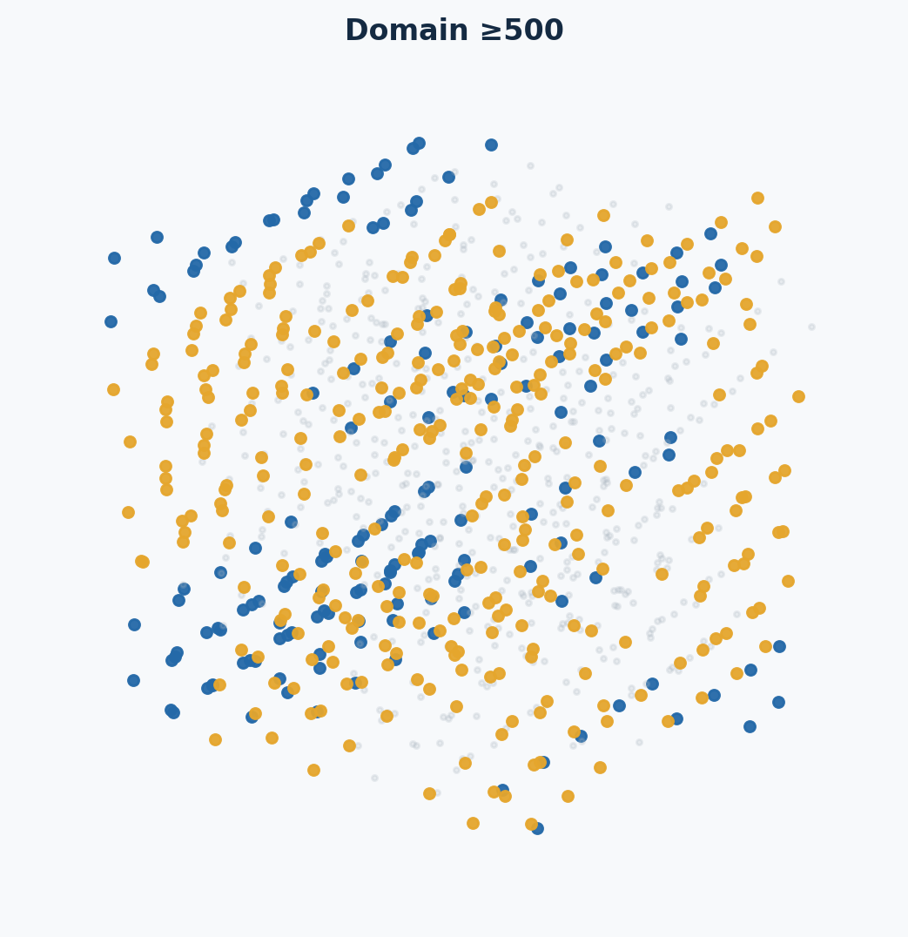
STRUCTURAL SNAPSHOTS · DR = 0.04
The domain grows, connects, and survives
largest domain: 0
largest domain: 118
largest domain: 252
largest domain: 501
largest domain: 484
Gray: liquid/other Blue: FCC in largest domain Gold: HCP in largest domain
Connectivity—not merely the number of colored particles—is the central visual test.
PTM classification with RMSD cutoff 0.10; connected FCC/HCP domain cutoff 1.45σ.
14

