Slide 1
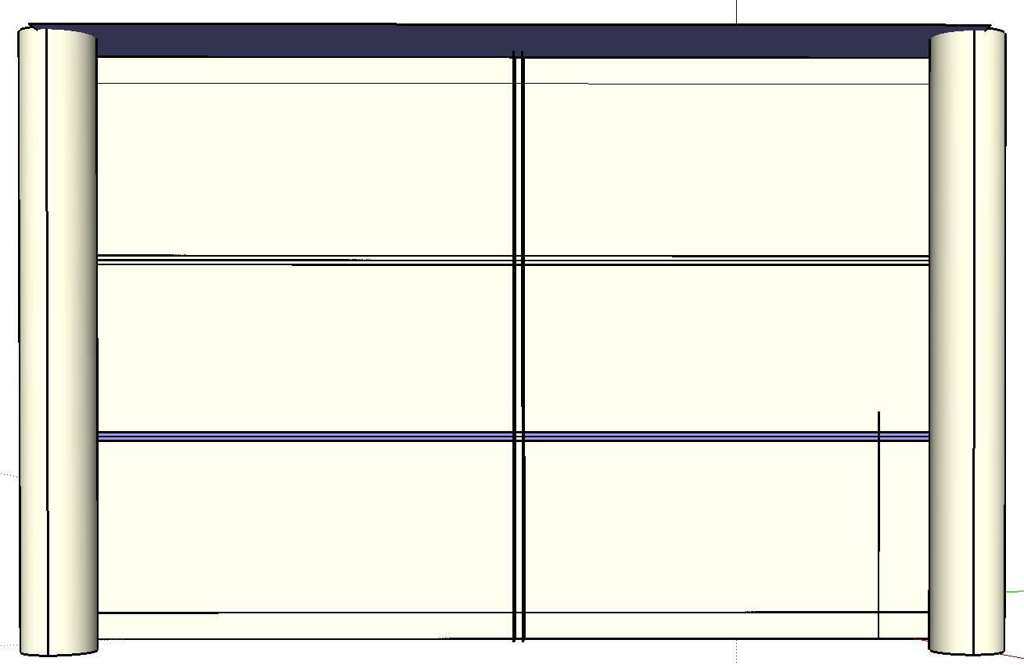
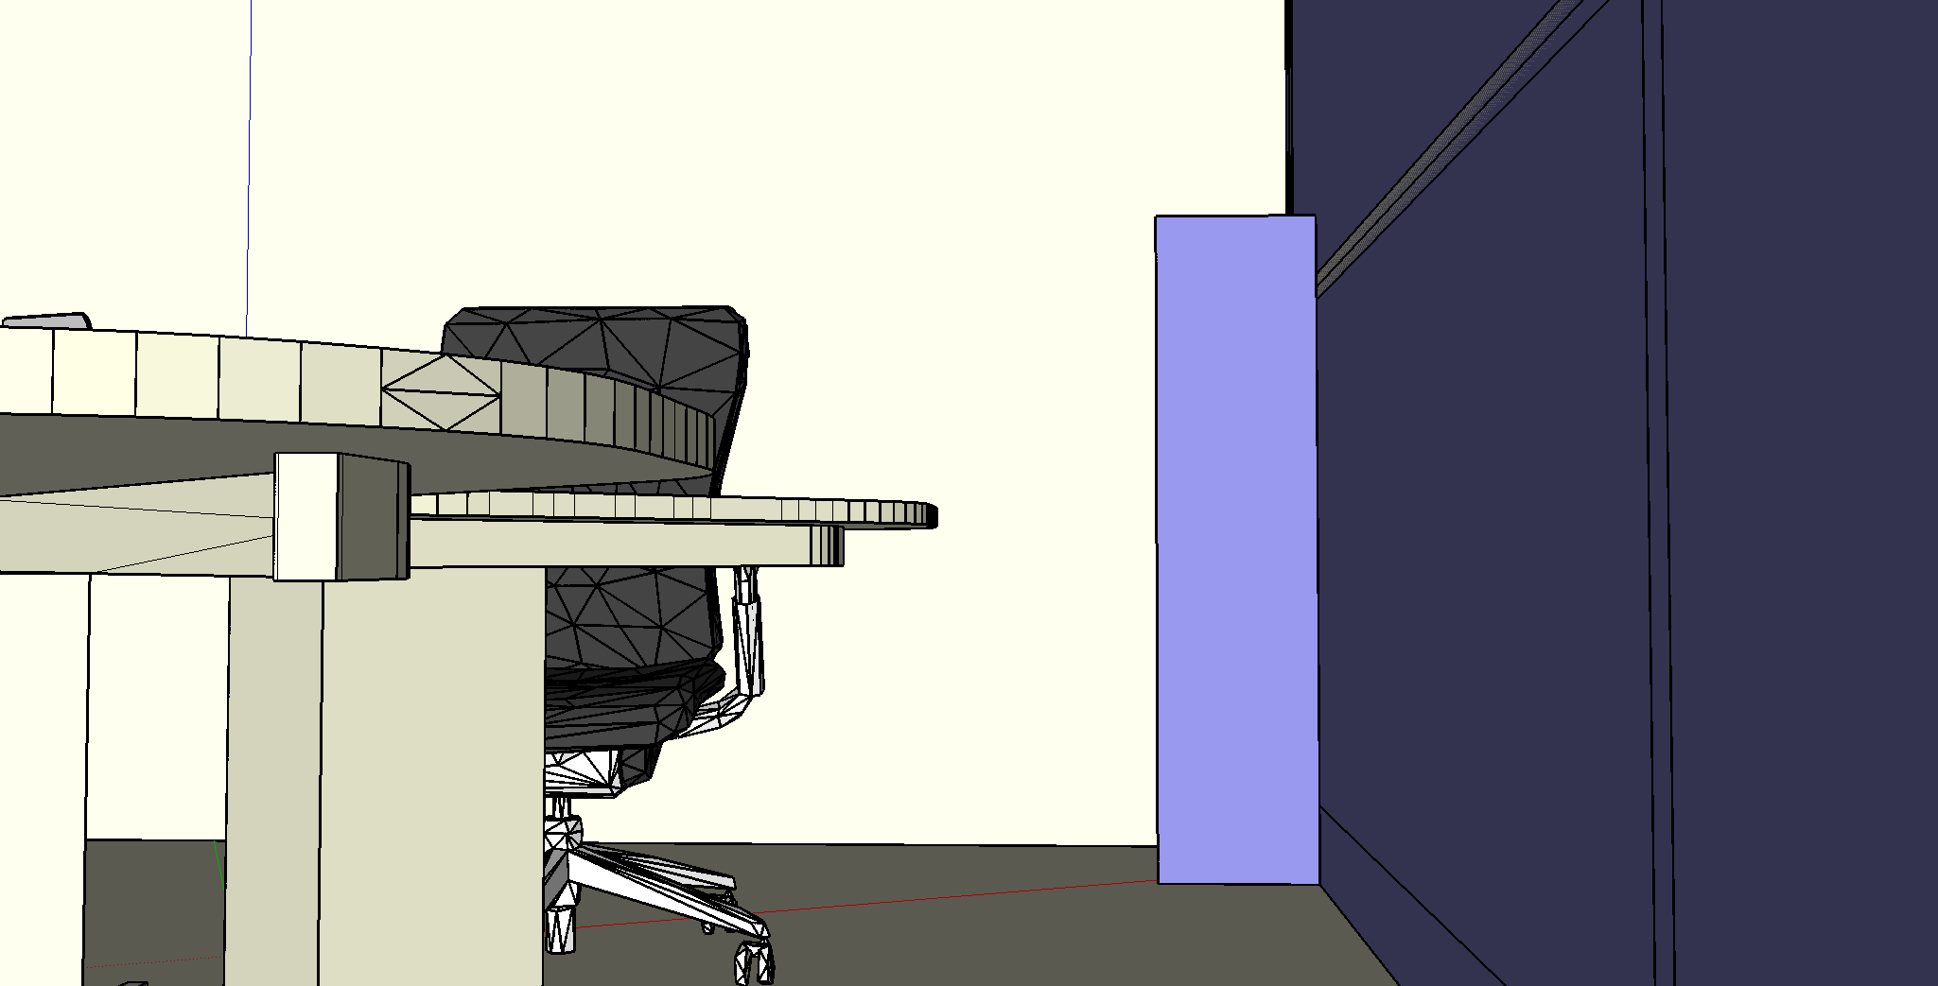
Validation experiment
Data collection
Illuminance sensor data
Collected at 10s interval
Down sampled to 1 min interval
Weather station data
Available at 5 min interval
Predicted direct and diffuse radiation
for simulation
Interpolated to 1 min interval
46 cm
31 cm
129 cm

Slide 2
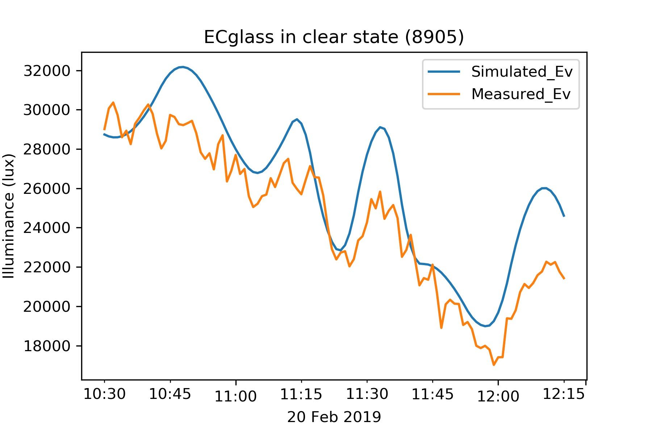

Slide 3
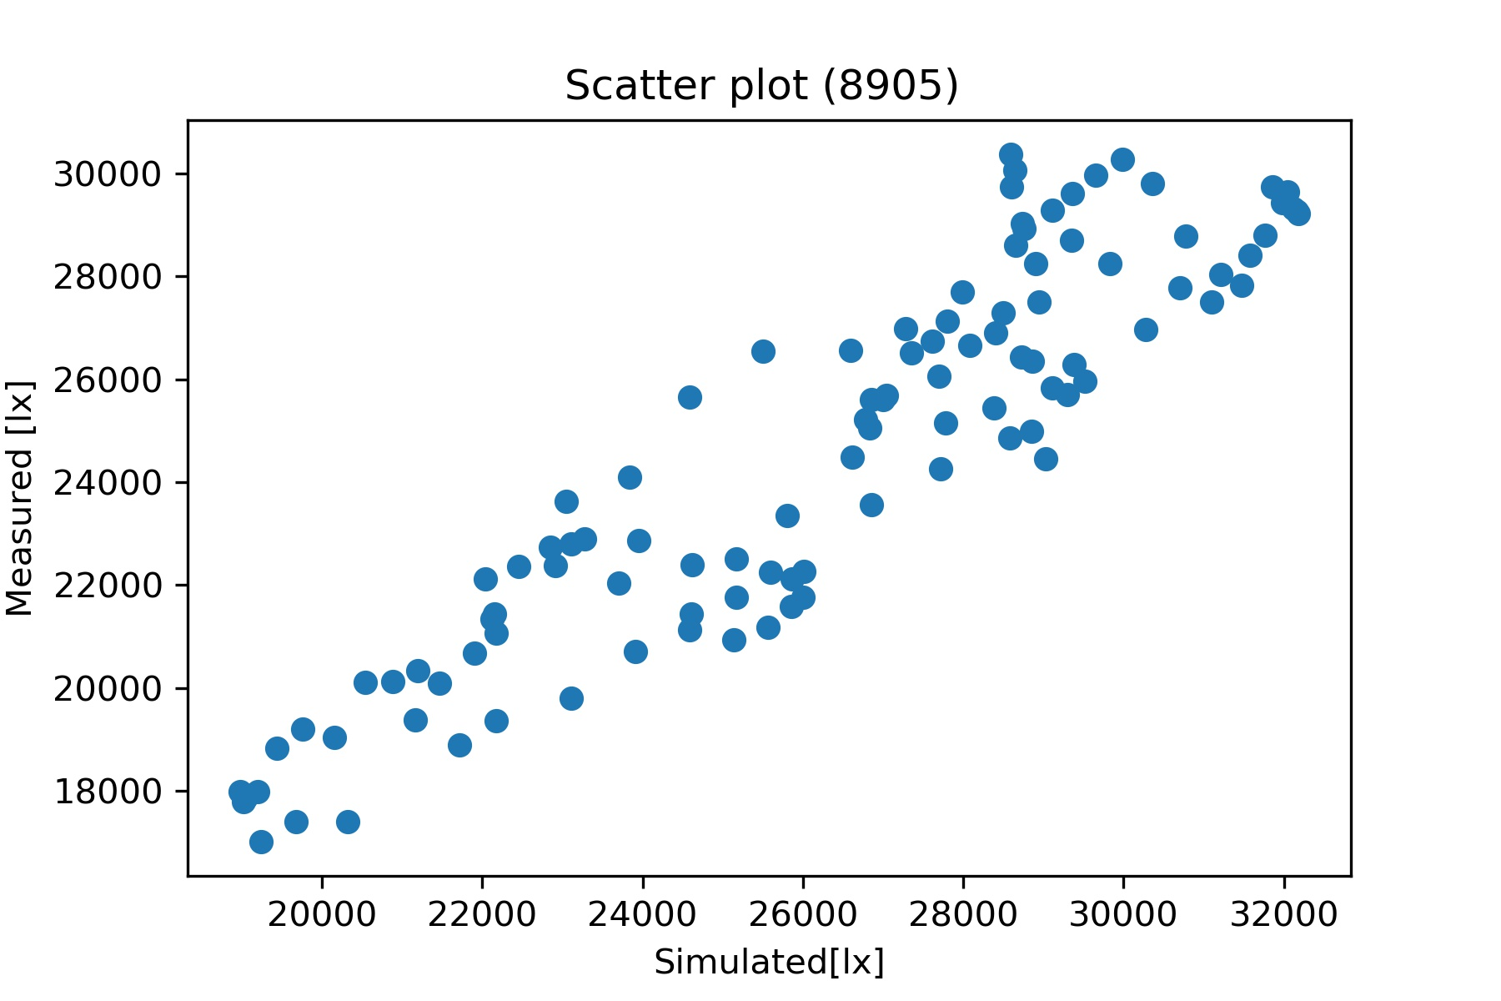
No. of data points = 106
RMSE= 2275 lx
%nRMSE = 9.2 %
%nMBE = 7.2 %

Slide 4
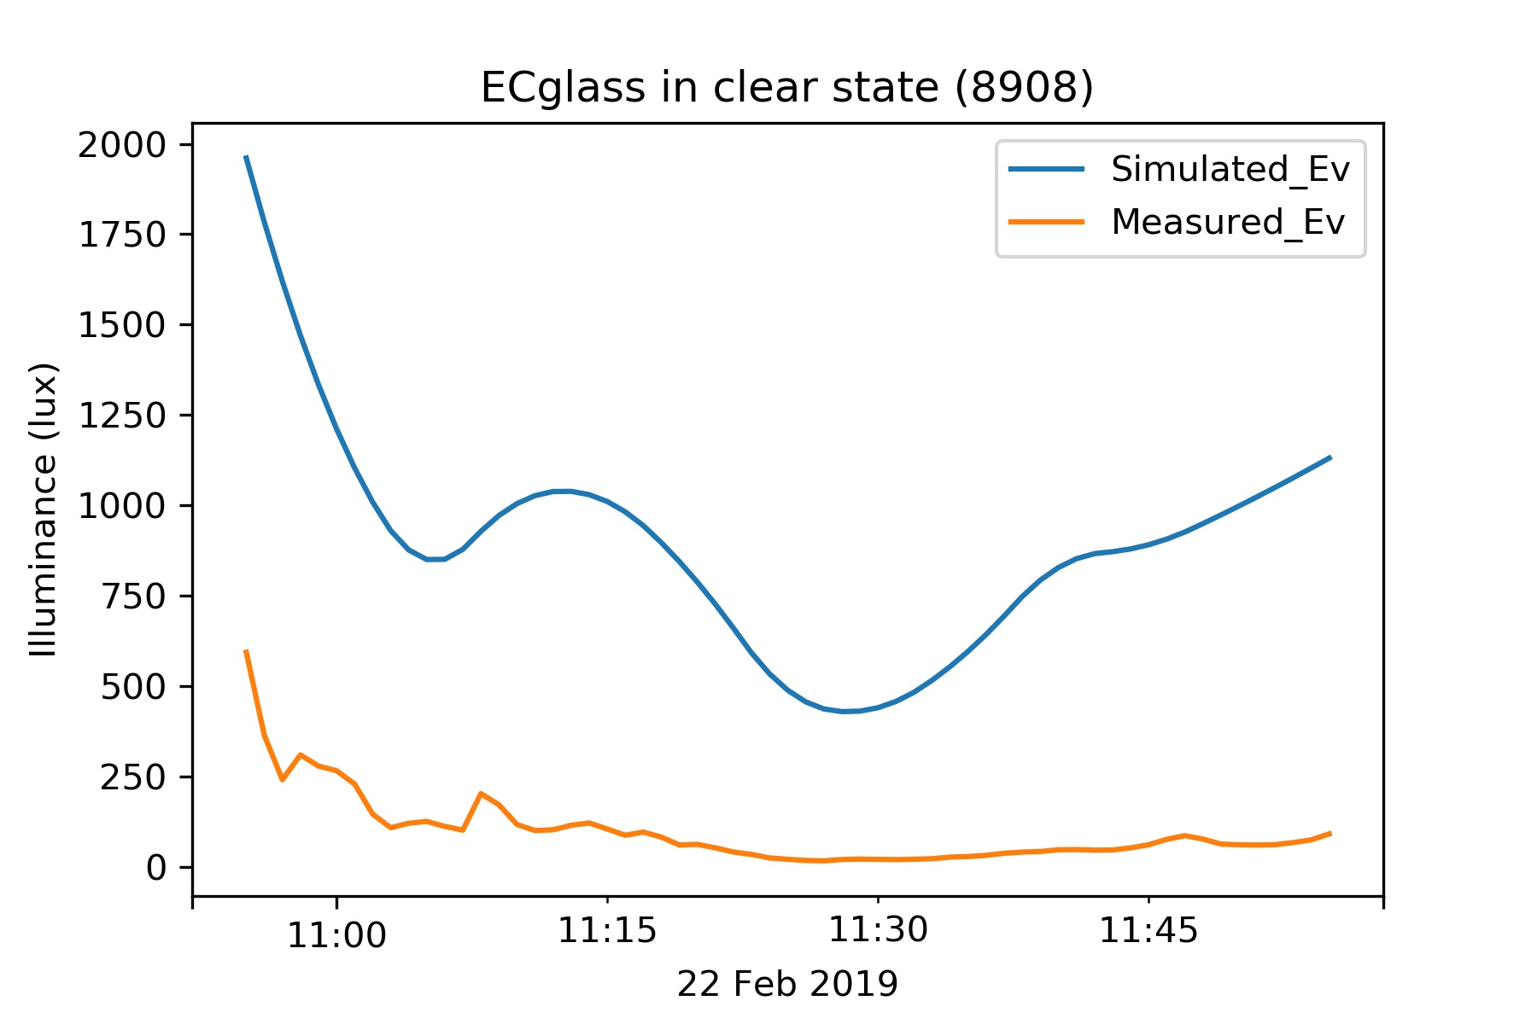
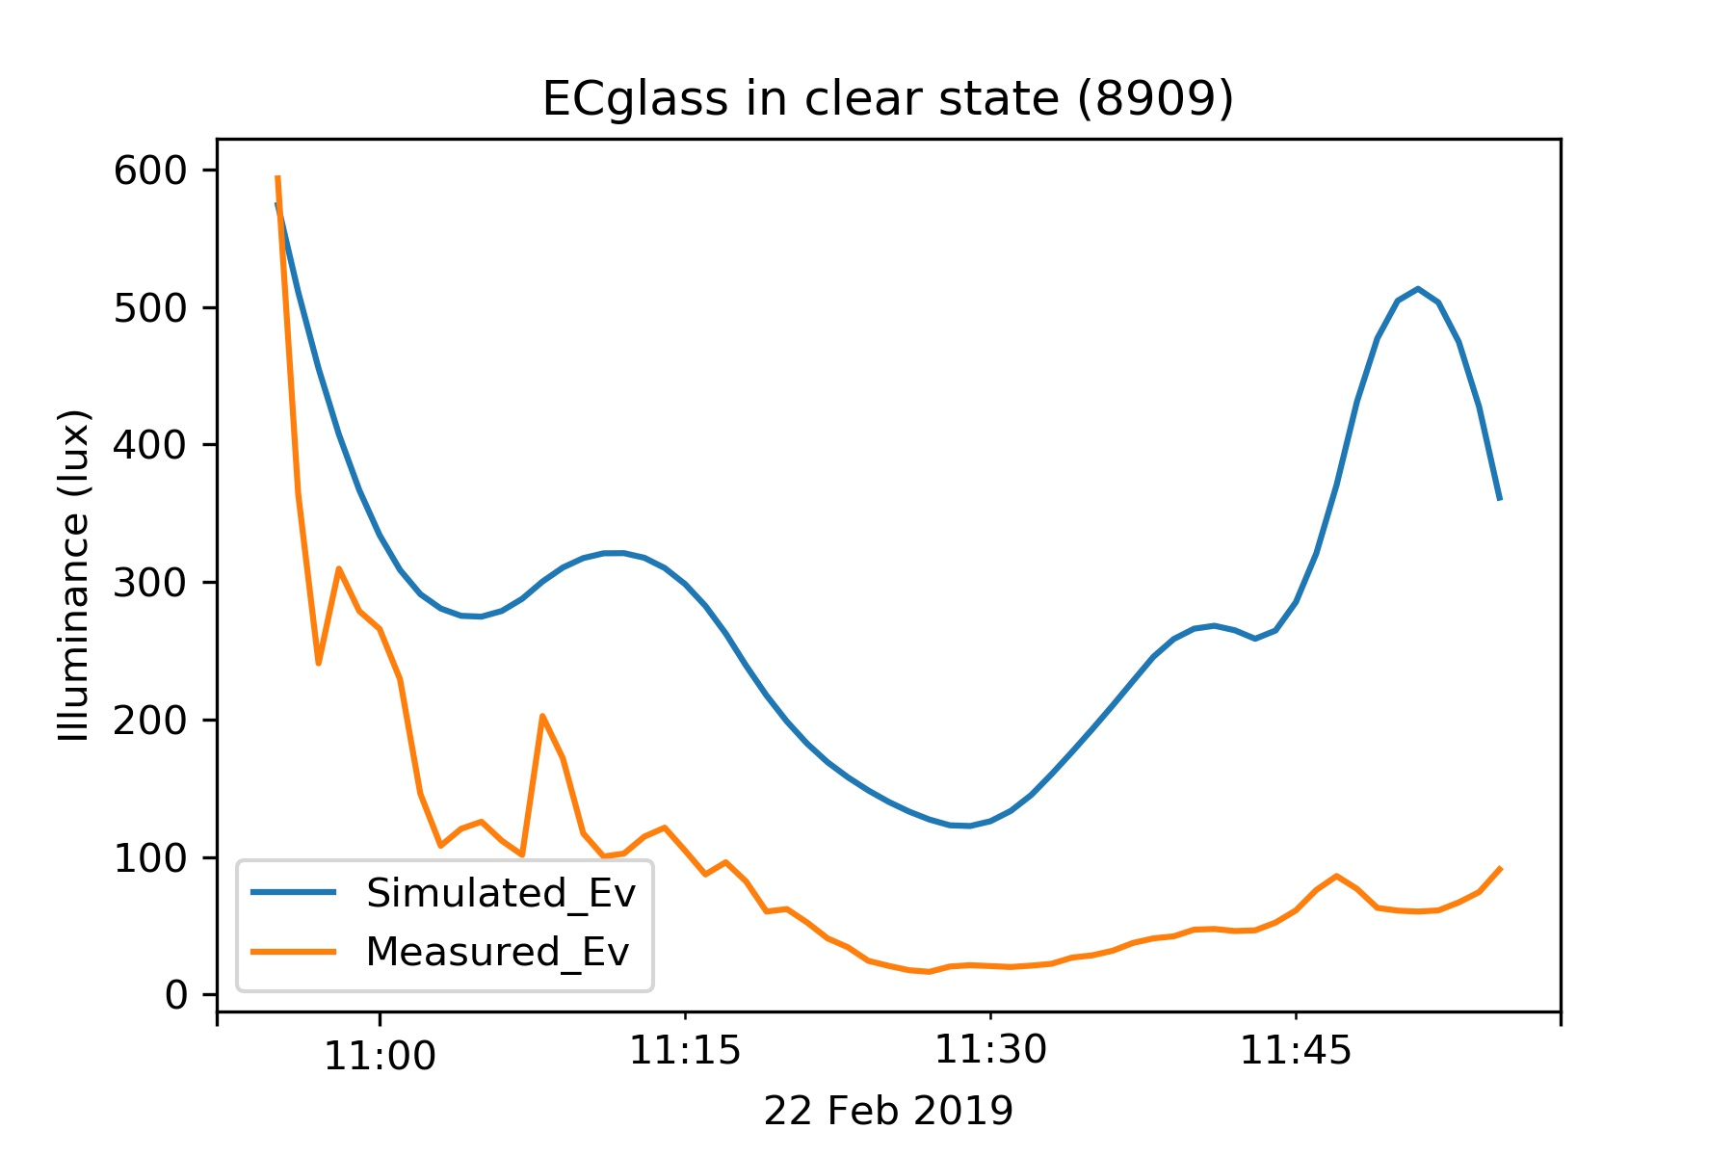

Slide 5
