Slide 1
Data Analysis of Employee Attrition Project
Created by : Raghul Prasanth .M
Dataset : Employee Attrition
Date : 07-04-2025
Batch : RP-33

Slide 2
Dataset Overview
The dataset includes information about employees such as:
Age, Education, Gender
Department, Job Role, Business Travel
Attrition Status
Satisfaction Scores (Environment, Work-Life Balance, Relation ship, Performance Rating )
Career Progression (Years at Company, Promotions, Total Working Years, Training Times Last Year, Years With Current Manager, Years Since Last Promotion, Years In Current Role )
Pay Role(Monthly Income, Monthly Rate, Daily Rate )
Total Attributes: 35 columns

Slide 3
Data Cleaning Process
Removed unnecessary columns (e.g., unnamed columns, Standard Hours , Employee Count, Over18 )
Handled missing values in Distance From Home , Age
Standardized categorical values (e.g., Attrition: Yes/No)
Verified data types for DAX compatibility
Replace Values(Education Field, Environment Satisfaction , Job Involvement, Job Satisfaction )

Slide 4
DAX Functions
Several DAX functions were used in Power BI for analysis:
CALCULATE: For conditional aggregations
COUNTROWS: To count filtered rows
AVERAGE: For monthly salary and daily rate
IF & SWITCH: For creating custom categorizations

Slide 5
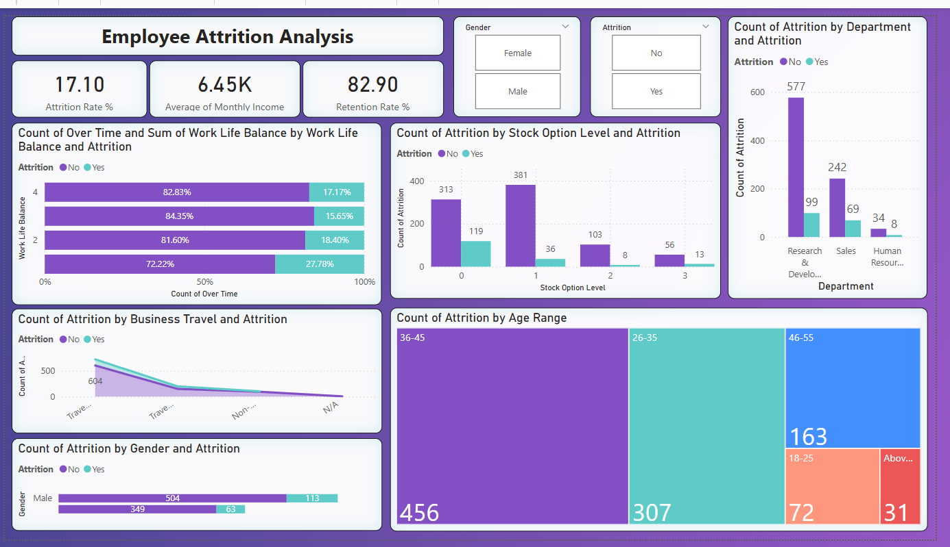
Dashboard Overview

Slide 6
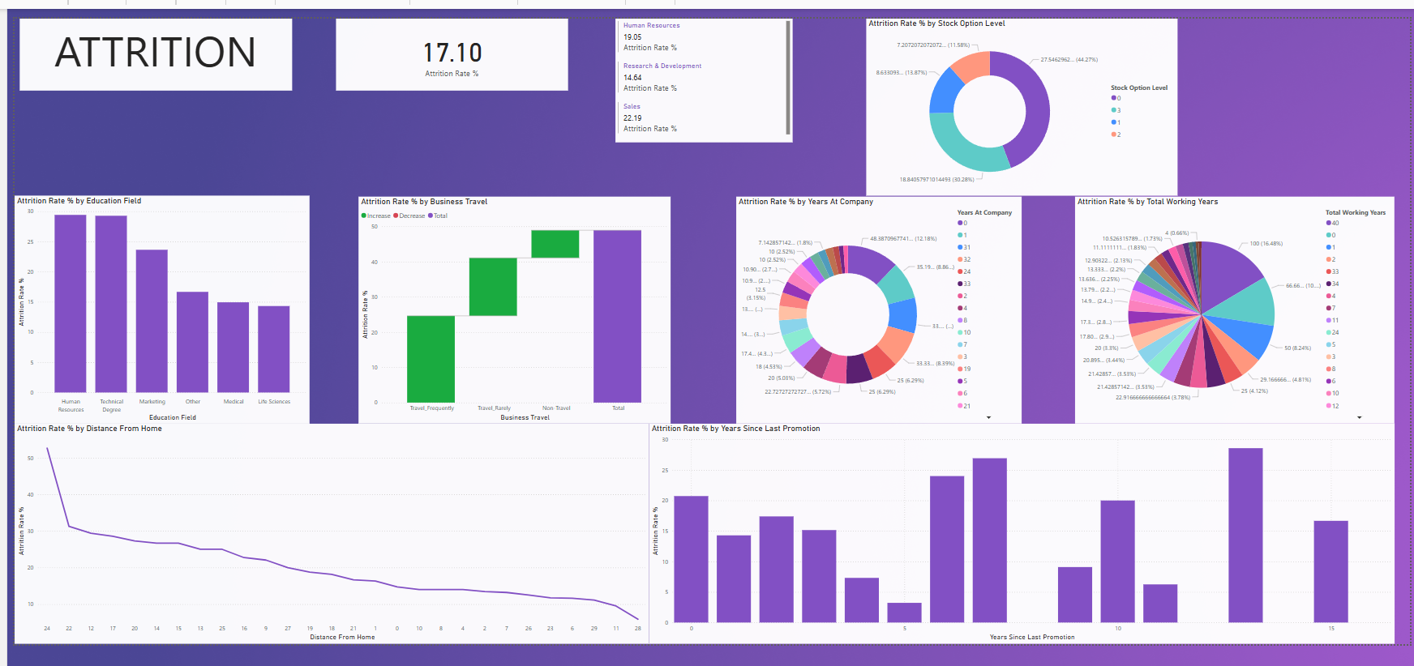
Attrition Dashboard

Slide 7
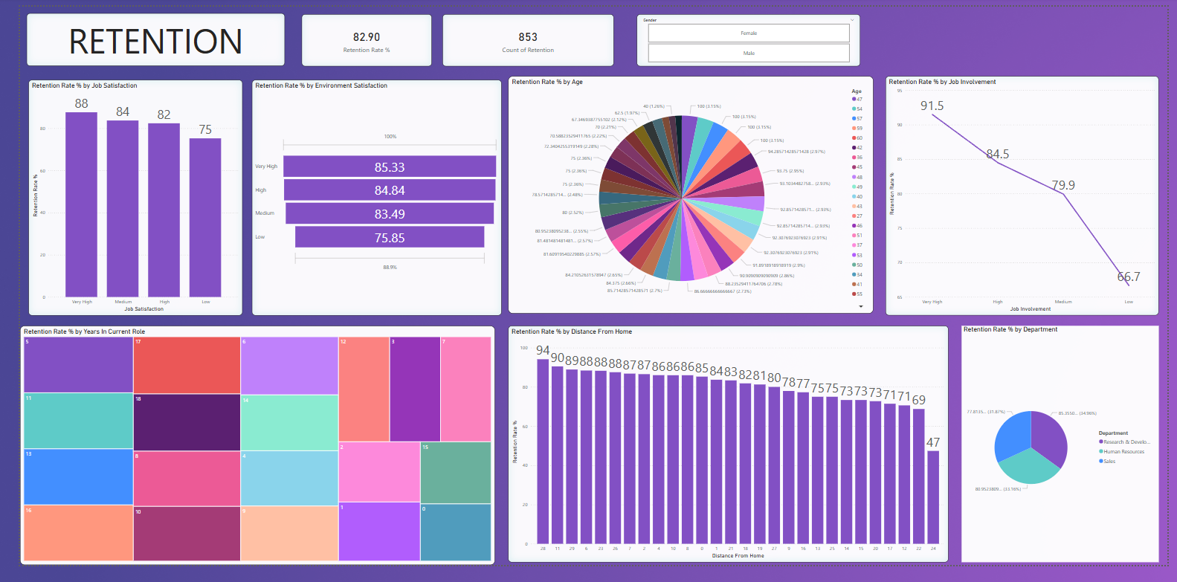
Retention Dashboard

Slide 8
Key Insights & Recommendations
Higher attrition observed in Sales department
Employees with low satisfaction scores more likely to leave
Younger and After 40 employees have higher attrition rates
Recommend improving engagement and satisfaction for at-risk groups
0 Stocks option level have high attrition
Provide travel allowance
Employees with low satisfaction had 2x higher attrition.
Employees with <2 years tenure are 30% more likely to leave
Introduce remote work options for Sales roles to reduce travel stress

Slide 9
Conclusion
The analysis helped identify key factors influencing attrition.
Attrition is driven by job role, satisfaction, and tenure.
Improve employee retention strategies
Use insights to tailor HR policies
Track progress using live dashboards in Power BI
Reducing attrition can save $2M annually in hiring/training costs.
Partner with HR to implement retention strategies and monitor progress.

Slide 10
Thanking You
Question ’s are Welcomed

