Slide 1

Dr.V.N.Sastry
Professor, IDRBT
vnsastry@idrbt.ac.in
Ph.+91-40-23294031

Slide 2

MCDM Concepts
  Decision and Optimization
  Pareto Optimality
  Decision and Criteria Space
MCDM Methods
  Weighting Method
  Lexicographic Method
  Goal Programming Method
  Fuzzy Goal Programming Method
  Stochastic Programming Method
  Dynamic Optimization and Optimal Control
MCDM APPLICATIONS
  ALM
  PORTFOLIO OPTIMIZATION

Slide 3

Select the best from the Given Alternatives (Given or Generate ? )
Decision Process
  Decision Maker ( Individual or Entity or Group)
  Context or System Domain
  Functions : Search, Screen and Select
  Measures : Criteria
  Result : Optimization
    ( Intelligence ? DSS ? Decision Style ? )

Slide 4


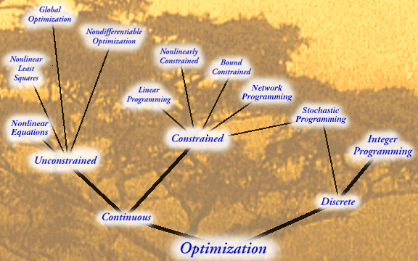

Slide 5
Optimization Problem: Structure, Solution & Process
Optimization implies Maximization and / or Minimization.
The structure of Optimization Model of a system consists of (i) Objective(s) to be optimized and (ii) constraints on resources to be satisfied. It is mathematically formulated as an Optimization Problem.
Examples of Objectives for a system may be Maximization of profit, returns, stability, reliability, NII, MVE, growth rate etc. and Minimization of time, distance, cost, error, loss, delay, space area, space volume, risk etc. The examples of resources are labour, material, machine, money, energy, time, space etc.
By the solution of an optimization problem, it means (i) finding the values of the decision variables that result in the optimum values of the objective(s) known as optimum solution and (ii) identification of right path(s) from given source to the destined solution known as strategy or technique.
Optimization Process involves decision making involving (i) Search for a set of alternatives ( candidates or entities to be selected ), (ii) Screen the undesirable alternatives from it and (iii) Select the best alternative from the remaining alternatives with respect to the decision makers preferences.

Slide 6
Steps in the Formulation of an
Optimization Problem of a System
Step 1. Identify the decision variables.
Step 2. Identify the set of constraints on resources and express them as equations or in-equations in terms of the decision variables.
Step 3. Identify the objective(s) and express as a linear or non-linear function of decision variables. Check whether it is to be maximized or minimized.
Step 4. Add the non-negativity restrictions on the decision variables, if required, as per the nature of the physical system, since negative values of decision variables may not have valid interpretation, in general.

Slide 7
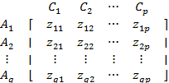
Multiple Objective Optimization Problem (MOOP):
  Max. (or Min.) {z_{i} =f_{i}(x) for i =1 to p }
  subject to x ε S
Multiple Attribute Decision Making (MADM):
A₁, A_{2 ,}…., A_{q} are possible alternatives
C₁, C₂ ,…, C_{p} are criteria
z_{ij} is the rating or measure of alternative A_{i} with respect to criterion C_{j.}

Slide 8

Minimize Liquidity Risk ( Short Term)
Maximize Return on Equity
Maximize Market Value of Equity
Maximize Net Interest Income
Minimize Non Performance Assets
Maximize Regulatory Compliance
Maximize Competitive Advantage
Maximize Operational Efficiency
Maximize Customer Satisfaction Levels
Minimize Reputation Risk
Minimize Cost of Funds
04/02/19

Slide 9

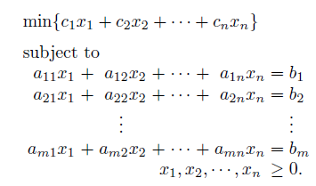


Slide 10
Mathematical Formulation of an LPP:
There are mainly four steps in the mathematical formulation of linear programming problem as a mathematical model.
Step 1. Identify the decision variables.
Step 2. Identify the set of resource constraints and express them as linear equations or inequations in terms of the decision variables.
Step 3. Identify the objective function and express it as a linear function of decision variables.
Step 4. Add the non-negativity restrictions on the decision variables, as in most of the physical problems, negative values of decision variables have no valid interpretation. However, they may be unrestricted in sign.
Methods to solve LPP : Graphical Method ( 2 & 3 variables), Simplex Method(s) with various flavours,
04/02/19

Slide 11
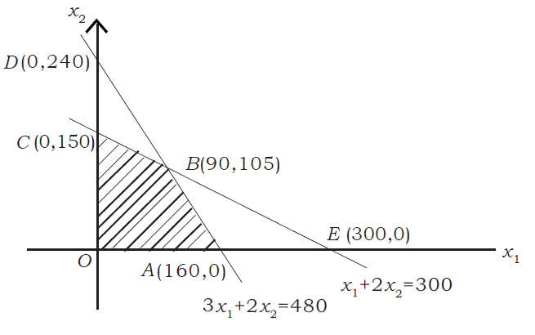
Linear Programming Problem (LPP) by Graphical Method
Example (LPP ):
Maximize z = 0.25x1 + 0.45x2 subject to
x1 + 2x2<=300,
3x1 + 2x2<= 480,
x1>= 0, x2>=0;
Point | Z value
O | 0
A | 40
B | 69.75
C | 67.50
Shaded region OABC is the feasible region satisfying all constraints of the LPP
Solution : Max z = 69.75 at the point B ie, at x1=90, x2=105
04/02/19

Slide 12
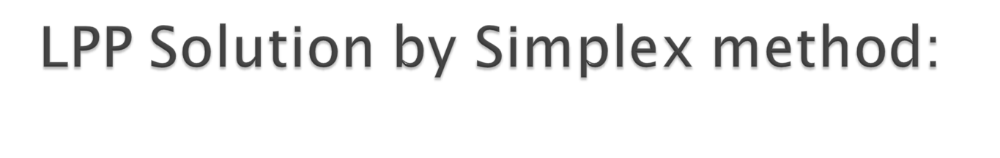
Minimize f(x): 990x₁+900x₂+5250
subject to:
0.4x₁+0.6x₂<=8.5
3x₁-x₂<=25
3x₁+6x₂<=70
x₁>=0; x₂>=0
f=[-990 -900];
A=[0.4 0.6;3 -1;3 6]
b=[8.5 25 70]
x=lpprog(f,A,b)
Ans: x1=10.476 x2=6.4286
Solution using Matlab Optimization Tool :
04/02/19

Slide 13

A nonlinear programming problem (NLPP) is a mathematical structure in which at least one of the constraint functions or the objective function is a non linear expression.
Example :
  ===============================
  Maximize f(x,y,z) = 3 sin x + xy + y³ - 3z + log z
  Subject to x² + y² = 1
  x + 4z ≥ 2
  z ≥ 0
  ===============================
Unlike LPP, for NLPP Optimal solution may be an inter point of the feasible region.
04/02/19

Slide 14
For maxima the objective function should be Concave type and for minima it should be of convex type.
If it is of mixed type over the feasible region, then local optimal solutions exist.
A local optimal solution is the best solution only with respect to feasible solutions close to that point.
A global optimal solution is the best solution to the complete problem.
Heuristic methods help in determining global optimum solution.
Global Optima
Local Optima
04/02/19

Slide 15

A quadratic programming (QP) problem is a special NLPP for which the objective is a quadratic function of the decision variables, but all the constraints are linear functions of the decision variables.
The general quadratic program can be written as
    Minimize f(x) = cx +(1/2) *x^T *Q x
    Subject to Ax <=b and x >=0
    Where x is an n dimensional vector in real space and Q
    is a square matrix of dimension n.
04/02/19

Slide 16
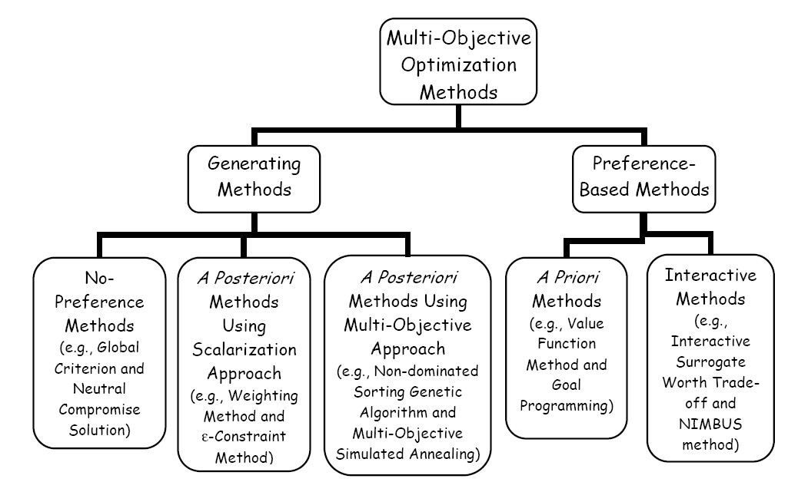
Decision space ( feasible region), Criteria Space ( Objectives region) and Pareto Optimality are basic concepts for MOOM
04/02/19

Slide 17
Maximize (or Minimize) z=c₁*x₁+c₂*x₂+…+c_{n}*x_{n}
Subject to the constraints:
a₁₁*x₁+a₁₂*x₂+………+a_{1n}*x_{n} (< or = or >) b₁
a₂₁*x₁+ a₂₂*x₂+………+ a_{2n}*x_{n} (<, =, >) b₂
…………………………………………………………………
a_{m1}*x₁+ a_{m2}*x₂+………+ a_{mn}*x_{n} (<, =, >) b_{m}
x₁, x₂ …., x_{n} > 0
Here, c_{j} are cost coefficients, x_{j} are n number of decision variables and a_{ij} are activity parameters, b_{i} are resource levels, z is the objective function and rest are constraints. There are m number of constraints on the resources and the rest are non-negativity restrictions on the decision variables.

Slide 18
An NLPP has at least one non-linear function either in the objective(s) or constraints or both.
A local optimal solution is the best solution only with respect to feasible solutions close to that point.
A global optimal solution is the best solution to the complete problem.
In NLP problem, optimal solution can occur at any point inside or on the boundary of the feasible region depending upon the nature of the objective function. Hence search strategy is not unique.
Global Optima
Local Optima

Slide 19
Methods to solve a LPP
Graphical Method ( 2D & 3D )
Simplex Method
Dual Simplex Method etc.
Tools:
MS-Excel Solver
Matlab Optimization Toolbox
OR Software : Lindo, Xeno etc.

Slide 20

In general, a MCDM or MOOP will have two or more objectives involving many decision variables and constraints.
For example, an MOO problem with two objectives f1(x) and f2(x) with a vector (x) of decision variables. Such problems are known as two- or bi-objective optimization problems.
    Minimize f1(x)
    Minimize f2(x)
    Subject to
    xL ≤ x ≤ xU
    h(x) = 0
    g(x) ≤ 0
Pareto Optimality

Slide 21
LPP-1:
Maximize z₁ =0.25x₁+0.45x₂
subject to the constraints
x₁ + 2x₂<=300,
3x₁ + 2x₂<= 480,
x₁>= 0, x₂>=0;
Point | (x_{1,} x₂) | z₁ = 0.25x₁ + 0.45x₂ | Solution
A | (160, 0) | 40.00
B | (90, 105) | 69.75 | Maximum
C | (0, 150) | 67.50
O | (0, 0) | 0

Slide 22
LPP-2
Maximize z₂ = 0.5x₁
subject to the constraints
x₁ + 2x₂<=300,
3x₁ + 2x₂<= 480,
x₁>= 0, x₂>=0;
Point | (x_{1,} x₂) | Z₂ =0.5 x₂ | Solution
A | (160, 0) | 80 | Maximum
B | (90, 105) | 45
C | (0, 150) | 0
O | (0, 0) | 0

Slide 23
MOLPP-1
Maximize z₁ =0.25x₁+0.45x₂
Maximize z₂ = 0.5x₁
subject to the constraints
x₁ + 2x₂<=300,
3x₁ + 2x₂<= 480,
x₁>= 0, x₂>=0;
Point | (x_{1,} x₂) | z₁ = 0.25x₁ + 0.45x₂ | z₂ =0.5 x₂ | Solution ?
A | (160, 0) | 40.00 | 80
B | (90, 105) | 69.75 | 45
C | (0, 150) | 67.50 | 0
O | (0, 0) | 0 | 0

Slide 24

For a Multiple Objective Optimization Problem ( of Max. type objectives), a solution x = ( x₁, x₂, x₃,…,x_{n} ) ε S is said to be Pareto Optimal Solution or Non-dominated solution iff there does not exist another x* =( x₁*,x₂*, …,x_{n}* ) ε S such that z (x) ≤ z (x*) with strict inequality holding true for at least one z_{i} i.e, there is no x* for which (f₁(x), f₂(x), …, f_{p}(x)) ≤ (f₁(x*), f₂(x*), …, f_{p}(x*)) holds true with f_{i}(x) < f_{i}(x*) for at least one i.
This means that a Pareto Optimal Solution is one for which one objective value cannot be increased without simultaneous decrease in some other objective value, because of conflicting nature of objectives

Slide 25
MOLPP-1
Maximize z₁ =0.25x₁+0.45x₂
Maximize z₂ = 0.5x₁
subject to the constraints
x₁ + 2x₂<=300,
3x₁ + 2x₂<= 480,
x₁>= 0, x₂>=0;
MOLPP-2
Maximize z₁
Maximize z₂
subject to the constraints
20z₁ – z₂<= 1350,
20z₁ + 17z₂<= 2160,
z₁>= 0, z₂>=0;
Equivalent problems in Decision Space and Criteria Space
Points in Decision Space | (x_{1,} x₂) | Points in Objective Space | (z₁ , z₂ )
A | (160, 0) | A’ | (40, 80)
B | (90, 105) | B’ | (69.75,45)
C | (0, 150) | C’ | (67.50,0)
O | (0, 0) | O’ | (0,0)

Slide 27
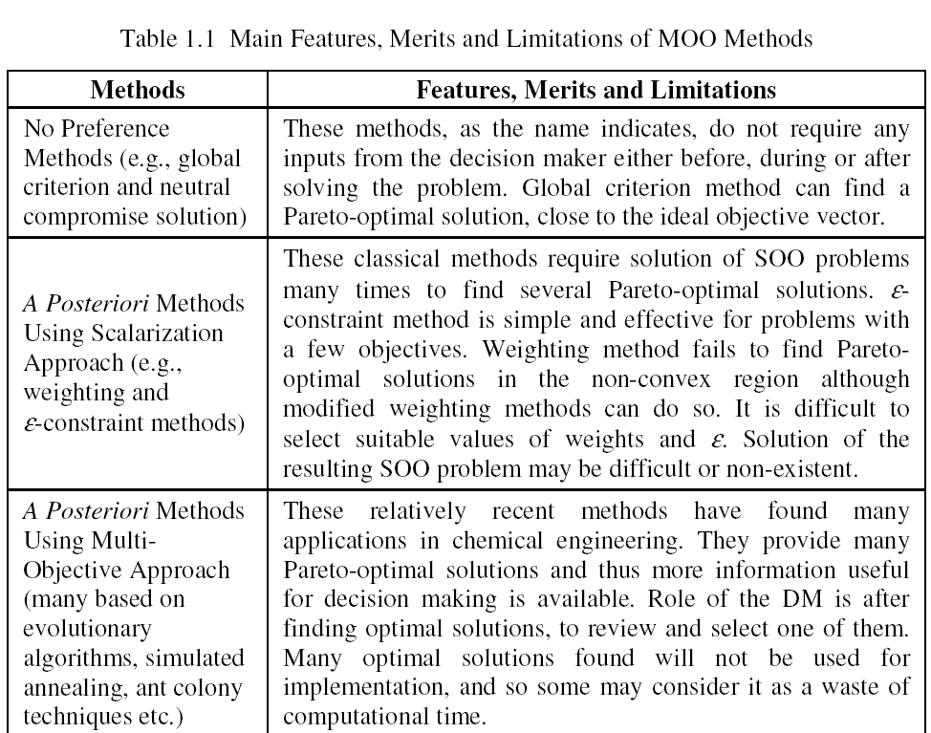

Slide 28
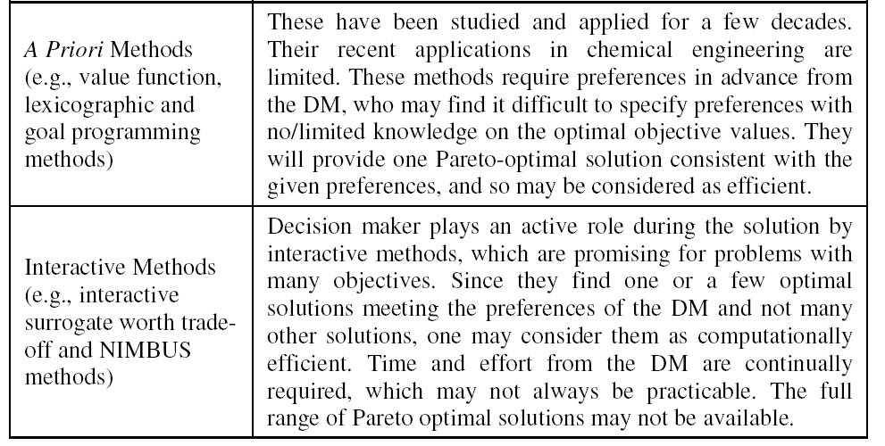

Slide 29

Scalarizing Methods
    Example : Weighting Method
Analytic Hierarchy Process(AHP)
    Example : Selection of Job
Goal Programming(GP)
    Example : Target tracking
Data Envelopment Analysis(DEA)
    Example : Classification based on multiple attributes
Homotopy Techniques
Normal-Boundary Intersection(NBI)
Multilevel Programming

Slide 30
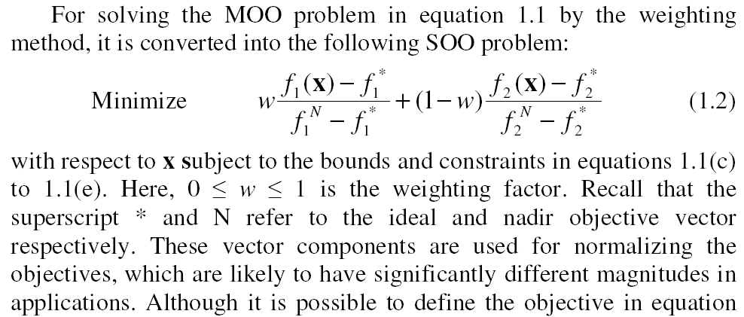

Slide 31


Slide 32

Goal is the target value assigned to an objective of an optimization problem.
When Goals are assigned to each objective, then we get multi-objective goal programming problem (MOGPP).
Deviation in the achievement of a Goal for an objective may happen on account of under achievement or over achievement.
d_{i}⁺ and d_{i}⁻ , deviation variables, are the amounts a targeted goal i is overachieved or underachieved, respectively (surplus and slack).
One approach to goal programming is to satisfy goals in a priority sequence. Second-priority goals are pursued without reducing the first-priority goals, etc.
For each priority level, the objective function is to minimize the (weighted) sum of the goal deviations.
Previous "optimal" achievements of goals are added to the constraint set so that they are not degraded while trying to achieve lesser priority goals.

Slide 33
Goal Programming Problem
(MO-LGPP)
Find x
that satisfies the following goal constraints
Z₁= c₁₁x₁+c₁₂x₂+………………+ c_{1n}x_{n} (<, =, >) G1
Z₂= c₂₁x₁+c₂₂x₂+………………+ c_{2n}x_{n} (<, =, >) G2
..………………………………………………
Z_{p}= c_{p1}x₁+c_{p2}x₂+………………+ c_{pn}x_{n} (<, =, >) Gn
and the following resource constraints
a₁₁*x₁+ a₁₂*x₂+………………+ a_{1n}*x_{n} (< or = or >) b₁
a₂₁*x₁+ a₂₂*x₂+………………+ a_{2n}*x_{n} (<, =, >) b₂
…………………………………………………………………
a_{m1}*x₁+ a_{m2}*x₂+…………… + a_{mn}*x_{n} (<, =, >) b_{m}
x₁, x₂ …., x_{n} > 0

Slide 34
Three basic approaches to GP
Weighted Goal Programming ( Min-sum )
Chebyshev Goal Programming (Mini-max)
Lexiographic Goal Programming (Pre-emptive
Priority )

Slide 35

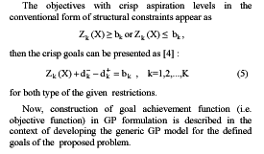

Slide 36

Step 1: Decide the priority level of each goal. Commensurable objectives need to be in a priority level.
Step 2: For each priority level, decide the weight of each goal in a priority level. If a priority level has more than one goal, for each goal i decide the weight, w_{i} , to be placed on the deviations, d_{i}⁺ and/or d_{i}⁻, from the goal.
Step 3: Set up the optimization problem with a new linear objective function with weights and deviation variables in the given priority level and solve.
For example if there are two objectives in the first priority level and if they have weights w₁ and w₂ then
Min f = w₁d₁⁺ + w₂d₂⁻
sub. to Functional Constraints,
and Goal Constraints
Step 4: If there is a lower priority level, go to step 3 otherwise, a final solution has been reached.

Slide 37
A computer company produces the CP400 and the CP500 computers. The computers use different mother boards produced in abundant supply by the company, but use the same cases and disk drives. The CP400 models use two floppy disk drives and no zip disk drives whereas the CP500 models use one floppy disk drive and one zip disk drive. The disk drives and cases are bought from vendors. There are 1000 floppy disk drives, 500 zip disk drives, and 600 cases available to the company on a weekly basis. It takes one hour to manufacture a CP400 and its profit is $200 and it takes one and one-half hours to manufacture a CP500 and its profit is $500
The company has three goals which are given below:
Priority 1: Meet a state contract of 200 CP400 computers weekly. (Goal 1)
Priority 2: Make at least 500 total computers weekly. (Goal 2)
Priority 3: Make a profit of at least $250,000 weekly. (Goal 3)

Slide 38
GP Formulation
Variables
x₁ = number of CP400 computers produced weekly
x₂ = number of CP500 computers produced weekly
d_{i}⁻ = amount the right hand side of goal i is deficient
d_{i}⁺ = amount the right hand side of goal i is exceeded
Functional Constraints
Availability of floppy disk drives: 2x₁ + x₂ < 1000
Availability of zip disk drives: x₂ < 500
Availability of cases: x₁ + x₂ < 600
Goals
(1) 200 CP400 computers weekly:
x₁ + d₁⁻ - d₁⁺ = 200
(2) 500 total computers weekly:
x₁ + x₂ + d₂⁻ - d₂⁺ = 500
(3) $250(in thousands) profit:
.2x₁ + .5x₂ + d₃⁻ - d₃⁺ = 250
Non-negativity:
x₁, x₂, d_{i}⁻, d_{i}⁺ > 0 for all i

Slide 39
Objective Functions
Priority 1: Minimize the amount the state contract is not met:
Min d₁⁻ for x₁ +d₁⁻ -d₁⁺ = 200
Priority 2: Minimize the number under 500 computers produced weekly:
Min d₂⁻ for x₁ +x₂ +d₂⁻ -d₂⁺ = 500
Priority 3: Minimize the amount under $250,000 earned weekly:
Min d₃⁻ for 0.2x₁+ 0.5x₂ +d₃⁻ -d₃⁺ = 250

Slide 40
A Company manufactures two products, A and B. Product A requires five hours on machine 1 and two hours on machine 2; product B requires two hours on machine 1 and four hours on machine 2. The weekly capacities of machine 1 and 2 are 50 hours and 48 hours, respectively.
The company has three goals which are given below:
Priority 1: Minimize underachievement of a total production of ten units per week (Goal 1)
Priority 2: Minimize underachievement of producing 8 units of product A weekly. (Goal 2)
Priority 3: Minimize underachievement of producing thirteen units of product B weekly. (Goal 3)

Slide 41
Variables
x₁ = number of units of A produced weekly
x₂ = number of units of B produced weekly
d_{i}⁻ = amount the right hand side of goal i is deficient
d_{i}⁺ = amount the right hand side of goal i is exceeded
Constraints
5x₁ + 2x₂ < 50
2x₁ + 4x₂ < 48
Goals
(1) 10 total production weekly:
x₁ + x₂ + d₁⁻ - d₁⁺ = 10
(2) 8 units product A weekly:
x₁ + d₂⁻ - d₂⁺ = 8
(3) 13 units product B weekly:
x₂ + d₃⁻ - d₃⁺ = 13
Non-negativity:
x₁, x₂, d_{i}⁻, d_{i}⁺ > 0 for all i

Slide 42


Slide 43

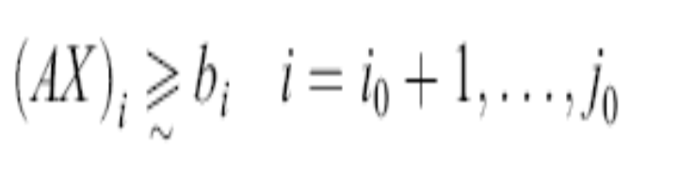

MOFGP Formulation :
Three types of fuzzy goals
A lower, one-sided goal sets a lower limit that we do not want to fall under (but exceeding the limit is fine).
2. An upper, one-sided goal sets an upper limit that we do not want to exceed (but falling under the limit is fine).
3. A two-sided goal sets a specific target that we do not want to miss on either side.

Slide 44
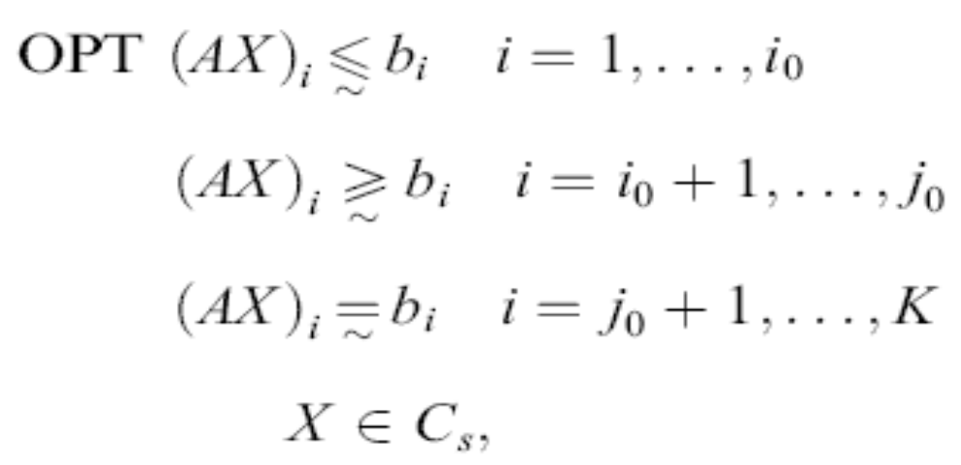
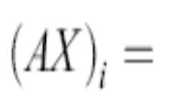
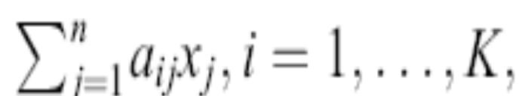
FGP model contains three kinds of fuzzy goals.
where OPT means finding an P optimal decision X such that all fuzzy goals are satisfied
“~” is a fuzzifier representing the imprecise fashion in which the goals are stated.

Slide 45
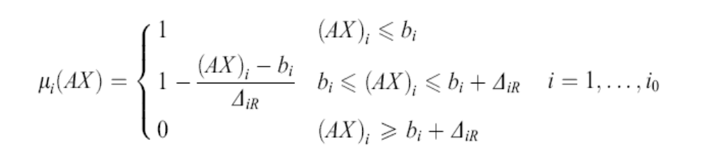
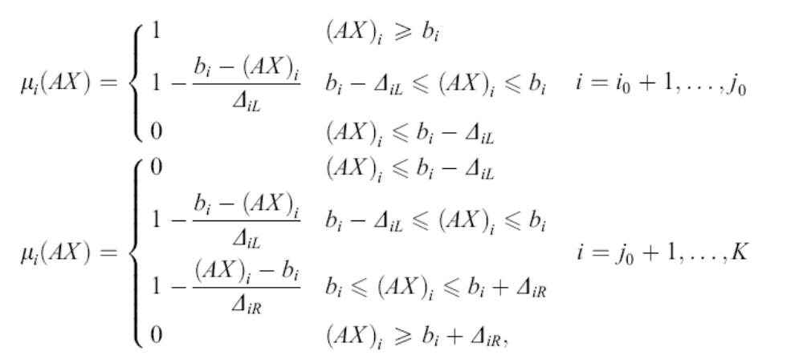
Transformation of Fuzzy Goals into its Crisp Form Using fuzzy membership functions

Slide 46
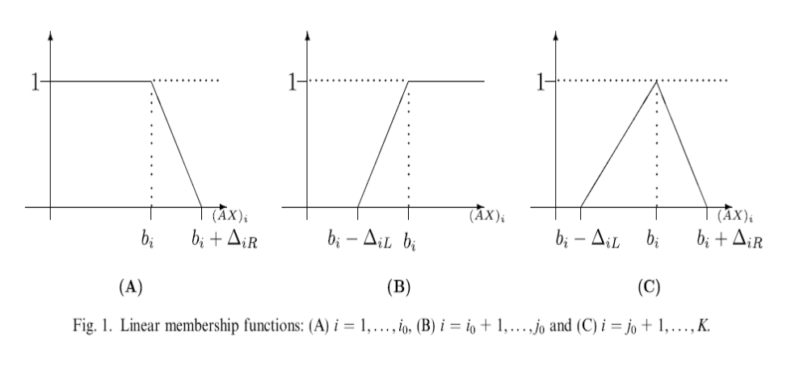

Slide 47
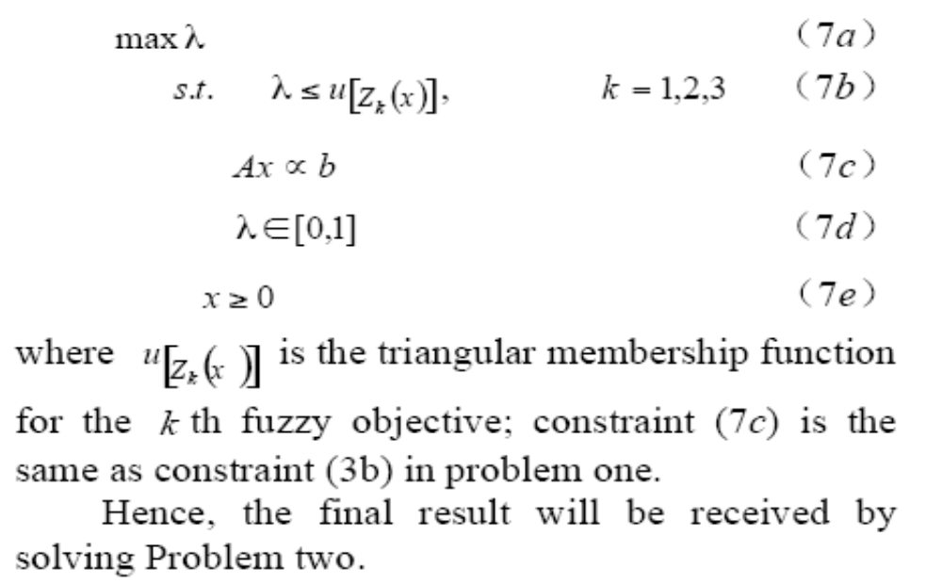
Based on that, another programming formulation defined to Problem two is given
Problem two:

Slide 48

Min (or Max) φ_{l} =⎢⎢f_{ol} (x(t),u(t),t ⎢⎢ for l =1(1)p,
Subject to
Dx(t) = f (x(t), u(t), t) where D is differential operator ( d/dt )
g (x(t), u(t), t) ≥ 0
h (x(t), u(t), t) = 0
x(t_{o}) = c where t_{o} is the initial time
S(x(t_{f})) = 0 where t_{f} is the final time
Dr.V.N.Sastry
February 21, 2004

Slide 49

Multiple Criteria Decision Making -Books ed. by (a)M. Zeleny , (b) Ambrose Goicoechea, © Ralph E. Steuer, (d) K. Paul Yoon, (e) Evangelos Triantaphyllou
Goal Programming and Extensions, J. P. Ignizio, Lexington Books, MA, USA.
European Journal of Operational Research
Fuzzy Multiple Criteria decision Making, Kaharman Cengiz, Springer, Vol.16, 2008
Int. J. of Fuzzy Sets and Systems

