Slide 1
BOND VALUATION
Dr.V.N.SASTRY
Professor, IDRBT
Institute for Development and Research in Banking Technology
Road No.1, Castle Hills,
Hyderabad 500057, AP, INDIA
91-040-23294031 vnsastry@idrbt.ac.in
Notes:
THE OBJECTIVE OF THIS LECTURE IS TO INTRODUCE THE FUNDAMENTALS OF A DECISION SUPPORT SYSTEM (DSS) AND ITS UTILITY IN MODERN BANKING.
IT WILL FOCUS ON DECISION MAKING PROCESS, DECISION MAKERS; COMPONENTS, CLASSES AND STAGES OF A DSS; WHY DSS IS NECESSARY IN BANKING, WHAT IS THE EVOLUTION AND TECHNOLOGICAL DEVELOPMENT IN DSS, HOW TO APPLY SYSTEMS APPROACH FOR THE DEVELOPMENT OF A DSS.
TWO CASE STUDIES ON DSS FOR (1) INFINET TRAFFIC MANAGEMENT AND (2) TECHNOLOGY IMPLEMENTATION IN BANKS WILL ILLUSTRATE THE IMPORTANCE AND METHODOLOGY FOR DEVELOPING A DSS OF YOUR NEED.

Slide 2
Characteristics of Bonds
Issuer
Face Value
Term to Maturity
Coupon
Provisions
Risks
YTM ( Yield to Maturity)
Dr.V.N.SASTRY

Slide 3
1. ISSUER
Name of issuer
Type of Issuer
Market Segment : Domestic, Foreign
Country of Origin
Registration Authority
Dr.V.N.SASTRY

Slide 4
ISSUER TYPE
It defines the Sector to which the bond belongs to and issued from , eg,
  Public Sector
    Governments (Central, State, foreign, federal )
      Govt.Treasury Bond
    Government agencies (Corporations, Nationalized Banks, Post Office etc.)
  Private Sector
    Companies
Dr.V.N.SASTRY

Slide 5
2. Face Value
Currency Denomination
Announcement date, Issue date and offer date.
Principal (Face, Par value) is the amount of the debt.
Interest accrued date : The date beginning which the interest gets accrued.
Settlement date
Dr.V.N.SASTRY

Slide 6
3. Maturity
Maturity denotes the date the bond will be redeemed.
Term-to-maturity denotes the number of years remaining until that date.
  Indicates the number of coupon interest payments the bond holder will receive.
  A factor in determining the yield of a bond.
Time period count : The effective days for the calculation may be 365 or 360 days in a year or the actual days in hold period.
Dr.V.N.SASTRY

Slide 7
4. Coupon
Coupon rate is the rate of interest on the principal.
Coupon frequency is the number of times the coupons are paid till maturity including the one paid on the maturity date.
Coupon payment is calculated as the product of the coupon rate and the principal.
Dr.V.N.SASTRY

Slide 8
5. Provisions
Provisions provide the issuer or holder the right to retire debt prematurely or require the issuer to retire a portion of outstanding debt according to a specified schedule.
Examples: call provision, refunding provision, sinking-fund provision, put provisions etc.
Type of compounding of interest
Dr.V.N.SASTRY

Slide 9
6. Risks
Associated Risks
  Collateral : Acceptable Asset pledged as a security against possible default.
  Pre-mature closure of Bond
  Unclaimed amount after maturity
  Liquidity and Legal issues
Rights of the Holder
Liabilities of the Issuer
Rating of the Bond
Dr.V.N.SASTRY

Slide 10
7. Bond value and yield
Time value of money : One hundred Rupees in hand today is more valuable than one hundred rupees in the future.
Present Value: 1/(1+r); where r is the respective spot rate.
Bid price : The price at which an investor can sell a Bond.
Ask Price : The price at which an investor can buy a Bond.
Spread : Difference in the yield on the bond and the yield on the benchmark (or standard treasury bill) bond.
Dr.V.N.SASTRY

Slide 11
Bond Pricing
Price is the sum of discounted cash flows.
Price = Σ[c(t)/(1+r_{t})^{t}]
where r_{t} is the spot rate at time t
c(t) is the payment at time t.
Dr.V.N.SASTRY

Slide 12
Examples
1) Treasury zero expiring in a year, priced at $98.
98 = 100/(1+r1); r1= 0.0204
2) Treasury 4.25 expiring in 2 years, priced at $95.
95 = 4.25/(1+r1) + 104.25/(1+r2)²;
as r1= 0.0204, then r2 = 0.0713
Note: Can view coupon payments as a series of zero coupon bonds.
Dr.V.N.SASTRY

Slide 13
Law of One Price
The Law of One Price dictates that two securities with identical cash flows should sell at the same price.
The spot rate extracted from one set of bonds may be used to price any set of bonds with identical cash flows.
Dr.V.N.SASTRY

Slide 14
Yield-to-Maturity (YTM)
Yield-to-Maturity is the single rate such that discounting a security’s cash flow at that rate produces the market price.
Price = Σ[c(t)/(1+y)^{t}]
Example: Treasury 4.25 expiring in 2 years, priced at $95.
95 = 4.25/(1+y) + 104.25/(1+y)²; y = 0.0702
Dr.V.N.SASTRY

Slide 15
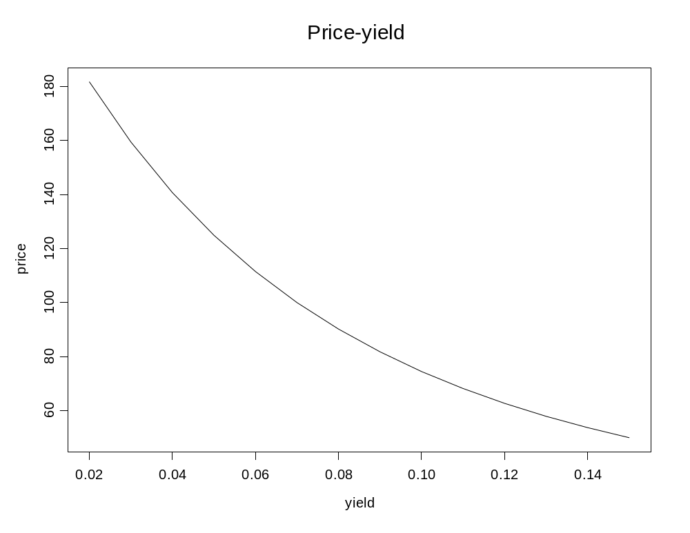
Price Yield Relationship
Dr.V.N.SASTRY

Slide 16
Discount & Premium
If Coupon = YTM
Bond is sold at par
If Coupon > YTM
Bond is sold at a premium
If Coupon < YTM
Bond is sold at a discount
Illustration
Dr.V.N.SASTRY

Slide 17
Bond Value Theorem - I
If a bond’s YTM increases, then its price decreases.
If a bond’s YTM decreases, then its price increases.
Dr.V.N.SASTRY

Slide 18
Bond Value Theorem - II
If a bond’s YTM does not change over its life, then the size of its discount or premium will decrease as its life gets shorter
Illustration
Dr.V.N.SASTRY

Slide 19
Bond Value Theorem - III
If a bond’s YTM does not change over its life, then the size of its discount or premium will decrease at an increasing rate as its life gets shorter.
Illustration
Dr.V.N.SASTRY

Slide 20
Bond Value Theorem - IV
A decrease in a bond’s yield will raise the bond’s price by an amount that is greater in size than the corresponding fall in the bond’s price that would occur if there were an equal-sized increase in the bond’s yield
Illustration
Dr.V.N.SASTRY

Slide 21
Bond Value Theorem - V
The percentage change in a bond’s price owing to a change in its yield will be smaller if its coupon rate is higher
(not applicable to perpetuities and bonds with life less than one year)
Dr.V.N.SASTRY

Slide 22
Convexity
Theorems I and IV lead to the concept of convexity Illustration
YTM
Price
Dr.V.N.SASTRY

Slide 23
Convexity
Convexity – measures how interest rate sensitivity changes with rates.
C = (d²P/dy²)(1/P) = Σ[(t)(t+1)c(t)(1+y)^{-t}]/P(1/(1+y) ²)
-A decline in yields creates stronger convexity impacts than does an equivalent rise in yields.
Dr.V.N.SASTRY

Slide 24
Second Order Taylor Approximation
Approximate price-yield function:
P(y+Δy) ≈ P(y) + (dP/dy)Δy + (1/2)(d²P/dy²)Δy²
Subtract P from both sides, and then divide by P:
ΔP/P ≈ (1/P)(dP/dy)Δy + (1/2)(d²P/dy²)Δy²
⁼ -DΔy + (1/2)C Δy²
Dr.V.N.SASTRY

Slide 25
Term Structure of Interest Rates
Term Structure of Interest Rates measures the relationship among the yields on default-free securities that differ only in their term to maturity.
Dr.V.N.SASTRY

Slide 26
Expectations Hypothesis
Bonds are priced so that the implied forward rates are equal to the expected spot rates. The only reason for an upward-sloping term structure is that the investors expect future spot rates to be higher than current spot rates. Fama (1984) tested the US Treasury market from 1959 to 1982 and found that the forward premium on average preceded a rise in the spot rate, but less than would be predicted.
Lutz
Dr.V.N.SASTRY

Slide 27
Liquidity Preference Hypothesis
Risk aversion will cause forward rates to be systematically greater than expected spot rates. The term premium is the increment required to induce investors to hold longer-term securities. Suggests that risk comes solely from uncertainty about the underlying real rate.
Hicks
Dr.V.N.SASTRY

Slide 28
Market Segmentation Hypothesis
Postulates that individuals have strong maturity preferences and that bonds of different maturities trade in separate and distinct markets. A shortcoming of this hypothesis is that bonds of close maturities will act as substitutes.
Culbertson
Dr.V.N.SASTRY

Slide 29
Preferred Habitat Theory
States that the shape of the yield curve is influenced by asset-liability management constraints.
Modigliani and Sutch
Dr.V.N.SASTRY

Slide 30
Further Study
Negotiable Instrument Act for Bonds and Securities
Reserve Bank of India Act for Bonds and Securities
Markets of Bonds and Regulations
Dr.V.N.SASTRY

