Slide 1
DURATION and DGAP MODEL
Dr.V.N.SASTRY
Professor, IDRBT
Institute for Development and Research in Banking Technology
Road No.1, Castle Hills,
Hyderabad 500057, AP, INDIA
+91-40-23294031 vnsastry@idrbt.ac.in
Notes:
THE OBJECTIVE OF THIS LECTURE IS TO INTRODUCE THE FUNDAMENTALS OF A DECISION SUPPORT SYSTEM (DSS) AND ITS UTILITY IN MODERN BANKING.
IT WILL FOCUS ON DECISION MAKING PROCESS, DECISION MAKERS; COMPONENTS, CLASSES AND STAGES OF A DSS; WHY DSS IS NECESSARY IN BANKING, WHAT IS THE EVOLUTION AND TECHNOLOGICAL DEVELOPMENT IN DSS, HOW TO APPLY SYSTEMS APPROACH FOR THE DEVELOPMENT OF A DSS.
TWO CASE STUDIES ON DSS FOR (1) INFINET TRAFFIC MANAGEMENT AND (2) TECHNOLOGY IMPLEMENTATION IN BANKS WILL ILLUSTRATE THE IMPORTANCE AND METHODOLOGY FOR DEVELOPING A DSS OF YOUR NEED.

Slide 2
Duration
It is a measure of sensitivity or riskiness of a bond in time units.
Since the value of a bond depends on interest rate, it is important to measure the sensitivity of bond value due to changes in interest rates.
It gives the average period at which the amounts are due from a bond
Dr.V.N.SASTRY vnsastry@idrbt.ac.in

Slide 3
Duration
It was given by Frederick Macaulay in 1938 and so called as Macaulay duration. It was not commonly used until the 1970s.
It is a measure of volatility or riskiness of a bond or security in time units.
It considers both timing and magnitude of all cash flows associated with a bond or security.
It gives the average period at which the amounts are due from a bond.
It is the weighted average maturity based on the present value of cash flows rather than the actual cash flows.
Dr.V.N.SASTRY vnsastry@idrbt.ac.in

Slide 4
Properties of Duration
Duration is a measure of risk.
Duration for a ZCB is same as its TTM.
Duration of a coupon paying bond is less than its TTM.
Duration increases as TTM increases.
Duration decreases as YTM increases.
Duration matching helps in hedging interest rate risk.
Dr.V.N.SASTRY vnsastry@idrbt.ac.in

Slide 5
Formula for Duration
Σ PV(C_{t}) * t + PV (FV) * n
D = ----------------------------------
Σ PV(C_{t}) + PV (FV)
1. Denominator is the present value of all returns from the bond. Its unit is in price.
2. Numerator is time weighted present values of all returns from the bond. Its unit is in price multiplied by time.
3. Duration is the weighted average of time periods with PVs of cash flows as weights. Its unit is in time.
Dr.V.N.SASTRY vnsastry@idrbt.ac.in

Slide 6
Example : Find the duration of a bond with face value 100 purchased on 1/7/92 having 5 years maturity and giving annual coupons @12.50%. The YTM being 15%.
Date
1/7/93
1/7/94
1/7/95
1/7/96
1/7/97
Total
No. of years
1
2
3
4
5
Cash flow
12.50
12.50
12.50
12.50
112.50
Present Value
(discounted @15% )
10.87
9.45
8.23
7.15
55.93
91.63
Year x PV
10.87
18.90
24.69
28.59
279.65
362.70
Duration = Total time weighted present value / Total present value
= 362.70 / 91.63 = 3.96 years
Dr.V.N.SASTRY vnsastry@idrbt.ac.in

Slide 7
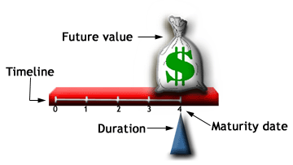
Duration of a Zero Coupon Bond
The fulcrum on the time line placed at the point of duration balances the amount paid for the bond and the cash flow received from the bond.
Dr.V.N.SASTRY vnsastry@idrbt.ac.in

Slide 8
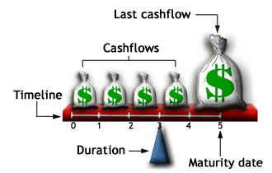
Duration of a Vanilla or Straight Bond
Unlike the zero-coupon bond, the straight bond pays coupon payments throughout its life and therefore repays the full amount paid for the bond sooner. The fulcrum placed at the duration is much before the maturity period.
Dr.V.N.SASTRY vnsastry@idrbt.ac.in

Slide 9
Duration as a Measure of Risk
Duration is a measure of risk. Higher the duration, riskier the bond
It is an approximate measure of the price elasticity of demand
Duration gives a relationship between percentage change in price and percentage change in YTM -
Δp Δ(1 + y)
-- = - D *------------ (approximately)
p (1 + y)
[ % change in price = - D * % change in (1 + YTM) ]
Dr.V.N.SASTRY vnsastry@idrbt.ac.in

Slide 10
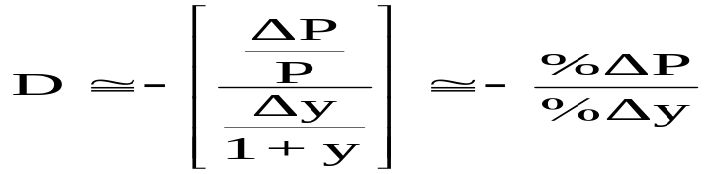
Duration
Solve for ΔPrice:
  ΔP ≅ -Duration x [Δy / (1 + y)] x P
Solve for % Change in Price
  % = −D (Δi / 1 + i)
Price (value) changes
  Longer maturity/duration larger changes in price for a given change in i-rates.
  Larger coupon smaller change in price for a given change in i-rates.
Dr.V.N.SASTRY vnsastry@idrbt.ac.in

Slide 11
Modified Duration
D
MD = ----------------
1 + y / p
where D is duration, y is YTM, p is number of payments per year
[ % change in price = - MD (Δ YTMBP / 100) ]
Dr.V.N.SASTRY vnsastry@idrbt.ac.in

Slide 12
Duration of a Portfolio
Let D1 and D2 be durations of two bonds
Let w1 and w2 be percentage investments made in the two bonds respectively
Duration of portfolio is given as
D= w1*D1 + w2*D2 where w1 + w2 = 1
If D1 and D2 are known and if a target value of D such that D1<D< D2 is to be achieved then solving the above two equations will result in the values of w1 and w2.
Dr.V.N.SASTRY vnsastry@idrbt.ac.in

Slide 13
Duration & Convexity
Since price-yield curve is
not linear and convex,
duration, which is a tangent
to that curve, can help in
finding percentage changes
only in narrow bands
Dr.V.N.SASTRY vnsastry@idrbt.ac.in

Slide 14
Duration and ALM
Assets and Liabilities have to be matched across time
More importantly, their durations have to be matched
Duration matching helps in managing interest rate risk of the portfolio of assets and liabilities
Dr.V.N.SASTRY vnsastry@idrbt.ac.in

Slide 15
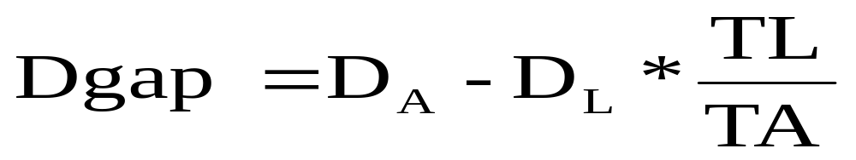
Duration Gap Analysis [ DGAP ]
Duration is a measure of the interest rate sensitivity of assets and liabilities
Duration =The Weighted Average Maturity of Future Cash Flows - Average time required to recover the funds committed to an investment
DGAP is defined as :
  D_{A} = weighted average duration of assets
  D_{L} = weighted average duration of Liabilities
  TL = total liabilities
  TA = total assets
Dr.V.N.SASTRY vnsastry@idrbt.ac.in

Slide 16
Duration Gap
DA = 2.5 years
DL = 3.0 years
TL = Rs.467 Cr.
TA = Rs.560 Cr.
Solution:
Dgap = 2.5 - (3.0 x 467/560)
2.5 - 2.5018
= - 0.018 years
Dr.V.N.SASTRY vnsastry@idrbt.ac.in

Slide 17
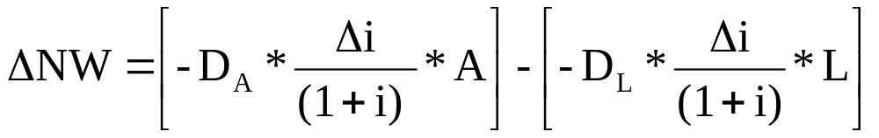
Change in the Value of a
Bank’s Net Worth
Δ MVE = - Dgap [Δ i / 1 + i] MVA
Dgap = DA- (DL x TL/TA)
= 3.25 - (1.75 x 485/512) = 3.25 - 1.66
= 1.6 years (positive)
ΔNW = (-3.25 x .01 x 512) - (-1.75 x .01 x 485)
1.07 1.07
= (- 15.551) - (- 7.932)
= − 7.619 Cr. Rs. (NW decreases)
DA = 3.25 years
DL = 1.75 years
TL = Rs.485 Cr.
TA = Rs.512 Cr.
i = 7.0 %
i increases to 8.0 %
Dr.V.N.SASTRY vnsastry@idrbt.ac.in

Slide 18
Relation between DGAP and Rate of Interest
DGAP
RATE
CHANGE IN MARKET VALUE
ASSETS
LIABILITIES
EQUITY
+VE
INCREASES
INCREASES
DECREASES
DECREASES
+VE
DECREASES
INCREASES
INCREASES
INCREASES
-VE
INCREASES
DECREASES
DECREASES
INCREASES
-VE
DECREASES
INCREASES
INCREASES
DECREASES
ZERO
INCREASES
DECREASES
DECREASES
NO EFFECT
ZERO
DECREASES
INCREASES
INCREASES
NO EFFECT
Dr.V.N.SASTRY vnsastry@idrbt.ac.in

