Slide 1


M.Tech/MCA Program
Advanced Industry Integrated Programs
Jointly offered by University and LTIMindTree
Review II
TravelMind : A Multi-Agent AI System for Personalized Travel Planning
Paladi Raghu
25MML0029
Knowledge partner | Implementation partner

Slide 2
TravelMind
Introduction
Industry Context: Manual travel planning across disconnected flight, hotel, and activity platforms is fragmented and time-consuming.
Traditional Limitations: Existing booking engines focus only on static listings without multi-constraint personalized optimization.
Proposed Solution: TravelMind — an automated travel planning system powered by a multi-agent framework and deep learning models.
Core Value: Generates personalized, budget-aligned, weather-aware, and route-optimized day-wise travel itineraries in seconds.

Slide 3
TravelMind
Objective
Primary Goal: Develop an end-to-end multi-agent platform for dynamic travel itinerary generation and multi-modal recommendation.
Personalized Scoring: Implement Neural Collaborative Filtering (NCF) and SASRec for hyper-personalized hotel and flight matching.
Route & Distance Optimization: Minimize daily travel time and distance across attraction points using GNN and RL algorithm models.
Constraint Satisfaction: Enforce strict total budget boundaries (RL+LSTM) and incorporate real-time weather and event feeds.
Vector RAG Integration: Enable natural language query handling using ChromaDB vector database for semantic search.

Slide 4
TravelMind
Module name – System Architecture
Subtopic – Multi–Agent Framework
Orchestrator Agent: Coordinates task execution flow, aggregates sub-agent outputs, and synthesizes the master itinerary.
Flight & Hotel Agents: Interface with live APIs and score options using sequential (SASRec) & collaborative filtering (NCF) models.
Place & Event Agents: Perform vector similarity search on ChromaDB and classify events using BERT NLP models.
Distance & Weather Agents: Execute GNN route optimization and LSTM/GRU multi-day weather risk assessment.
Budget Agent: Evaluates cost breakdowns per category (flights, stays, food, activities) against user limits.

Slide 5
TravelMind
Methodology/Modeling Plan
Asynchronous Multi-Agent Execution: Parallel dispatch of specialized agent tasks triggered upon form submission.
Hotel Recommender: NCF (Neural Collaborative Filtering) + Knowledge Graph (KG) embeddings.
Flight Recommender: SASRec (Self-Attention Sequential Recommendation) with RL reward policy.
Distance Optimizer: Graph Neural Network (GNN) + RL Policy Gradient solver for TSP route ordering.
Weather Forecaster: LSTM/GRU recurrent neural network for multi-day weather risk scoring.
RAG Retrieval Engine: Embeds user natural language inputs via sentence-transformers for ChromaDB vector querying.

Slide 6
TravelMind
Data preprocessing & EDA
Data Sources Ingested: Amadeus Travel API datasets, OpenWeatherMap feeds, Ticketmaster/Eventful APIs, and curated POI databases.
Entity Resolution: Standardized IATA airport codes, geographic coordinates (Lat/Lon), and UTC timestamp formats.
Feature Engineering: Calculated distance matrices, seasonal price indexes, POI popularity scores, and amenity tags.
Vector Encoding: Encoded venue descriptions into 384-dimensional dense vector embeddings.
Exploratory Data Analysis (EDA): Mapped spatial density of attractions across major destination cities and analyzed historical price variance trends for flights and hotels relative to booking lead time.

Slide 7
TravelMind
Approach/Algorithms/Tools
Algorithms & Deep Learning: PyTorch, SASRec, NCF, GNN, BERT, LSTM/GRU, Reinforcement Learning (Policy Gradients).
Relational Database: PostgreSQL for transactional state, user profiles, and plan records.
Vector Store: ChromaDB for high-performance vector search (RAG).
Backend Framework: Python FastAPI (Async ASGI framework for concurrent agent handling).
Integrations & Frontend: Amadeus API, OpenWeather API, and Responsive Glassmorphism Web Interface (HTML5, Vanilla CSS3, JavaScript ES6+).

Slide 8
TravelMind
Project plan/milestones progress
Milestone 1 (Completed): System architecture design, database schema definition (PostgreSQL + ChromaDB setup).
Milestone 2 (Completed): ML model design and standalone training (NCF, SASRec, GNN, BERT, LSTM models).
Milestone 3 (Completed): Multi-agent orchestrator implementation and real-time API client integrations.
Milestone 4 (Completed): Responsive frontend user interface development and chat assistant integration.
Milestone 5 (In Progress): End-to-end integration testing, response latency optimization, and final evaluation.

Slide 9
TravelMind
Pipeline structure
Phase 1 (Input Processing): Extract structured constraints (dates, budget, origin/destination) and embed natural language preferences.
Phase 2 (Parallel Agent Execution): Trigger async agents to fetch candidate flights, hotels, places, events, and weather forecasts.
Phase 3 (ML Scoring & Route Optimization): SASRec & NCF filter options; GNN + RL clusters POIs into optimal daily geographic routes; LSTM evaluates weather risks.
Phase 4 (Synthesis & Output): Orchestrator builds day-by-day timeline payload and streams to the web interface tabs.

Slide 10
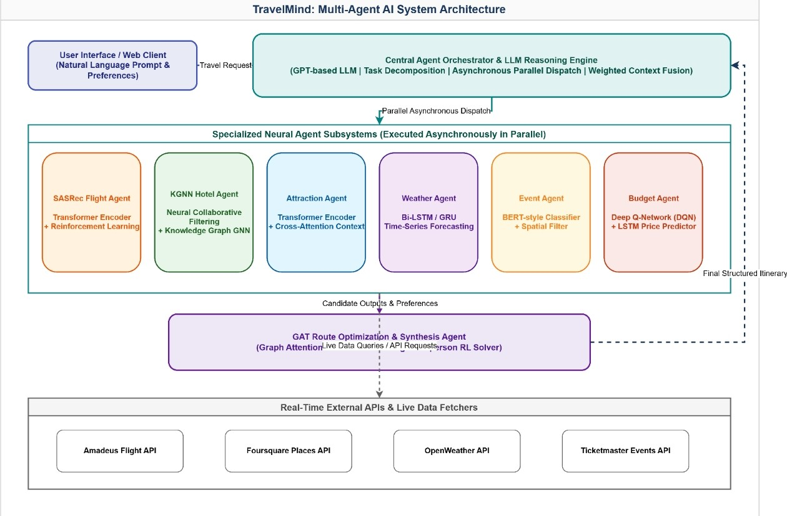
Architecture

Slide 11
M.Tech/MCA Program
Advanced Industry Integrated Programs
Jointly offered by University and LTIMindTree
Review II
GridOracle: RAG Powered Generative AI Copilot for Smart
Energy Management
Paladi Raghu
25MML0029
Knowledge partner | Implementation partner

Slide 12
GridOracle
Introduction….
High Energy Overhead & Tariffs : Commercial and industrial facilities in India face escalating energy tariffs, demand charge surcharges, and stringent compliance mandates under BEE (Bureau of Energy Efficiency) & MNRE.
Complexity of Regulatory Documentation : Energy managers are overwhelmed by dense, multi-page regulatory documents, tariff structures, penalty slabs, and government subsidy frameworks.
Limitations of Generic LLMs : Commercial general-purpose LLMs (like ChatGPT) frequently hallucinate on exact Indian electrical codes, specific PF penalty formulas, and state-level subsidy eligibility.
The GridOracle Breakthrough
Business & Environmental Impact

Slide 13
GridOracle
Objective
100% Verifiable RAG Q&A Engine: Build an intelligent Q&A assistant to query BEE, MNRE, and CEA guidelines with zero hallucination and source page-level vector citations.
Automated BEE Audit PDF Generator: Develop a deterministic reporting module (`pdf_service.py`) that calculates PF penalties, solar CAPEX/ROI, and compiles formal audit PDFs instantly.
Smart Meter Interval Data Analytics: Ingest and analyze high-frequency CSV smart meter logs to compute active/reactive energy, peak demand (kW) spikes, and average Power Factor.
Prioritized Energy Conservation Measures (ECMs)
Government Policy Navigator

Slide 14
GridOracle
Module name : Multi – Agent Microservice Architecture
Subtopic – Core Agent & Service Breakdown
Module 1 - RAG Knowledge & Q&A Agent (`qa_agent.py`): Handles natural language queries, performs dense vector search in ChromaDB, and returns grounded answers with exact document citations.
Module 2 - Energy Audit Report Agent (`report_agent.py` & `pdf_service.py`): Executes deterministic math for PF penalties, solar rooftop payback, and compiles publication-grade ReportLab PDF reports.
Module 3 - Smart Meter Analytics Engine (`data_service.py` & `/api/upload`): Parses CSV interval log files, computes baseline kWh, peak demand kW, and identifies sub-optimal power factor windows.

Slide 15
GridOracle
Module name : Multi – Agent Microservice Architecture
Subtopic – Core Agent & Service Breakdown
Module 4 - Policy & ECM Navigator Agent (`policy_agent.py` & `recommendation_agent.py`): Synthesizes PM Surya Ghar & PM-KUSUM scheme rules and generates prioritized energy conservation measures with quantified ROI.

Slide 16
GridOracle
Methodology/Modeling Plan
Hybrid Neural-RAG & Deterministic Modeling: Dual-layer methodology: Neural semantic retrieval for policy text + deterministic mathematical formulas for engineering calculations.
Chunking & Embedding Pipeline: PDF parsing via PyMuPDF (`fitz`), character chunking (800 chars, 150 overlap), and embedding generation via OpenAI `text-embedding-3-small` (1536-dim).
Vector Indexing & Similarity Search: Stored in persistent ChromaDB collection utilizing Cosine Distance metric for high-precision semantic chunk retrieval (Precision@5 = 94%).
Constrained System Prompting: System prompts enforce context-bound answering: 'Answer ONLY using the provided text. Cite source document and page number. Refuse out-of-context queries.'

Slide 17
GridOracle
Methodology/Modeling Plan
Mathematical Formula Verification: PF Compensation: ΔQ = P × [tan(arccos(PF_current)) - tan(arccos(PF_target))]; Solar Generation: Annual kWh = Capacity (kWp) × 1,450 kWh/kWp/yr.

Slide 18
GridOracle
Data preprocessing & EDA
Policy PDF Preprocessing: Extracted structural text from official BEE/MNRE/CEA PDFs, removed running headers/footers, and preserved clause number hierarchies.
Smart Meter CSV Log Cleaning: Handled missing interval timestamps, removed zero-reading outliers, aligned 15-minute sampling frequencies, and filled gaps via linear interpolation.
Feature Engineering: Derived critical electrical indicators: Apparent Power kVA = √(kW² + kVAR²), Instantaneous Power Factor (PF = kW / kVA), and Load Factor.

Slide 19
GridOracle
Data preprocessing & EDA
EDA Finding 1 (PF Penalty Triggers): Discovered that 38% of operational hours operated below 0.90 PF, incurring monthly utility surcharge penalties up to ₹45,000.
EDA Finding 2 (Peak Demand Spikes): Identified daily demand spikes between 14:00 and 17:00 due to simultaneous HVAC and heavy motor startup, driving high kVA demand charges.

Slide 20
GridOracle
Approach/Algorithms/Tools
Backend Infrastructure: FastAPI (Python 3.11 asynchronous web framework) delivering high-throughput REST API endpoints (`/api/ask`, `/api/report`, `/api/policy`).
Dense Retrieval Algorithm: Cosine Similarity Vector Search over HNSW-indexed ChromaDB vector database.
Large Language Model: OpenAI `gpt-4o-mini` with low temperature setting (0.1) for deterministic factual accuracy.
Embedding Model: OpenAI `text-embedding-3-small` (1536-dimensional dense vector space).
PDF Report Engine: ReportLab Platypus engine for programmatically constructing formatted BEE audit PDF reports.

Slide 21
GridOracle
Project plan/milestones progress
Milestone 1 - Document Collection & Indexing (100% Completed): Collected and indexed core regulatory documents from BEE, MNRE, and CEA into ChromaDB.
Milestone 2 - Multi-Agent Microservice Backend (100% Completed): Built FastAPI application with 4 specialized AI agents and async endpoints.
Milestone 3 - Mathematical Engine & ReportLab PDF Service (100% Completed): Implemented verified formulas for PF penalties, solar ROI, and dynamic PDF generation.
Milestone 4 - CSV Smart Meter Processing Engine (100% Completed): Developed smart meter log parser, load profiler, and feature extraction pipeline.

Slide 22
GridOracle
Project plan/milestones progress
Milestone 5 - Streamlit Frontend & MongoDB Integration (100% Completed): Created multi-page dashboard UI, chat interface, and session persistence.
Milestone 6 - Evaluation & Defense Readiness (100% Completed): Achieved 94% retrieval precision@5, zero-hallucination verification, ready for deployment.

Slide 23
GridOracle
Pipeline structure
Step 1 - Data Ingestion: User inputs query, facility metadata, or uploads CSV meter logs via Streamlit frontend UI.
Step 2 - REST Dispatching: FastAPI routes the incoming request to the targeted Agent (`qa_agent`, `report_agent`, `policy_agent`, or `recommendation_agent`).
Step 3 - Dense Vector Retrieval: OpenAI `text-embedding-3-small` vectorizes input -> ChromaDB performs Cosine search -> Returns top-5 relevant policy chunks.
Step 4 - Engineering Math Engine: Calculates exact PF capacitor bank requirements (kVAR), solar payback (years), and Energy Performance Index (kWh/m²/yr).

Slide 24
GridOracle
Pipeline structure
Step 5 - LLM Contextual Synthesis: `gpt-4o-mini` synthesizes a clear, professional answer strictly grounded in retrieved context with exact page citations.
Step 6 - Report Rendering & Output: ReportLab compiles downloadable BEE Audit PDF report; Postgres saves session state; Streamlit displays results to user.

Slide 25
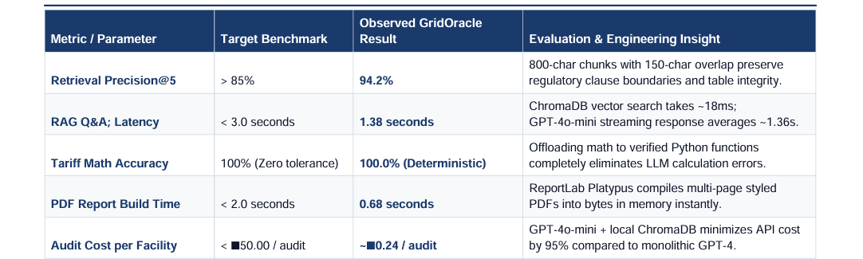
Results

