Slide 1
DATA-621 Final Project
Team:
- Albina Gallyavova
- Chad Smith
- Duubar Villalobos Jimenez
- Nkasi Nedd
- Raghunathan Ramnath
CUNY School of Professional Studies
Master’s in Data Science
Fall, 2018

Slide 2

Impact of Grants to the condition of Education
Education investment is crucial to the well-being of nation’s future. It has already proven that investing in education help reduce unemployment; fight against crime and over all strengthens communities.
On the other hand, as we also know very well, how schools are currently struggling to keep up with the high demand of quality education, inclusiveness and no child left behind policies, thus, add extra expenses and require extra resources to satisfy the need, securing funds for investing in education is highly desirable.
Child care expenses, characteristics of teachers and student loans are some of the spotlight that affect the condition of education. There is an assumption that the funds are not equally spread or spent towards certain geographies.
In this Project, we were trying to get an insight on the grants provided historically and based on that predict for the next two years.

Slide 3
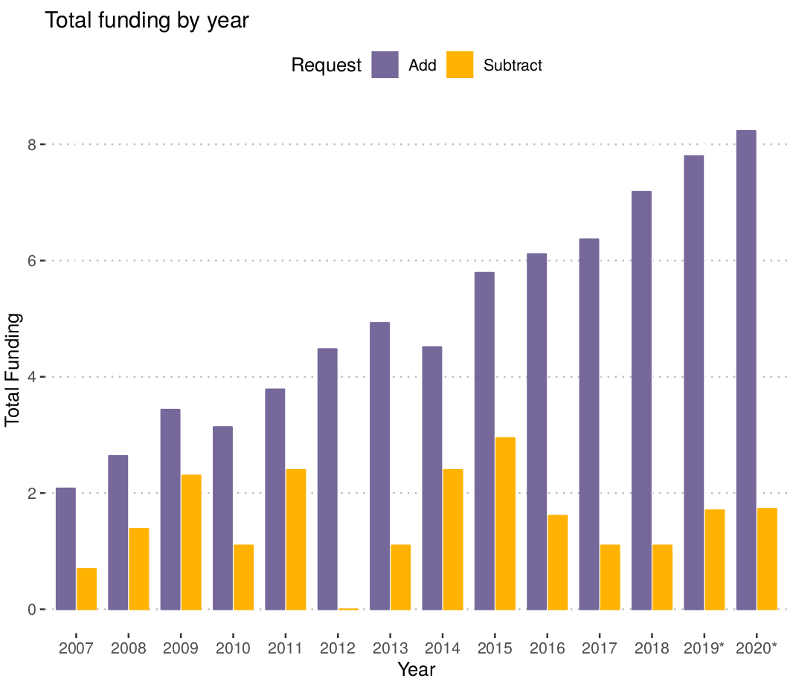
Total funding by year
Figure 1: Total funding in millions of US dollars by request type. The scale is set to logarithmic.
The graph include predictions for 2019 and 2020. Prediction years show a star (*) next to the year.

Slide 4
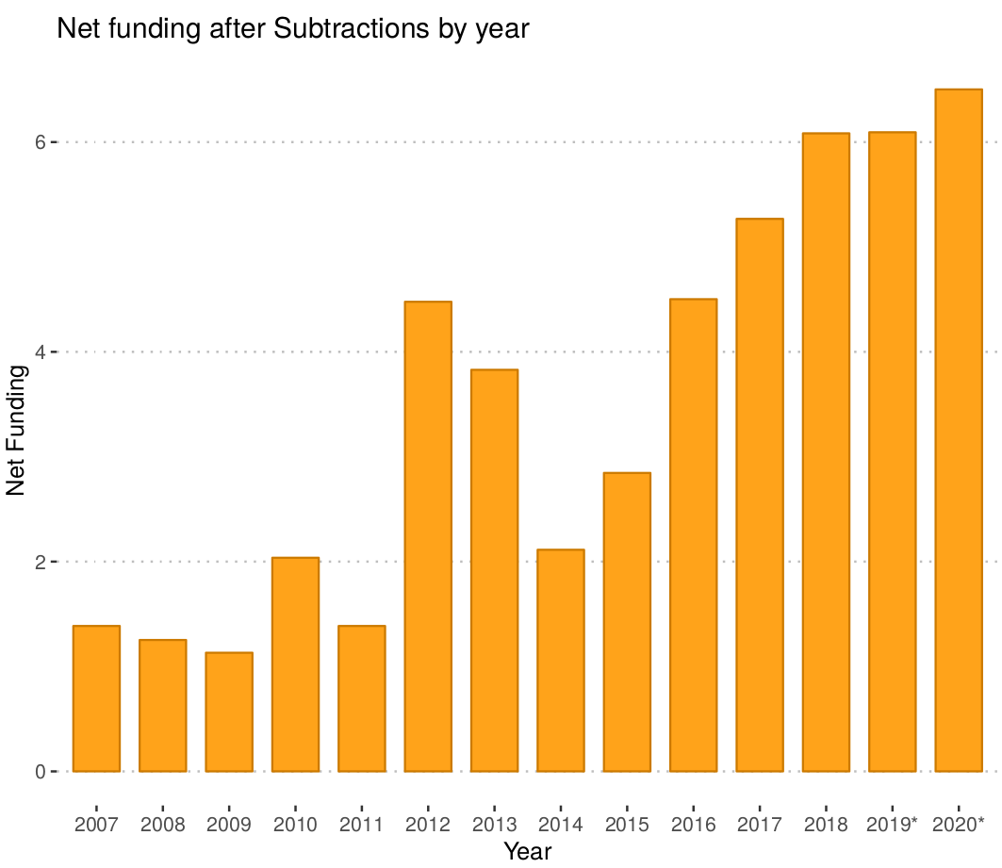
Net Funding after Subtractions by year
We can see that funding was very low from 2007 to 2011 and has significantly increased after that with the exception of 2014-15. we do see a continuous growth since 2015.
Figure 2: Net funding in millions of US dollars. The scale is set to logarithmic. The graph include predictions for 2019 and 2020. Prediction years show a star (*) next to the year.

Slide 5
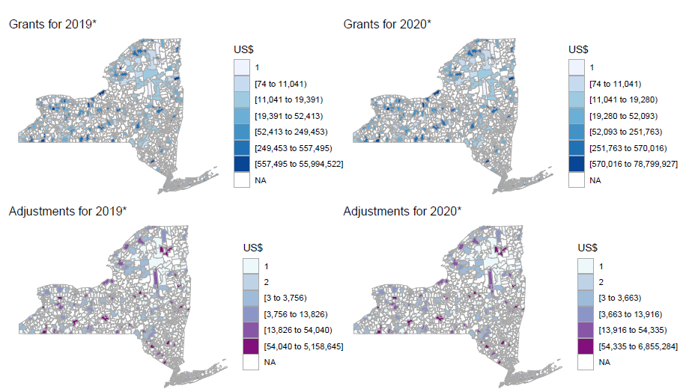
Predictions on Grants/Adjustments for year 2019 and 2020 by Congressional District

Slide 6
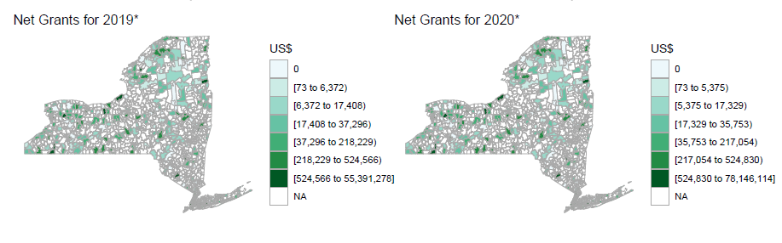
Predictions on Net Grants for year 2019 and 2020 by Congressional District

Slide 7
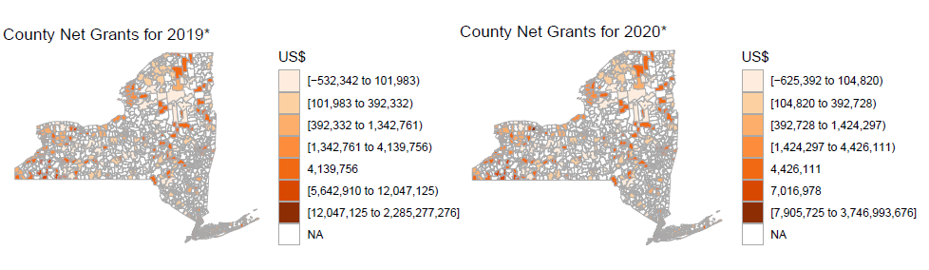
Predictions on Net Grants for year 2019 and 2020 by County

Slide 8
References
Eligibility
https://www.grants.gov/web/grants/learn-grants/grant-eligibility.html
DUNS
https://www.grants.gov/applicants/organization-registration/step-1-obtain-duns-number.html
CFDA Catalog of Federal Domestic Assistance
https://beta.sam.gov/

Slide 9
References
Does money matter -commentary
https://cepa.stanford.edu/sites/default/files/cofr-efp.pdf
Unequal funding in the us
https://www.usnews.com/news/best-states/articles/2018-02-27/in-most-states-poorest-school-districts-get-less-funding
https://www.nap.edu/read/10023/chapter/9
Funding methodology
https://www.usnews.com/news/best-states/articles/2017-12-08/state-education-finance-systems-take-center-stage

Slide 10
References
Education reports
http://reports.weforum.org/global-competitiveness-report-2015-2016/education/
https://opendocs.ids.ac.uk/opendocs/ds2/stream/?#/documents/3546245/page/5
http://hanushek.stanford.edu/sites/default/files/publications/Hanushek%2BWoessmann%202010%20IntEncEduc%202.pdf
Meta regression
https://mpra.ub.uni-muenchen.de/46143/1/MPRA_paper_46143.pdf
https://www.nber.org/papers/w20847.pdf
http://www.oecd.org/innovation/research/1825455.pdf
Barro 2001
http://hanushek.stanford.edu/sites/default/files/publications/Hanushek%202012%20FourPercentSolution_0.pdf
Policy, Funding and Education
http://theconversation.com/does-government-spending-on-education-promote-economic-growth-60229
http://edpolicy.education.jhu.edu/wp-content/uploads/2017/05/Does-Money-Matter-Commentary.pdf
http://www.ascd.org/publications/educational-leadership/may02/vol59/num08/Unequal-School-Funding-in-the-United-States.aspx
https://edtrust.org/resource/funding-gaps-2018/
http://hanushek.stanford.edu/sites/default/files/publications/Hanushek%202003%20EJ%20113%28485%29.pdf

