Slide 1


Home/Lab Security System
Supervisor : Prof. Bidhan Pramanik
Team members
G Raghunath
D.S Praveen

Slide 2
OBJECTIVE
To implement a Security System in low cost for lab and home purposes.
PROJECT PURPOSE
To reduce the consumption of electricity by automatically turning them off when there is no one in the lab.
High level security and surveillance system
Controlling the security system using app even in remote places.
Implementing the system in low cost
Controlling the fans and lights using the app.

Slide 3
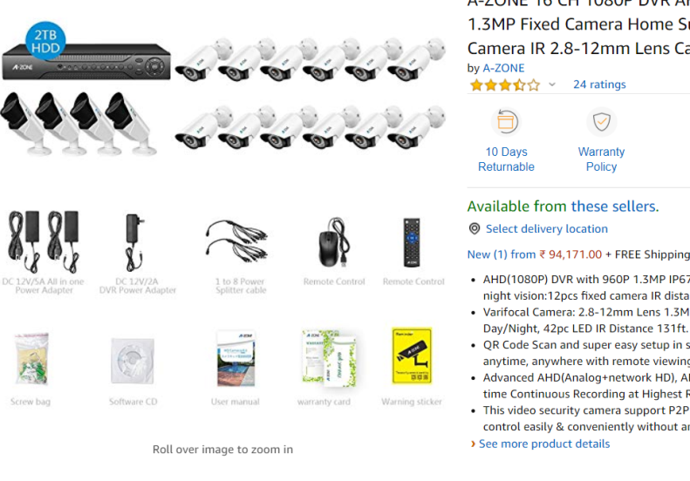
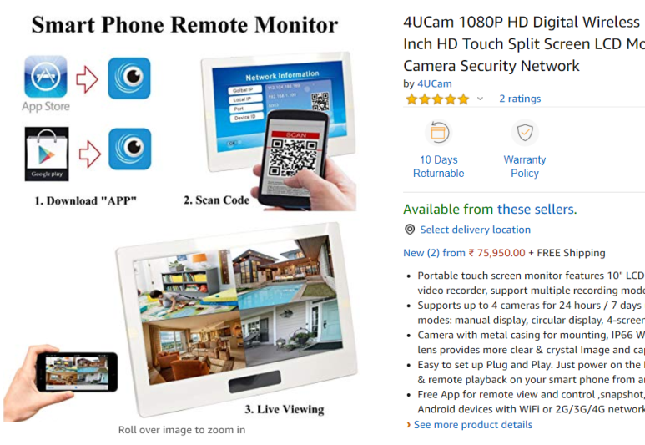
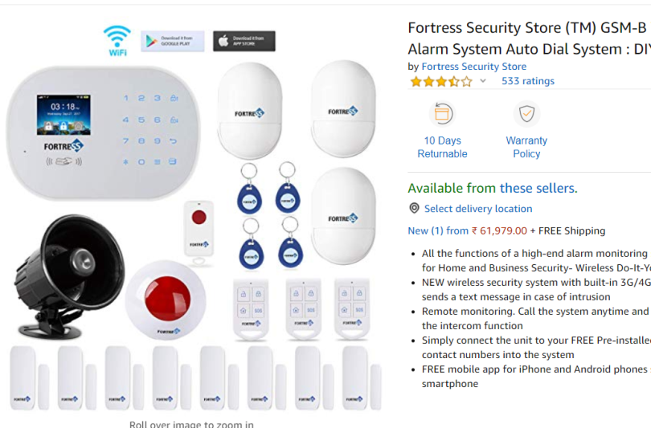
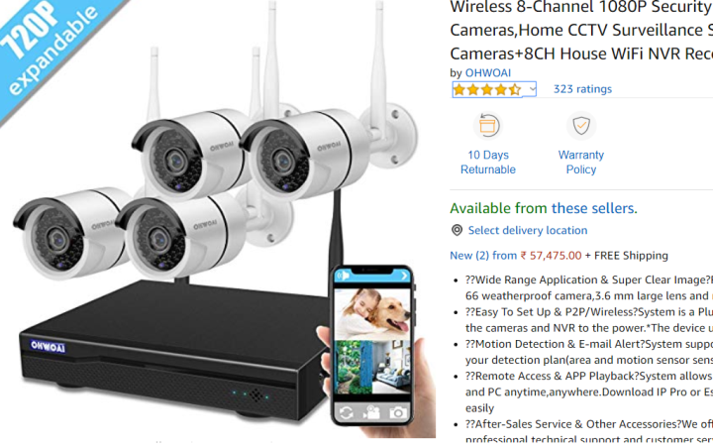
SECURITY SYSTEMS IN MARKET
Cost : 90k
Cost : 70k
Cost : 50 k
Cost : 60k

Slide 4
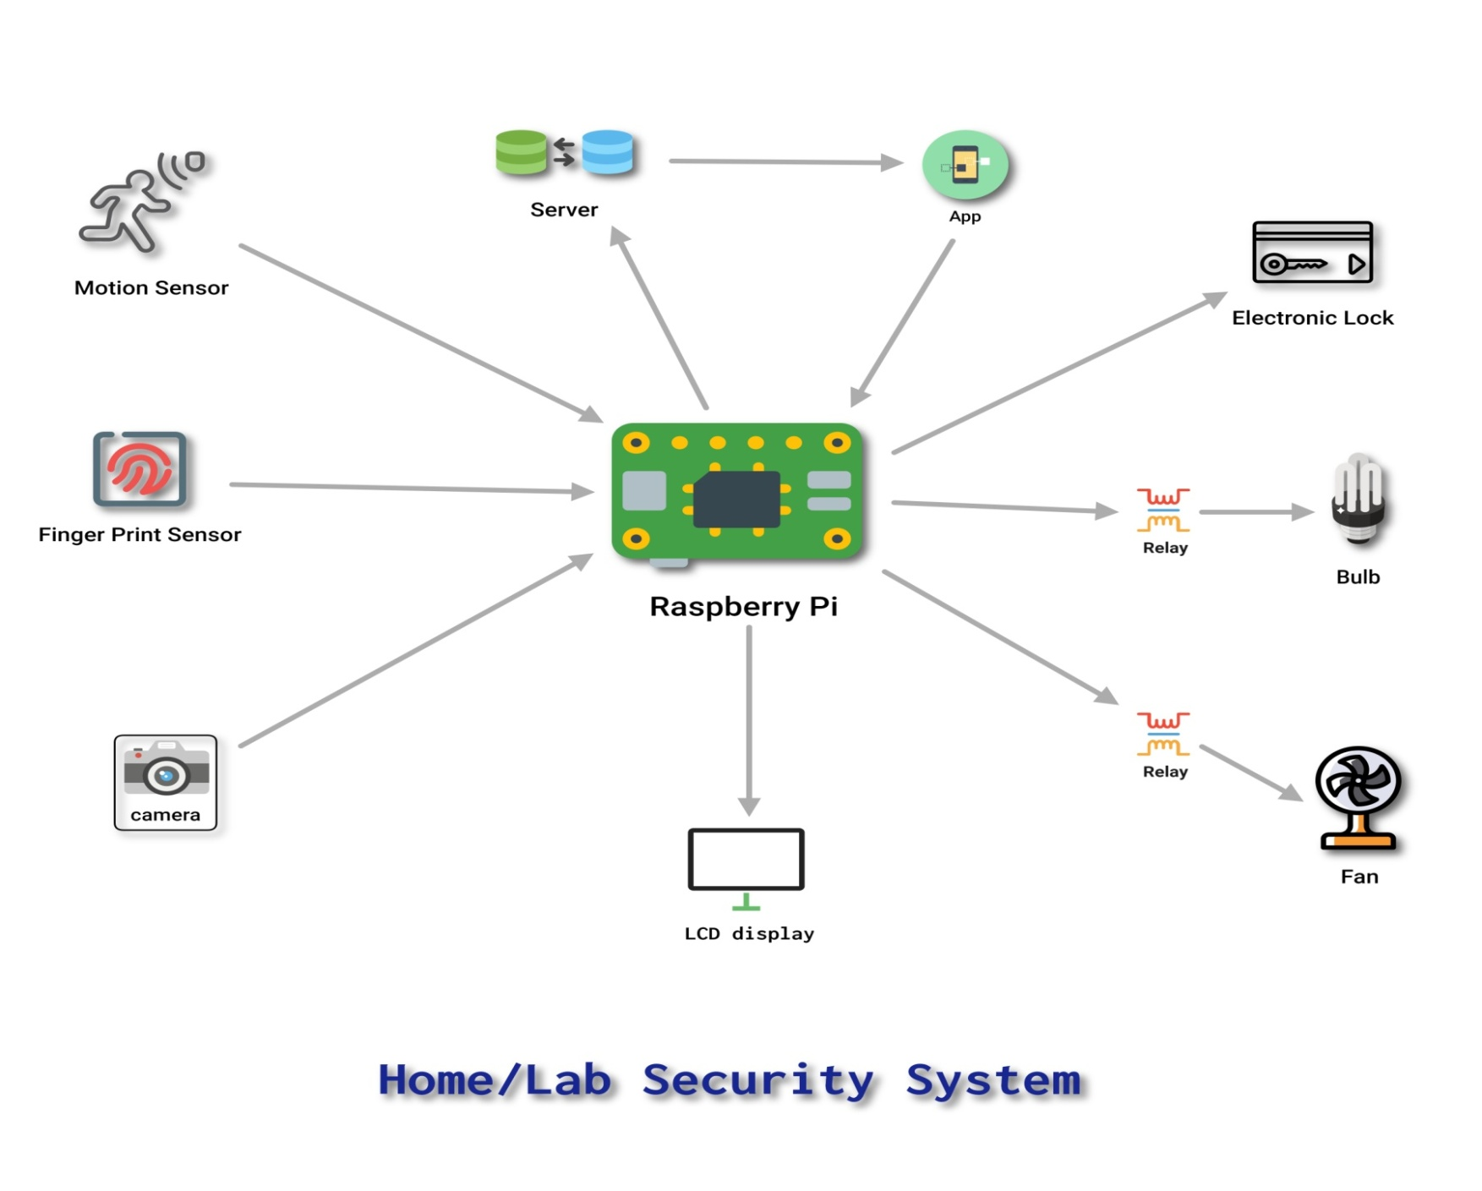
BLOCK DIAGRAM

Slide 5
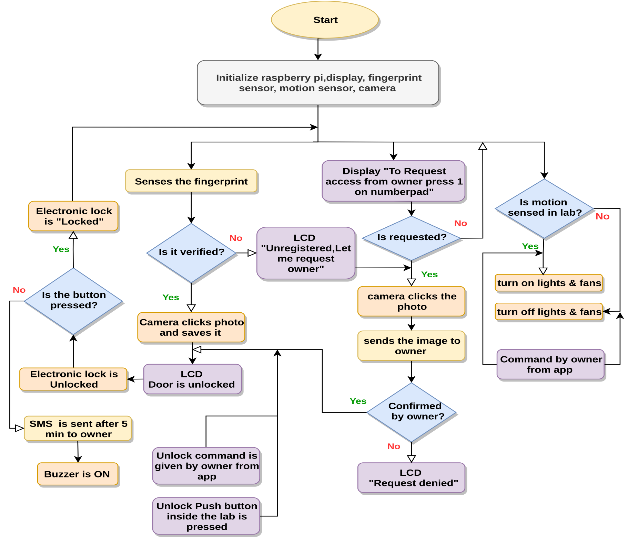
FLOW CHART

Slide 6
HOW THE SYSTEM WORKS
When a person tries to unlock the door the camera will capture his photo and save it in memory
If any person tries to unlock the door using a unregistered finger, the picture of the person will be clicked by the camera
The picture thus clicked is sent to the authorised person's phone in an app
The authorised person can send commands through the app to the raspberry pi to unlock the door for the person
When the person enters the lab the motion sensor will detect the presence of the person immediately and switch on the fans and lights for him
The person will be able to control the fans and lights using app
The lights and fans will get off when the persons leaves lab

Slide 7
THANK-YOU

