Slide 1
Intro To DevOps

Slide 2
What is Linux?
Just like Windows XP, Windows 7, Windows 8, and Mac OS X, Linux is an operating system. An operating system is software that manages all of the hardware resources associated with your desktop or laptop. To put it simply – the operating system manages the communication between your software and your hardware. Without the operating system (often referred to as the “OS”), the software wouldn’t function.

Slide 3
Linux Components
The Bootloader
The kernel
Daemons
The Shell
Graphical Server - X
Desktop Environment- Unity, GNOME etc..,
Applications

Slide 4
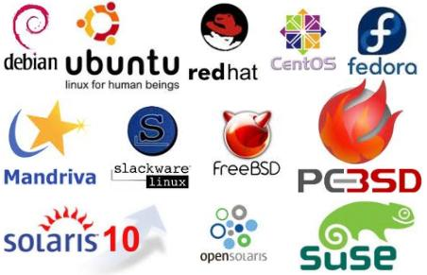
Linux flavours

Slide 5
Difference between Mac and linux
Mac OS is based on a BSD code base, while Linux is an independent development of a unix-like system. This means that these systems are similar, but not binary compatible.
Furthermore, Mac OS has lots of applications that are not open source and are build on libraries that are not open source. Because of this reason, it is not possible to port those applications to run on Linux without being the copyright owner of those applications and libraries

Slide 6
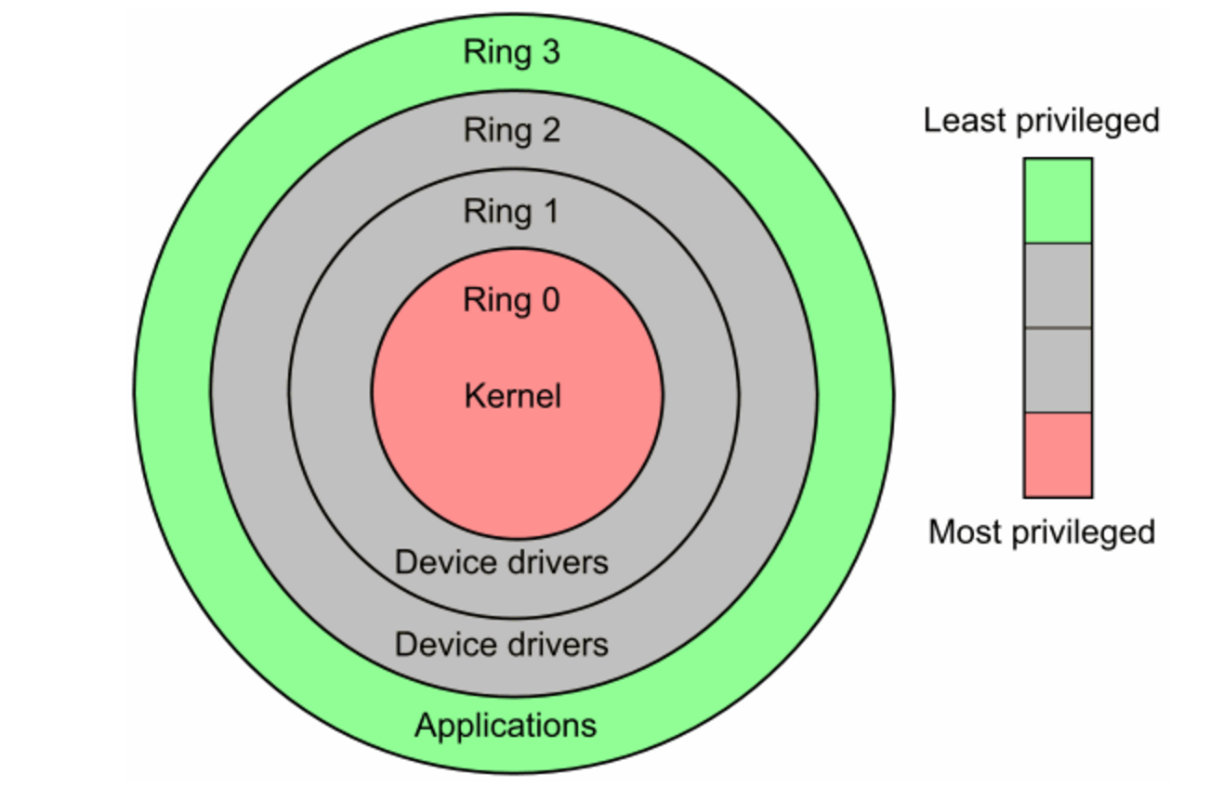
Linux Hardware

Slide 7
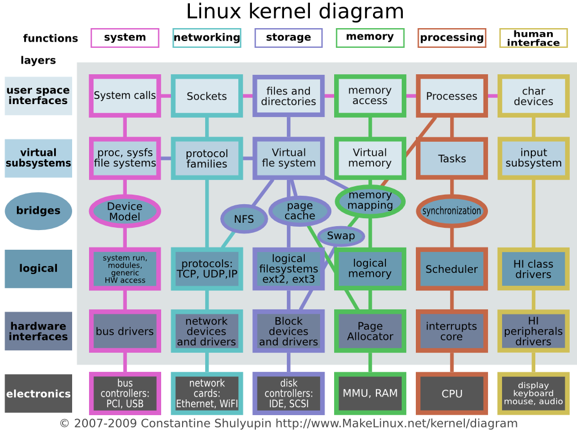
Kernal diagram

Slide 8
References
More to know References:
Run Levels
http://www.comptechdoc.org/os/linux/howlinuxworks/linux_hlrunlevels.html
USER Mode And Kernal Mode
https://blog.codinghorror.com/understanding-user-and-kernel-mode/

Slide 9
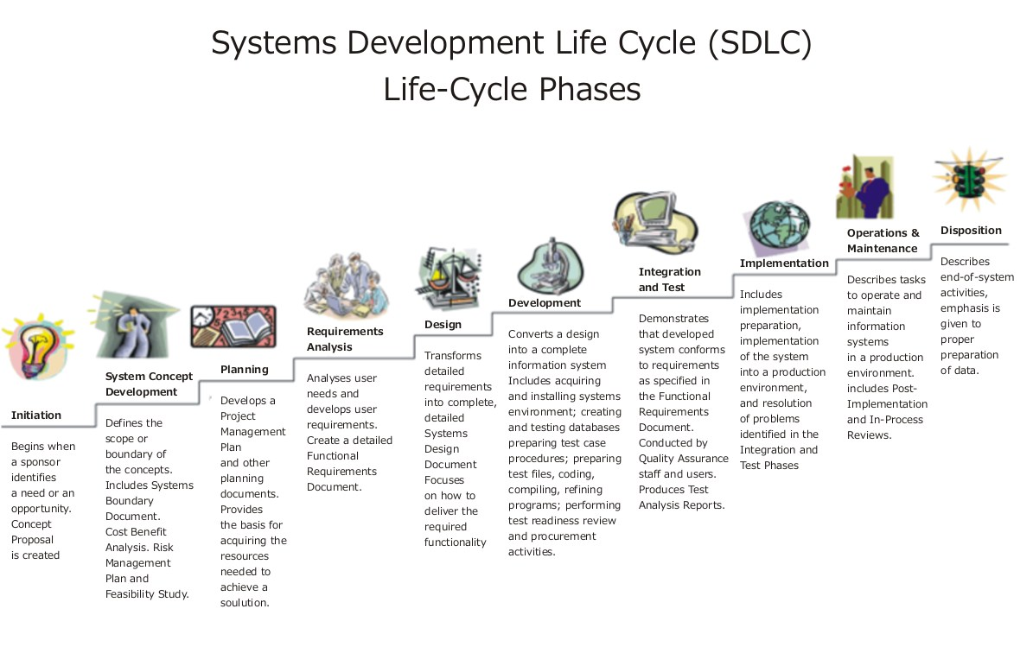
SDLC

Slide 10
What is DevOps
DevOps (development and operations) is an enterprise software development phrase used to mean a type of agile relationship between Development and IT Operations. The goal of DevOps is to change and improve the relationship by advocating better communication and collaboration between the two business units.

Slide 11
Application Life cycle management
Application Lifecycle Management refers to the capability to integrate, coordinate and manage the different phases of the software delivery process. From development to deployment, ALM is a set of pre-defined process and tools that include definition, design, development, testing, deployment and management. Throughout the ALM

Slide 12
What is Agile
Deliver working software frequently, from a couple of weeks to a couple of months, with a preference to the shorter timescale.
Working software is the primary measure of progress.
The most efficient and effective method of conveying information to and within a development team is face-to-face conversation.
The best architectures, requirements, and designs emerge from self-organizing teams.
At regular intervals, the team reflects on how to become more effective, then tunes and adjusts its behavior accordingly.
http://agilemanifesto.org/principles.html

Slide 13
What is a sprint in Scrum?
In the Scrum method of Agile software development, work is confined to a regular, repeatable work cycle, known as a sprint or iteration. Scrum sprints used to be 30 days long, but today we advise one-week or two-week sprints.

Slide 14
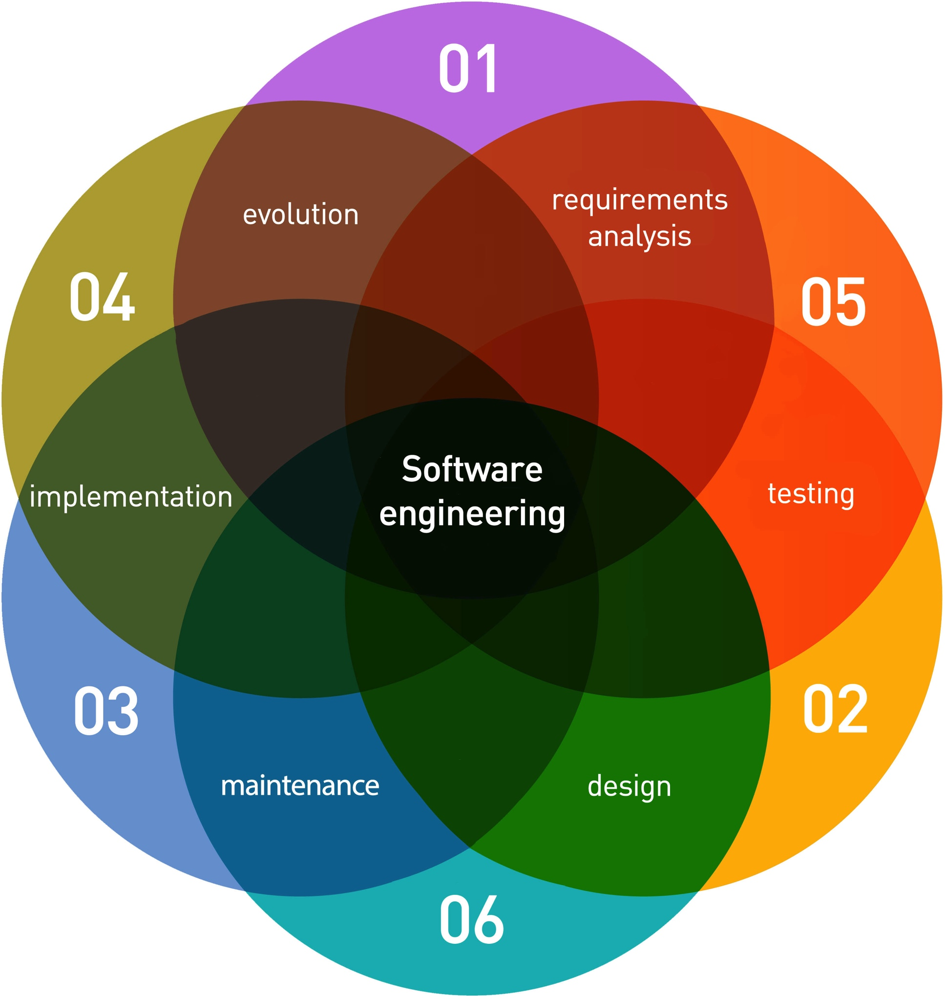
AGILE SDLC

Slide 15
T0-DO/LEARN
Tools DevOps
Cloud computing – AWS, Azure and Openstack
Githhub – SCM Try to create github account
Configuration management- Puppet, Ansible or Terraform-
Build tools – Maven , Ant And Jenkins – CI-CD
Scripting – Shell / Python.

Slide 16
TO-DO/LEARN
ssh into a box
How to use Putty- how to add private keys
Sudo
Linix Directory

Slide 17
CI-CD
Automated Tests
Automated Build
Automated Quality
Automated Deployment
Automated Feedback

Slide 18
Without CI
Slow/Long Releasing
Late testing
Waterfall
Slow feedback
Complex integration

Slide 19
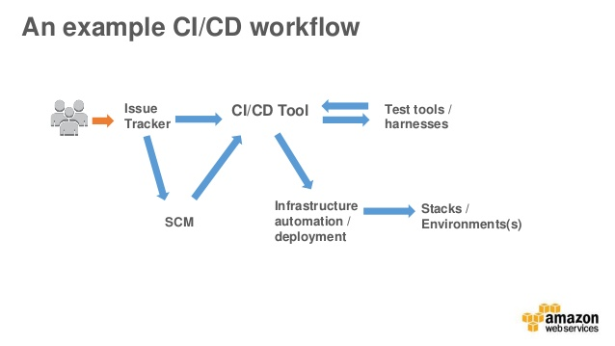
CI-CD

Slide 20
Why CI/CD
Deliver value to Business More Frequently
Better Quality
Early Bugs
Bugs Prevention instead of late detection
Fast and Frequent feedback

Slide 21
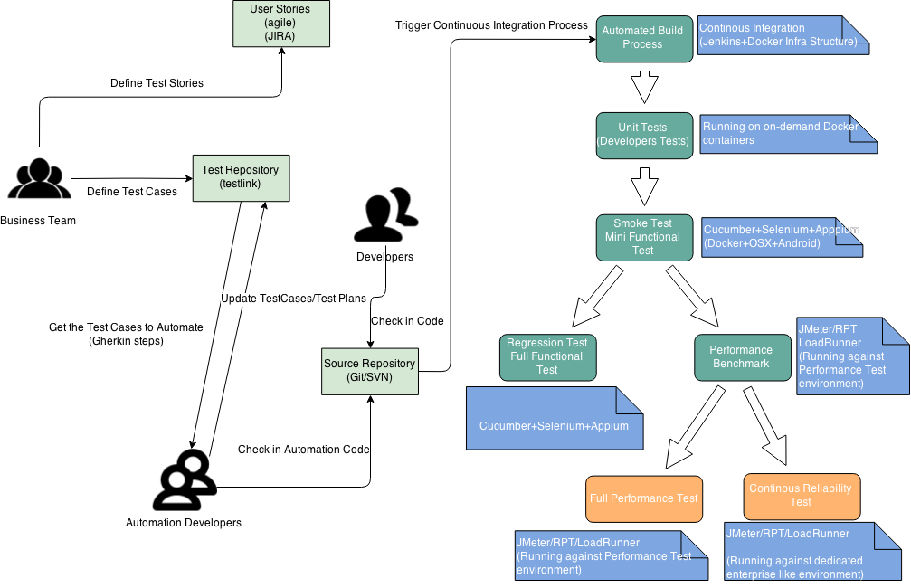
CI

Slide 22
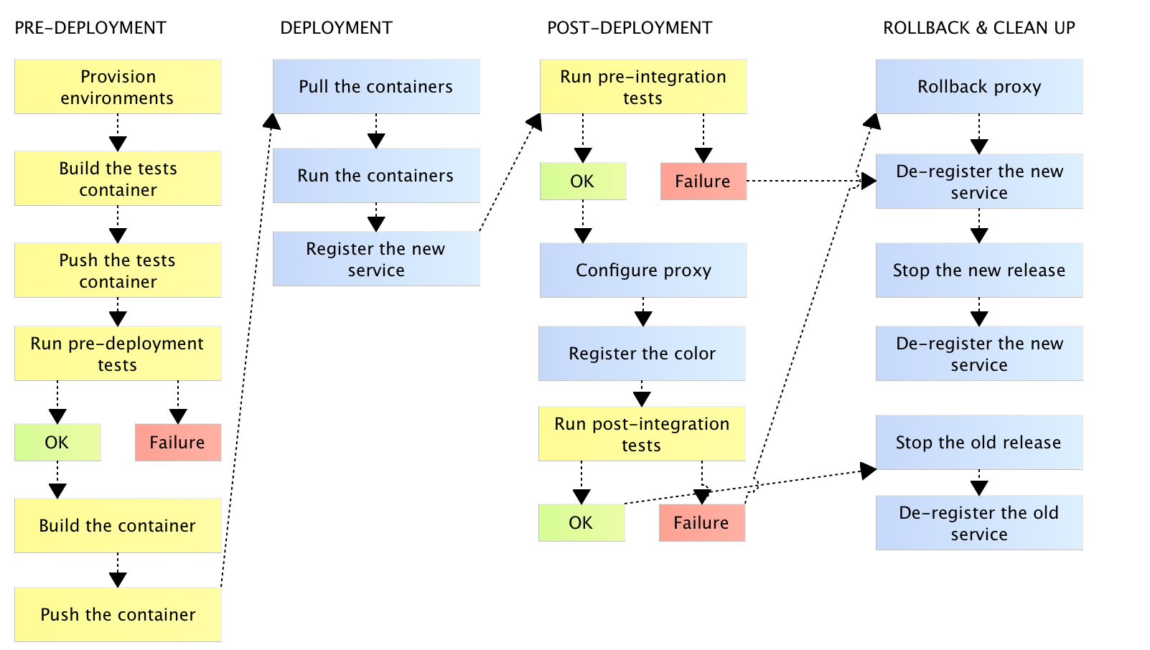
CD

Slide 23
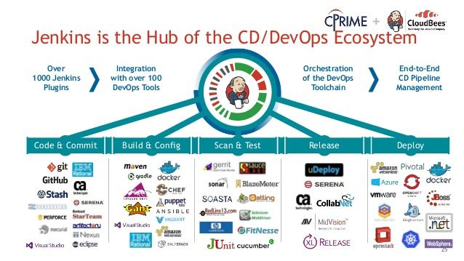
Tools Of DevOps

Slide 24
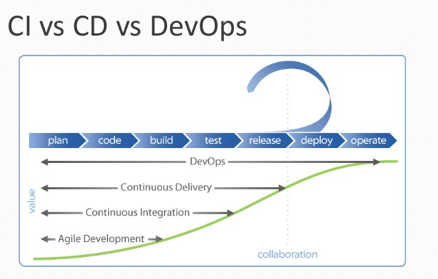
CI-CD-DevOps

Slide 25
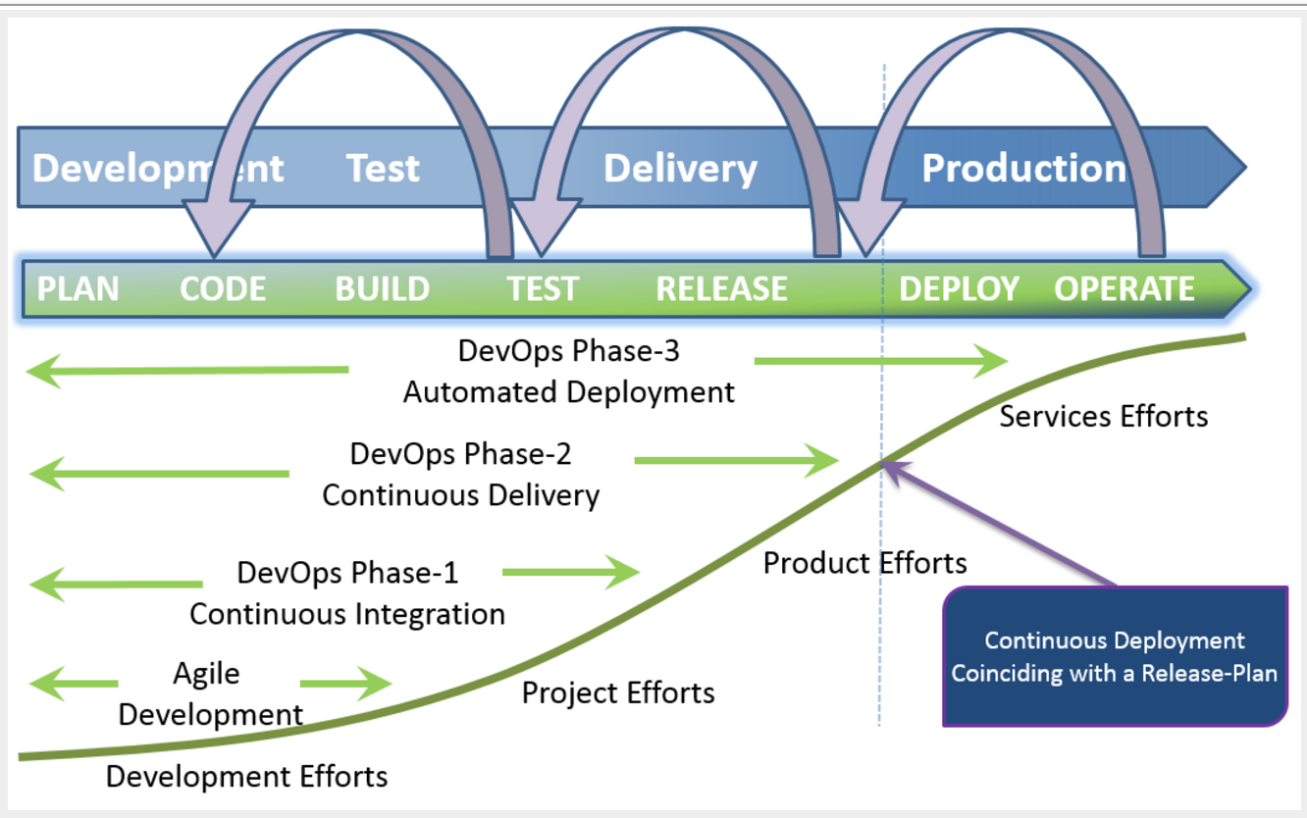
DevOps C-ITD

Slide 26
AWS
Amazon IP
TEST INSTANCE DETAILS:
ec2-user@52.42.124.49

Slide 27
GitHub
SCM
Git Commands

