Slide 1



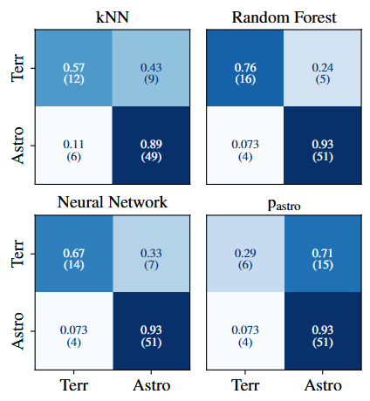
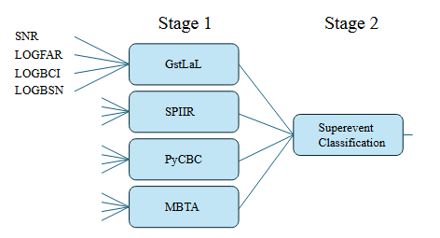
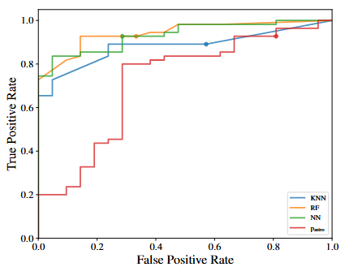
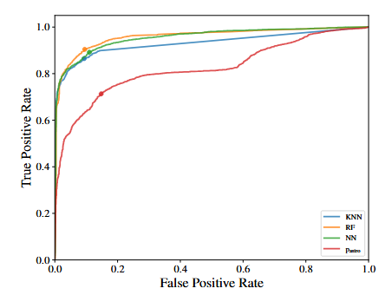
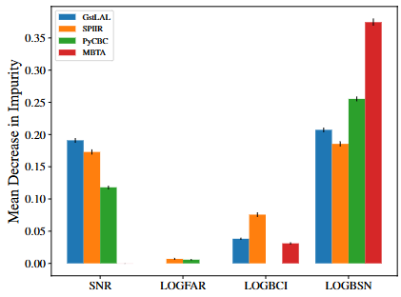
Astrophysical or Terrestrial: Machine learning classification of gravitational-wave
Avyukt Raghuvanshi, Michael Coughlin, Andrew Toivonen
University of Minnesota | School of Physics and Astronomy
Abstract
Model Training and Architecture
Results
Rapid follow-up of gravitational-wave candidates is essential for multi-messenger astronomy, but terrestrial “glitches” generate a handful of false alarms each observing run. Current significance metrics (sky localization, FAR, pₐₛₜᵣₒ) come from individual pipelines and can disagree. We introduce a multi-pipeline machine-learning classifier that ingests signal-vs-noise and coherence Bayes factors (LOGBSN, LOGBCI) from BAYESTAR[1] plus preferred SNR and FAR from four low-latency searches. Trained on the 50 000-injection Mock Data Challenge[2] and tested on real O3 events, it significantly reduces false positives relative to pₐₛₜᵣₒ alone. Our score can guide more reliable electromagnetic and neutrino follow-up.
We use a two-stage ensemble:
1. Per-pipeline sub-models (KNN, RF with 300 trees at max depth 5, and a 7-layer MLP with ReLU activations) each output a preliminary “astro” score or –1.
2. A superevent aggregator ingests the four pipeline scores to produce the final probability.
Hyperparameters were tuned via 10-fold cross-validation on the MDC[2]. Class imbalance is addressed by KDE-based resampling of rare terrestrial cases.
- MDC[2] (train): RF/NN AUC = 0.96; KNN AUC = 0.93; accuracy ≃ 0.91.
- O3 (test): RF/NN AUC ≈ 0.94; KNN AUC ≈ 0.88; accuracy ≃ 0.88.
Compared to pₐₛₜᵣₒ baselines, our RF/NN reduce false-positive glitch acceptance by ~15% while maintaining high detection efficiency for confirmed astrophysical events.
Fig. 3 Confusion matrix of model performance on real GW events from the O3 dataset.
Data Sets
- Training (MDC[2]): 40 days of O3 strain with 5×10⁴ simulated BNS/NSBH/BBH injections yields ~5 600 true positives and ~1 800 noise triggers.
- Testing (O3 real-events): Confirmed “astrophysical” candidates from the GWTC catalog versus formally retracted alerts labeled “terrestrial.”
This split ensures robust evaluation on both simulated and genuine alert streams.
Fig.1 Diagram of model architecture. If a pipeline is not used in a superevent, a value of -1 is sent to super-event classification.
Fig.4 ROC curves obtained from the testing the on O3dataset.
Discussion and Future Work
Key Features
Limitations:
Without direct strain-data quality inputs, loud detector glitches can occasionally mimic real signals. MDC[2] FAR values are biased by the high injection density, reducing FAR’s discriminative weight.
Next steps:
- Run a pre-O5 MDC[2] using pure O4 noise (no injections) to correct FAR calibration.
- Incorporate spectrogram-based or conditional glitch-flag metrics into feature set.
- Deploy this ML classifier alongside pₐₛₜᵣₒ and GWSkyNet in real-time O5 and beyond alert streams.
From each low-latency search (GstLAL[3], MBTA[4], PyCBC[5], SPIIR[6]) we extract:
- Preferred SNR and log FAR of the trigger passing the FAR threshold.
- LOGBSN (signal vs. noise Bayes factor) and LOGBCI (coherent vs. incoherent Bayes factor) from the BAYESTAR[1] sky-map FITS.
If a pipeline does not recover an event, its four features are flagged “–1,” encoding non-detection and naturally down-weighting that pipeline’s contribution.
Fig.5 ROC curves obtained from the MDC[2].
Feature Importance
Permutation tests on the RF model rank features :
1. LOGBSN: log₁₀[P(data | signal) ÷ P(data | noise)] -Bayes factor comparing signal vs. noise hypotheses
2. LOGBCI: log₁₀[coherent-signal BSN ÷ incoherent-signal BSN] - Coherence test for multi-detector consistency
3. Preferred SNR: Peak signal-to-noise ratio from the top pipeline - measure of signal strength above detector noise
4. No. of Pipelines: Number of independent searches that recovered the event - cross-pipeline validation
5. FAR: (false-alarm rate) of the preferred trigger - expected rate of noise events with similar properties
This ordering highlights the key role of coherent Bayes odds and cross-pipeline agreement in distinguishing real gravitational wave signals.
Acknowledgements
We thank our mentors Michael Coughlin and Andrew Toivonen for guidance, and S. Sharma-Chaudhary for internal review. This work builds on the LVK Mock Data Challenge [2] and the GstLAL [3], PyCBC [4], MBTA [5], SPIIR [6], and BAYESTAR [1] pipelines.
Support was provided by NSF grants PHY-2117997, PHY-2308862, PHY-2409481, and the LIGO Laboratory.
References:
[1] S. Sharma-Chaudhary et al., “Mock Data Challenge design,” 2023.
[2] J. Messick et al., “The GstLAL Search Analysis Methods,” Phys. Rev. D 93, 042001 (2016).
[3] T. Dal Canton et al., “PyCBC: Open-source gravitational-wave analysis,” Phys. Rev. D 102, 063029 (2020).
[4] C. Aubin et al., “MBTA: Multi-Band Template Analysis,” Class. Quantum Grav. 37, 215009 (2020).
[5] M. Chu et al., “SPIIR: Low-latency gravitational-wave search,” Phys. Rev. D 102, 024076 (2020).
[6] L. Singer et al., “BAYESTAR: Rapid sky localization,” Astrophys. J. Lett. 829, L15 (2016).
Contact & code: raghu119@umn.edu
Fig.2 Permutation importance for the random forest classifier for each pipeline.

