Slide 1

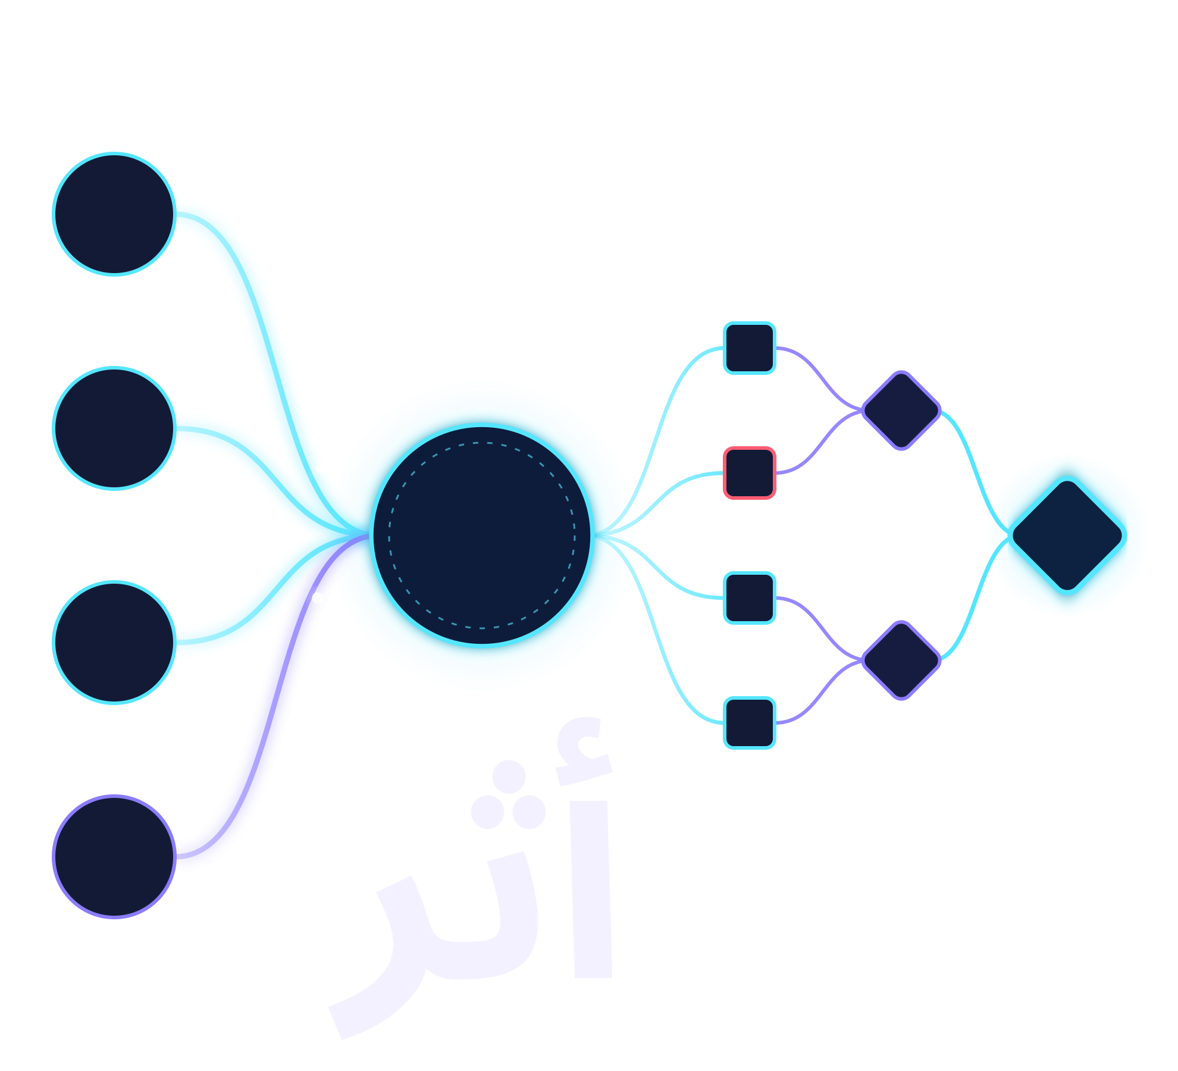

GISEC HACKATHON
ATHAR
AWS
FINDINGS
Arabic for “trace”
Azure
Who can do what, since when —
and proof the answer wasn’t changed.
ONE
MODEL
GCP
MERKLE ROOT
Unified AWS · Azure · GCP identity governance — blast-radius-ranked risk, proven on real cloud exports, with a verifiable on-chain audit trail.
✓ verified on-chain
HR
TEAM
Raghubir Prasad (Captain) · Sachin Premkumar
Nishal Ahmed · Sai Uday · Mohammed Ruknuddin
BITS Pilani, Dubai Campus · Advisor: Dr Ashish Gupta
Notes:
[~40 sec] Hello judges, we're Team ATHAR. Athar is Arabic for "trace".
In a multi-cloud government or enterprise estate, there's a simple question nobody can answer today: who can do what, and since when? And even when a governance report exists, nobody can prove its findings weren't edited afterwards.
ATHAR answers both. It unifies AWS, Azure and GCP access into one model, ranks every identity by measured blast radius, and anchors every finding to a Merkle root on-chain, so an auditor can verify it independently.
The visual says it all: three clouds and an HR feed, traced into one model, rolled up into a root you can check.

Slide 2




02 · PROJECT OBJECTIVE
ATHAR 02 / 05
Nobody can say who can do what — or since when
In shared-services cloud estates, access outlives its purpose — and a report nobody can verify is a claim, not evidence.
GAP TODAY | OUR MEASURABLE OBJECTIVE
Siloed per-cloud consoles; no cross-cloud view | 01 Unify AWS, Azure & GCP IAM plus HR into one canonical permission model
Access accumulates silently; no one can answer “who, what, since when” | 02 Surface risk ranked by measured blast radius, with causal history
No tamper-evidence: findings can be changed after the fact | 03 Make every finding independently verifiable against an on-chain root
THE PROBLEM
AWS
Azure
GCP
No shared view — and access keeps piling up
Role creep
Incomplete offboarding
Cross-cloud superusers
Findings can be edited later — and nobody can tell
WHO’S AFFECTED
Cloud security & IT governance teams
Compliance officers
Auditors
CISOs
Notes:
[~60 sec] Government and enterprise shared-services teams run identity across AWS, Azure and GCP, each in its own console. There's no unified view.
Meanwhile access accumulates silently: role creep, offboarding that misses a cloud, and accounts that end up as superusers across more than one provider. Nobody can answer "who can do what, and since when."
And when a governance report does exist, an auditor or a board has no way to know the findings weren't edited after the fact.
This hits cloud security and governance teams, compliance officers, auditors and CISOs.
So our objective has three measurable parts: one — unify all three clouds plus HR into one canonical permission model; two — rank risk by measured blast radius, with the history of how it happened; three — make every finding independently verifiable against an on-chain root.

Slide 3





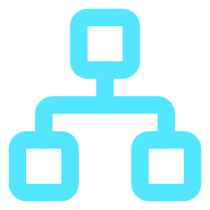








03 · PROPOSED SOLUTION
ATHAR 03 / 05
Three clouds in. One verifiable answer out.
End-to-end pipeline — deterministic core, optional LLM, every result anchored.
1 · INGEST
2 · NORMALISE
3 · DETECT & SCORE
4 · PROVE · EXPLAIN · ACT
5 · DELIVER
AWS IAM export
Rule engine
owns every decision
Merkle ledger
Root committed to GovernanceLedger.sol
Dashboard
11 detection rules · R0–R10
Azure IAM export
Normaliser & linker
7 views incl. Identities, Timeline, Ledger
Access graph
LLM agents · ATHAR-MCP
GCP IAM export
One canonical permission model
Blast-radius scoring
Investigate · plan fix · MCP tools any AI can call
Drift engine · monthly diff
Provenance: raw provider JSON kept on every row
Human-approved fixes
Exports
HR feed
Findings store
severity · score · action
CSV · JSON · PDF, each re-verifiable against the root
Least-privilege drafts · enforced SoD
The rules decide. The LLM only explains.
Every scan and decision is anchored.
Reproducible stack
Severity, score and action are deterministic. Over ATHAR-MCP any AI can read and propose — never approve or apply. API roles enforce it.
Merkle roots on-chain let anyone recompute and verify. Edit one finding and the verification badge turns red.
Python 3.12 · FastAPI · PostgreSQL · networkx · React 18 + TS · Solidity 0.8.24 + Foundry · web3.py · Docker Compose · 2 m 27 s to dashboard
Notes:
[~75 sec] Here's the full pipeline, left to right.
One: we ingest native AWS, Azure and GCP IAM exports, plus an HR feed.
Two: the normaliser and linker build one canonical permission model — and every row keeps its raw provider JSON, so any finding can be traced back to the source.
Three: the rule engine. Eleven detection rules, R0 to R10 — orphaned access of departed employees, cross-cloud superusers, self-escalation chains — feed an access graph and a blast-radius scorer. A drift engine diffs the estate month over month. Output goes to the findings store with severity, score and action.
Four: three things happen. Each scan and decision is Merkle-committed to our GovernanceLedger contract. LLM agents explain findings at three altitudes — headline, causal explanation, raw evidence — but they never decide. And remediation is agent-drafted least privilege that a human must approve, with separation of duties enforced.
Five: a dashboard and CSV, JSON and PDF exports, each re-verifiable against the on-chain root.
Two things make this different: the rule engine, not the LLM, owns every decision — and if the LLM is switched off, templates take over. And every finding is anchored, so tampering is detectable.

Slide 4




04 · SOLUTION VALIDATION
ATHAR 04 / 05
Attacked before it was submitted
Every claim here was run, not asserted — including a pass over a real AWS IAM export.
WE ATTACKED IT | WHAT HAPPENED
Edited a stored severity | Caught. Verification fails; badge turns red
LLM proposed unseen grants | Rejected. 4 named violations; root byte-identical
Fed broken input files | Handled. Structured error, no stack trace
Ran make demo twice | Idempotent. 12× “already anchored”, no duplicates
HOW WE TESTED
1,859 · 167 · 21 automated tests
Backend · frontend · smart-contract suites
Contract fuzzing + proof check
256 Foundry fuzz runs; a 7-node Merkle proof verified by the contract
61 robustness fixtures
Malformed, non-UTF-8, wrong-provider and unknown-action inputs
MEASURED REMEDIATION
100 → 0
69.3% → 0.0%
11 adversarial decoys
Departed engineer: plan approved by a second account, applied, re-scanned
Risk score
Blast radius
Look risky, legitimate via a register entry — tests judgment
2 rounds of adversarial review
WHAT THIS DOES NOT PROVE — DOCUMENTED LIMITATIONS
5 real flaws found and fixed, incl. an open redirect and a double-commit
Ledger ≠ correctness Proves a finding wasn’t edited — not that it’s right.
Single-host writer key Production path: HSM keys + per-approver wallets.
2 m 27 s, clean machine → dashboard
Docker + make only; make ci reruns lint, tests, audits, gitleaks
R7 peer-outlier now fires on real data 36 hits on a real AWS export.
Simulated apply No provider SDK yet; production opens an IaC pull request.
Notes:
[~75 sec] We didn't just test ATHAR — we attacked it before submitting.
On the left: 1,859 backend, 167 frontend and 21 smart-contract tests; 256 Foundry fuzz runs on the Merkle tree, plus a real seven-node proof checked by the contract itself; 61 robustness fixtures; 11 decoys that look risky but are legitimate through a governance-register entry; and two rounds of adversarial review that found five real flaws — including an open redirect and a ledger job that could commit twice — all fixed. From a clean machine with only Docker and make, it reaches the dashboard in 2 minutes 27 seconds.
On the right, four attacks and what happened. Edit one stored severity: verification fails, both roots are printed, the badge turns red. Let a real local model propose grants it wasn't shown: rejected with four named violations, and findings, scores and the root stayed byte-identical. Feed it broken or wrong-provider files: structured errors, no stack traces. Run the demo twice: twelve "already anchored" lines, nothing duplicated.
We measured a fix end to end: a departed engineer's plan, approved by a second account, applied and re-scanned — risk 100 to 0, blast radius 69.3% to zero.
And the limits: the ledger proves a finding wasn't edited, not that it's right. The writer key sits on one host today. R7 fires on nothing because the simulated estate saturates every department's breadth — we disclose it rather than tune it. And "apply" changes the simulated estate; in production that step becomes a pull request against infrastructure-as-code.

Slide 5

05 · RESULTS & CONCLUSIONS
ATHAR 05 / 05
A cross-cloud answer you can verify
Synthetic demo estate at month 12 · fictional customer “Nahar Digital Authority” · plus a real AWS IAM export
507
99
47 → 99
318
identities
open findings
findings, month 1 → 12
findings on a real AWS export
382 people · 125 service accounts
21 critical · 47 high · 27 medium · 4 low
growth traced to broken offboarding
122 real principals · R7 fired 36×
OBJECTIVE | WHAT WE MEASURED
01 Unified cross-cloud view | 735 principals → 507 identities; 104,593 grant rows in one model
02 Ranked, explainable risk | Blast-radius ranking, 3-altitude explanations; one approved fix: 100 → 0
03 Tamper-evident audit trail | Scans and decisions Merkle-anchored; a tampered finding is caught
✓ Robust and repeatable | Broken inputs handled; second run: 12× already anchored
WHAT A GOVERNANCE TEAM GETS
One view of who can do what, since when
Root causes, e.g. broken offboarding
Drafted fixes — via dashboard or MCP — human-approved with SoD
Evidence auditors can re-verify themselves
LIMITS TODAY Single-host writer key · simulated apply · mapping coverage on real AWS
Don’t trust the report.
Verify it.
NEXT
HSM-backed writer key
Per-approver wallets
Permissioned chain
Live government estate
Notes:
[~60 sec] What did we get? On the demo estate at month 12: 507 identities — 382 people and 125 service accounts — and 99 open findings, 21 of them critical.
Findings grew from 47 in month 1 to 99 in month 12, and ATHAR traced that to a broken offboarding process: one department granted 500 permissions over the year and revoked only 27 on departure.
That maps directly to our objectives: 735 principals linked into 507 identities and 104,593 grant rows in one model; risk ranked by blast radius and explained; a tamper-evident trail; and a system that survives broken input and a second run without duplicating anything.
For a governance team, that means one place to answer who can do what, root causes instead of alerts, human-approved fixes, and evidence an auditor can check.
Limits today: synthetic data, a single-host key, and R7 unexercised. Next: HSM-backed keys, per-approver wallets, a permissioned chain, and a real-cloud pilot.
Our takeaway: don't trust the report — verify it. Thank you.

