Slide 1

Face Recognition using Eigenfaces and Artificial Neural Networks
Ghodkari Chowdary, raghunatha Rao
EEL 6825

Slide 2
Introduction
Increase of electronic systems in the human world have given new challenging problems
Some of them include secure and authenticate their electronic devices, to cluster people over social media and to monitor surveillance over large scale
Many of the above problems can be solved using Face Recognition
Face Recognition systems enhance security, and provide personal privacy
Advantage of using Face Recognition is, less human interaction, don’t require any pin to remember or an access card to carry

Slide 3
Face Recognition
Face Recognition involves :
Face Detection : Check if an image contain face
Feature Extraction : Extract important features about the image
Face Recognition : Features of input image is compared against a model containing Features of all images to find closest match

Slide 4
Problem Statement
Face Recognition involves two stages:
Face Recognition : To identify a face exists in Image
Face Verification : To identify face in image belongs to which person
Idea to implement Face Recognition systems using
Eigenface Algorithm
Artificial Neural Networks

Slide 5
Data Set
Labeled Faces in the Wild – LFW, provided by Computer Vision Lab, University of Massachusetts
The dataset consist of 1300 images of various celebrities collected over web
Each picture is labelled with name of person it contains
Around 1680 people in the dataset have more than one image

Slide 6
Eigenface Algorithm
Eigenfaces was one of first technique for Face Recognition invented at Media Lab, MIT 1991
Eigenfaces are considered as points in vector space
Use Principal Component Analysis to reduce the dimensionality of the images
Eigenfaces are set of features that represent variation in the face images
Each image in the training set can be represented by Linear Combination of the eigenfaces

Slide 7
Principal Component Analysis
PCA is dimensionality reduction of dataset consisting of many variable correlated to each other
PCA also retains the variance in the original dataset
PCA gives an orthogonal basis for the eigenspace

Slide 8
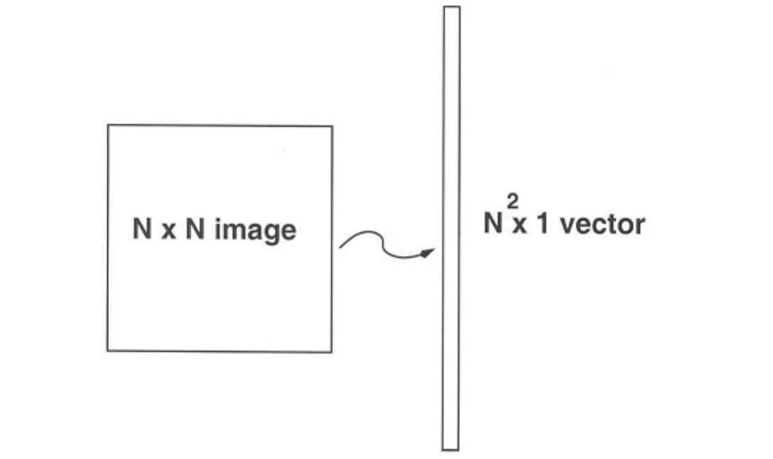
Implementation: Eigenfaces
Read all the Images from the dataset, Let images be A = {A₁, …, A_{n}} be of ( r x c ) resolution
Now convert every image A_{i} as a vector of size (1 x rc)

Slide 9
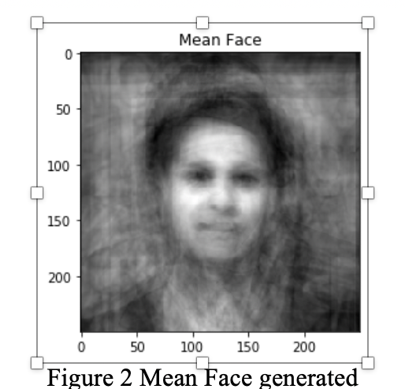
Mean Image
Compute the mean face μ. The mean vector consists of average of each image from the training data set.
Compute the mean face μ. The mean vector consists of average of each image from the training data set.
Compute the Mean face μ. It consists of average of each image from the dataset

Slide 10
Principal Component Analysis
PCA is done as described below:
Subtract each image in training data with mean image.
Compute the Covariance Matrix
Calculate the eigenvalues and eigenvectors of Covariance Matrix S

Slide 11
Eigenspace
Principal Components (some k) are chosen from the eigenvalues sorted in descending order, these principal components for Basis for eigenspace
Every image can be represented as the linear combination of eigenfaces

Slide 12
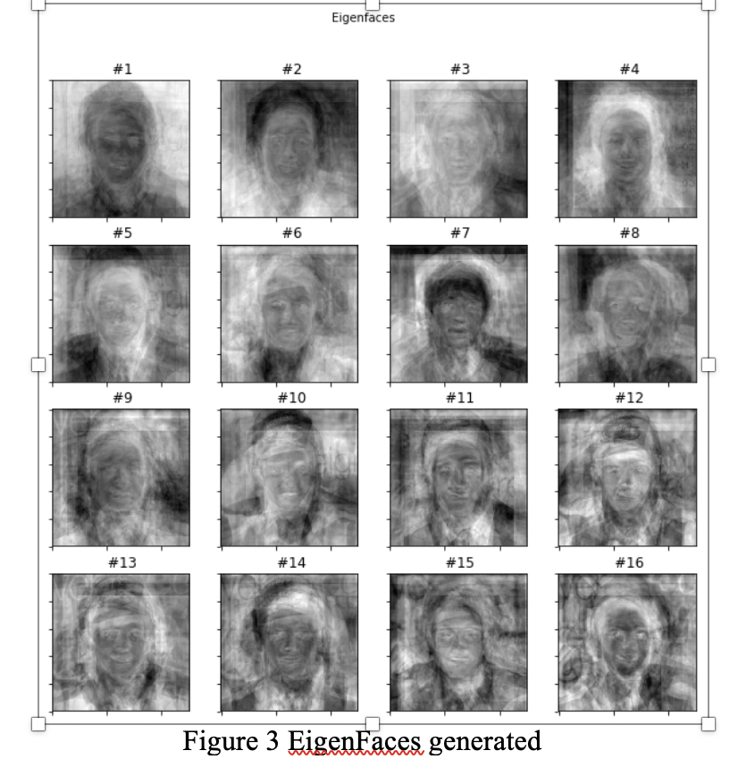
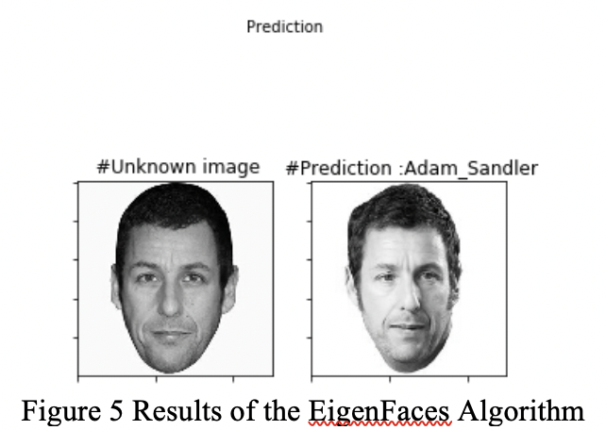
Face recognition
Face Recognition is now performed using the eigen space, Project the input image on the eigen space and find the closest match of the input image to the images in eigenspace

Slide 13
Artificial Neural Networks
Biologically inspired computation model used for Clustering, Classification and Pattern Recognition
Neural Networks support Adaptive Learning and Self Organization
ANNs have many neurons connected together as layers (input, output, hidden), with each neuron has fixed inputs, activated function and some initial weights
ANNs work based on the backpropagation algorithm

Slide 14
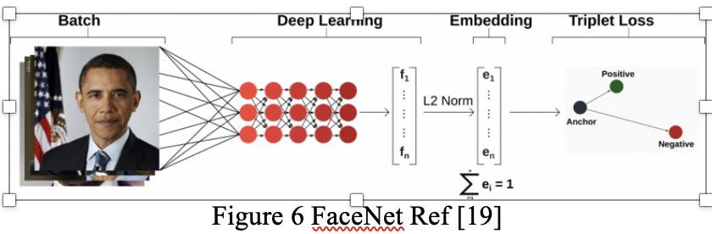
Implementation: Artificial Neural Networks
We are using a trained neural network, implementation of FaceNet for our experiment
FaceNet does mapping from face images to a compact Euclidean space and creates embedding where the distances is the measure of face similarity
Once embeddings are created remaining tasks of verification and recognition can be achieved using any other standard techniques over them.

Slide 15
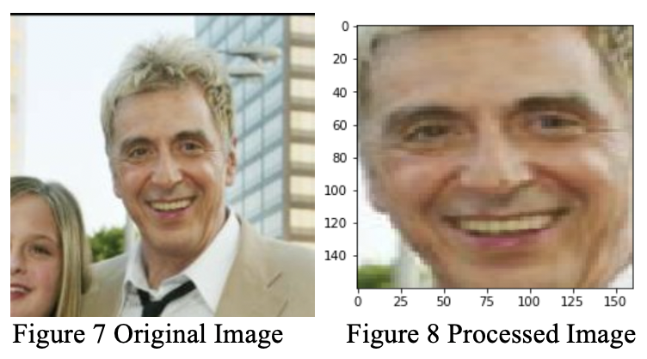
Preprocessing
We need to make sure the all the images are of same size and have human face in it
We are using Multi-Task Cascaded Neural Network MTCNN, a face detector algorithm implemented in Keras

Slide 16
Implementation
A pretrained FaceNet neural network is used for implementation to reduce overhead of training the neural network
The preprocessed set of images are used by FaceNet to create embeddings which act as feature vectors in Euclidean space for classification
Now, classifier Support Vector Machine (SVM) is used over the embeddings (feature vectors) to classify the images present in the Euclidean space
A random image is picked and tested using the SVM classifier model to find top images having closed matches

Slide 17
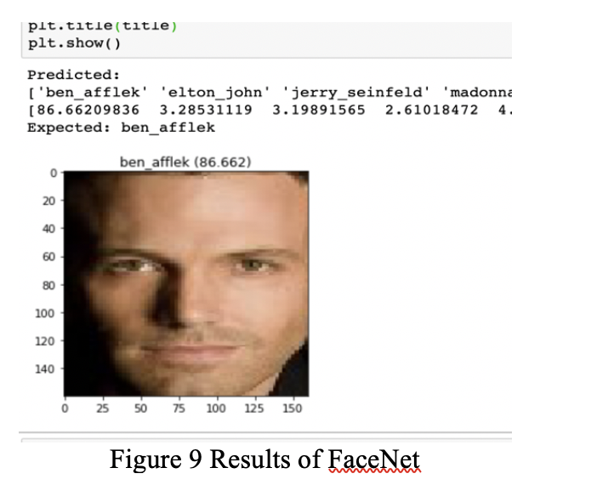
Results
The image show a list of top 5 matches resulted from the test image
The test image was predicated with probability of 0.86

Slide 18
Demo
https://youtu.be/5bWGP0hxVoQ

Slide 19
Summary & Results
Two models were executed for Face Recognition: Eigenfaces and Artificial Neural Networks
Both were tested over the LFW dataset, Eigenfaces was based on statistical model PCA and FaceNet was based on Artificial Neural Networks
Eigenfaces system performs a litter poorly giving a probability of 63%
FaceNet performs much better with success rate of 88%

Slide 20
Future Work
Success rate of Eigenfaces model can be increased by training it over larger data of face images or it can also be combined with other existing techniques to create hybrid models
We have used a pretrained FaceNet neural network for our implementation to save time, a rigorous training of FaceNet over the dataset can also be done to achieve better results

Slide 21
End of Presentation

