Slide 1
Main technologies used in the Nimbus framework
Java
Spring Boot and Spring cloud
MongoDB
Lombok
Drools
Maven
NodeJs
STS
Docker
Groovy
GitHub

Slide 2
Purpose of the framework
Project Nimbus was formed to create the next generation care management platform for Anthem and its partners and customers.
Nimbus is a set of open source tools that together provide an "Infrastructure-as-a-Service" (IaaS) cloud computing solution.
In a nutshell, Nimbus allows a client to lease remote resources by deploying virtual machines (VMs) on those resources and configuring them to represent an environment desired by the user.

Slide 3
Purpose of the framework
Project Nimbus will be utilizing an Agile Lifecycle Management methodology, in order to deliver usable software in the least amount of time and to gain as much visibility and impact within the organization as possible.
Nimbus Platform reduces application development time by
Providing the ability to build application through configuration
Providing boilerplate code for cross cutting concerns.

Slide 4
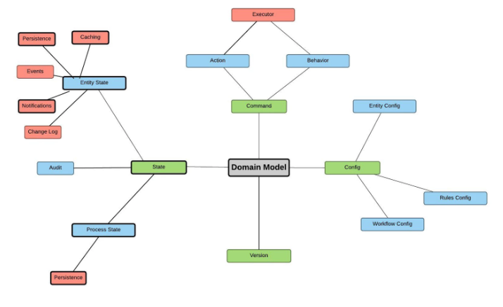
Architecture of the Nimbus framework

Slide 5
Technologies used in Nimbus
Spring Boot:
To provide a radically faster and widely accessible ‘getting started’ experience for all Spring development
To be opinionated out of the box, but get out of the way quickly as requirements start to diverge from the defaults
To provide a range of non-functional features that are common to large classes of projects
Maven:
Convention over Configuration
Project Modularization
Dependency Management and Project Lifecycle

Slide 6
GitHub
GitHub is a repository hosting service.
GitHub will host your source code projects in a variety of different programming languages and keep track of the various changes made to every iteration.
Using GitHub has numerous benefits including easier collaboration with colleagues and peers, ability to look back on previous versions, and tons of easy integration options.

Slide 7
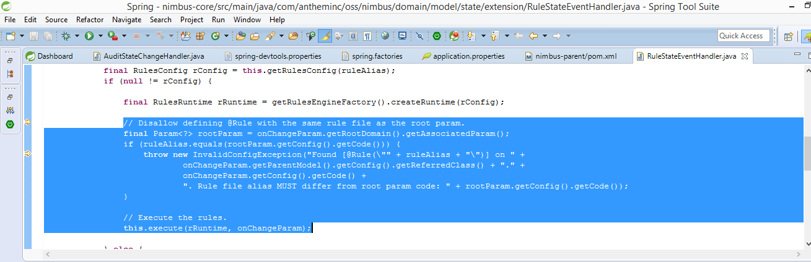

Slide 8
lombok
Lombok is used to reduce boilerplate code for model/data objects, e.g., it can generate getters and setters for those object automatically by using Lombok annotations.
The easiest way is to use the @Data annotation.

Slide 9
