Slide 1
HACKATHON
PROJECT-SMIT NEWS WEB APP
TEAM NUMBER-59

Slide 2
Project Overview
PROBLEM
Builiding a Daily News Web App for SMIT .
With functionalities like add,delete or update.
User can see details by clicking and mark it to read later.

Slide 3
Functionalities
News Can be added from Admin Panel.
Admin Panel is Password Protected.
Mysql Database is used for database.
Category Wise News Adddable.
Views on Each Post

Slide 4
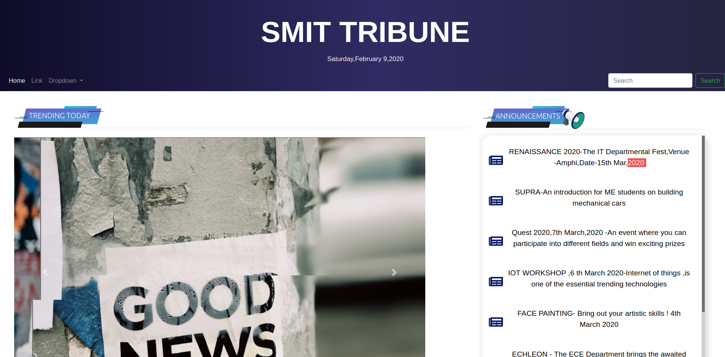
View

Slide 5
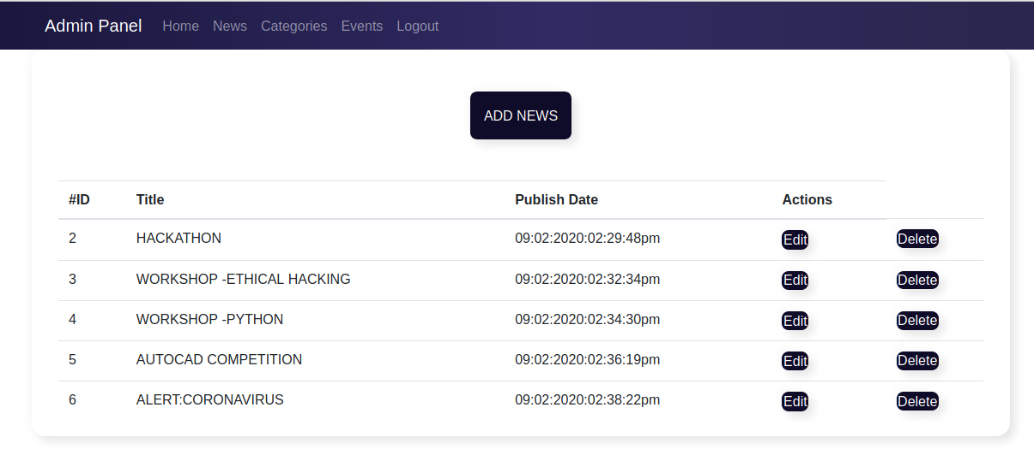
Admin Panel View

Slide 6
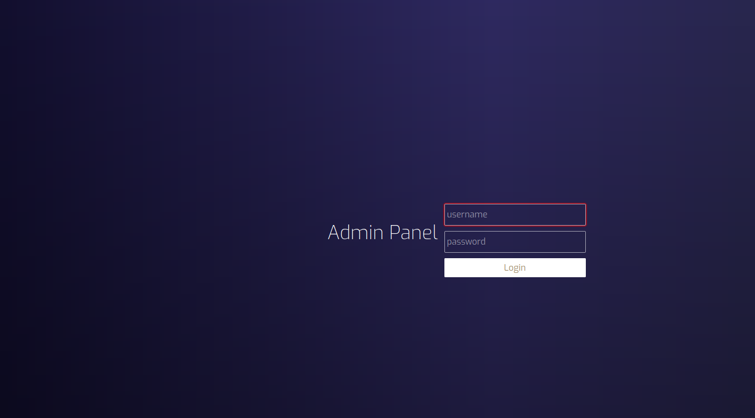
Login

Slide 7
Architecture Diagram

Slide 8
Technical Description
Tools/Technologies | Versions | Setup/Installations
1.HTML/CSS | HTML5/CSS3 | SUBLIME TEXT
2.JAVASCRIPT | 1.8.5 | ATOM
3.BOOTSTRAP | 4.4 | VS CODE
4.PHP | 7
5.MYSQL AND AJAX | 5

Slide 9
Team Members
NAME | CONTRIBUTIONS | EMAIL
1.SHASHWAT KUMAR | BACKEND DEVELOPMENT | rahullraz@gmail.com
2.NILESH RAJ | FRONTEND DEVELOPMENT | nileshraj1988@gmail.com
3.RAGHUNANDAN CHAUDHARY |  | chaudhary.raghusmit@gmail.com

