Slide 1
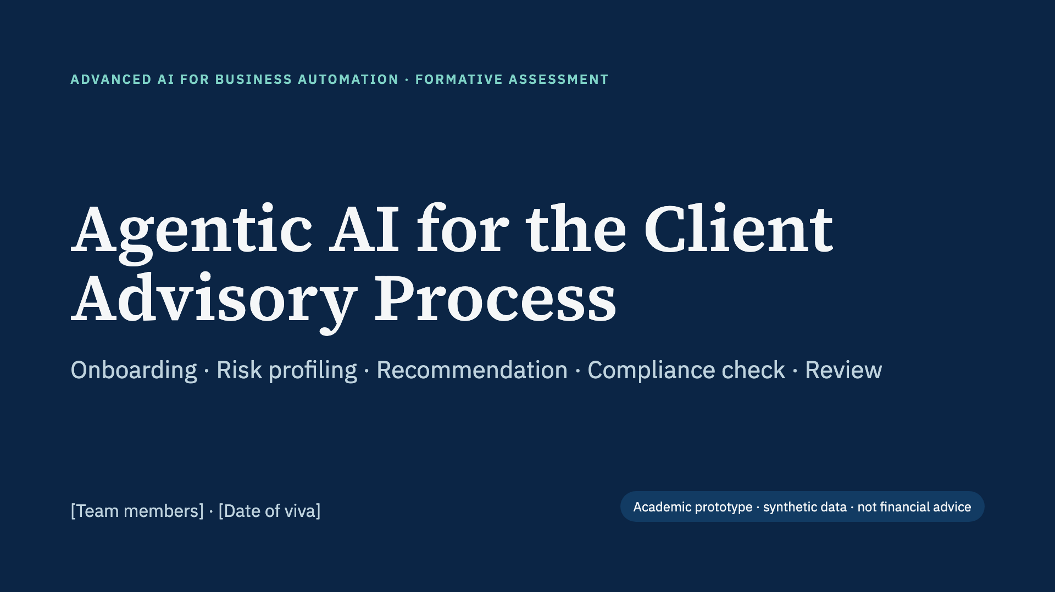
Notes:
Introduce the team. One line: we built a working multi-agent AI system that runs the full client advisory process, from onboarding to an advisor-approved report, and we will demo it live.

Slide 2
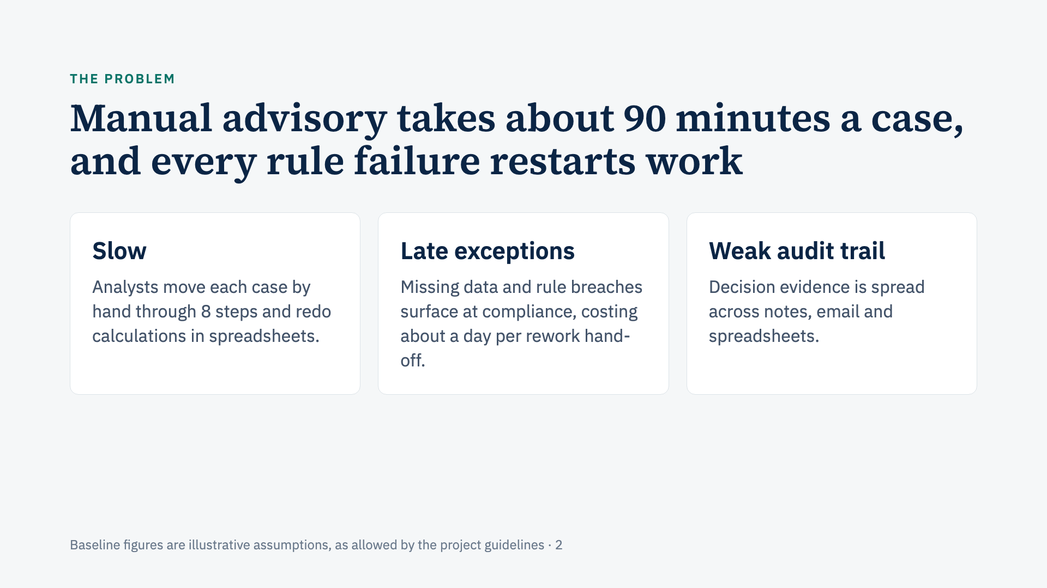
Notes:
A chatbot can answer a question, but it cannot run this process: it keeps no case state, does not react to exceptions and does not coordinate human approval. That is the gap an agentic system fills. 90 minutes is our assumed baseline: 15 min checks, 10 risk scoring, 20 analysis, 15 recommendation, 15 compliance, 15 documentation.

Slide 3
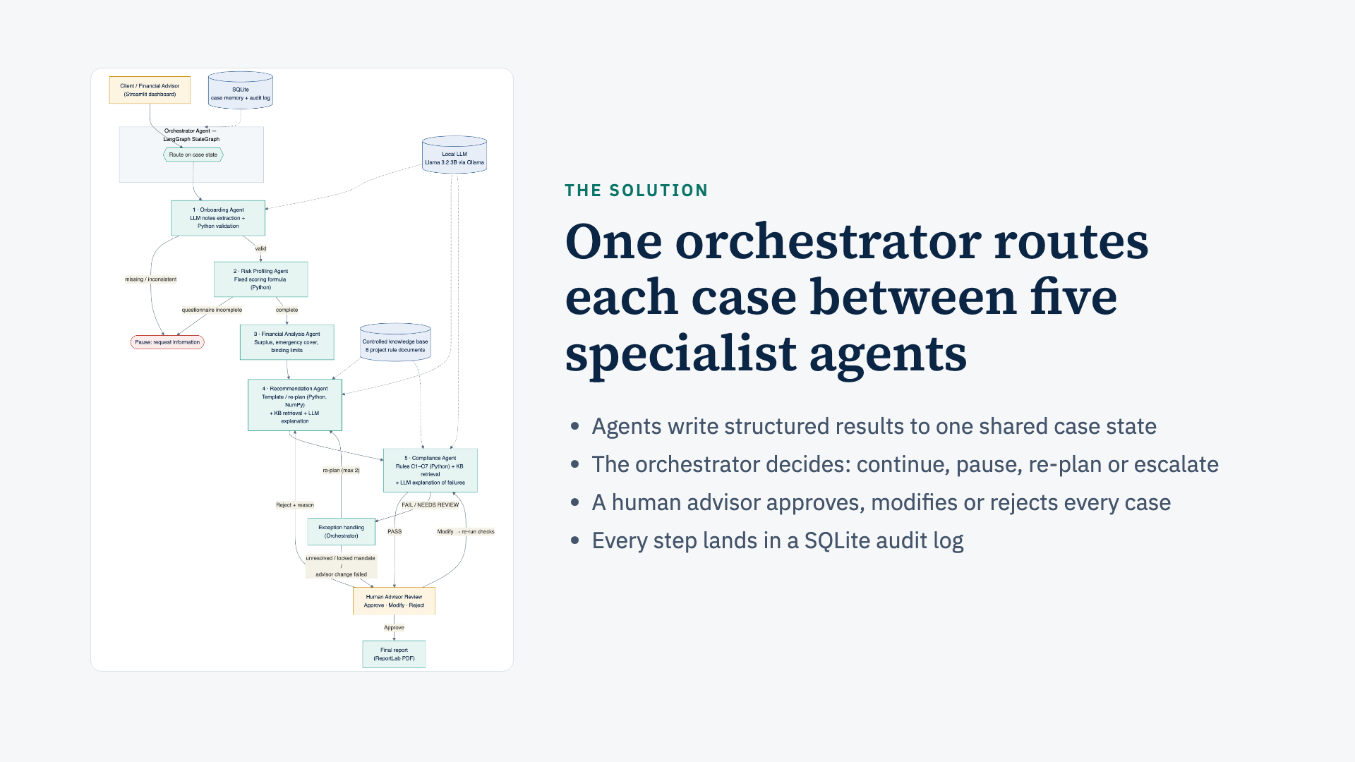
Notes:
Walk the figure top to bottom: onboarding, risk profiling, financial analysis, recommendation, compliance. On failure the orchestrator either loops back to recommendation (re-plan) or escalates to the advisor. Dotted lines are tools: the knowledge base, the local LLM and SQLite.

Slide 4
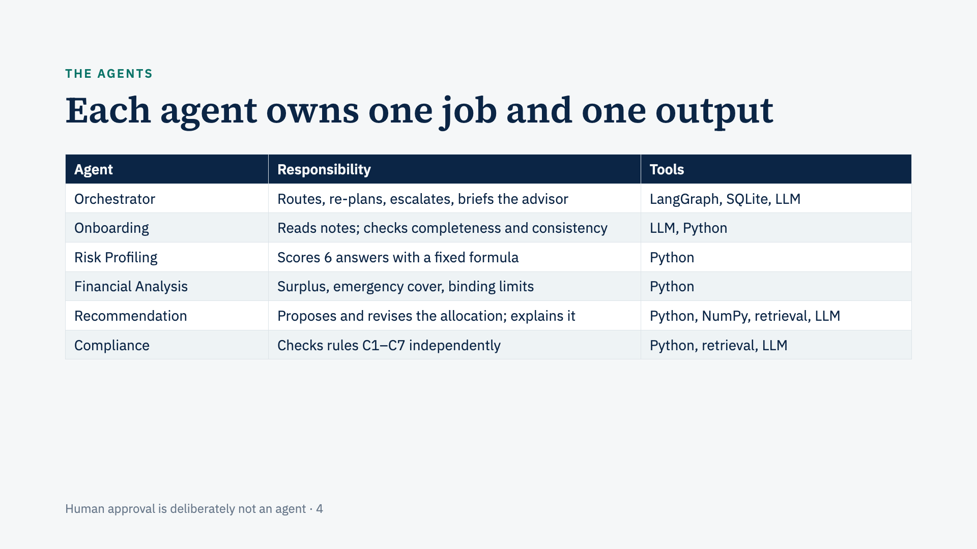
Notes:
Point out that not every agent needs an LLM. The Risk Profiling and Financial Analysis agents are pure Python because their job is arithmetic. The Compliance Agent is independent of the Recommendation Agent, so the recommender cannot mark its own homework.

Slide 5
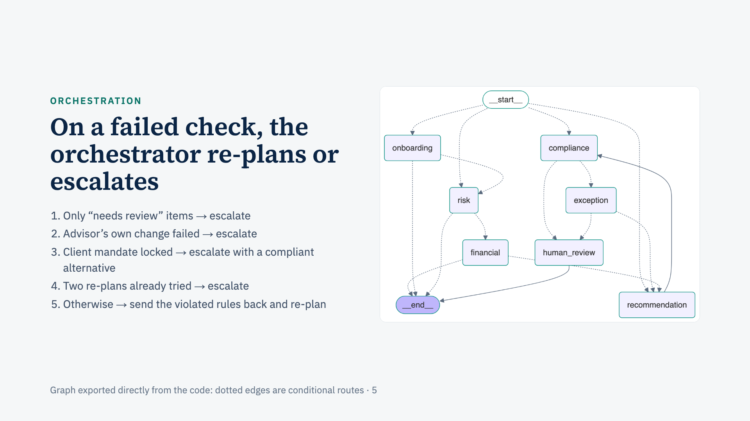
Notes:
This graph is generated from the running code, not drawn by hand, so it proves the routing is real. The loop compliance → exception → recommendation is the re-plan cycle. Stress rule 2: the agents never overrule a human advisor.

Slide 6
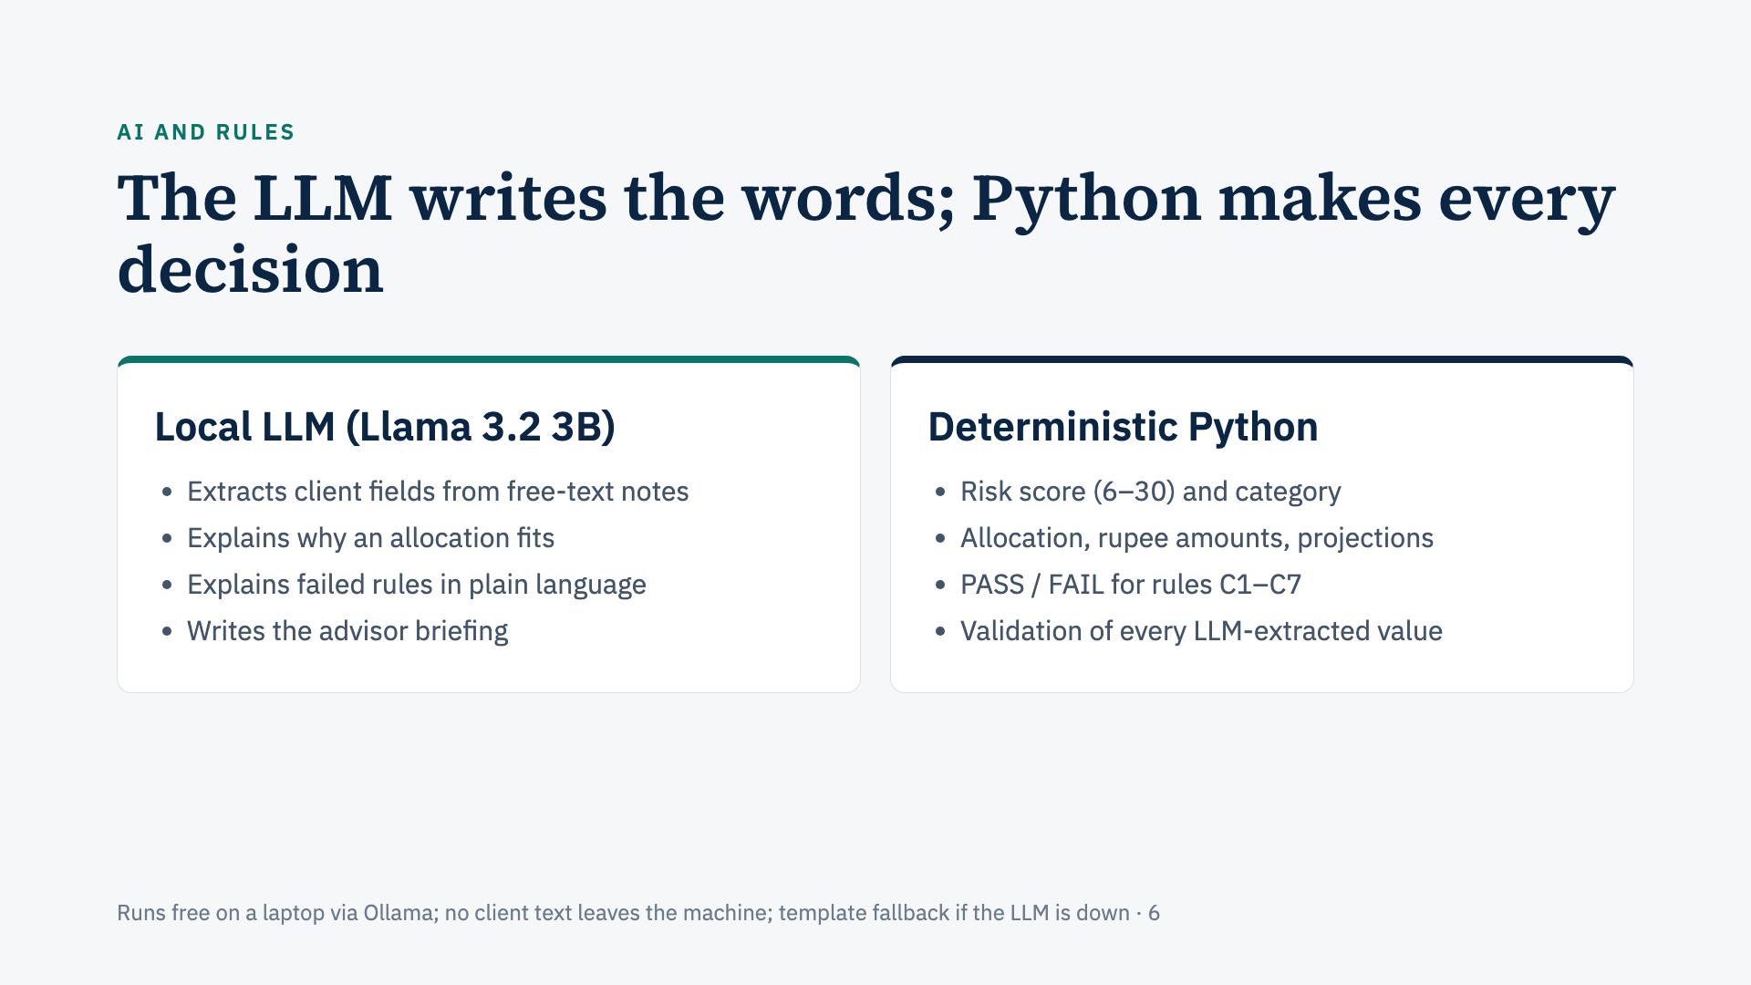
Notes:
Why local? Free, private, and no API key. Why split the work? An LLM can be wrong with numbers, so it never computes or decides. If the LLM fails, every agent falls back to template text and the results are identical, which is also why our tests run with the LLM off.

Slide 7
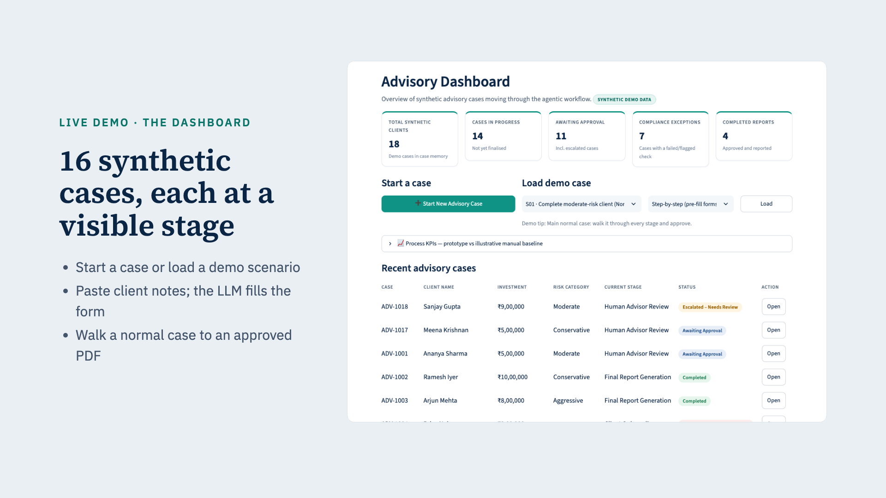
Notes:
Switch to the live app here. Demo path: Start New Advisory Case, paste notes, Extract details with AI, Validate, Calculate Risk Score, Generate Recommendation, Compliance Review, Approve, download the PDF.

Slide 8
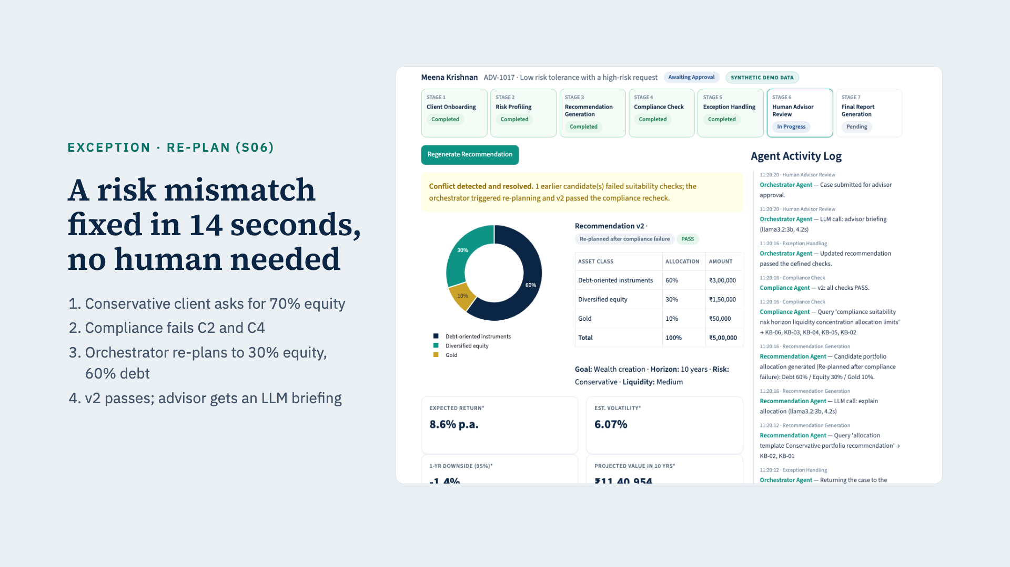
Notes:
Load S06 with Run full workflow. Point at the yellow banner, the candidate history (v1 FAIL, v2 PASS) and the activity log on the right, which shows each agent and each LLM call with timings. 14 seconds includes four local LLM calls.

Slide 9
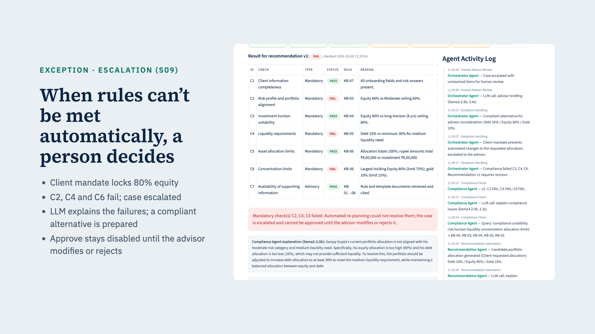
Notes:
Open S09 on Advisor Approval: show the disabled Approve button. Then Modify, which is pre-filled with the orchestrator's compliant alternative of 30/60/10, and apply it: compliance re-runs and passes, and only then can the advisor approve.

Slide 10
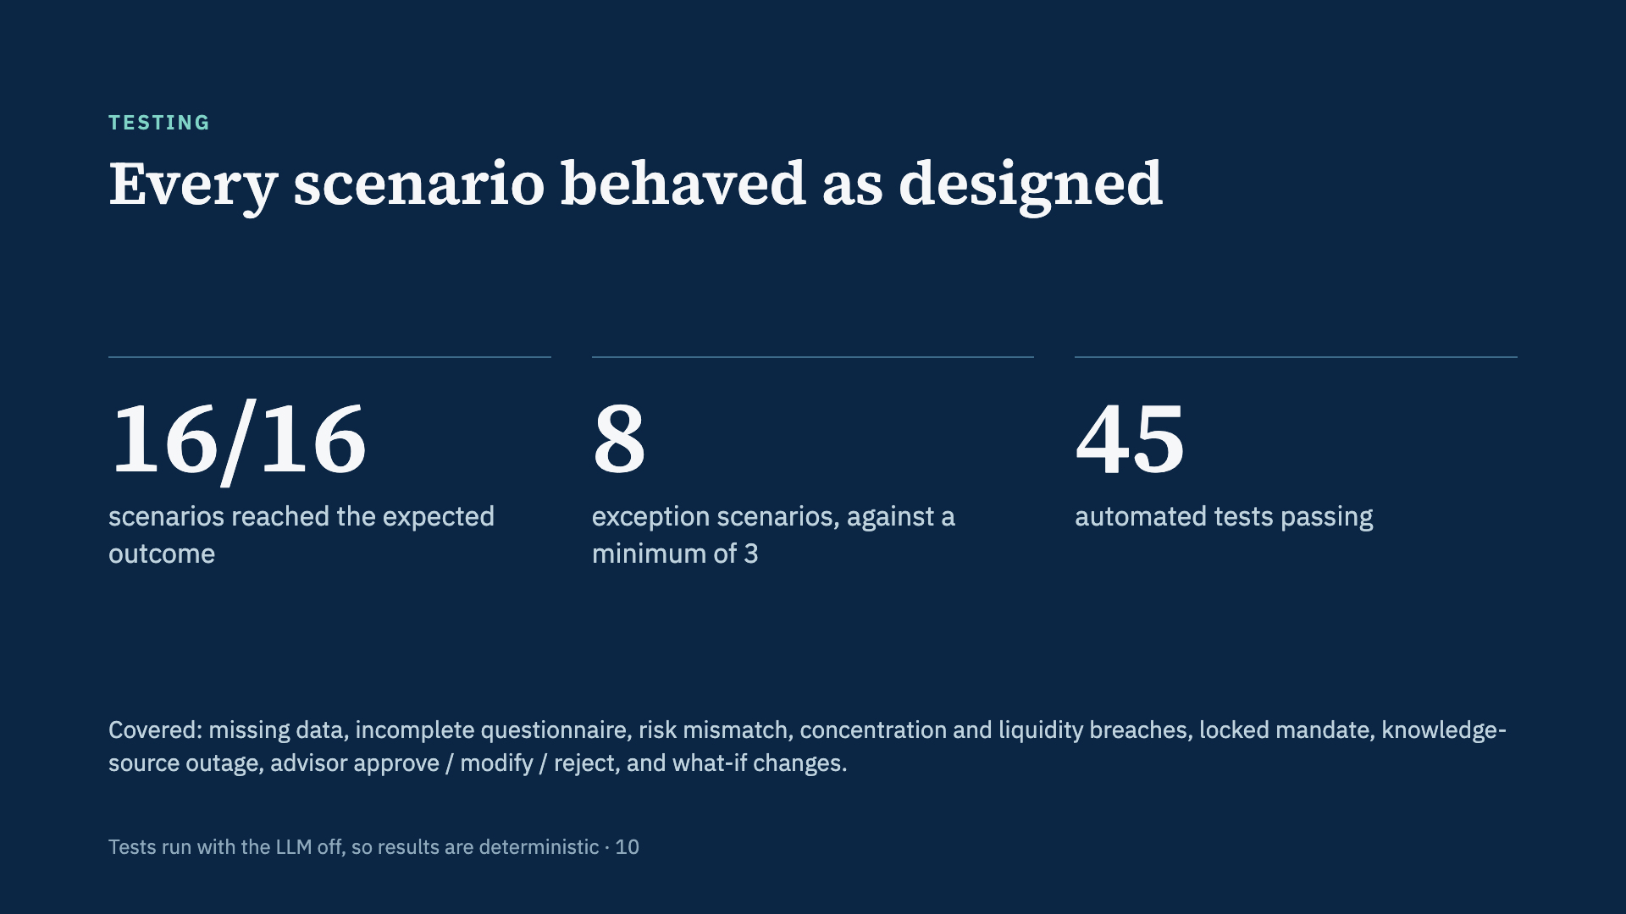
Notes:
The automated tests also check determinism, that every allocation totals 100% and reconciles to the rupee, and that approval is impossible while a mandatory check fails.

Slide 11
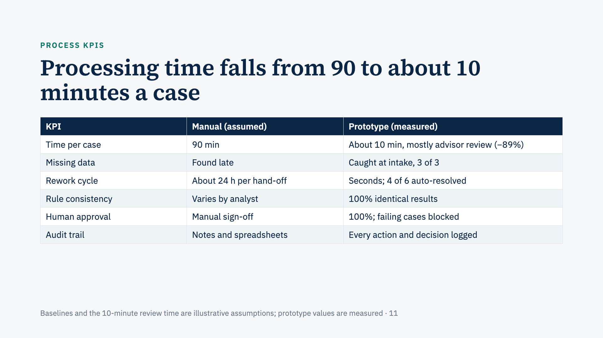
Notes:
Be upfront that the baseline is assumed, as the guidelines allow. The automated part takes under a second, or 10–15 seconds with the LLM; the 10 minutes is our assumed advisor review time. The 2 flagged cases that were not auto-resolved were correctly escalated to a person.

Slide 12
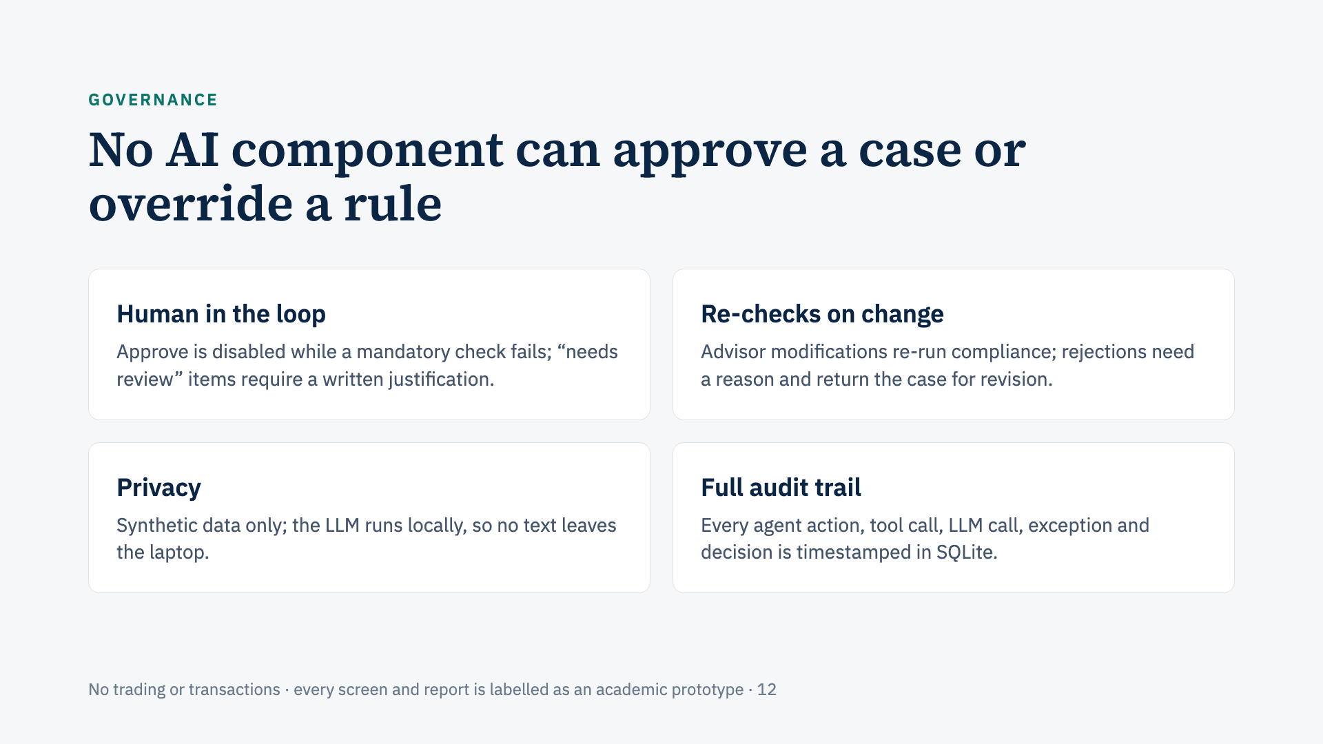
Notes:
If asked "what stops the AI from approving a bad portfolio?": agents cannot approve at all, and the approve function itself refuses while any mandatory check fails. This is enforced in code and covered by automated tests.

Slide 13
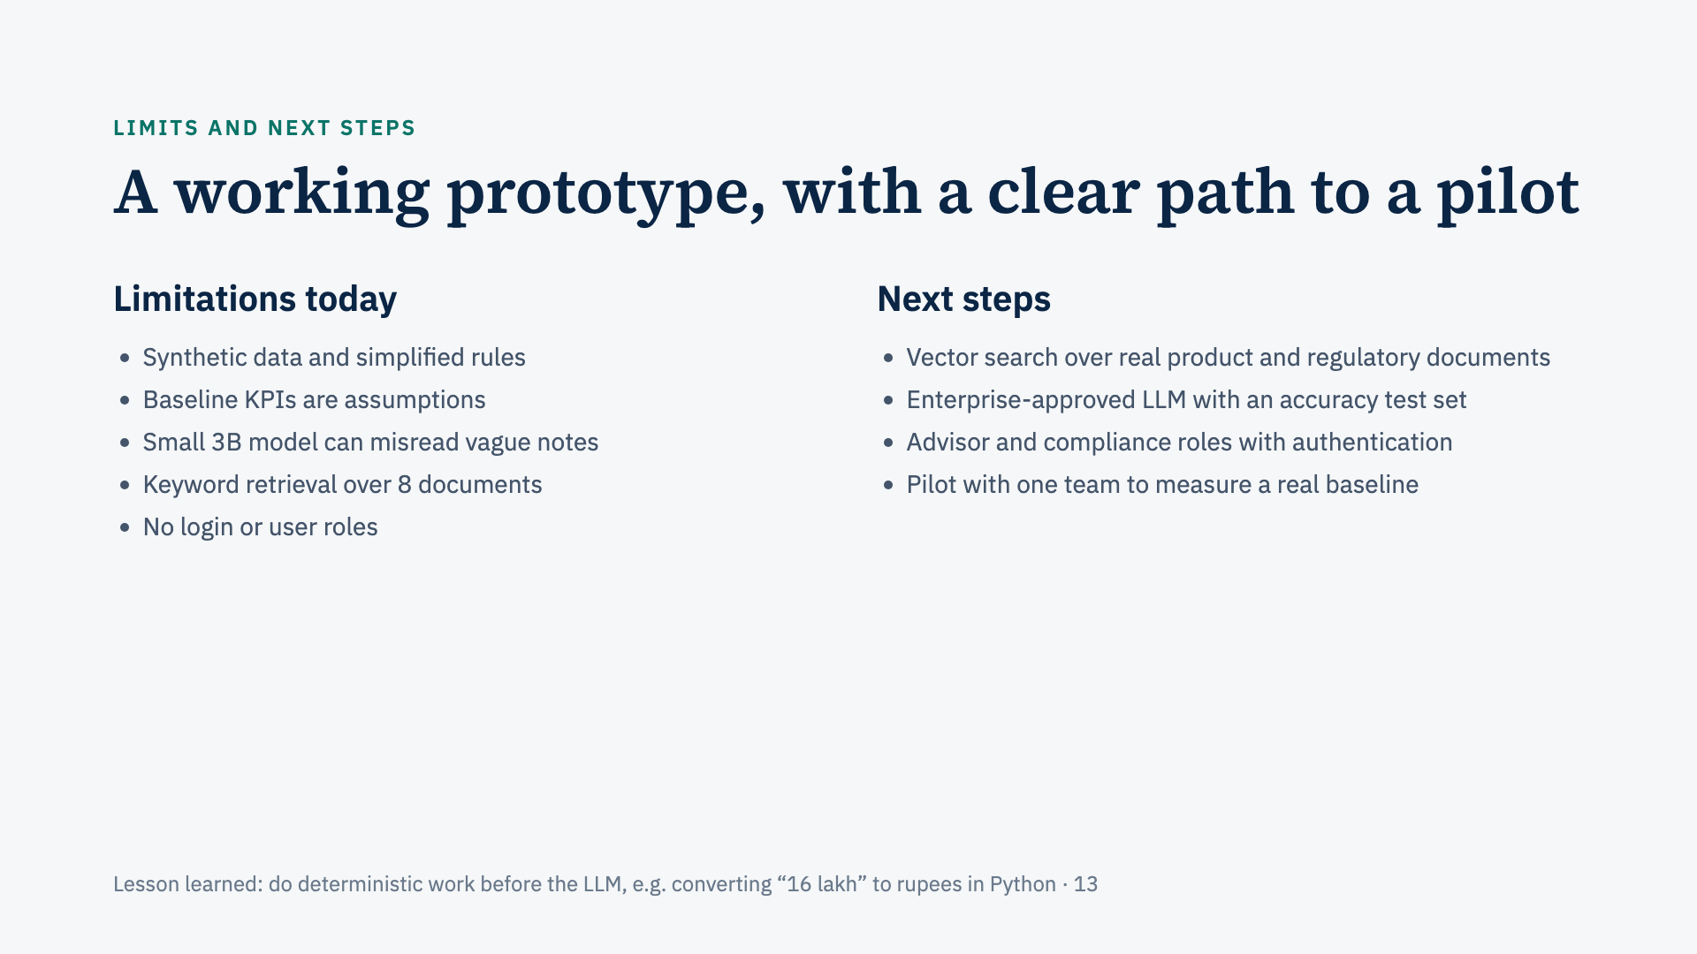
Notes:
Mention the honest LLM test: 21 of 22 extracted fields were correct; "may need some money early" was read as Low liquidity instead of Medium. That is exactly why a person reviews every extracted value.

Slide 14
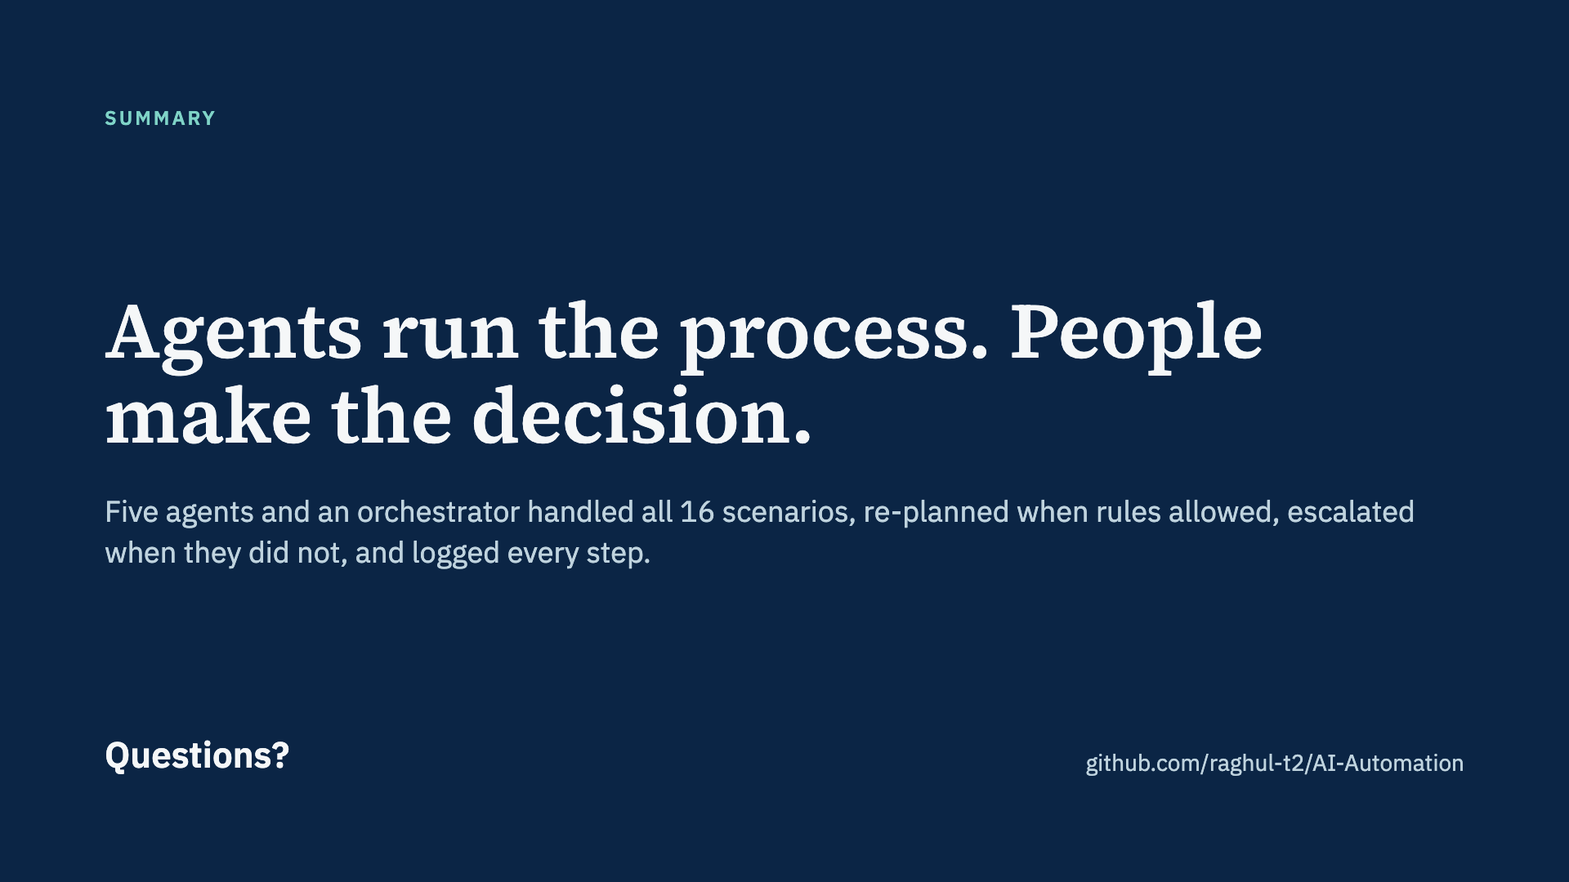
Notes:
Close on the one-line message, then take questions. Likely questions: why multi-agent (each agent has a distinct job and the orchestrator really routes between them), why a local LLM (free, private, no API key), and what happens if the LLM is wrong (it never decides; fallbacks and human review).

