Slide 1
Digital Portfolio
Student Name : G.sanjay
Register No And NmId: astvu20520524u18030
Department : B.Sc. Computer science
College : Indo-american college, cheyyar.
University : Thiruvalluvar university

Slide 2
Project Title :
Digital Portfolio Website

Slide 3
Agenda:
Problem Statement
Project Overview
End Users
Tools and Technologies
Portfolio Design and Layout
Features and Functionality
Results and Screenshots
Conclusion
Github Link

Slide 4
Problem statement :
In today’s digital world, individuals need a professional online presence to showcase their skills, achievements, and projects. Traditional resumes are often limited in presenting creativity and interactivity.

Slide 5
Project overview :
This project is a personal portfolio website designed to showcase an individual’s skills, background, and projects in a professional and interactive way. The website is structured into four main sections — Home, About, Projects, and Contact — to provide visitors with a complete understanding of the developer’s profile.

Slide 6
End users:
Recuiters
Professor’s
Clients
Network people
The owner of the portfolio (used to organize their achievement properly)

Slide 7
Tools And Techniques:
HTML5 – For structuring the content of the website.
CSS3 – For styling, layout, responsive design, and animations. JavaScript – For interactivity (navbar highlighting, fade-in effects, smooth scrolling). Text Editor / IDE – (e.g., VS Code, Sublime Text, or Notepad++) for writing code. Web Browser – (e.g., Chrome, Edge, Firefox) for testing and running the website.

Slide 8

Portfolio Design And Layout :
Section includes home ,about ,project and contact.
Home menu contains information about me
About menu containsmy photo and my personal information.
Project my portfolio contains2 Project
(digital portfolio and service based application).
Contact it includes name ,email and message it wasBuilt using Javascript for dynamic Website.

Slide 9
Features And Functionality :
Fixed Navigation Bar – Easy movement between sections. Responsive Design – Works well on mobile, tablet, and desktop. Fade-in Animations – Sections appear smoothly while scrolling. Projects Showcase – Big images with hover effects. Contact Form – Users can send messages directly.

Slide 10
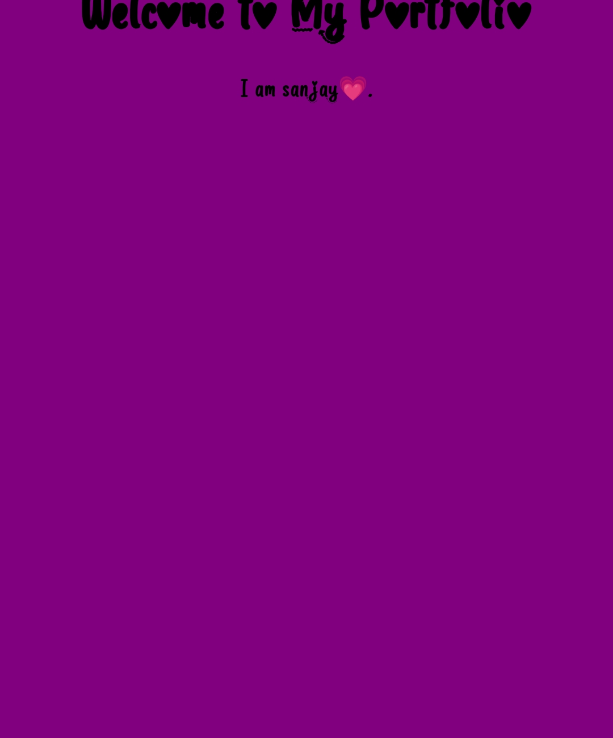
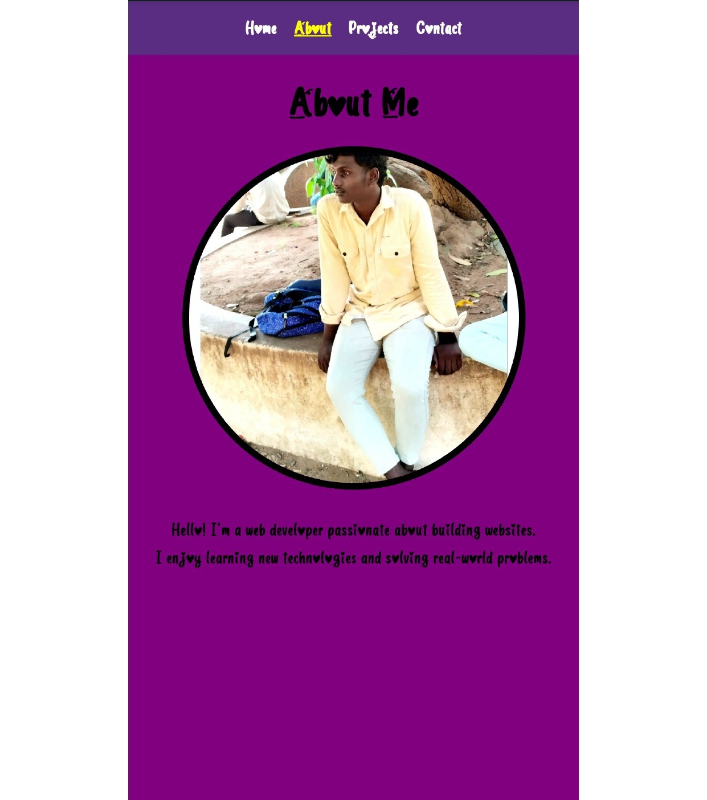
Results And Screenshot :

Slide 11
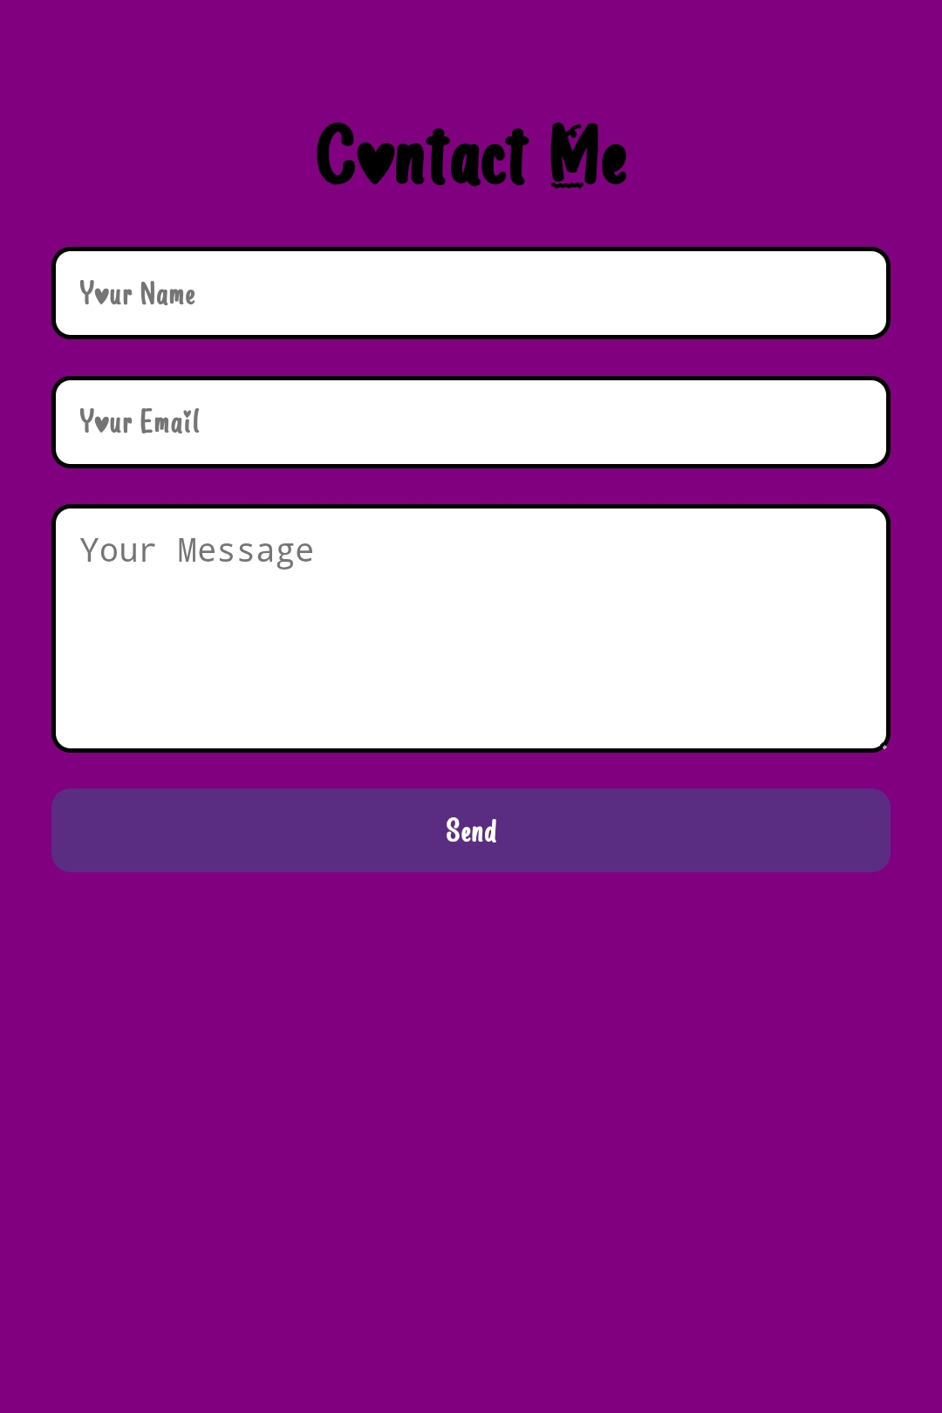
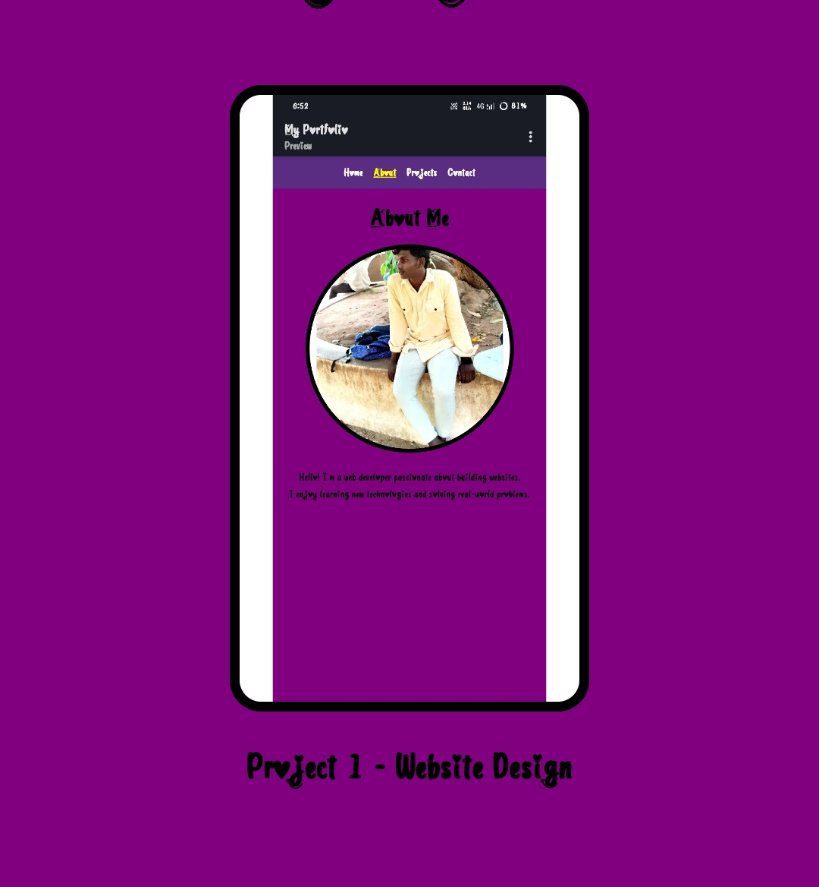
Results And Screenshot :

Slide 12
Conclusion:
Built using HTML,CSS and Javascript.
Clean and userfriendly design.
Responsive layout(Workson mobile phone and desktops)
Organized section (home,about,projects and contact).
Acts as an online resume/portfolio.
Showcases academicPlus technical achie.

