Slide 1

DNF Sparsification and Counting
Raghu Meka
(IAS, Princeton)
Parikshit Gopalan (MSR, SVC)
Omer Reingold (MSR, SVC)

Slide 2
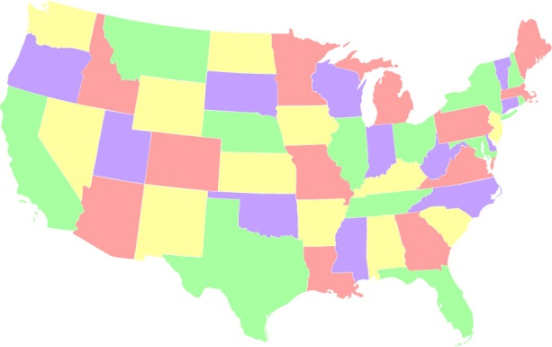
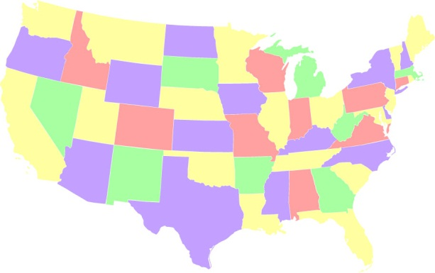
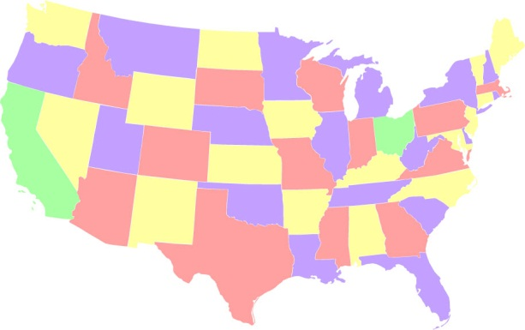
Can we Count?
Count proper 4-colorings?
533,816,322,048!
O(1)

Slide 3
Can we Count?
Count satisfying solutions to a 2-SAT formula?
Count satisfying solutions to a DNF formula?
Count satisfying solutions to a CNF formula?
Seriously?

Slide 4
Counting vs Solving
Counting interesting even if solving “easy”.
Four colorings: Always solvable!

Slide 5
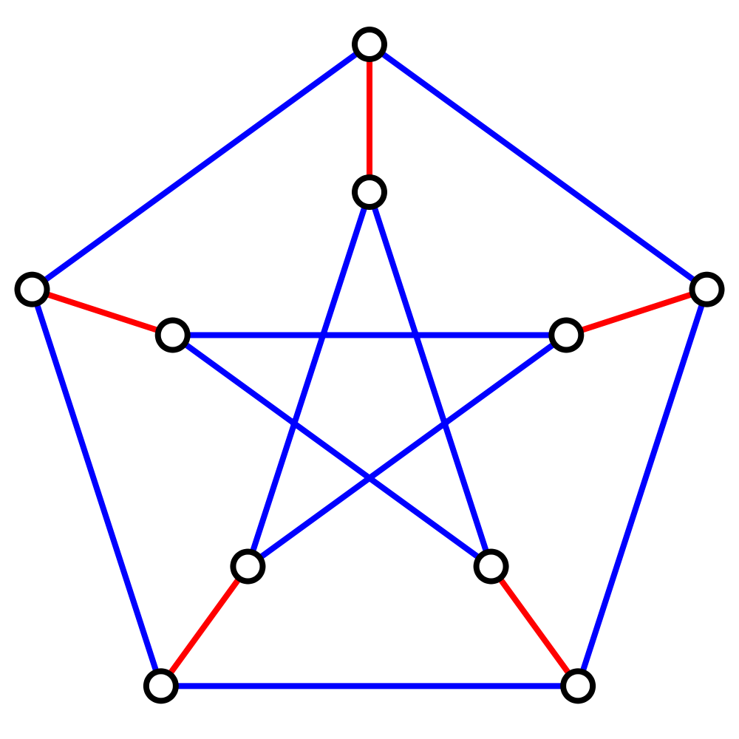
Counting vs Solving
Counting interesting even if solving “easy”.
Matchings
Solving – Edmonds 65
Counting – Jerrum, Sinclair 88
Jerrum, Sinclair Vigoda 01

Slide 6
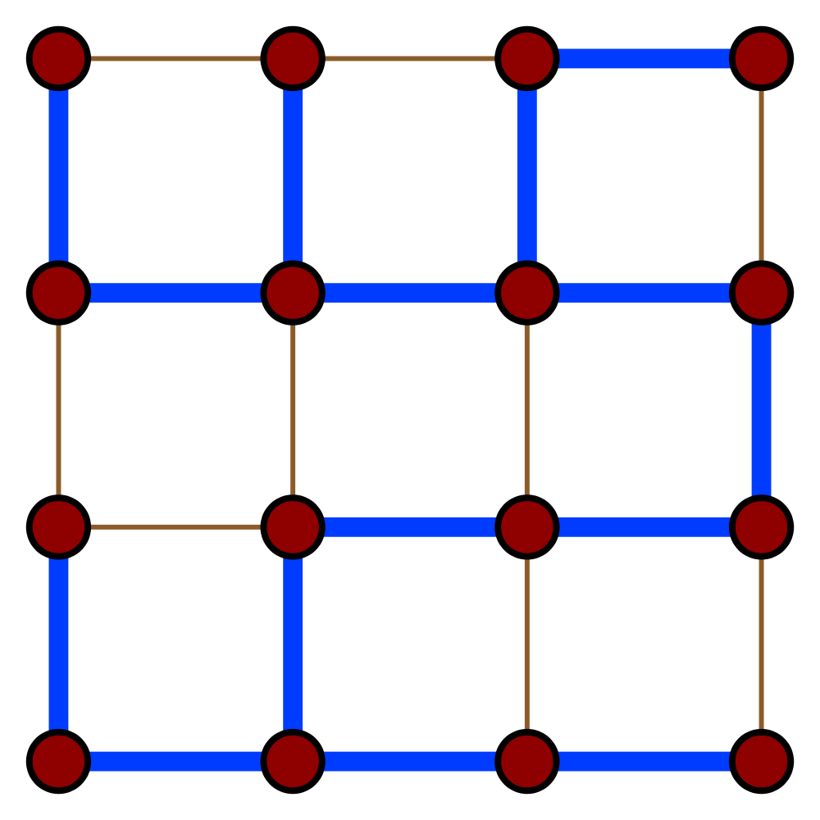
Counting vs Solving
Counting interesting even if solving “easy”.
Spanning Trees
Counting/Sampling:
Kirchoff’s law, Effective resistances

Slide 7
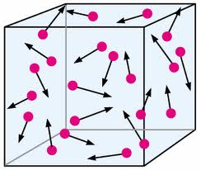
Counting vs Solving
Counting interesting even if solving “easy”.
Thermodynamics = Counting

Slide 8









Conjunctive Normal Formulas
Width w
Size m

Slide 9
Conjunctive Normal Formulas
Extremely well studied
Width three = 3-SAT

Slide 10
Disjunctinve Normal Formulas
Extremely well studied

Slide 11
Counting for CNFs/DNFs
INPUT: CNF f
OUTPUT: No. of
accepting solutions
INPUT: DNF f
OUTPUT: No. of
accepting solutions
#CNF
#DNF
#P-Hard

Slide 12
Counting for CNFs/DNFs
INPUT: CNF f
OUTPUT: Approximation
for No. of solutions
INPUT: DNF f
OUTPUT: Approximation for No. of solutions
#CNF
#DNF

Slide 13

Approximate Counting
Additive error: Compute p
Focus on additive for good reason

Slide 14
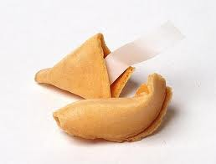
Counting for CNFs/DNFs
Randomized algorithm: Sample and check
“The best throw of the die is to throw it away”
-

Slide 15
Why Deterministic Counting?
#P introduced by Valiant in 1979.
Can’t solve #P-hard problems exactly. Duh.
Approximate Counting ~ Random Sampling
Jerrum, Valiant, Vazirani 1986
Derandomizing simple classes is important.
  Primes is in P - Agarwal, Kayal, Saxena 2001
  SL=L – Reingold 2005
CNFs/DNFs as simple as they get
Triggered counting through MCMC:
Eg., Matchings (Jerrum, Sinclair, Vigoda 01)
Does counting require randomness?

Slide 16
Counting for CNFs/DNFs
Karp, Luby 83 – MCMC counting for DNFs
Reference | Run-Time
Ajtai, Wigderson 85 | Sub-exponential
Nisan, Wigderson 88 | Quasi-polynomial
Luby, Velickovic, Wigderson
Luby, Velickovic 91 | Better than quasi, but worse than poly.
No improvemnts since!

Slide 17

Our Results
Main Result: A
deterministic algorithm.
New structural result on CNFs
Strong “junta theorem’’ for CNFs
New approach to switching lemma
  Fundamental result about CNFs/DNFs, Ajtai 83, Hastad 86; proof mysterious

Slide 18
Counting Algorithm
Step 1: Reduce to small-width
  Same as Luby-Velickovic
Step 2: Solve small-width directly
  Structural result: width buys size

Slide 19






Width vs Size
Size does not depend on n or m!
How big can a width w CNF be?
Eg., can width = O(1), size = poly(n)?
Recall: width = max-length of clause
size = no. of clauses

Slide 20
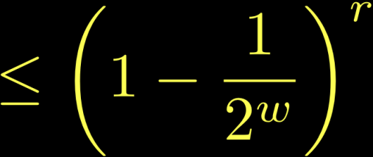

Proof of Structural result
Observation 1: Many disjoint clauses =>
small acceptance prob.

Slide 21




Proof of Structural result
2: Many clauses => some (essentially) disjoint
Assume no negations.
Clauses ~ subsets of variables.
Petals
(Core)

Slide 22
Proof of Structural result
2: Many clauses => some (essentially) disjoint
Many small sets => Large

Slide 23




Lower Sandwiching CNF
Error only if all petals satisfied
k large => error small
Repeat until CNF is small

Slide 24

Upper Sandwiching CNF
Error only if all petals satisfied
k large => error small
Repeat until CNF is small

Slide 25


Main Structural Result
Setting parameters properly:
“Quasi-sunflowers” (Rossman 10) with appropriately adapted analysis:
Suffices for counting result.
Not the dependence we promised.

Slide 26
Implications of Structural Result
PRGs for small-width DNFs
DNF Counting

Slide 27


PRGs for Narrow DNFs
Sparsification Lemma: Fooling small-width same as fooling small-size.
Small-bias fools small size: DETT10 (Baz09, KLW10).
Previous best (AW85, Tre01):
Thm: PRG for width w with seed

Slide 28
Counting Algorithm
Step 1: Reduce to small-width
  Same as Luby-Velickovic
Step 2: Solve small-width directly
  Structural result: width buys size
PRG for width w with seed

Slide 29






Reducing width for #CNF (LV91)
Hash using pairwise independence
Use PRG for small-width in each bucket
Most large clauses break; discard others
x2
x3
x2
x2
x3
x3
x4
x4
x4
x5
x5
x5
x1
x5
…
xk
x1
…
xk
…
xk
…
xn
xn
xn
xn
1
2
t
2
t

Slide 30


Open Question
Necessary:
Q: Deterministic polynomial time algorithm for #CNF? PRG?

Slide 31

Thank you

