Slide 1

Better Pseudorandom Generators from Milder Pseudorandom Restrictions
Raghu Meka (IAS)
Parikshit Gopalan, Omer Reingold (MSR-SVC) Luca Trevian (Stanford), Salil Vadhan (Harvard)

Slide 2


Can we generate random bits?

Slide 3
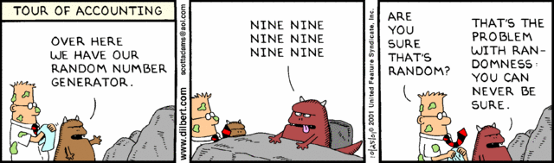
Can we generate random bits?

Slide 4

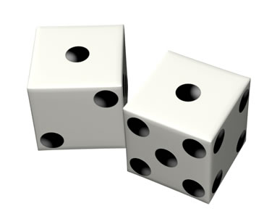
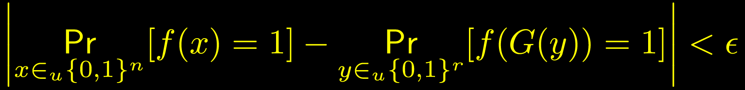
Pseudorandom Generators
Stretch bits to fool a class of “test functions” F

Slide 5
Can we generate random bits?
Complexity theory, algorithms, streaming
Strong positive evidence: hardness vs randomness – NW94, IW97, …
Unconditionally? Duh.

Slide 6






Can we generate random bits?
Restricted models: bounded depth circuits (AC0), bounded space algorithms
Nis91, Bazzi09, B10, …
Nis90, NZ93, INW94, …

Slide 7






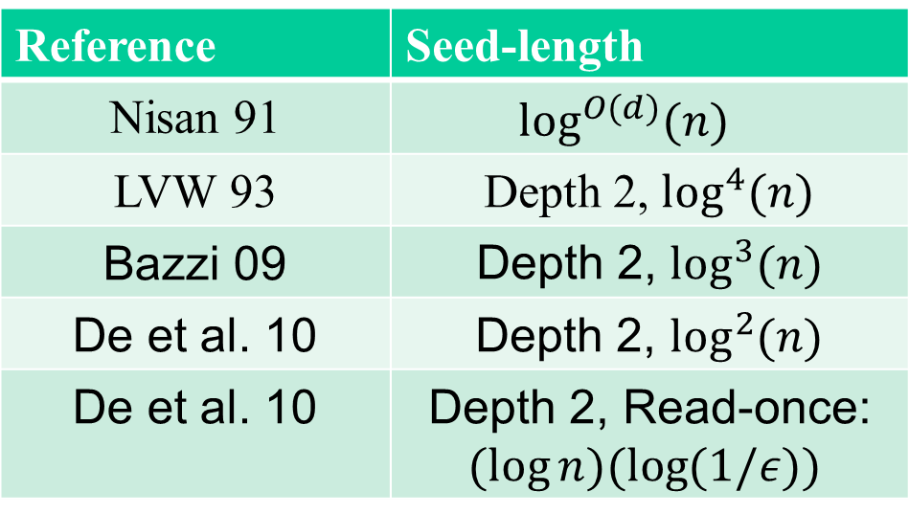

PRGs for AC0
Reference | Seed-length
Nisan 91
LVW 93
Bazzi 09
DETT 10
DETT 10
For polynomially small error best was
$\log^{2}{n }$even for read-once CNFs.

Slide 8

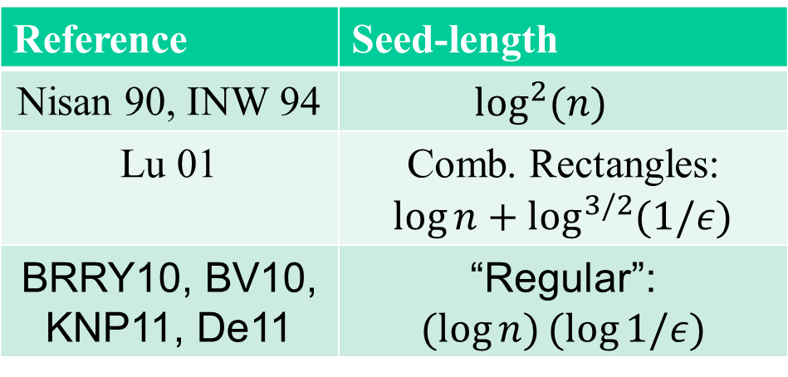

PRGs for Small-space
Reference | Seed-length
Nisan 90, INW 94
Lu 01
BRRY10, BV10, KNP11, De11
For polynomially small error best was
$\log^{1.5}{n }$even for comb. rectangles.

Slide 9
This Work
PRGs with polynomial small error

Slide 10
Why Small Error?
Because we “should” be able to
Symptomatic: const. error for large depth implies poly. error for smaller depth
Applications: algorithmic derandomizations, complexity lowerbounds

Slide 11

This Work
1. PRG for comb. rectangles with seed .
2. PRG for read-once CNFs with seed .
Generic new technique: iterative application of mild random restrictions.
3. HSG for width 3 branching programs with seed .

Slide 12

Combinatorial Rectangles
Applications: Number theory, analysis, integration, hardness amplification

Slide 13
PRGs for Comb. Rectangles
Small set preserving volume
Volume of rectangle
~ Fraction of positive PRG points

Slide 14

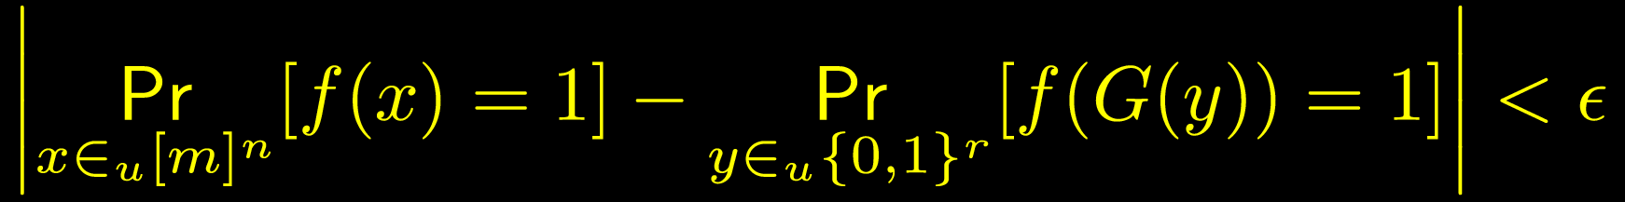
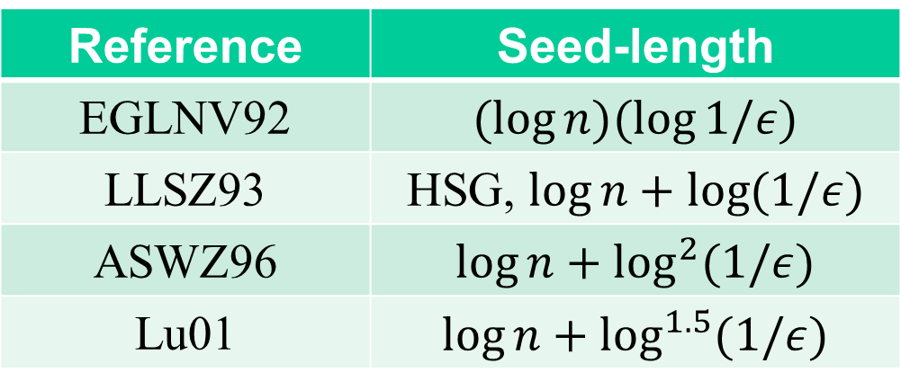
PRGs for Combinatorial Rectangles
Thm: PRG for comb. rectangles with seed .
Reference | Seed-length
EGLNV92
LLSZ93
ASWZ96
Lu01

Slide 15




Read-Once CNFs
Thm: PRG for read-once CNFs with seed .
Each variable appears at most once

Slide 16
This Talk
Thm: PRG for read-once CNFs with seed .
Comb. Rectangles similar but different

Slide 17
Outline
Main generator: mild (pseudo)random restrictions.
Interlude: Small-bias spaces, Tribes
Analysis: variance dampening, approximating symmetric functions.
The “real” stuff happens here.

Slide 18

Random Restrictions
Switching lemma – Ajt83, FSS84, Has86
*
1
0
0
1
0
0
*
*
*
*
*
*
*
*

Slide 19

PRGs from Random Restrictions
AW85: Use “pseudorandom restrictions”.
*
*
*
*
*
*
*
*
*
Problem: No strong derandomized switching lemmas.

Slide 20
Mild Psedorandom Restrictions
Restrict half the bits (pseudorandomly).
0 0 0
0 0 1
0 0 0
* * *
* * *
* * *
* * *
* * *
* * *
“Simplification”: Can be fooled by small-bias spaces.

Slide 21

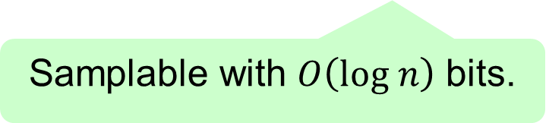

Full Generator Construction
Pick half using almost k-wise
* *
* * * *
* * * * * * * *
Small-bias
Small-bias
Small-bias
Repeat $O(\log{\log{n) }}times.$
Randomness: $O((\log{n)(\log{\log{n)).}}}$
Thm: PRG for read-once CNFs with seed .

Slide 22
Outline
Main generator: mild (pseudo)-random restrictions.
Interlude: Small-bias spaces, Tribes
Analysis: variance dampening, approximating symmetric functions.

Slide 23





Toy example: Tribes
Read-once CNF and a Comb. Rectangle

Slide 24


Small-bias Spaces
Fundamental objects in pseudorandomness
NN93, AGHP92: can sample with $O(\log{n+\log{(1/δ))}}$ bits

Slide 25



Small-bias Spaces
PRG with seed $O((\log{n)(\log{1/ε))}}$
Tight: need bias $n^{−Ω(\log{(1/ε))}}$

Slide 26
Outline
Main generator: mild (pseudo)-random restrictions.
Interlude: Small-bias spaces, Tribes
Analysis: variance dampening, approximating symmetric functions.
The “real” stuff happens here.

Slide 27


Analysis Sketch
Pick half using almost k-wise
* * * * * * * *
* * * * * * * *
* *
* * * *
Uniform
Small-bias
Small-bias
Small-bias
Error is small
Size reduces: $n→√n$

Slide 28







Analysis for Tribes
0 0 0
0 1 0
0 0 1
* * *
* * *
* * *
* * *
* * *
* * *
Pick half using almost k-wise
Pick exactly half from each clause
0 0 0
* * *
0 1 0
* * *
0 0 1
* * *
* * *
* * *
* * *
First try: fix uniform bits (averaging argument)
Problem: still Tribes
Main idea: Average over uniform to study “bias function”.
White = small-bias
Yellow = uniform

Slide 29

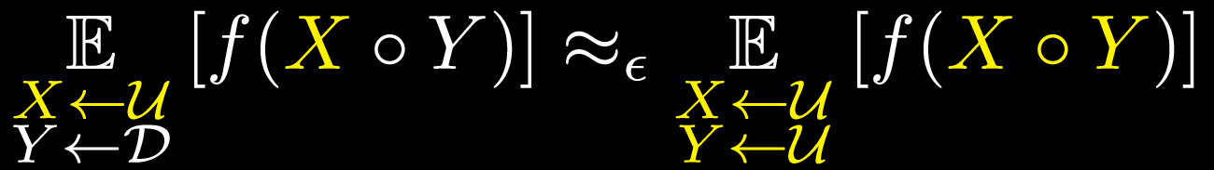


Fooling Bias Functions
Fix a read-once CNF f. Want:
Define bias function:
False if we fixed X!

Slide 30









Fooling Bias Functions
Let

Slide 31











Fooling Bias Functions
$$1−2^{−w}$$
(Without “dampening”)
“Variance dampening”: makes things work.

Slide 32



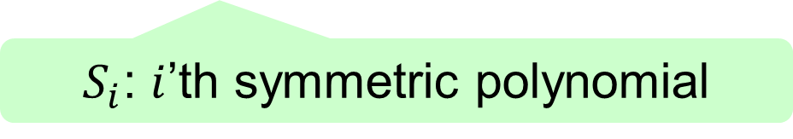
Fooling Bias Functions
F$irst few S_{i}$’s fooled by small-bias
$E[\left|S_{i}\right|]$’s decrease geometrically under uniform
No such decrease for small-bias
Conditional decrease: decrease conditioned on a high probability event (cancellations happen)
$S_{i}$: $i$’th symmetric polynomial

Slide 33



An Inequality for Symmetric Polynomials
Lem:
Comes from variance dampening.
Proof uses Newton-Girard identities.
Ex: If $S_{1}\left(…\right)=S_{2}\left(…\right)=0,$then $S_{k}\left(…\right)=0.$

Slide 34

Summary
Main generator: mild (pseudo)-random restrictions.
Small-bias spaces and Tribes
Analysis: variance dampening, approximating sym. functions.
PRG for RCNFs
Combinatorial rectangles similar but different

Slide 35

Open Problems
Q: Use techniques for other classes? Small-space?

Slide 36
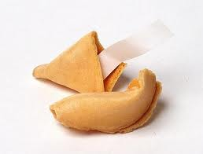
Thank you
“The best throw of the die is to throw it away”
-

