Slide 1

Discrepancy Minimization by Walking on the Edges
Raghu Meka (IAS & DIMACS)
Shachar Lovett (IAS)

Slide 2








Discrepancy
Subsets $S_{1},S_{2},…, S_{m}⊆[n]$
Color with $1$or -$1$ to minimize imbalance
1 2 3 4 5
1 2 3 4 5
1 | * | 1 | 1 | *
* | 1 | 1 | * | 1
1 | 1 | 1 | 1 | 1
* | * | * | 1 | 1
1 | * | 1 | * | 1
1 | * | 1 | 1 | *
* | 1 | 1 | * | 1
1 | 1 | 1 | 1 | 1
* | * | * | 1 | 1
1 | * | 1 | * | 1
3
1
1
0
1

Slide 3
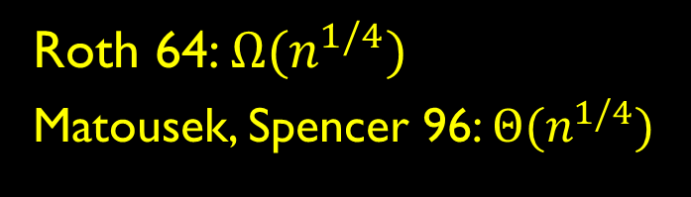
Discrepancy Examples
Fundamental combinatorial concept
Arithmetic Progressions
Roth 64: $Ω{(n}^{1/4})$
Matousek, Spencer 96: $Θ{(n}^{1/4})$

Slide 4
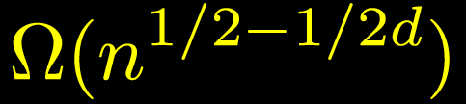
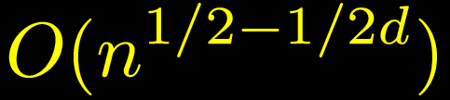
Discrepancy Examples
Fundamental combinatorial concept
Halfspaces
Alexander 90:
Matousek 95:

Slide 5
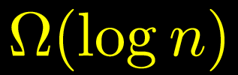
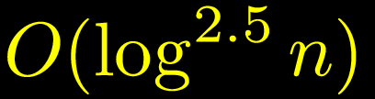
Discrepancy Examples
Fundamental combinatorial concept
Axis-aligned boxes
Beck 81:
Srinivasan 97:

Slide 6
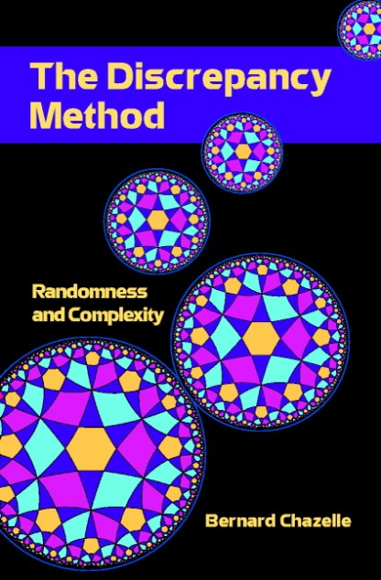
Why Discrepancy?
Complexity theory
Communication Complexity
Computational Geometry
Pseudorandomness
Many more!

Slide 7


Spencer’s Six Sigma Theorem
“Six standard deviations suffice”
Spencer 85: System with n sets has discrepancy at most .
Central result in discrepancy theory.
Beats random:
Tight: Hadamard.

Slide 8

A Conjecture and a Disproof
Spencer 85: System with n sets has discrepancy at most .
Non-constructive pigeon-hole proof
Conjecture (Alon, Spencer): No efficient algorithm can find one.
Bansal 10: Can efficiently get discrepancy .

Slide 9

This Work
New elemantary constructive proof of Spencer’s result
Main: Can efficiently find a coloring with discrepancy $O\left(\sqrt{n}\right).$
Truly constructive
Algorithmic partial coloring lemma
Extends to other settings
EDGE-WALK: New algorithmic tool

Slide 10



Beck-Fiala Setting
Each element occurs in at most $t$ sets
1 2 3 4 5
1 | * | 1 | * | *
* | 1 | 1 | * | 1
* | 1 | * | 1 | *
* | * | * | 1 | *
1 | * | * | * | 1
Beck-Fiala 80: $2t$
Srinivasan 97: $O(√t$(log n))
(non-algorithmic)
Banszczyk 98: $O(\sqrt{t log n})$
(non-algorithmic)

Slide 11

Beck-Fiala Setting
Each element occurs in at most $t$ sets
Thm: Can efficiently find a coloring with discrepancy $O(\sqrt{t }(\log{n)}).$
Matches Bansal 10

Slide 12
Outline
Partial coloring Method
EDGE-WALK: Geometric picture
Analysis of algorithm

Slide 13










Partial Coloring Method
Beck 80: find partial assignment with $<n/2$zeros
1 -1 1 1 -1
1 -1 0 0 0
1 1 0
-1
1 | * | 1 | 1 | *
* | 1 | 1 | * | 1
1 | 1 | 1 | 1 | 1
* | * | * | 1 | 1
1 | * | 1 | * | 1
1 | * | 1 | 1 | *
* | 1 | 1 | * | 1
1 | 1 | 1 | 1 | 1
* | * | * | 1 | 1
1 | * | 1 | * | 1
1 | * | 1 | 1 | *
* | 1 | 1 | * | 1
1 | 1 | 1 | 1 | 1
* | * | * | 1 | 1
1 | * | 1 | * | 1
1 | * | 1 | 1 | *
* | 1 | 1 | * | 1
1 | 1 | 1 | 1 | 1
* | * | * | 1 | 1
1 | * | 1 | * | 1
1 | * | 1 | 1 | *
* | 1 | 1 | * | 1
1 | 1 | 1 | 1 | 1
* | * | * | 1 | 1
1 | * | 1 | * | 1

Slide 14







Partial Coloring Method
Input:
Output:
Lemma: Can do this in randomized
time.
Focus on m = n case.

Slide 15
Outline
Partial coloring Method
EDGE-WALK: Geometric picture
Analysis of algorithm

Slide 16





Discrepancy: Geometric View
Subsets $S_{1},S_{2},…, S_{m}⊆[n]$
Color with $1$or -$1$ to minimize imbalance
1 2 3 4 5
1 | * | 1 | 1 | *
* | 1 | 1 | * | 1
1 | 1 | 1 | 1 | 1
* | * | * | 1 | 1
1 | * | 1 | * | 1
3
1
-1
1
1
-1
3
1
1
0
1
1
1
0
1

Slide 17


Discrepancy: Geometric View
Vectors $v_{1}, v_{2},…, v_{m}∈{\left\{0,1\right\}}^{n}.$
Want
1 2 3 4 5
1 | * | 1 | 1 | *
* | 1 | 1 | * | 1
1 | 1 | 1 | 1 | 1
* | * | * | 1 | 1
1 | * | 1 | * | 1
1
-1
1
1
-1
3
1
1
0
1

Slide 18



Discrepancy: Geometric View
Vectors $v_{1}, v_{2},…, v_{m}∈{\left\{0,1\right\}}^{n}.$
Want
Polytope view used earlier by Gluskin’ 88.
Goal: Find non-zero lattice point inside

Slide 19
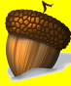

Edge-Walk
Goal: Find non-zero lattice point in
Claim: Will find good partial coloring.
Start at origin
Gaussian walk until you hit a face
Gaussian walk within the face

Slide 20


Edge-Walk: Algorithm
Gaussian random walk in subspaces
Subspace V, rate $γ$
Gaussian walk in V
Standard normal in V:
Orthonormal basis change

Slide 21
Edge-Walk Algorithm
Discretization issues: hitting faces
Might not hit face
Slack: face hit if close to it.

Slide 22
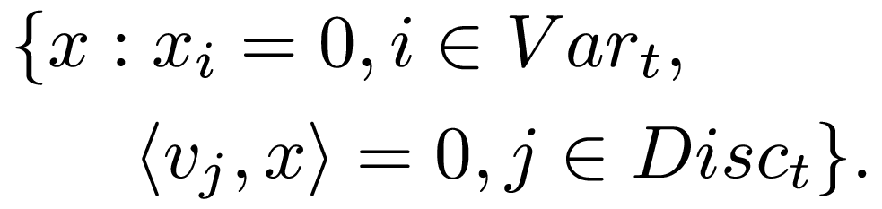



Edge-Walk: Algorithm
Input: Vectors $v_{1},v_{2},…, v_{m}.$
Parameters: $δ, Δ, γ\left(≪δ\right), T=1/γ^{2}$
$X_{0}=0.$For $t=1,…, T.$
$Var_{t}=$Cube faces nearly hit by $X_{t}$.
$Disc_{t}=$Disc. faces nearly hit by $X_{t}$.
$V_{t}=$Subspace orthogonal to ${Var}_{t}, Disc_{t}$

Slide 23




Edge-Walk: Intuition
Discrepancy faces much farther than cube’s
$$\operatorname{Pr}\left[Walk hits a disc. face\right] ≪Pr⁡[ Walk hits a cube^{′}s]$$
$$\operatorname{Pr}\left[Walk hits a disc. face\right]$$
$$∝\exp\left(−{100}^{2}\right).$$
$$\operatorname{Pr}\left[Walk hits a cube face\right]$$
$$∝\exp\left(−1\right).$$
100
Hit cube more often!
1

Slide 24
Outline
Partial coloring Method
EDGE-WALK: Geometric picture
Analysis of algorithm

Slide 25


Edge-Walk: Analysis
Lem: For
with prob 0.1 and

Slide 26



Edge-Walk Analysis
Claim 1: Never cross polytope.
Claim 2: Number of disc. faces hit $≪n$.
Win-Win: Hit many cube faces or grow

Slide 27


Edge-Walk Analysis
Claim 1: Never cross polytope
Must make a big jump
Unlikely: $γ≪δ$
$$δ$$

Slide 28


Edge-Walk Analysis
Claim 2: Number of disc. faces hit $≪n.$
Small progress each step
Martingale tail bound:
  $σ<γ, T=1/γ^2$.
Linearity of expectation
100

Slide 29

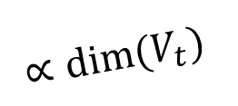

Edge-Walk Analysis
Claim 3: Hit many cube faces -
$(ℓ_{2}$ norm$)^{2}$ grows $∝$ dimension of subspace
Final dimension small:
$$∝dim⁡(V_{t})$$

Slide 30




Main Partial Coloring Lemma
Th: Given $v_{1},…, v_{m},$thresholds $λ_{1},λ_{2},…λ_{m},$
Can find $X∈{\left[−1,1\right]}^{n}$with
1.
2.
Algorithmic partial coloring lemma

Slide 31
Summary
Edge-Walk: Algorithmic partial coloring lemma
Recurse on unfixed variables
Spencer’s Theorem
Beck-Fiala setting similar

Slide 32
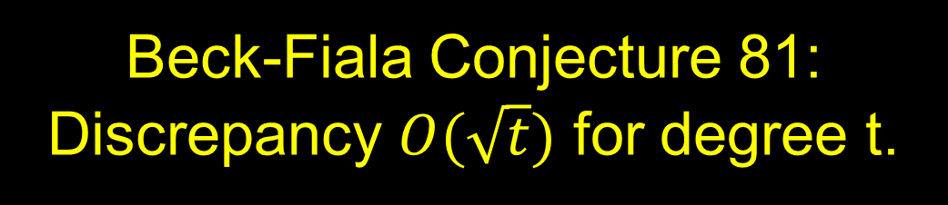
Open Problems
Q:
Beck-Fiala Conjecture 81: Discrepancy $O(\sqrt{t})$ for degree t.
Some promise: our PCL “stronger” than Beck’s
Q: Other applications?
General IP’s, Minkowski’s theorem?
Constructive version of Banszczyk’s bound?

Slide 33
Thank you

