Slide 1
Counting Algorithms for Knapsack and Related Problems
Raghu Meka
(UT Austin, work done at MSR, SVC)
Parikshit Gopalan (Microsoft Research, SVC)
Adam Klivans (UT Austin)
Daniel Stefankovic (Univ. of Rochester)
Santosh Vempala (Georgia Tech)
Eric Vigoda (Georgia Tech)

Slide 2
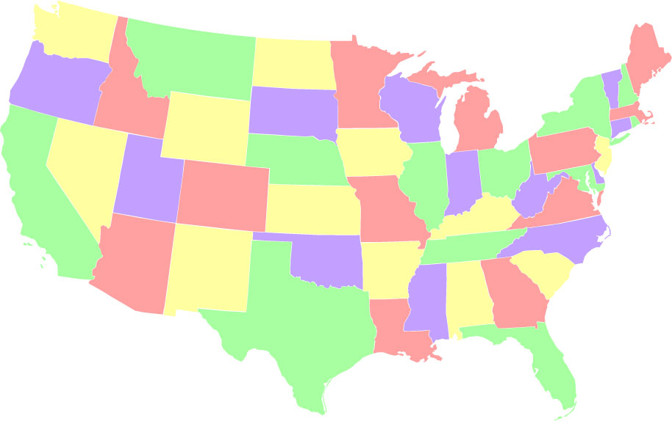
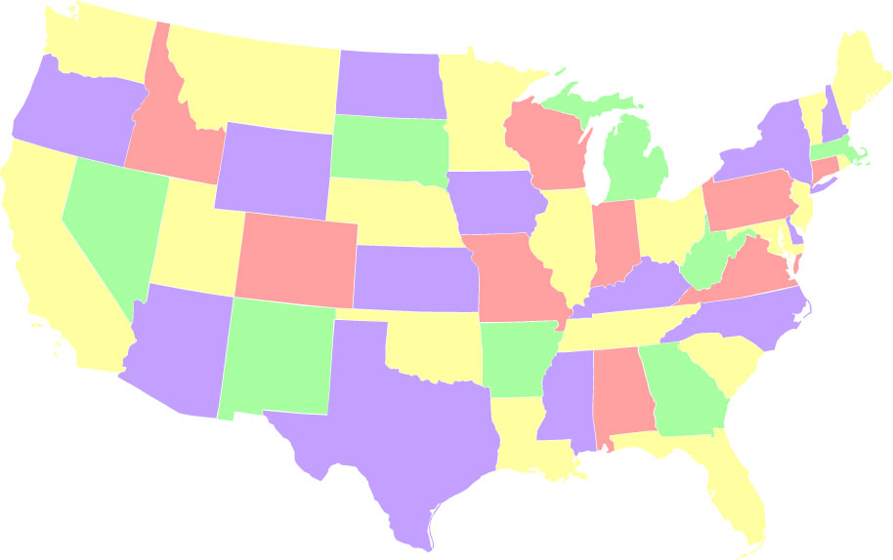
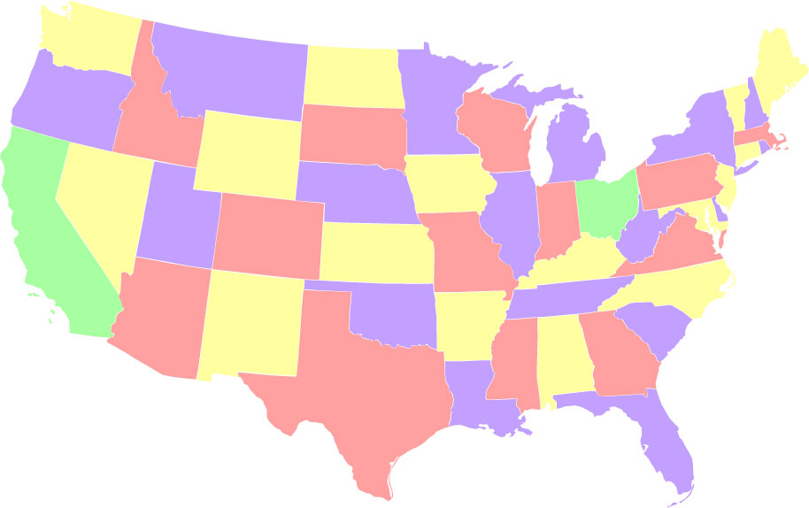
Can we Count?
Count proper 4-colorings?
533,816,322,048!
O(1)

Slide 3
Can we Count?
Count the num. of sols. to a 2-SAT instance?
Count the number of perfect matchings?
Counting ~ Random Sampling
Volume estimation, statistics, statistical physics.
Above problems are #P-hard
#P ~ NP in the counting world

Slide 4
Approximate Counting for #P
#P introduced by Valiant in 1979.
Don’t expect to solve #P-hard problems exactly. Duh.
How about approximating?
Want relative error: compute p such that

Slide 5
Approximate Counting for #P
Triggered counting through MCMC:
Permanent/Matchings: Jerrum, Sinclair 1988; Jerrum, Sinclair, Vigoda 2001
Volume estimation: Dyer, Frieze, Kannan 1989; Lovasz, Vempala 2003
Approximate Counting ~ Random Sampling
Jerrum, Valiant, Vazirani 1986
Does counting require randomness?

Slide 6
Deterministic Approximate Counting for #P?
Derandomizing simple complexity classes is important.
Primes is in P – Agarwal, Kayal, Saxena 2001
SL=L – Reingold 2005
Most previous work through sampling
Need new techniques for counting
Efficiency?
Examples: Weitz 06, Bavati et al. 07,
Ultimate Goal: Derandomize BPP …

Slide 7
Our Work
First deterministic approximate counting algorithm for Knapsack.
Near-linear time sampling.
Techniques of independent interest
Similar results for multi-dimensional knapsack, contingency tables.
Efficient algorithm for learning functions of halfspaces with small error.

Slide 8
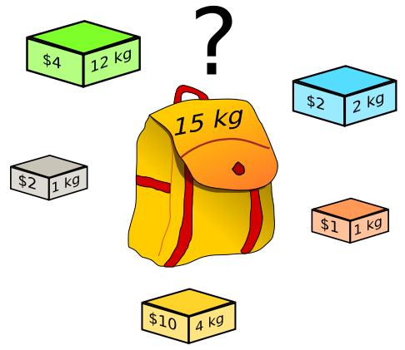
Knapsack
Weight could be exponential
Applications: Optimization,
Packing, Finance, Auctions

Slide 9
Counting for Knapsack
Estimate
Reference | Complexity
Dynamic programming
Dyer et al. 1993 | Randomized
Morris and Sinclair 1999 | Randomized
Dyer 2003 | Randomized

Slide 10

Counting for Knapsack
Efficient sampling: after a preprocessing phase each sample takes time O(n).
Deterministic algorithm for knapsack in time .

Slide 11
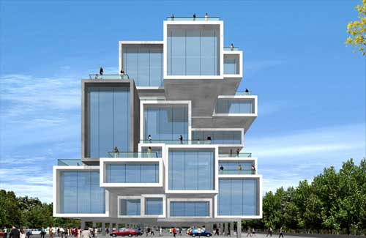
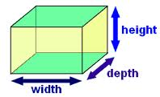
Multi-Dimensional Knapsack
Given , estimate

Slide 12

Multi-Dimensional Knapsack
Near linear-time sampling after preprocessing.
Previously: randomized analogues due to Morris and Sinclair, Dyer.
Thm: Deterministic counting algorithm for k-dimensional knapsack in time

Slide 13
Counting Contingency Tables
 | Right-handed | Left-handed | TOTALS
Males | 43 | 9 | 52
Females | 44 | 4 | 48
TOTALS | 87 | 13 | 100
 |  |  | TOTALS
 | ? | ? | 52
 | ? | ? | 48
TOTALS | 87 | 13 | 100
Dyer: randomized poly. time when rows constant.
This work: deterministic poly. time when rows constant

Slide 14
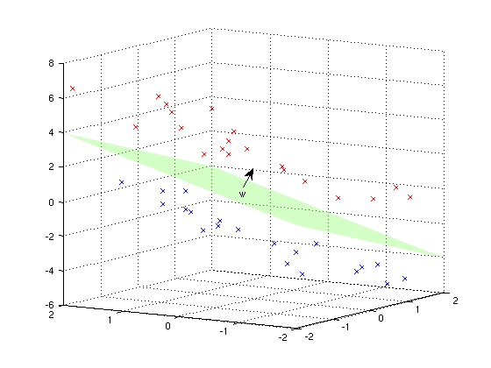

Learning Results: Halfspaces
Applications: Perceptrons, Boosting, Support Vector Machines

Slide 15
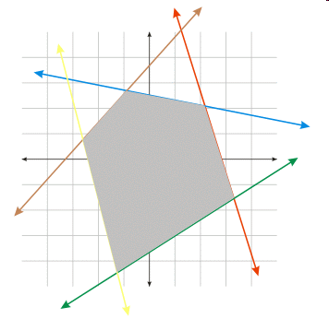
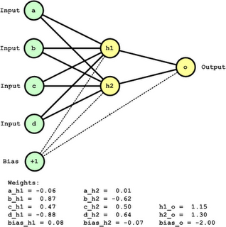

Functions of Halfspaces
Depth 2 Neural Networks
Intersections

Slide 16

Learning Functions of Halfspaces
Input: Uniformly random examples and labels.
Output: Hypothesis agreeing with f.
Query algorithm to learn functions of k halfspaces in time .
First algorithm for intersection
of two halfspaces.

Slide 17
Main Technique: Approximation by Branching Programs.
Explicitly construct a small-width approximating branching program.
Motivated by monotone trick of M. and Zuckerman 2010.

Slide 18
Read Once Branching Programs
Layered directed graph
vertices per layer
Edges between consecutive layers
Edges labeled
Input:
Output: Label of final vertex reached
n layers

Slide 19
Counting for ROBPs
Can count number of accepting solutions in
time by dynamic programming.
n layers

Slide 20
Knapsack computable by ROBPs
Can we use counting for ROBPs? No – width too large.
Our observation: Yes – reduce width by approximating.
n layers

Slide 21
Knapsack and Monotone ROBPs
Order vertices by partial sums
n layers

Slide 22
Approximating with Small Width
Intuition: Only need to know when acc. prob. increase.

Slide 23
Approximating ROBP: Rounding
Say we know when jumps occur. How about edges?
Round edges
Approximating: error-factor per layer is

Slide 24
Computing an Approximating ROBP
Build ROBP backwards with binary search.
Problem: Finding probabilities is another knapsack instance.
Solution: Build ROBP backward one layer at time.
When rounding layer i, already know the following layers.

Slide 25
Thank You

