Slide 1

Recent Progress in Derandomization
Raghu Meka
Oberwolfach, Nov 2012

Slide 2
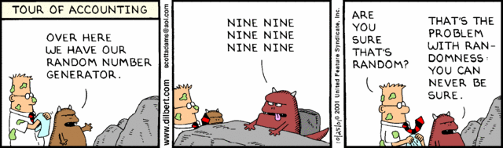
Can we generate random bits?

Slide 3

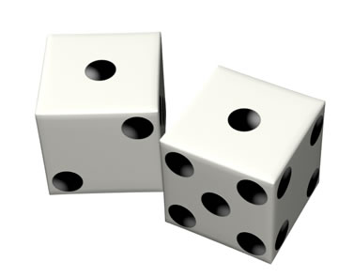
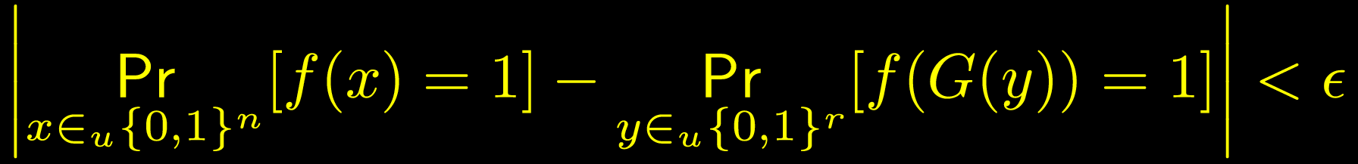
Pseudorandom Generators
Stretch bits to fool a class of “test functions” F

Slide 4
Can we generate random bits?
Complexity theory, algorithms, streaming
Evidence suggests P=BPP!
Hardness vs Randomness: BMY83, NW94, IW97
Unconditionally? Duh.

Slide 5






Can we generate random bits?
Restricted models: bounded depth circuits (AC0), bounded space algorithms
Nis91, Bazzi09, B10, …
Nis90, NZ93, INW94, …

Slide 6
Outline
I. PRGs for small space
II. PRGs for bounded-depth
III. Deterministic approximate counting
Omitting many others

Slide 7




Read Once Branching Programs
W
Layered graph
$W$ vertices each
Edges: $0,1$
Input: $\left(x_{1},…, x_{n}\right)$
Output: final vertex reached.
$$…$$
n layers
$$\left(W,n\right)−ROBP$$

Slide 8



PRGs for ROBPs
Nis90, INW94: PRGs for poly. width with seed $O(\log^{2}{n)}$.
Central challenge: RL = L?
PRGs for poly-width ROBPs?
W
$$…$$
n layers

Slide 9
Small Space: Recent results
1. PRGs for garbled ROBPs
IMZ12: PRGs from shrinkage.
2. PRGs for combinatorial rectangles
GMRTV12: (mild)random restrictions

Slide 10








PRGs for Garbled ROBPs
Earlier model assumes order of bits known
What if not? Nisan, INW break!
BPW11: PRG with seed .8n.
IMZ12: PRG for garbled ROBPs with seed $\tilde{O}(\sqrt{nW})$.
$$x_{5}$$
$$x_{1}$$
$$x_{7}$$
$$x_{1}$$
W
$$x_{2}$$
$$x_{n}$$
$$…$$
n layers

Slide 11
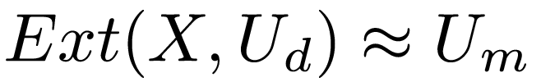

An Old New PRG
Use Nisan-Zuckerman96 PRG
Input: $x$, $y_{1},y_{2},…, y_{T}$
Output:
$Ext\left(x,y_{1}\right)∘Ext\left(x,y_{2}\right)∘⋯∘Ext\left(x,y_{T}\right)$
Recycling x’s randomness.
(if X has high min-entropy)

Slide 12




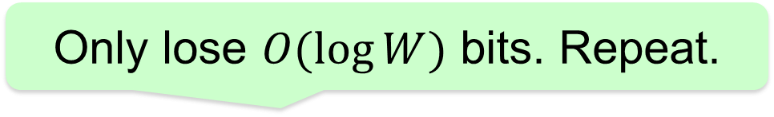
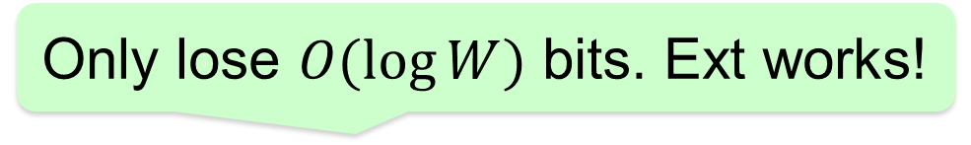
Nisan-Zuckerman PRG
No problems here
Only lose $O(\log{W)}$ bits. Ext works!
Only lose $O(\log{W)}$ bits. Repeat.
W

Slide 13




Garbled ROBPs?
Condition on $E\left(x,y_{1}\right):$ G$ive |E\left(x,y_{1}\right)|$ transitions.
Entropy loss: $O(\left|E\left(x,y_{1}\right)\right| (w\log{w))}.$Repeat.
W
Notes:
One line explanation of parameters

Slide 14


Garbled ROBPs?
Balance: $\left|E\left(x,y\right)\right| T=n,$ bits used $\sim \left|E\left(x,y\right)\right|+T.$
IMZ12: PRG for garbled ROBPs with seed $\tilde{O}(\sqrt{nW})$.
W
Much more: Pseudorandomness from “shrinkage”

Slide 15

Garbled ROBPs
Better seed? NZ recurse. We cannot.
Challenge 1: PRGs for garbled ROBPs with seed $poly(\log{n)}$?

Slide 16
Small Space: Recent results
1. PRGs for garbled ROBPs
IMZ12: PRGs from shrinkage.
2. PRGs for combinatorial rectangles
GMRTV12: (mild)random restrictions

Slide 17

Combinatorial Rectangles
Applications: Number theory, analysis, integration, hardness amplification

Slide 18
PRGs for Comb. Rectangles
Small set preserving volume
Volume of rectangle
~ Fraction of positive PRG points

Slide 19


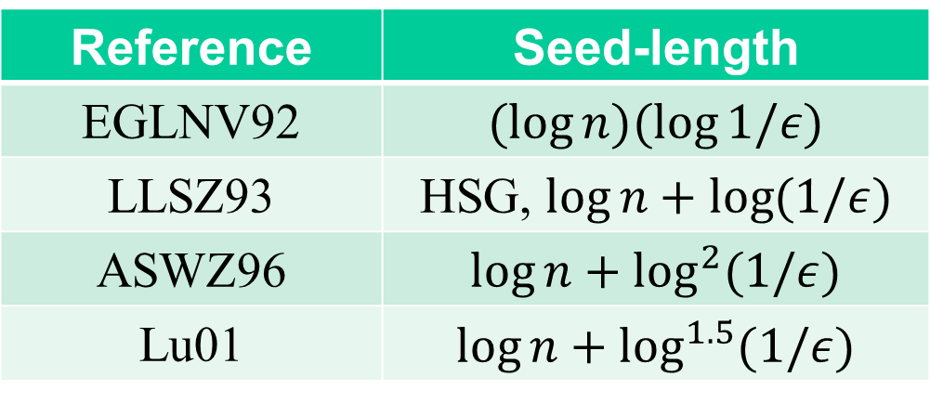
PRGs for Combinatorial Rectangles
GMRTV12: PRG for comb. rectangles with seed .
Non explicit: $O(log (n/ε))$
Reference | Seed-length
EGLNV92
LLSZ93
ASWZ96
Lu01

Slide 20
Outline
I. PRGs for small space
II. PRGs for bounded-depth
III. Deterministic approximate counting

Slide 21






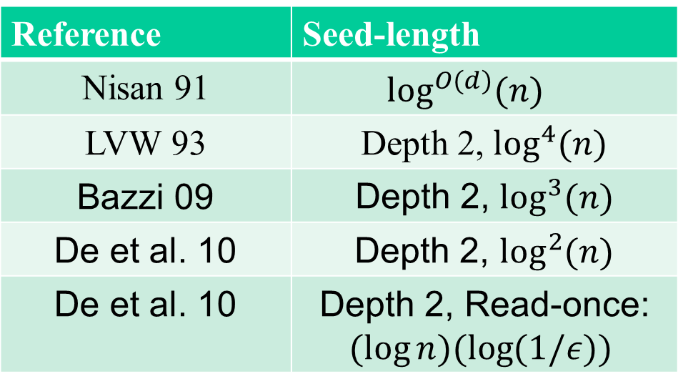

PRGs for AC0
Reference | Seed-length
Nisan 91
LVW 93
Bazzi 09
DETT 10
DETT 10
For polynomially small error best was
$\log^{2}{n }$even for read-once CNFs.

Slide 22
Why Small Error?
Because we “should” be able to
Symptomatic: const. error for large depth implies poly. error for smaller depth
Applications: algorithmic derandomizations, complexity lowerbounds

Slide 23
Small Error: GMRTV12
1. PRG for comb. rectangles with seed .
2. PRG for read-once CNFs with seed .
New generator: iterative application of mild random restrictions.

Slide 24




Now: PRG for RCNFs
Thm: PRG for read-once CNFs with seed .
Non explicit: $O(log (n/ε))$

Slide 25

Random Restrictions
Switching lemma – Ajt83, FSS84, Has86
*
1
0
0
1
0
0
*
*
*
*
*
*
*
*

Slide 26
PRGs from Random Restrictions
AW85: Use “pseudorandom restrictions”.
*
*
*
*
*
*
*
*
*
Problem: No strong derandomized switching lemmas.

Slide 27
Mild Psedorandom Restrictions
Restrict half the bits (pseudorandomly).
0 0 0
0 0 1
0 0 0
* * *
* * *
* * *
* * *
* * *
* * *
Simplification: “average function” can be fooled by small-bias spaces.

Slide 28

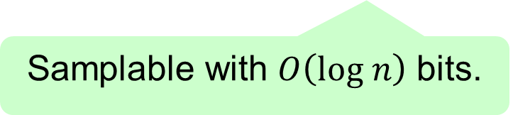

Full Generator Construction
Pick half using almost k-wise
* *
* * * *
* * * * * * * *
Small-bias
Small-bias
Small-bias
Repeat $O(\log{\log{n) }}times.$
Randomness: $O((\log{n)(\log{\log{n)).}}}$
Thm: PRG for read-once CNFs with seed .
Notes:
Mention why log log n

Slide 29
Interleaved Small-Bias Spaces
What else can the generator fool?
Combining small-bias spaces powerful
PRGs for GF2 polynomials (BV, L, V)
Challenge 2 (RV): XOR of two small-bias fools Logspace?
Question: XOR of several small-bias fools Logspace? How about interleaved?

Slide 30
Outline
I. PRGs for small space
II. PRGs for bounded-depth
III. Deterministic approximate counting

Slide 31
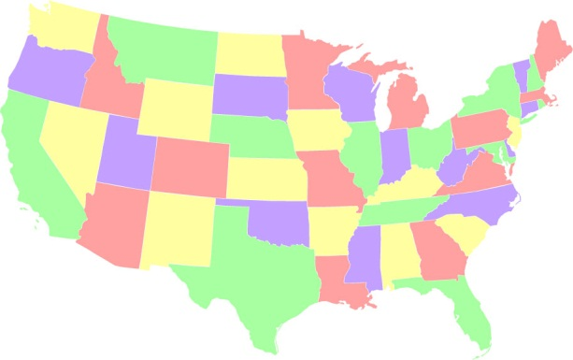
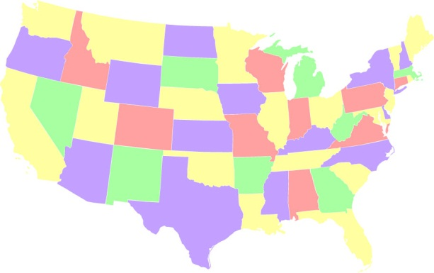
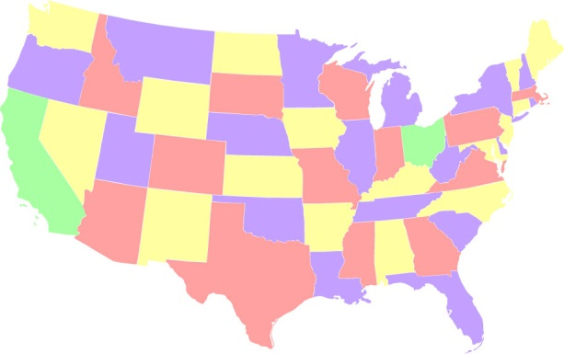
Can we Count?
Count proper 4-colorings?
533,816,322,048!
O(1)

Slide 32
Can we Count?
Count satisfying solutions to a 2-SAT formula?
Count satisfying solutions to a DNF formula?
Count satisfying solutions to a CNF formula?
Seriously?

Slide 33
Counting vs Deciding
Counting interesting even if solving “easy”.
Four colorings: Always solvable!

Slide 34
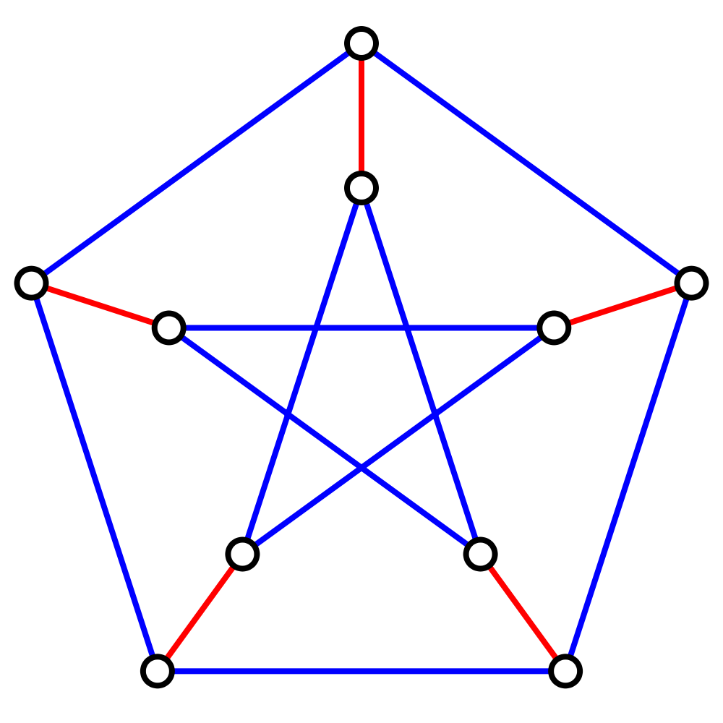
Counting vs Solving
Counting interesting even if solving “easy”.
Matchings
Solving – Edmonds 65
Counting = Permanent (#P)

Slide 35
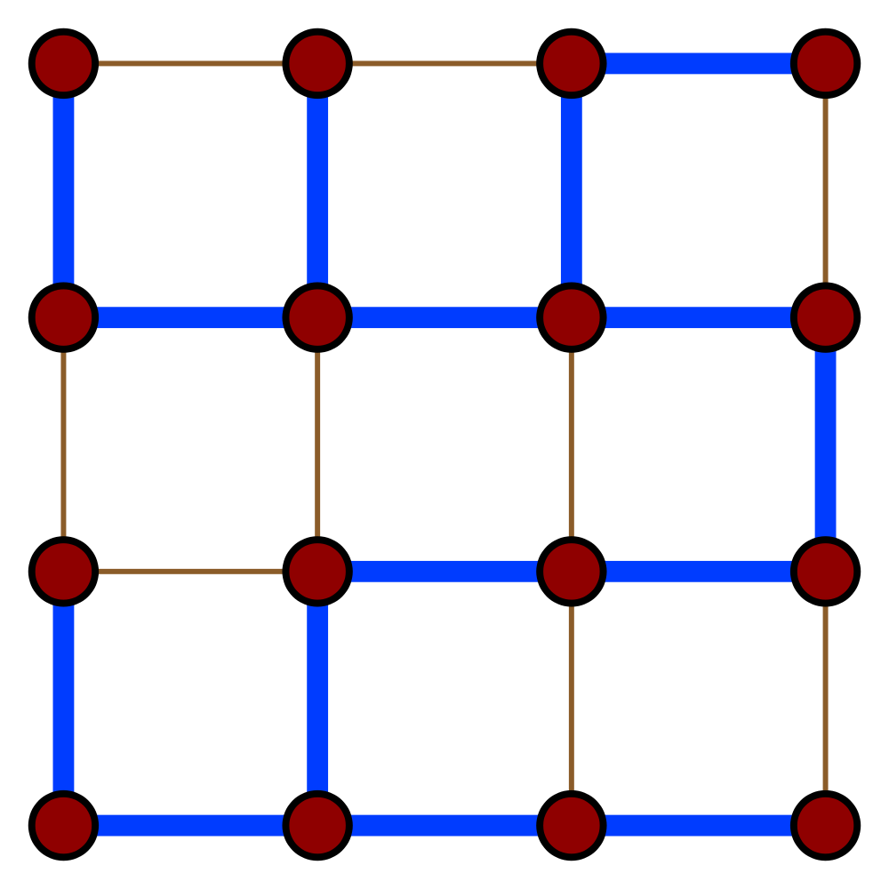
Counting vs Solving
Counting interesting even if solving “easy”.
Spanning Trees
Counting/Sampling:
Kirchoff’s law, Effective resistances

Slide 36
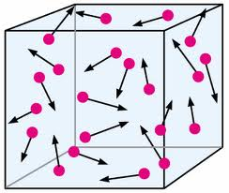
Counting vs Solving
Counting interesting even if solving “easy”.
Thermodynamics = Counting

Slide 37
Counting for CNFs/DNFs
INPUT: CNF f
OUTPUT: No. of
accepting solutions
INPUT: DNF f
OUTPUT: No. of
accepting solutions
#CNF
#DNF
#P-Hard

Slide 38
Counting for CNFs/DNFs
INPUT: CNF f
OUTPUT: Approximation
for No. of solutions
INPUT: DNF f
OUTPUT: Approximation for No. of solutions
#CNF
#DNF

Slide 39

Approximate Counting
Additive error: Compute p
Focus on additive for good reason

Slide 40
Why Deterministic Counting?
#P introduced by Valiant in 1979.
Can’t solve #P-hard problems exactly. Duh.
Approximate Counting ~ Random Sampling
Jerrum, Valiant, Vazirani 1986
Triggered counting through MCMC:
Eg., Matchings (Jerrum, Sinclair, Vigoda 01)
Does counting require randomness?
CNFs/DNFs as simple as they get

Slide 41
Counting for CNFs/DNFs
Karp, Luby 83 – counting for DNFs
Reference | Run-Time
Ajtai, Wigderson 85 | Sub-exponential
Nisan, Wigderson 88 | Quasi-polynomial
Luby, Velickovic, Wigderson
Luby, Velickovic 91 | Better than quasi, but worse than poly.

Slide 42

New results: GMR12
Main Result: A
deterministic algorithm.
New structural result on CNFs
Strong “junta theorem’’ for CNFs

Slide 43

Counting Algorithm
Step 1: Reduce to small-width
Same as Luby-Velickovic
Step 2: Solve small-width directly
Structural result: width buys size

Slide 44






Width vs Size
Size does not depend on n or m!
How big can a width w CNF be?
Ex: can width = O(1), size = poly(n)?
Recall: width = max-length of clause
size = no. of clauses

Slide 45
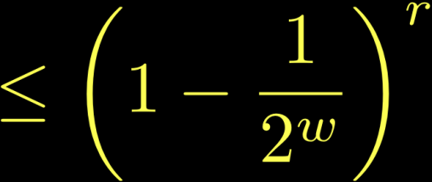

Proof of Structural result
Observation 1: Many disjoint clauses =>
small acceptance prob.

Slide 46




Proof of Structural result
2: Many clauses => some (essentially) disjoint
Assume no negations.
Clauses ~ subsets of variables.
Petals
(Core)

Slide 47
Proof of Structural result
2: Many clauses => some (essentially) disjoint
Many small sets => Large

Slide 48




Lower Sandwiching CNF
Error only if all petals satisfied
k large => error small
Repeat until CNF is small

Slide 49

Upper Sandwiching CNF
Error only if all petals satisfied
k large => error small
Repeat until CNF is small

Slide 50


Main Structural Result
Setting parameters properly:
“Quasi-sunflowers” (Rossman 10) with appropriately adapted analysis:
Suffices for counting result.
Not the dependence we promised.

Slide 51
Implications of Structural Result
PRGs for narrow DNFs
DNF Counting

Slide 52


PRGs for Narrow DNFs
Sparsification: Fooling small-width ~ fooling small-size.
Small-bias fools small size: DETT10 (Baz09, KLW10).
Previous best (AW85, Tre01):
Thm: PRG for width w with seed

Slide 53
Counting Algorithm
Step 1: Reduce to small-width
Same as Luby-Velickovic
Step 2: Solve small-width directly
Structural result: width buys size
PRG for width w with seed

Slide 54
Counting for AC0
Q: Deterministic polynomial time algorithm for #CNF? PRG?
Q: Better counting for AC0?

Slide 55
Approximate Counting
Not many deterministic (ex: Weitz, Gavinsky)
Want something general for MCMC
Challenge/Question: Deterministic approximate counting of matchings (permanent)? Or hardness?
LSW: Polynomial time $e^{n}$ factor approximation

Slide 56
Summary
I. PRGs for small space
II. PRGs for bounded-depth
III. Deterministic approximate counting

Slide 57
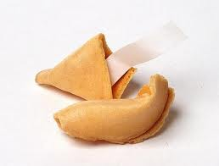
Thank you
“The best throw of the die is to throw it away”
-

