Slide 1
Shorter Long Codes and Applications to Unique Games
Raghu Meka (IAS, Princeton)
Boaz Barak (MSR, New England)
Parikshit Gopalan (MSR, SVC)
Johan Håstad (KTH)
Prasad Raghavendra (GA Tech)
David Steurer (MSR, New England)

Slide 2
Is Unique Games Conjecture true?
UGC ~ Hardness of a certain CSP
Settles longstanding open problems in approximation algorithms
E.g., Max-Cut, vertex cover
Interesting even if not
Integrality gaps: Khot-Vishnoi’04.

Slide 3


Is Unique Games Conjecture true?
Fastest algorithm [ABS10]: .
Source of gap:
Long code is actually quite long!
Huge Gap!
Best evidence: lowerbound
in certain models.
[Khot-Vishnoi’04, Khot-Saket’09, Raghavendra-Steurer’09]
Captures ABS algorithm – BRS11, GS11.
Best algorithms for most problems!
E.g., Max-Cut, Sparsest-Cut.

Slide 4

Our Result
Main: Exponentially more efficient “replacement” for long code.
Preserves main properties: Fourier analysis, dictatorship testing etc.
Not necessarily a blackbox replacment.

Slide 5
Is Unique Games Conjecture true?
Fastest algorithm [ABS10]: .
Smaller gap …
This Work: Near quasi-polynomial
lowerbounds in certain models.

Slide 6
Outline of Talk
1. Applications of short code
2. Small set expanders with many large eigenvalues
Construction and analysis

Slide 7
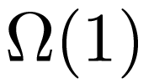

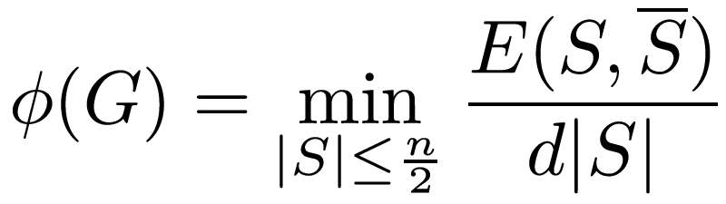

Application I: Expansion vs Eigenvalue Profiles
1
S
Cheeger Inequalities
Expansion:
Spectral:

Slide 8
Small Set Expansion
Complete graph
Complete graph
Dumbell graph: not expanding
… Is it really?
Small sets expand!

Slide 9
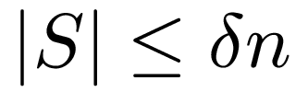

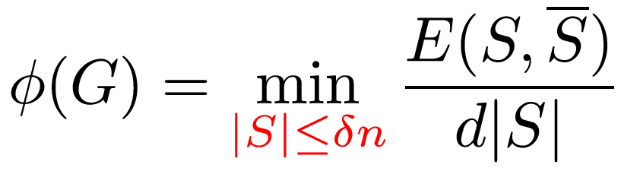
Small Set Expansion (SSE)
1
S
When is a graph SSE?
Interesting by itself
Closely tied to Unique Games – RS10
Spectral:
???

Slide 10



Small Set Expansion (SSE)
1
Core of ABS algorithm for Unique Games
S
Arora-Barak-Steurer’10
Spectral:
Atmost eigenvalues larger than .

Slide 11
Small Set Expansion
Question: How many large eigenvalues can a SSE have?
BAD CUT
Small sets expand
“Many” bad balanced cuts
BAD CUT
Small set
BAD CUT

Slide 12
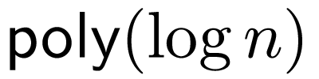

Small Set Expansion
Question: How many large eigenvalues can a SSE have?
Corollary: Rules out quasi-polynomial run time for ABS algorithm.
Previous best: Noisy cube – .
Our Result: A SSE with
large eigenvalues.

Slide 13
Application II: Efficient Alphabet Reduction
MAX-CUT
Given G find S maximizing E(S,S^{c})
Goemans-Williamson: 0.878 approximation
KKMO’04 + MOO’05: UGC true -> 0.878 tight!

Slide 14


Application II: UGC hardness for Max-CUT
KKMO’04 + MOO’05: UGC true -> 0.878 tight!
Are we done? (Short of proving UGC …)
KKMO+MOO
UGC with n vars
alphabet size k
MAX-CUT of size

Slide 15

Application II: Efficient Alphabet Reduction
Linear UG with n vars
alphabet size k
MAX-CUT of size
MAX-CUT is a UG instance with k = 2

Slide 16
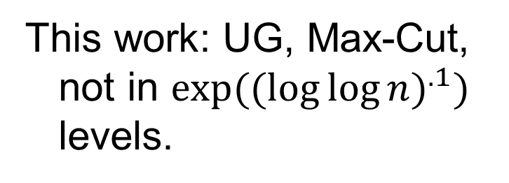
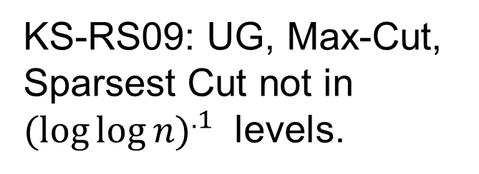
Application III: Integrality Gaps
SDP Hierarchies: Powerful paradigm for optimization problems.
Which level suffices?
Basic SDP
This work: UG, Max-Cut,
not in $exp((\log{\log{n)^{.1}) }}$
levels.
KS-RS09: UG, Max-Cut,
Sparsest Cut not in
$(\log{\log{n)^{.1} }}$ levels.
KV04: UG, Max-Cut,
Sparsest Cut not in
O(1) levels.
No. Variable Levels
Optimal Solution
Eg: SDP+SA, LS, LS+, Lasserre, …
SDP + SA

Slide 17
Outline of Talk
1. Applications of short code
2. Small set expanders with many large eigenvalues
Construction and analysis

Slide 18
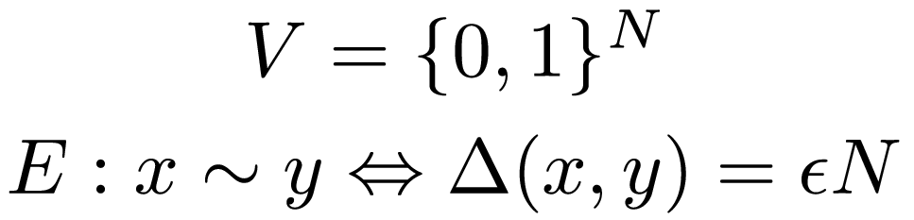
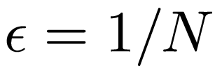
Long Code and Noisy Cube
Long code: Longest code imaginable
Work with noisy cube – essentially the same
Eg., is hypercube

Slide 19
Noisy Cube is an SSE
Thm: Noisy cube is a SSE.
Powerful: implies KKL for instance
Our construction “sparsifies” the noisy cube

Slide 20
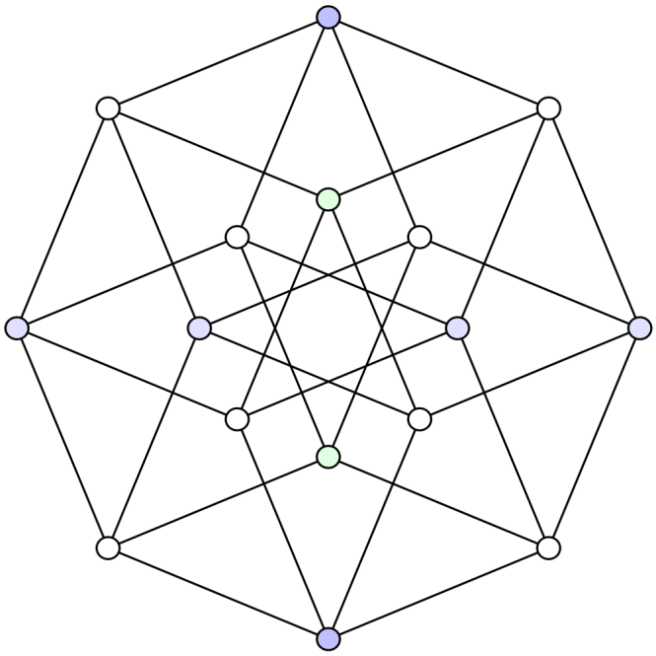
Better SSEs from Noisy Cube
Idea: Find a subgraph of the noisy cube.
Natural approach: Random subset
Complete failure: No edges!
Our Approach: pick a linear code
Need: bad rate, not too good distance!
But not too bad…
want local testablity of dual

Slide 21
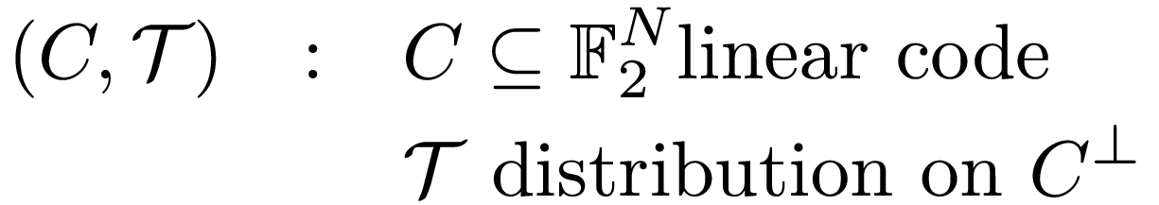
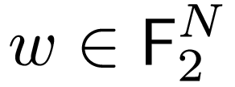

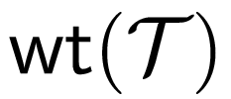
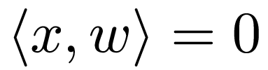
Locally Testable Codes
Testing
Parameters
Input:
Distance: D
Pick
Query Comp.:
Accept if
Good soundness:

Slide 22
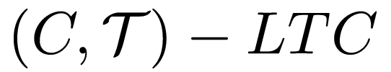

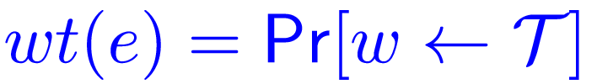



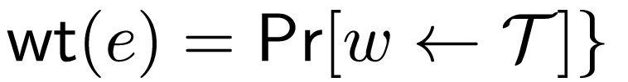
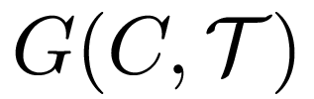
SSEs from LTCs
Given

Slide 23




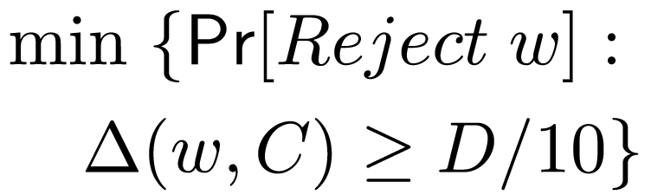


SSEs from LTCs
Thm: Given If
Symmetry across coordinates.
Fraction of non-zero coordinates.

Slide 24



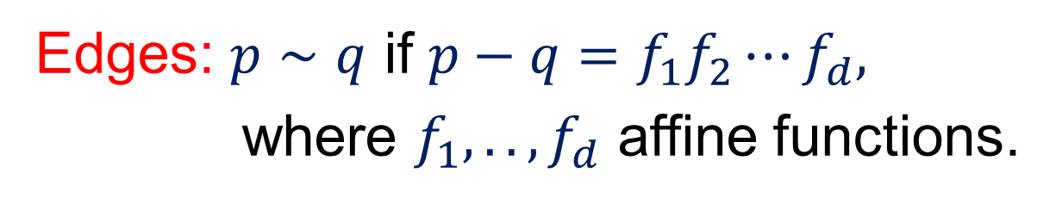
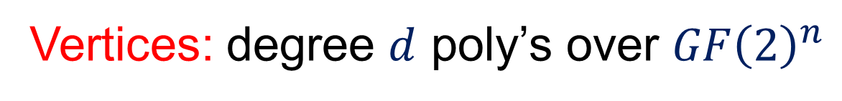
SSEs from RM Codes
Instantiate with Reed-Muller (RM) Codes
C = RM code of degree $n−d−1.$
Dual = RM of degree $d$
Testability: Batthacharya-Kopparty-Schoenbeck-Sudan-Zuckerman’10
Vertices: degree $d$ poly’s over $GF{\left(2\right)}^{n}$
Edges: $p∼q$ if $p−q=f_{1}f_{2}⋯f_{d},$
where $f_{1},..,f_{d}$ affine functions.
Thm: Graph has vertices and large eigenvalues and is a SSE.

Slide 25
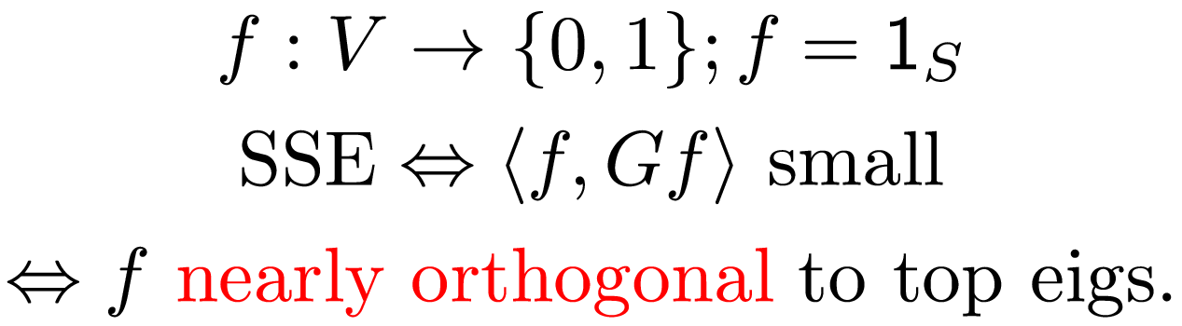
Analyzing expansion
When do small sets expand?
Need: Indicators of small sets are far from span of top eigenvectors
First analyze noisy cube.

Slide 26
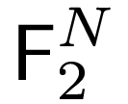

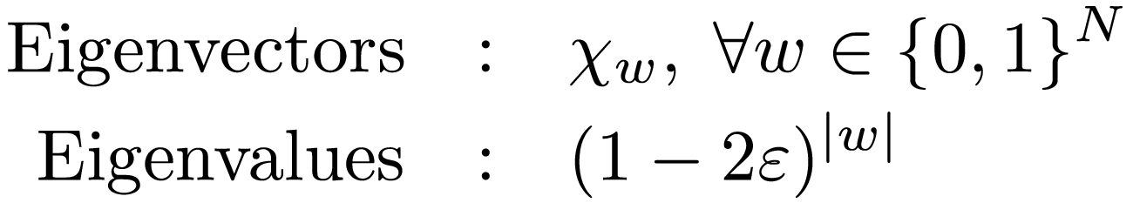


Analyzing expansion for noisy cube
Is (essentially) a Cayley graph.
Eigenvectors: Characters of
Need: Indicators of small sets far from span of low-weight characters
N eigenvalues
Exponential decay:
Large eig. -> weight small
Eigenvalues
Follows from (2,4)-hypercontractivity!
0 1 2
Hamming weight

Slide 27
SSEs from LTCs
SSE for Noisy Cube
SSE for
Eigenvecs -> Characters
Large eval -> low-weight
(2,4)-Hypercontractivity
Cayley Graph
Local Testability
K-wise independence

Slide 28
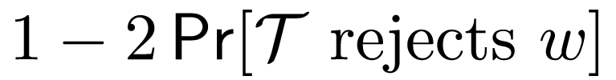
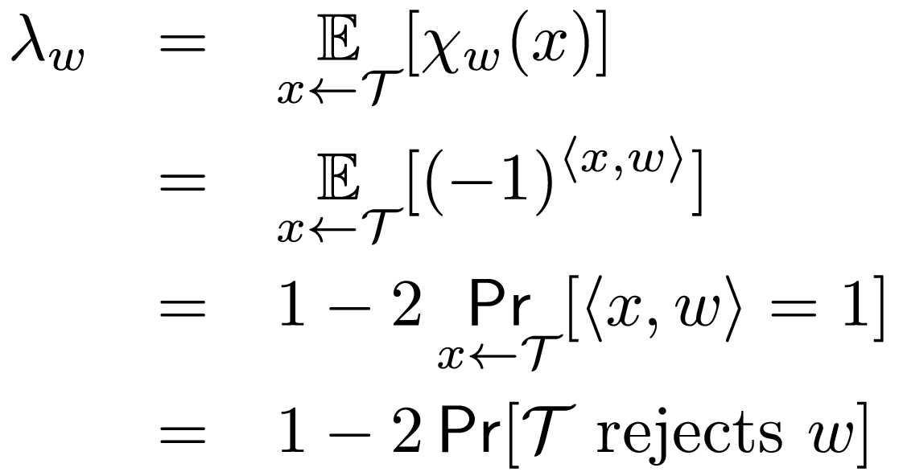

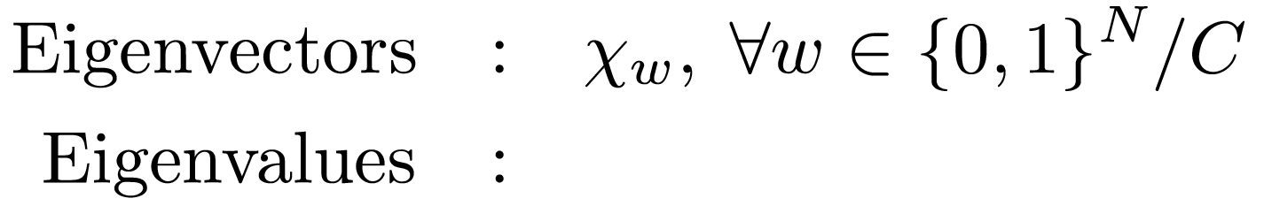
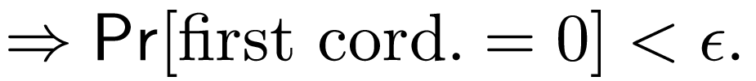
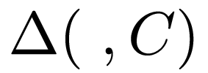

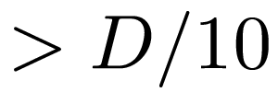

Proof of Expansion
Edges of :
A Cayley graph!
$$χ_{w}\left(x\right)={\left(−1\right)}^{〈w, x〉}$$
Soundness of
Smoothness, low query com. of
N eigenvalues
Threshold decay:
Large eig. -> “weight” small
Eigenvalues
0 1 2

Slide 29

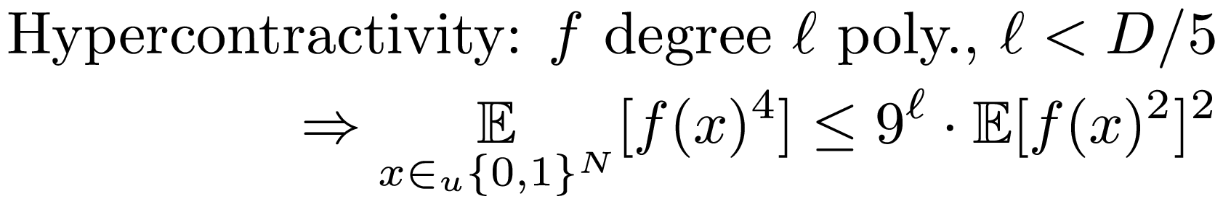
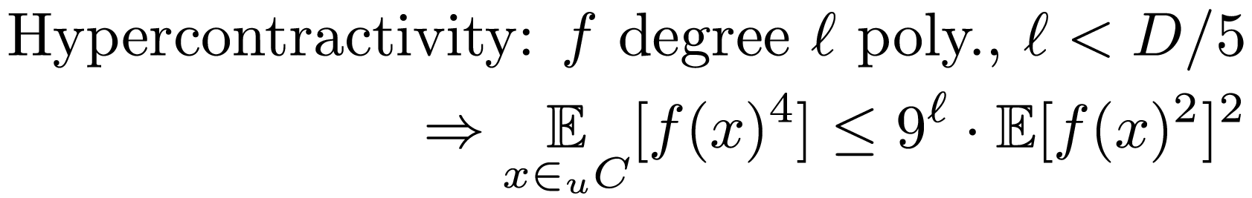

Proof of Expansion
SSE for Noisy Cube
SSE for
Eigenvecs -> Characters
Large eval -> low-weight
(2,4)-Hypercontractivity
Cayley Graph
Local Testability
K-wise independence
Fact: is (D-1)-wise independent.
QED.

Slide 30
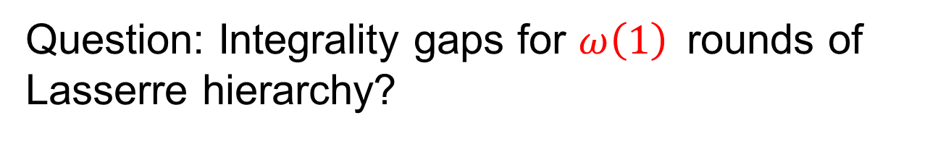
Open Problems
Prove/refute the UGC
Proof: Larger alphabets?
Refute: Need new algorithmic ideas or maybe stronger SDP hierarchies
Question: Integrality gaps for $ω\left(1\right)$rounds of Lasserre hierarchy?
Very recent work - Barak, Harrow, Kelner, Steurer, Zhou :
Lasserre(8) breaks current instances!

Slide 31
Open Problems
Is ABS bound for SSE tight?
Need better LTCs

Slide 32
Thank you

Slide 33
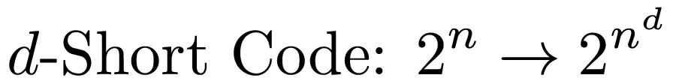

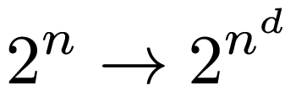
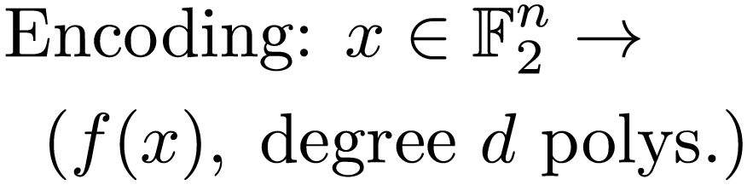
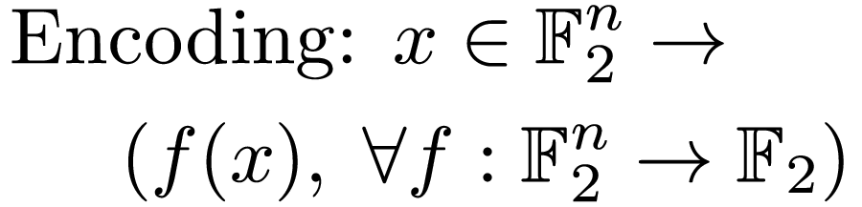
Take Home …
Using Long code? Try the “Short code” …
Long Code | d-Short Code
Dict. testing: Noisy cube | Dict. testing: RM tester
Analysis: Maj. is stablest | Analysis: SSE, Maj. is stablest

Slide 34
Sketch for Other Applicatons
Dictatorship testing for long code/noisy cube
[Kahn-Kalai-Linial’88, Friedgut’98, Bourgain’99, Mossel-O’Donnel-Oleszkiewicz’05], ...
Focus on MOO: Majority is Stablest
Invariance principle for low-degree polynomials

Slide 35

MOO’05: Invariance principle for Polynomials
P multilinear, no variable influential.
Need . Can’t prove in general …
… but true for RM code!
Corollary: Majority is stablest over RM codes.
Corollary: Alphabet reduction with quasi-polynomial blowup.
RM codes fool polynomial threshold functions
PRG for PTFs [M., Zuckerman 10].

Slide 36
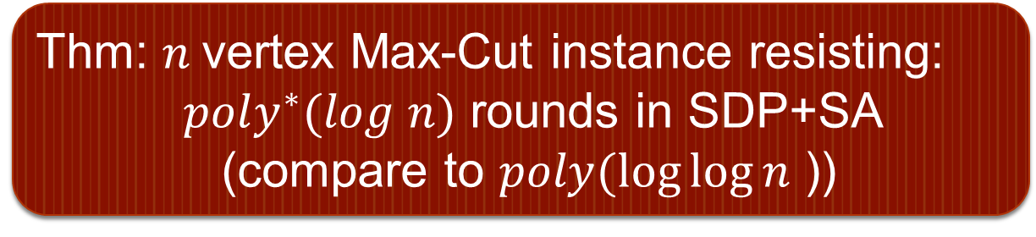
Integrality Gaps for Unique Games, MAX-CUT
Idea: Noisy cube -> RM graph in [Khot-Vishnoi’04], [KKMO’05] etc.,
Analyze via Raghavendra-Steurer’09
Thm: $n$vertex Max-Cut instance resisting:
$poly^{∗}(log n)$ rounds in SDP+SA (compare to $poly(\log{\log{n}}$ ))

