Slide 1
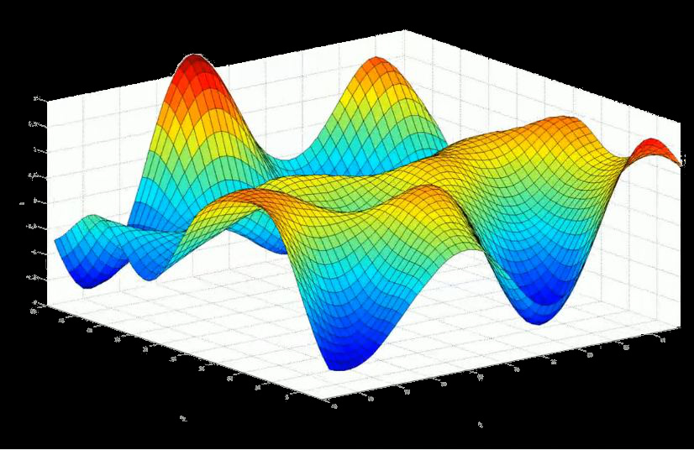
A PTAS for Computing the Supremum of Gaussian Processes
Raghu Meka (IAS/DIMACS)

Slide 2

Gaussian Processes (GPs)
Jointly Gaussian variables $({\left(X_{t}\right)}_{\left\{t∈T\right\}})$:
Any finite sum is Gaussian

Slide 3


Supremum of Gaussian Processes (GPs)
Given $\left({\left(X_{t}\right)}_{\left\{t∈T\right\}}\right)$ want to study

Slide 4
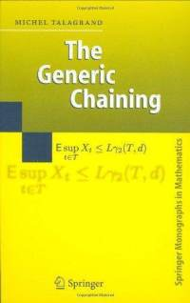

Why Gaussian Processes?
Stochastic Processes
Functional analysis
Convex Geometry
Machine Learning
Many more!

Slide 5


Cover times of Graphs
Aldous-Fill 94: Compute cover time deterministically?
Fundamental graph parameter
Eg: $cov\left(K_{n}\right)=Θ(n\log{n)}$
$cov\left(Grid\right)=Θ(n\log^{2}{n)}$
KKLV00: $O((log{{\log{n)}}^{2}) }$approximation
Feige-Zeitouni’09: FPTAS for trees

Slide 6


Cover Times and GPs
Thm (Ding, Lee, Peres 10): O(1) det. poly. time approximation for cover time.
Transfer to GPs
Compute supremum of GP
Thm (DLP10): Winkler-Zuckerman “blanket-time” conjectures.

Slide 7






Computing the Supremum
Question (Lee10, Ding11): PTAS for computing the supremum of GPs?
Question (Lee10, Ding11): Given $V⊆R^{d}$, compute a $\left(1+ε\right)$ factor approx. to
$$\sup{X_{t}}$$
Covariance matrix
More intuitive
$$v_{2}$$
$$v_{1}$$
$$0$$
Random
Gaussian

Slide 8
Computing the Supremum
Question (Lee10, Ding11): Given $V⊆R^{d}$, compute a $\left(1+ε\right)$ factor approx. to
DLP10: O(1) factor approximation
Can’t beat O(1): Talagrand’s majorizing measures

Slide 9

Main Result
Thm: A PTAS for computing the supremum of Gaussian processes.
Thm: Given $V⊆R^{d}$, a $d^{O\left(1\right)}{\left|V\right|}^{O_{ε}\left(1\right)}$ det. algorithm to compute $\left(1+ε\right)$ approx. to
Thm: PTAS for computing cover time of bounded degree graphs.
Comparison inequalities from convex geometry

Slide 10
Outline of Algorithm
1. Dimension reduction
Slepian’s Lemma, Johnson-Lindenstrauss
2. Optimal eps-nets in Gaussian space
Kanter’s lemma, univariate to multivariate

Slide 11

Dimension Reduction
Idea: JL projection, solve in projected space
Use deterministic JL – EIO02, S02.
V
$V⊆R^{d}$
$W=Proj\left(V\right)⊆R^{k}$,
$k=O(log\left|V\right|/ε^{2})$.
W

Slide 12

Analysis: Slepian’s Lemma
$$W=Proj\left(V\right)$$
Problem: Relate supremum of projections

Slide 13
Analysis: Slepian’s Lemma
$$W=Proj\left(V\right)$$
Enough to solve for W
Enough to be exp. in dimension

Slide 14
Outline of Algorithm
1. Dimension reduction
Slepian’s Lemma, Johnson-Lindenstrauss
2. Optimal eps-nets in Gaussian space
Kanter’s lemma, univariate to multivariate

Slide 15


Nets in Gaussian Space
Goal: $W⊆R^{k}$, in time $\exp\left(k\right)$ approximate
We solve the problem for all semi-norms

Slide 16
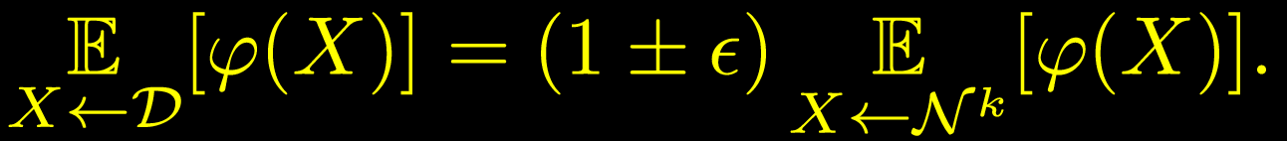


Nets in Gaussian space
Discrete approximations of Gaussian
Explicit
Integer rounding: $k^{O\left(k\right)}$(need granularity $1/√k$)
Dadusch-Vempala’12: $(log{{k)}^{O\left(k\right)}}$
Main thm: Explicit $ε$-net of size $(1/{ε)}^{O\left(k\right)}$.
Optimal: Matching lowerbound

Slide 17



Construction of eps-net
Simplest possible: univariate to multivariate
$$k$$
$$k$$
What resolution? Naïve: $1/√k$.
How far out on the axes?

Slide 18







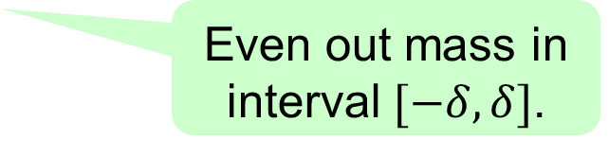


Construction of eps-net
Analyze ‘step-wise’ approximator
Even out mass in interval $[−δ, δ]$.
$$−4δ$$
$$−3δ$$
$$−2δ$$
-$δ$
$$δ$$
$$2δ$$
$$3δ$$
$$4δ$$
$γ_{u}$

Slide 19












Construction of eps-net
Take univariate net and lift to multivariate
$$k$$
$$k$$
$$γ$$
$$−4δ$$
$$−3δ$$
$$−2δ$$
-$δ$
$$δ$$
$$2δ$$
$$3δ$$
$$4δ$$
$$γ_{u}$$
What resolution $δ$ enough?
What resolution? Naïve: $1/√k$.
How far out on the axes?
Main Lemma: Can take $δ\sim f(ε).$

Slide 20











Dimension Free Error Bounds
Lem: For $δ\sim ε^{1.5}$, $φ$ a norm,
Proof by “sandwiching”
Exploit convexity critically
$$γ$$
$$−4δ$$
$$−3δ$$
$$−2δ$$
-$δ$
$$δ$$
$$2δ$$
$$3δ$$
$$4δ$$
$$γ_{u}$$

Slide 21





Analysis of Error
Def: Sym. $μ, ν.$ $μ≼ν$ (less peaked), if $∀$ sym. convex sets K$,$
$μ\left(K\right)≤ν\left(K\right).$
Why interesting? For any norm,

Slide 22

Sandwiching and Lifting Nets
Fact: $γ_{u}≼γ.$
Proof:
Spreading away from origin!
$$−4δ$$
$$−3δ$$
$$−2δ$$
-$δ$
$$δ$$
$$2δ$$
$$3δ$$
$$4δ$$

Slide 23







Sandwiching and Lifting Nets
Fact: By definition,
Cor: By Kanter’s lemma,
$$k$$
$$k$$
$γ_{u}$
$$γ_{ }$$
Kanter’s Lemma(77): and unimodal,
Cor: Upper bound,

Slide 24



Sandwiching and Lifting Nets
Fact: $γ≼γ_{ℓ}.$
Proof: For $δ≪ε,$inward push compensates earlier spreading.
Def: $γ_{ℓ}=$scaled down version of $γ_{u}.$
$X←γ_{u}$, $Y=\left(1−ε\right)X$, $γ_{ℓ}=$pdf of $Y$.
Push mass towards origin.
$γ_{ℓ}$

Slide 25



Sandwiching and Lifting Nets
Fact: By definition,
Cor: By Kanter’s lemma,
$$k$$
$$k$$
$$γ$$
$${γ_{ℓ}}_{ }$$
Kanter’s Lemma(77): and unimodal,
Cor: Lower bound,

Slide 26








Sandwiching and Lifting Nets
Combining both:
$$k$$
$$k$$
$$k$$
$γ_{u}$
$$γ_{ }$$
$${γ_{ℓ}}_{ }$$

Slide 27
Outline of Algorithm
1. Dimension reduction
Slepian’s Lemma
2. Optimal eps-nets for Gaussians
Kanter’s lemma
PTAS for Supremum

Slide 28
Open Problems
FPTAS for computing supremum?
Black-box algorithms?
JL step looks at points
PTAS for cover time on all graphs?
Conjecture of Ding, Lee, Peres 10

Slide 29
Thank you

