Slide 1

Beating the Union Bound by Geometric Techniques
Raghu Meka (IAS & DIMACS)

Slide 2



Union Bound
Popularized by Erdos
“When you have eliminated the impossible, whatever remains,
however improbable, must be the truth”

Slide 3
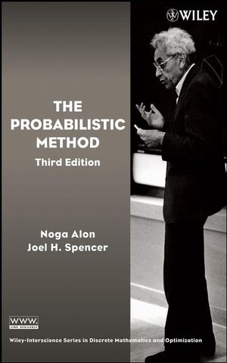
Probabilistic Method 101
Ramsey graphs
Erdos
Coding theory
Shannon
Metric embeddings
Johnson-Lindenstrauss
…

Slide 4

Beating the Union Bound
Not always enough
Constructive: Beck’91, …, Moser’09, …
Lovasz Local Lemma:
$E_{1},E_{2},…, E_{n}$, $d$ dependent.
$\operatorname{Pr}\left[E_{i}\right]<1/4d,$ $⇒$ $Pr\left[∪E_{i}\right]<1.$

Slide 5

Beating the Union Bound
Optimal, explicit $ε$-nets for Gaussians
Kanter’s lemma, convex geometry
Constructive Discrepancy Minimization
EdgeWalk: New LP rounding method
Geometric techniques
“Truly” constructive

Slide 6
Outline
Optimal, explicit $ε$-nets for Gaussians
Kanter’s lemma, convex geometry
Constructive Discrepancy Minimization
EdgeWalk: New LP rounding method

Slide 7
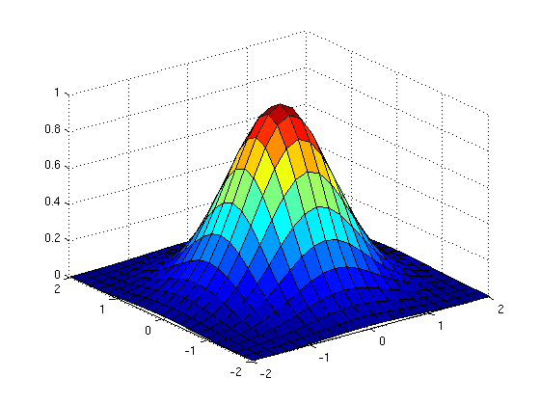
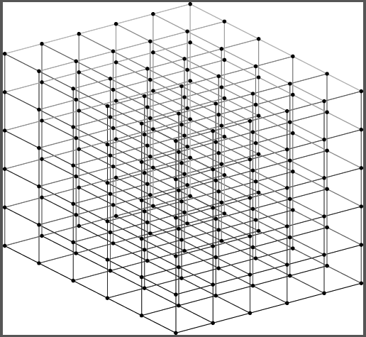

Epsilon Nets
Discrete approximations
Applications: integration, comp. geometry, …

Slide 8
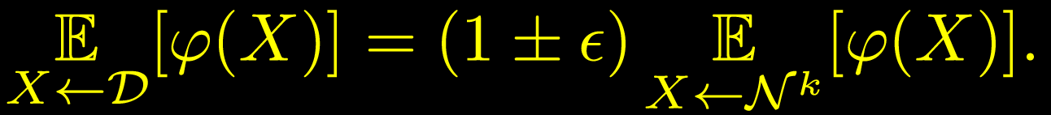
Epsilon Nets for Gaussians
Discrete approximations of Gaussian
Explicit
Even existence not clear!

Slide 9


Nets in Gaussian space
Thm: Explicit $ε$-net of size $(1/{ε)}^{O\left(k\right)}$.
Optimal: Matching lower bound
Union bound: ${(k/ε)}^{k}$
Dadusch-Vempala’12: $((log{{k)/ε)}^{k}}$

Slide 10
First: Application to Gaussian Processes and Cover Times

Slide 11
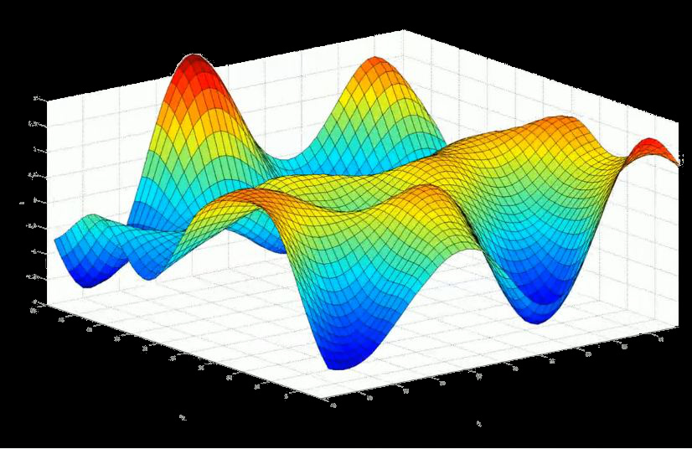
Gaussian Processes (GPs)
Multivariate Gaussian Distribution

Slide 12


Supremum of Gaussian Processes (GPs)
Given $\left((X_{i})\right)$ want to study
Supremum is natural: eg., balls and bins

Slide 13







Supremum of Gaussian Processes (GPs)
Given $v_{1},…, v_{n}∈R^{d},$want to study
$$\sup{X_{i}}$$
$$v_{2}$$
Union bound: $\sqrt{\log{n}}$.
Covariance matrix
More intuitive
$$v_{1}$$
$$0$$
When is the supremum smaller?
Random
Gaussian

Slide 14
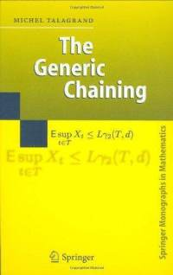
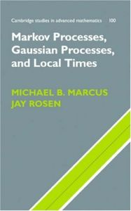
Why Gaussian Processes?
Stochastic Processes
Functional analysis
Convex Geometry
Machine Learning
Many more!

Slide 15


Cover times of Graphs
Aldous-Fill 94: Compute cover time deterministically?
Fundamental graph parameter
Eg: $cover\left(K_{n}\right)=Θ(n\log{n)}$
$cover\left(Grid\right)=Θ(n\log^{2}{n)}$
KKLV00: $O((log{{\log{n)}}^{2}) }$approximation
Feige-Zeitouni’09: FPTAS for trees

Slide 16


Cover Times and GPs
Thm (Ding, Lee, Peres 10): O(1) det. poly. time approximation for cover time.
Transfer to GPs
Compute supremum of GP

Slide 17

Computing the Supremum
Question (Lee10, Ding11): PTAS for computing the supremum of GPs?
Ding, Lee, Peres 10: $O(1)$ approximation
Can’t beat $O(1)$: Talagrand’s majorizing measures

Slide 18
Main Result
Thm: PTAS for computing the supremum of Gaussian processes.
Thm: PTAS for computing cover time of bounded degree graphs.
Heart of PTAS: Epsilon net
(Dimension reduction ala JL, use exp. size net)

Slide 19
Construction of Net

Slide 20




Construction of $ε$-net
Simplest possible: univariate to multivariate
$$k$$
$$k$$
1. How fine a net?
Naïve: $1/k$. Union bound!
2. How big a net?

Slide 21

Construction of $ε$-net
Simplest possible: univariate to multivariate
$$k$$
$$k$$
Lem: Granularity $δ\sim f(ε)$ enough.
Key point that beats union bound

Slide 22







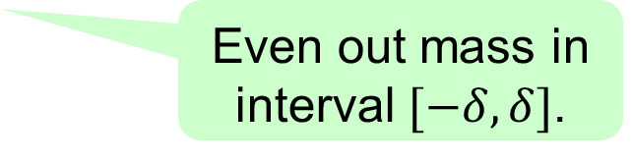


Construction of $ε$-net
This talk: Analyze ‘step-wise’ approximator
Even out mass in interval $[−δ, δ]$.
$$−4δ$$
$$−3δ$$
$$−2δ$$
-$δ$
$$δ$$
$$2δ$$
$$3δ$$
$$4δ$$
$γ_{ℓ}$

Slide 23











Construction of $ε$-net
Take univariate net and lift to multivariate
$$k$$
$$k$$
$$γ$$
$$−4δ$$
$$−3δ$$
$$−2δ$$
-$δ$
$$δ$$
$$2δ$$
$$3δ$$
$$4δ$$
$$γ_{ℓ}$$
Lem: Granularity $δ\sim f(ε)$ enough.

Slide 24











Dimension Free Error Bounds
Thm: For $δ\sim ε^{1.5}$, $φ$ a norm,
Proof by “sandwiching”
Exploit convexity critically
$$γ$$
$$−4δ$$
$$−3δ$$
$$−2δ$$
-$δ$
$$δ$$
$$2δ$$
$$3δ$$
$$4δ$$
$$γ_{ℓ}$$

Slide 25



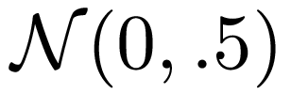

Analysis of Error
Def: Sym. $p, q.$ $p≼q$ (less peaked), if $∀$ sym. convex sets K$,$
$p\left(K\right)≤q\left(K\right).$
Why interesting? For any norm,

Slide 26

Analysis for Univarate Case
Fact: $γ_{ℓ}≼γ.$
Proof:
Spreading away from origin!
$$−4δ$$
$$−3δ$$
$$−2δ$$
-$δ$
$$δ$$
$$2δ$$
$$3δ$$
$$4δ$$

Slide 27



Analysis for Univariate Case
Fact: $γ≼γ_{u}.$
Proof: For $δ≪ε,$inward push compensates earlier spreading.
Def: $γ_{u}=$scaled down $γ_{ℓ}.$
$X←γ_{ℓ}$, $Y=\left(1−ε\right)X$, $γ_{u}=$pdf of $Y$.
Push mass towards origin.
$γ_{u}$

Slide 28





Analysis for Univariate Case
Combining upper and lower:
$γ_{ℓ}$
$$γ_{ }$$
$${γ_{u}}_{ }$$

Slide 29









Lifting to Multivariate Case
$$k$$
$$k$$
$$k$$
$γ_{ℓ}$
$$γ_{ }$$
$${γ_{u}}_{ }$$
$γ_{ℓ}$
$$γ_{ }$$
$${γ_{u}}_{ }$$
Kanter’s Lemma(77): and unimodal,
Key for univariate: “peakedness”
Dimension free!

Slide 30


Lifting to Multivariate Case
$$k$$
$$k$$
$$k$$
$γ_{ℓ}$
$$γ_{ }$$
$${γ_{u}}_{ }$$
Dimension free: key point that beats union bound!

Slide 31


Summary of Net Construction
Granularity $ε^{1.5}$ enough
Cut points outside $\sqrt{k}$-ball
Optimal $ε$-net

Slide 32
Outline
Optimal, explicit $ε$-nets for Gaussians
Kanter’s lemma, convex geometry
Constructive Discrepancy Minimization
EdgeWalk: New LP rounding method

Slide 33








Discrepancy
Subsets $S_{1},S_{2},…, S_{m}⊆[n]$
Color with $1$or -$1$ to minimize imbalance
1 2 3 4 5
1 2 3 4 5
1 | * | 1 | 1 | *
* | 1 | 1 | * | 1
1 | 1 | 1 | 1 | 1
* | * | * | 1 | 1
1 | * | 1 | * | 1
1 | * | 1 | 1 | *
* | 1 | 1 | * | 1
1 | 1 | 1 | 1 | 1
* | * | * | 1 | 1
1 | * | 1 | * | 1
3
1
1
0
1

Slide 34
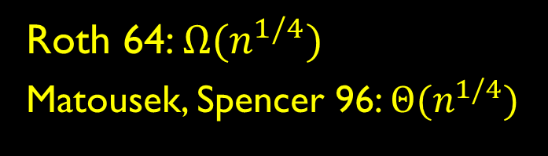
Discrepancy Examples
Fundamental combinatorial concept
Arithmetic Progressions
Roth 64: $Ω{(n}^{1/4})$
Matousek, Spencer 96: $Θ{(n}^{1/4})$

Slide 35
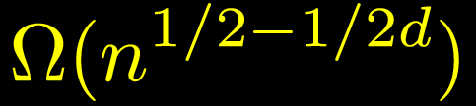
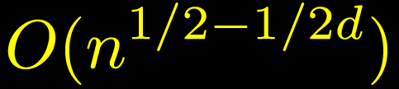
Discrepancy Examples
Fundamental combinatorial concept
Halfspaces
Alexander 90:
Matousek 95:

Slide 36
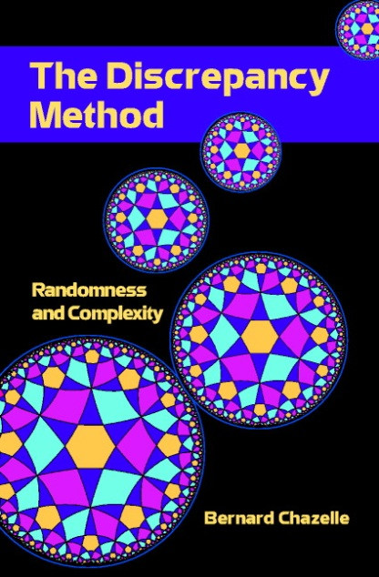
Why Discrepancy?
Complexity theory
Communication Complexity
Computational Geometry
Pseudorandomness
Many more!

Slide 37


Spencer’s Six Sigma Theorem
“Six standard deviations suffice”
Spencer 85: System with n sets has discrepancy at most .
Central result in discrepancy theory.
Tight: Hadamard
Beats union bound:

Slide 38

A Conjecture and a Disproof
Spencer 85: System with n sets has discrepancy at most .
Non-constructive pigeon-hole proof
Conjecture (Alon, Spencer): No efficient algorithm can find one.
Bansal 10: Can efficiently get discrepancy .

Slide 39

Six Sigma Theorem
New elementary geometric proof of Spencer’s result
Main: Can efficiently find a coloring with discrepancy $O\left(\sqrt{n}\right).$
Truly constructive
Algorithmic partial coloring lemma
Extends to other settings
EDGE-WALK: New LP rounding method

Slide 40
Outline of Algorithm
Partial coloring method
EDGE-WALK: geometric picture

Slide 41










Partial Coloring Method
Beck 80: find partial assignment with $<n/2$zeros
1 -1 1 1 -1
1 -1 0 0 0
1 1 0
-1
1 | * | 1 | 1 | *
* | 1 | 1 | * | 1
1 | 1 | 1 | 1 | 1
* | * | * | 1 | 1
1 | * | 1 | * | 1
1 | * | 1 | 1 | *
* | 1 | 1 | * | 1
1 | 1 | 1 | 1 | 1
* | * | * | 1 | 1
1 | * | 1 | * | 1
1 | * | 1 | 1 | *
* | 1 | 1 | * | 1
1 | 1 | 1 | 1 | 1
* | * | * | 1 | 1
1 | * | 1 | * | 1
1 | * | 1 | 1 | *
* | 1 | 1 | * | 1
1 | 1 | 1 | 1 | 1
* | * | * | 1 | 1
1 | * | 1 | * | 1
1 | * | 1 | 1 | *
* | 1 | 1 | * | 1
1 | 1 | 1 | 1 | 1
* | * | * | 1 | 1
1 | * | 1 | * | 1

Slide 42





Partial Coloring Method
Input:
Output:
Lemma: Can do this in randomized
time.

Slide 43
Outline of Algorithm
Partial coloring Method
EDGE-WALK: Geometric picture

Slide 44





Discrepancy: Geometric View
Subsets $S_{1},S_{2},…, S_{m}⊆[n]$
Color with $1$or -$1$ to minimize imbalance
1 2 3 4 5
1 | * | 1 | 1 | *
* | 1 | 1 | * | 1
1 | 1 | 1 | 1 | 1
* | * | * | 1 | 1
1 | * | 1 | * | 1
3
1
-1
1
1
-1
3
1
1
0
1
1
1
0
1

Slide 45

Discrepancy: Geometric View
Vectors $v_{1}, v_{2},…, v_{m}∈{\left\{0,1\right\}}^{n}.$
Want
1 2 3 4 5
1 | * | 1 | 1 | *
* | 1 | 1 | * | 1
1 | 1 | 1 | 1 | 1
* | * | * | 1 | 1
1 | * | 1 | * | 1
1
-1
1
1
-1
3
1
1
0
1

Slide 46



Discrepancy: Geometric View
Vectors $v_{1}, v_{2},…, v_{m}∈{\left\{0,1\right\}}^{n}.$
Want
Gluskin 88: Polytopes, Kanter’s lemma, ... !
Goal: Find non-zero lattice point inside

Slide 47


Edge-Walk
Goal: Find non-zero lattice point in
Claim: Will find good partial coloring.
Start at origin
Brownian motion till you hit a face
Brownian motion within the face

Slide 48


Edge-Walk: Algorithm
Gaussian random walk in subspaces
Subspace V, rate $γ$
Gaussian walk in V
Standard normal in V:
Orthonormal basis change

Slide 49
Edge-Walk Algorithm
Discretization issues: hitting faces
Might not hit face
Slack: face hit if close to it.

Slide 50
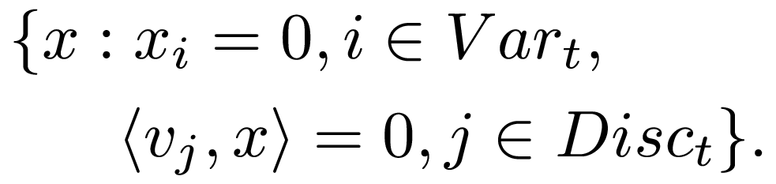


Edge-Walk: Algorithm
Input: Vectors $v_{1},v_{2},…, v_{m}.$
Parameters: $δ, Δ, γ\left(≪δ\right), T=1/γ^{2}$
$X_{0}=0.$For $t=1,…, T.$
$Var_{t}=$Cube faces nearly hit by $X_{t}$.
$Disc_{t}=$Disc. faces nearly hit by $X_{t}$.
$V_{t}=$Subspace orthogonal to ${Var}_{t}, Disc_{t}$

Slide 51


Edgewalk: Partial Coloring
Lem: For
with prob 0.1 and

Slide 52




Edgewalk: Analysis
Discrepancy faces much farther than cube’s
$$\operatorname{Pr}\left[Walk hits a disc. face\right] ≪Pr⁡[ Walk hits a cube^{′}s]$$
$$\operatorname{Pr}\left[Walk hits a disc. face\right]$$
$$∝\exp\left(−{100}^{2}\right).$$
$$\operatorname{Pr}\left[Walk hits a cube face\right]$$
$$∝\exp\left(−1\right).$$
Hit cube more often!
100
Key point that beats union bound
1

Slide 53
Six Suffice
Edge-Walk: Algorithmic partial coloring
Recurse on unfixed variables
Spencer’s Theorem

Slide 54
Summary
Optimal, explicit $ε$-nets for Gaussians
Kanter’s lemma, convex geometry
Constructive Discrepancy Minimization
EdgeWalk: New LP rounding method
Geometric techniques
Others: Invariance principle for polytopes
(Harsha, Klivans, M.’10), …

Slide 55

Open Problems
FPTAS for computing supremum?
Beck-Fiala conjecture 81?
Discrepancy $O(\sqrt{t})$ for degree $t$.
Applications of Edgewalk rounding?
Rothvoss’13: Improvements for
bin-packing!

Slide 56
Thank you

Slide 57




Edgewalk Rounding
Th: Given $v_{1},…, v_{m},$thresholds $λ_{1},λ_{2},…λ_{m},$
Can find $X∈{\left[−1,1\right]}^{n}$with
1.
2.

