Slide 1

AI-INTERVIEW PREPARATION COACH
CVR COLLEGE OF ENGINEERING
(An UGC Autonomous Institute, Accredited by NAAC with ‘A’ Grade)
Department of CSE(AI&ML)
B. Tech CSE(AI&ML)-C III Year II Semester
Industry Oriented Mini Project
PROJECT SUPERVISOR:
Dr. B. Prasanthi
Presented By:-
N. Raghunandan, 23B81A66G0
M. Surya Teja, 23B81A66J3

Slide 2
Agenda of the IOMP Presentation
Abstract
Introduction
Literature Review
Problem Statement
Objectives
Functional & Non-functional Requirements
Hardware & Software Requirements
Proposed Methodology
System Architecture, Class diagram, Sequence Diagram & Activity Diagram
Future course of action

Slide 3
Abstract
The AI Interview Preparation Coach is an intelligent web-based application developed using Python and Streamlit that simulates real-world interview environments. The system supports HR, Behavioral, and Technical interviews, including live coding rounds with automated evaluation. By leveraging OpenAI’s GPT models, the application dynamically generates interview questions, evaluates user responses, provides structured feedback, and generates performance scorecards. This project aims to help students and job seekers improve interview readiness through realistic practice and instant AI-driven feedback.

Slide 4
Introduction
Interview preparation is a critical yet challenging phase for students and professionals. Traditional preparation methods lack interactivity, personalization, and real-time feedback. With the advancement of Artificial Intelligence and Large Language Models, interview simulations can now closely mimic real interview scenarios.
The AI Interview Preparation Coach provides a unified platform where users can practice different interview types, attempt coding problems in a live editor, and receive AI-evaluated feedback, thereby bridging the gap between preparation and real interviews.

Slide 5
Literature Review
Several existing platforms such as online mock interviews, coding practice websites, and interview preparation portals provide partial solutions. However:
Most platforms focus only on coding or only on HR questions
Feedback is often generic or delayed
Lack of integrated evaluation and scoring
Recent research on AI-based assessment systems highlights the effectiveness of Large Language Models in natural language evaluation, code analysis, and feedback generation. This project builds upon these advancements by integrating AI-driven question generation, evaluation, and scoring into a single application.

Slide 6
Problem Statement
Students lack access to a single integrated platform that provides:
Realistic interview simulations
Live coding practice with evaluation
Personalized feedback and performance analysis
Existing solutions do not combine HR, Behavioral, and Technical interviews with AI-based assessment, making interview preparation fragmented and inefficient.

Slide 7
Objectives
To simulate real-time interview environments
To generate interview questions dynamically using AI
To provide live coding practice with evaluation
To analyze answers and provide structured feedback
To generate scorecards for performance tracking
To enhance interview confidence and readiness

Slide 8
Functional Requirements
User selection of job role and interview type
AI-generated interview questions
Live code editor for technical interviews
Time-bound coding rounds
AI-based answer evaluation
Score generation and feedback display
Interview reset and session management

Slide 9
Non-Functional Requirements
User-friendly interface
Fast response time
Secure API key handling
Scalability for multiple users
High availability and reliability

Slide 10
Hardware Requirements
Processor: Intel i3 or above
RAM: Minimum 8 GB
Storage: 10 GB free space

Slide 11
Software Requirements
Operating System: Windows / Linux / macOS
Programming Language: Python 3.10/above
Framework: Streamlit
Libraries: OpenAI SDK, Streamlit-ACE
API: OpenAI GPT models

Slide 12
Proposed Methodology
User selects job role, interview type, difficulty, and language
AI generates interview questions dynamically
User submits textual or coding answers
AI evaluates responses using predefined prompts
Scores and feedback are generated
Final scorecard is displayed after interview completion

Slide 13
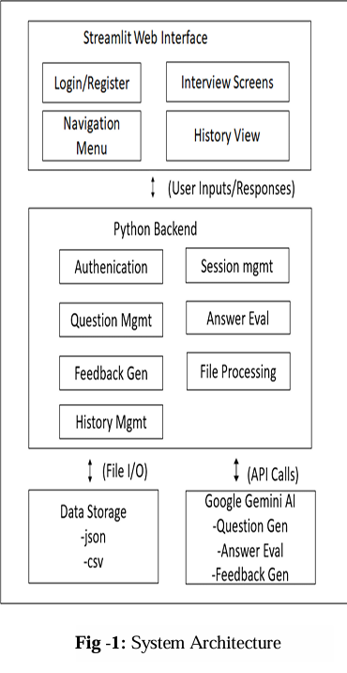
System Architecture
The system follows a client–server architecture:
Frontend: Streamlit UI for interaction
Backend: Python logic for session management
AI Engine: OpenAI GPT models for generation and evaluation
Editor: Streamlit ACE for live coding

Slide 14
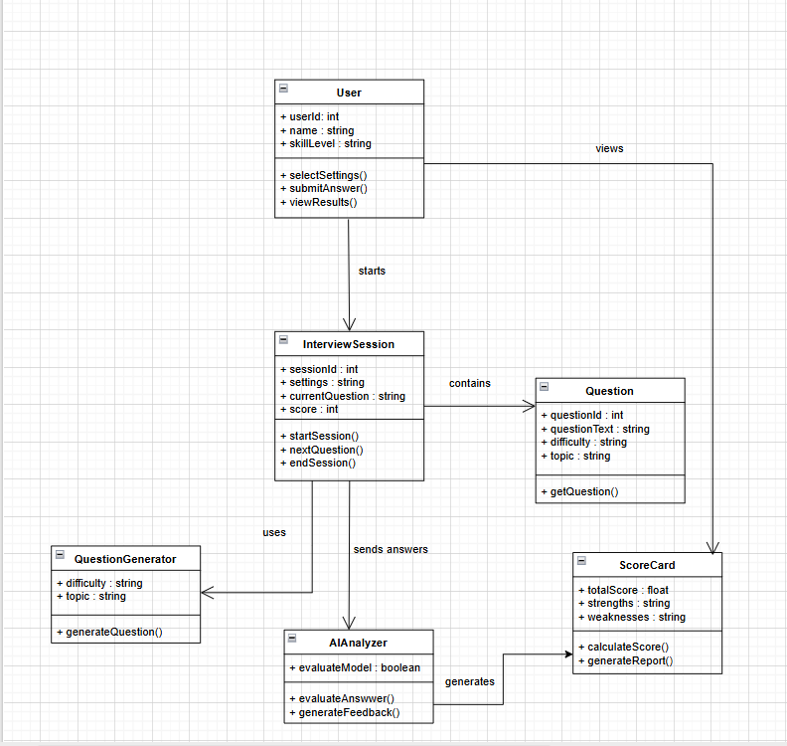
Class Diagram

Slide 15
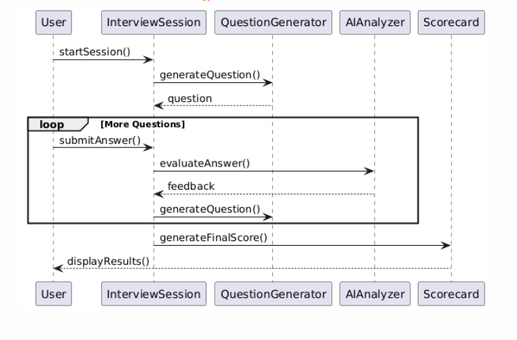
Sequence Diagram

Slide 16
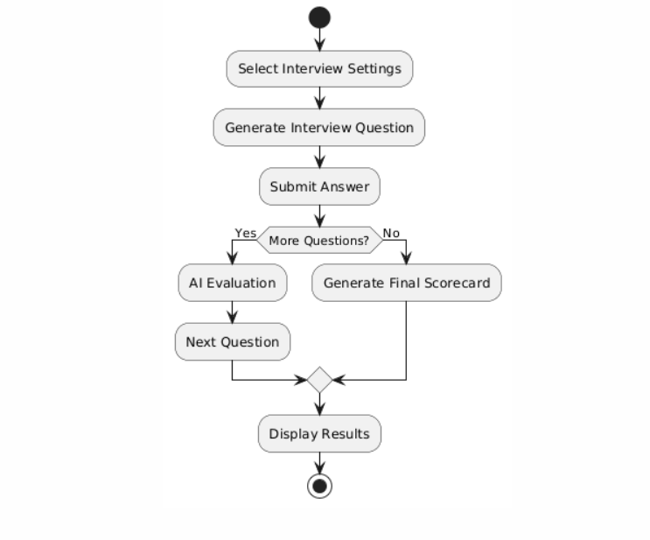
Activity Diagram

Slide 17
Future Course of Action
Resume-based interview personalization
Voice-based mock interviews
Company-specific interview preparation
Real-time emotion and confidence analysis
Integration with placement portals
Detailed analytics and progress tracking

Slide 18
THANK YOU

