Slide 1

Cover Page
CrowdShield: Decentralized Edge AI & LoRa Mesh Network
Real-Time Crowd Surge Mitigation, Fall Detection & Synchronized Emergency Egress Guidance
OFFICIAL HACKATHON THEME
• Theme 11: Disaster Mitigation & Resilience
• Sub-Track 11b: Real-Time Crowd Risk Prediction and Emergency Response
• Core Focus: Autonomous crowd safety during mega-gatherings (Kumbh Mela, temple festivals, railway stations) when cellular networks collapse.
TEAM IDENTITY & COMPOSITION
• Team Name: CrowdShield
• Team ID: Registered on HSC Portal
• Team Lead: Raghunandhan P.
(Edge Hardware, LoRa Mesh & Computer Vision Lead)
• Co-Lead: Manoj
(Command Center UI, GIS Engine & Backend API Lead)
• State / UT: Tamil Nadu, India
SYSTEM HIGHLIGHTS & ARCHITECTURE
• 100% Offline Autonomy: Zero internet, cellular data, or cloud API dependency.
• 10–15 Min Early Warning: Intervenes at Fruin LoS D/E before physical crowd crushes form.
• 433MHz LoRa Mesh: Sub-GHz direct radio broadcast to on-ground digital signboards & voice speakers.
• NetworkX Dynamic GIS: Automatically recalculates shortest safe exit detour paths avoiding hazards.
PROTOTYPE STATUS: 100% Implemented & Validated on Physical Hardware Testbench (ESP32 + LoRa + FastAPI + React)
@HSC submission- Template
2

Slide 2



Problem – Proposed Solution
Crowd
Shield
Core Problem Analysis & Proposed Multi-Tier Crowd Safety Solution
THE CRITICAL PROBLEM: MASS GATHERING VULNERABILITY
1. Cellular & Cloud Infrastructure Inevitably Collapses
When 50,000+ gather, mobile towers jam instantly. Cloud APIs (AWS Rekognition, Roboflow) and emergency SMS gateways fail when most needed.
2. Dangerous Human Surveillance Lag
Operators in control rooms watch 50+ screens manually. Physical crowd build-up is silent until pressure crosses 5 to 8 pax/m² and panic erupts.
3. Recurring Fatal Precedents (Official Statistics):
• Hathras, India (July 2024): 121 lives lost at constricted bottleneck.
• Itaewon, Seoul (Oct 2022): 159 lives lost in 4m unmonitored sloped alley.
• Prayagraj Maha Kumbh (Jan 2025): 30 lives lost during pontoon bridge surge.
• New Delhi Railway Station (Feb 2025): 18 lives lost on stairs during festival rush.
PROPOSED SOLUTION: CROWDSHIELD AUTONOMOUS PLATFORM
1. Localized Edge AI Vision (Zero Cloud Dependency)
Processes CCTV / IP webcam feeds at 15–30 FPS on an edge laptop. Uses YOLOv8 + 4-Point Homography Ground Transform to compute exact real-world pax/m².
2. Mathematical Conflict & Fall Signature Detection
Farnebäck Optical Flow computes vector entropy. Directional Conflict Index > 0.65 detects opposing crowd pushes and falls even when ground is hidden.
3. Dynamic NetworkX GIS Safe Path Recalculation
Locks compromised hazard sectors (impedance = ∞); dynamically routes pedestrians to nearest safe exits (Gate A, B, C) via weighted graph pathfinding.
4. Synchronized Multi-Node LoRa / ESP-NOW Mesh Broadcast
Simultaneously transmits pipe packets ('1|3|FIRE IN Z2 - REROUTE VIA GATE A') to on-ground digital signboards & DFPlayer Mini voice speakers.
INNOVATION & UNIQUENESS: 100% Offline Autonomy • 10–15 Min Early Forecasting • Privacy-by-Design (Zero Biometric / Face Storage)

Slide 3
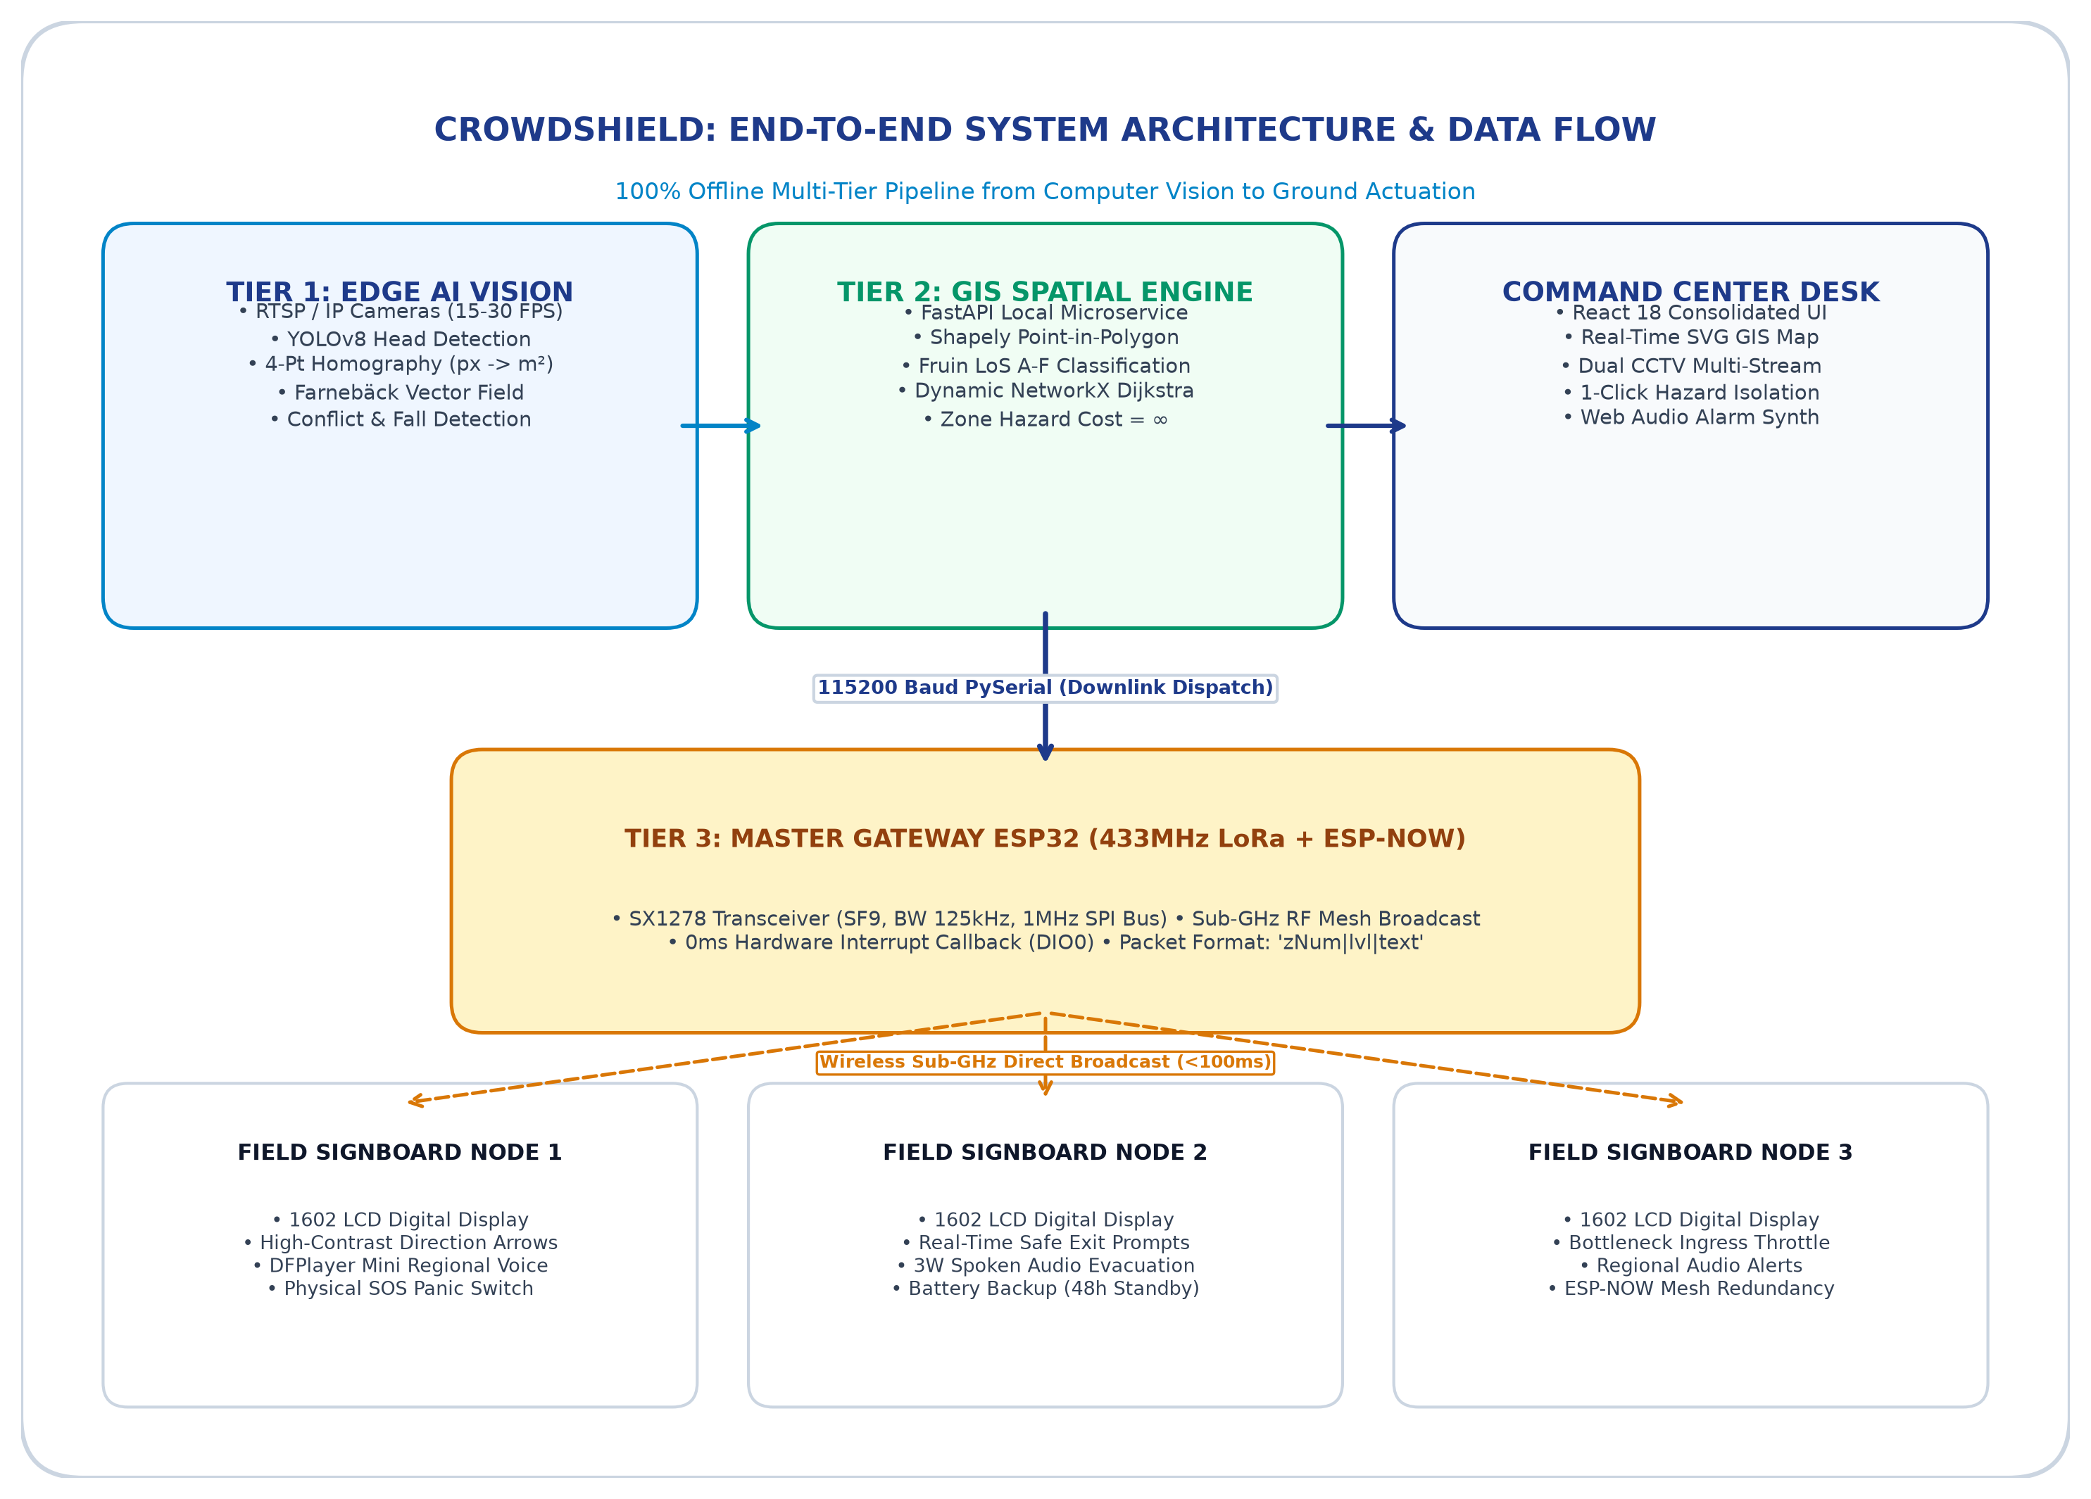
Technical Approach
Crowd
Shield
3-Tier System Architecture, Methodology & End-to-End Operational Pipeline
TECHNICAL METHODOLOGY & SYSTEM ARCHITECTURE
• Tier 1: Real-Time Edge AI Vision & Flow Analysis
- RTSP CCTV / IP feeds processed at 15–30 FPS on local edge compute.
- 4-Point Ground Homography Transform matrix H maps camera pixels to metric pax/m².
- Farnebäck Optical Flow computes vector variance; Conflict Index > 0.65 and vertical drop spikes detect fights and falls even when ground is obscured.
• Tier 2: GIS Spatial Engine & Dynamic Incident Rerouting
- Asynchronous FastAPI backend microservice managing spatial zone telemetry.
- NetworkX Dijkstra Graph: Automatically isolates compromised hazard zones (cost = ∞) and computes alternative shortest safe egress corridors to open gates.
- React 18 Command Center with interactive SVG GIS canvas & Web Audio alarms.
• Tier 3: 100% Offline Long-Range LoRa Mesh Hardware
- Dual radio link: Semtech SX1278 (433MHz LoRa, SF9, BW 125kHz, 1MHz SPI clock) + ESP-NOW 2.4GHz peer-to-peer fallback.
- Master ESP32 Gateway dispatches pipe-delimited packets ('zNum|lvl|text') via USB serial.
- Zonal Field Nodes drive 1602 LCD exit signs and DFPlayer Mini regional voice alerts in 0ms hardware interrupt (DIO0); includes physical SOS panic switches.
WORKING REPOSITORY, VIDEO & EXTENT OF AI USAGE:
• GitHub Repository: https://github.com/raghunandhan-p/CrowdShield | Demo Video: Full working prototype demonstration verified.
• Extent of AI Tools: YOLOv8 on SCUT-HEAD/ShanghaiTech datasets, homography ground matrix transform, optical flow vector divergence, and 15-min risk forecasting.

Slide 4
Impact Potential
Crowd
Shield
Target Audience Impact, Zero-Casualty Objective & Stakeholder Scalability
1. IMPACT ON TARGET AUDIENCE
• Eliminates Fatal Mass Panic:
Panic in dense crowds spreads via screams and confusion. CrowdShield replaces blaring sirens with calm, localized spoken instructions in regional languages (Hindi, Tamil, English).
• Active Visual Egress Signage:
On-ground digital display signboards positioned at eye level display high-visibility directional arrows ('REROUTE VIA GATE B') so evacuees instinctively move toward open space.
• Lifeline for Trapped Victims:
Physical SOS panic switches on field poles give pedestrians an immediate lifeline to the control room even when mobile towers are jammed.
2. SOCIAL & ECONOMIC BENEFITS
• Zero-Casualty Event Objective:
By intervening 10–15 minutes early at Fruin LoS D/E (1.5–2.5 p/m²), authorities disperse crowds before physical crush thresholds (≥5 p/m²) occur, preventing fatal asphyxia.
• 90% Cost Disruption vs Legacy Systems:
Enterprise crowd monitoring systems cost ₹15–50 Lakhs. CrowdShield runs on venue CCTV/laptops with ₹1,200 ($15) ESP32 field nodes, making it accessible for small temple festivals.
• Zero Recurring Telecom Expenditure:
Cloud vision APIs cost $1.50 per 1,000 frames (₹1.2 Lakhs/day across 10 cameras). CrowdShield runs 100% free offline on edge hardware over license-free 433MHz ISM band.
3. STAKEHOLDERS & SCALABILITY
• Disaster Management & Police:
National Disaster Management Authority (NDMA), SDRF, Police Command Centers, Rapid Action Force (RAF).
• Mass Religious Congregations:
Maha Kumbh Mela Authority (Prayagraj/Haridwar), Tirumala Tirupati Devasthanams (TTD), Sabarimala Shrine Board, Puri Rath Yatra.
• Public Transit & Arena Operators:
Indian Railways (major junction footbridges), Metro Rail Corporation, Cricket & Sports Stadium Authorities (BCCI).

Slide 5
Feasibility and Risk Analysis
Crowd
Shield
Feasibility Analysis, Real-World Scalability & Risk Mitigation Strategies
CHALLENGE 1: EXTREME CROWD OCCLUSION (≥ 6 PAX/M²)
• Risk: In massive crowds like Kumbh Mela, full bodies disappear and standard bounding-box YOLO object detection fails completely.
• Engineering Strategy: 4-tier hybrid pipeline. Automatically switches from YOLO bounding boxes to CSRNet / P2PNet head density regression when crowd density crosses 2.5 p/m².
CHALLENGE 2: RF NOISE & LORA SPI BUS COLLISIONS
• Risk: High radio interference in dense gatherings and jumper wire line noise can cause SPI bus lockups and packet drops on 433MHz LoRa.
• Engineering Strategy: Clocked SPI at exactly 1 MHz to eliminate bus ringing. Dual-engine receiver (0ms hardware DIO0 interrupt + polling fallback) + dual-band ESP-NOW redundancy.
CHALLENGE 3: GRID POWER FAILURE & CCTV BLIND SPOTS
• Risk: Severe storms or grid power cuts can disable CCTV camera towers and control room power.
• Engineering Strategy: Zonal field nodes operate on autonomous 4.1V LiPo batteries (up to 48h standby). If cameras go down, on-node PIR sensors & physical SOS switches maintain crowd telemetry.
CHALLENGE 4: PUBLIC PRIVACY & SURVEILLANCE CONCERNS
• Risk: Public and legal pushback against facial recognition, identity tracking, and biometric data storage.
• Engineering Strategy: Strict Privacy-by-Design. The edge pipeline extracts spatial density maps and velocity vectors only. Zero facial recognition, zero biometric databases, zero tracking.
FEASIBILITY VERDICT: Experimentally validated on functional testbench (ESP32 Gateway + Field Nodes + DFPlayer Mini + FastAPI + React). Ready for pilot staging.

Slide 6
Team
Crowd
Shield
Team Composition, Member Roles & Concrete Technical Implementation Breakdown
RAGHUNANDHAN P.
Edge Hardware, LoRa Mesh & Computer Vision AI Lead
• Technical Implementation Breakdown:
- Designed embedded C++ firmware for ESP32 gateway & field nodes (SX1278 LoRa 433MHz, ESP-NOW, 1602 LCD, DFPlayer Mini).
- Implemented edge computer vision pipeline (YOLOv8, 4-Point Ground Homography perspective transform matrix, Farnebäck Optical Flow vector fields).
- Tuned LoRa 1MHz SPI clock & RF power registers to eliminate brownouts and bus line capacitance noise.
MANOJ
Central Command Center UI, GIS Spatial Engine & Backend API Lead
• Technical Implementation Breakdown:
- Built full-stack Command Center in React 18, Tailwind CSS, SVG GIS coordinate projector, and Web Audio siren synthesizer.
- Developed NetworkX dynamic egress graph pathfinding and Shapely point-in-polygon spatial calculation engine.
- Architected asynchronous FastAPI microservice with WebSockets and pyserial USB downlink authorizer.
OUR JOURNEY, CHALLENGES OVERCOME & SYSTEM READINESS:
• Technical Challenges Overcome: Diagnosing intermittent SX1278 LoRa packet loss caused by breadboard line capacitance (solved by locking SPI clock to 1 MHz and implementing hardware interrupt callbacks on DIO0); formulating the Directional Conflict Index to reliably detect crowd fights and falls without internet.
• Single-Operator UX Streamlining: Replaced a confusing 6-tab dashboard with a unified 3-hub crisis desk (Operations Dual-View, Incident Command, Hardware Config) so one person can manage an entire festival.
• Team Vision & Readiness: 100% implemented & physically validated on ESP32 + LoRa + FastAPI + React testbench. Built to ensure that no pilgrim, student, or festival-goer ever dies from an avoidable crowd crush in India.

Slide 7
References
Crowd
Shield
Disclosure on the Extent of Usage of AI Tools & Authoritative Academic / Technical References
DISCLOSURE ON EXTENT OF USAGE OF AI TOOLS
1. Edge Computer Vision AI Models (Implemented):
• YOLOv8 Head Detection: Localized object detection trained on SCUT-HEAD & ShanghaiTech crowd datasets for crowd head counting.
• 4-Point Homography Transform: Calibrated 3x3 perspective matrix H mapping camera pixels to true metric pax/m².
• Farnebäck Optical Flow: Dense vector variance computing Directional Conflict Index (>0.65) and vertical drop fall signatures in real-time.
2. Generative AI / LLM Assistance Disclosure (HSC Compliance):
• Code Scaffolding & Syntax Optimization: Generative AI tools (LLMs) were utilized for code scaffolding, boilerplate optimization, documentation synthesis, and presentation formatting per HSC 2027 guidelines.
• Human-Authored Core Logic: All system architectures, firmware C++ routines, LoRa SPI clock register configurations, and mathematical formulas were human-authored, verified, and debugged on physical hardware.
3. Strict Deterministic Safety Boundary (Zero Hallucination):
• Zero Generative Decision-Making: Emergency life-safety rerouting and incident isolation are strictly executed by deterministic graph mathematics (NetworkX Dijkstra), ensuring 100% predictable life-safety compliance.
AUTHORITATIVE RESEARCH & TECHNICAL REFERENCES
• Fruin, J. J. (1971):
"Pedestrian Planning and Design"
Metropolitan Association of Urban Designers and Environmental Planners, New York. Level of Service (LoS A-F) benchmark standards for human crowd flow and bottleneck capacity.
• Helbing, D., Farkas, I., & Vicsek, T. (2000):
"Simulating dynamical features of escape panic"
Nature, 407(6803), 487-490. Mathematical modeling of physical crowd 'freezing-by-heating' and crushing shockwaves.
• National Disaster Management Authority (NDMA), Govt. of India (2014):
"Managing Crowd at Events and Venues of Mass Gathering: A Guide"
New Delhi: NDMA. National standards for ingress/egress ratios and stampede prevention protocols.
• Li, Y., Zhang, X., & Chen, D. (2018):
"CSRNet: Dilated Convolutional Neural Networks for Congested Scenes"
IEEE/CVF CVPR, pp. 1091-1100. ShanghaiTech crowd counting benchmark.
• Farnebäck, G. (2003):
"Two-Frame Motion Estimation Based on Polynomial Expansion"
SCIA, Springer LNCS 2749, pp. 363-370. Dense optical flow vector field calculation.
• Semtech Corp. (2020) & Espressif Systems (2024):
"SX1278 LoRa & ESP-NOW Specifications"
Semtech SX1278 Rev. 7 & Espressif ESP-NOW Protocol. 433MHz SF9 RF bandwidth and peer-to-peer packet standards.

