Slide 1

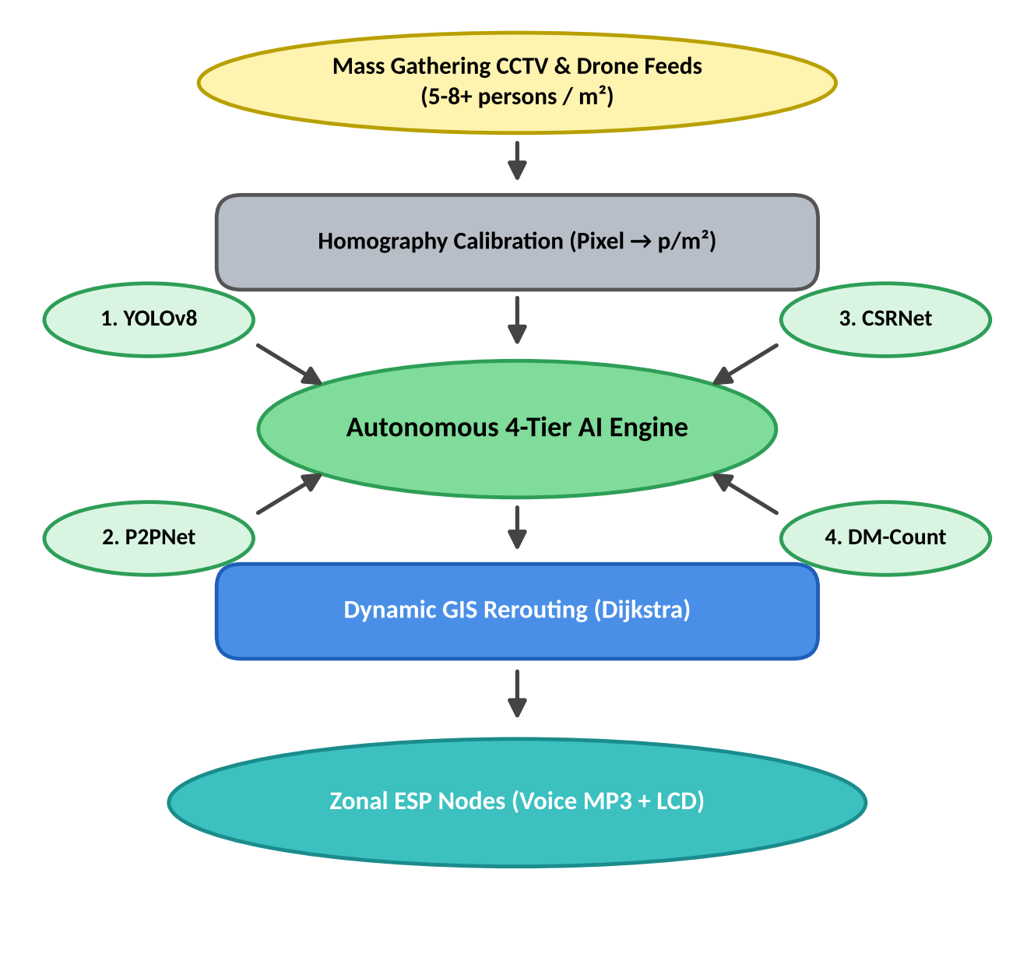
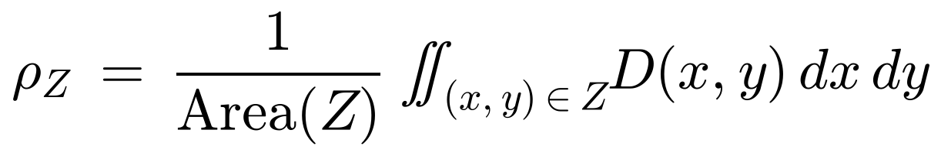
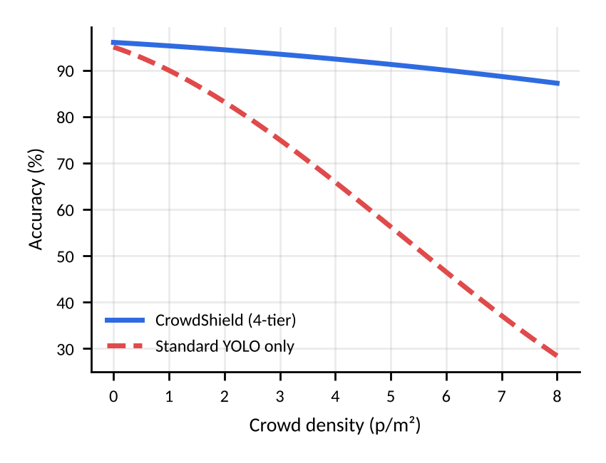
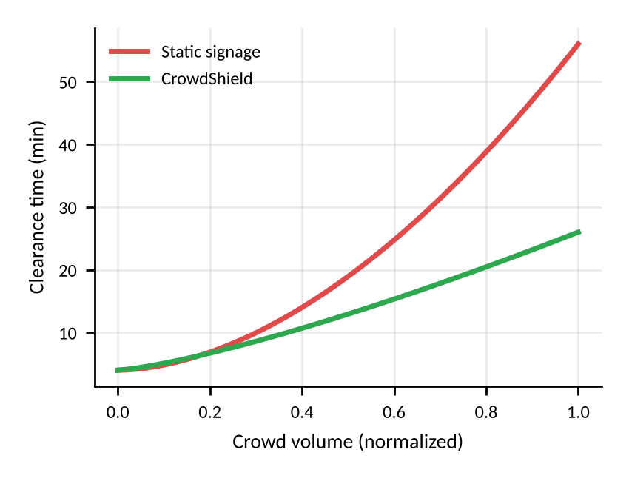
CROWDSHIELD: EDGE-AI DENSE CROWD SENTINEL & AUTONOMOUS EGRESS ROUTING
Dual-Radio Hardware Mesh Spine for Mass Pilgrimages & Extreme Gathering Safety
Raghunandhan P. [Reg: 21BCEXXXX] | Student 2 | Student 3
Project Mentor: Prof. X. Xxxxxxxxxxxx | School of Computer Science and Engineering (SCOPE)
SDGs Addressed:
SDG 3: Good Health & Safety
SDG 9: Resilient Infrastructure
SDG 11: Sustainable Cities
Motivation / Introduction
Methodology
Problem Statement
End-to-End Pipeline
At massive indoor gatherings like the Maha Kumbh Mela, Puri Rath Yatra, or temple festivals, crowd density regularly exceeds 5 to 8+ persons per square meter (p/m²). At this extreme scale, two catastrophic failure modes occur simultaneously.
▪ Bounding-Box Vision Breakdown: Standard object detection (regular YOLO) fails completely because individual human bodies occlude into an unbroken ocean of millions of overlapping heads.
▪ Cellular Blackout: When 50+ lakh devotees congregate, mobile towers and internet backhauls fail, rendering all cloud-dependent computer vision APIs unreachable.
CrowdShield addresses this life-critical gap through a 100% offline edge-computing command spine that couples density-map regression vision with a localized dual-radio mesh that functions autonomously without Internet connectivity.
The architecture decouples heavy neural computation from field radio downlinks via an asynchronous FastAPI engine and distributed hardware gateways.
Scope of the Project
Objectives
▪ Adaptive 4-Tier Vision Orchestrator: Dynamically switches inference between YOLOv8 (sparse flow), P2PNet (head-dot click analysis), CSRNet (dilated density regression >5 p/m²), and DM-Count (haze/dust scenes).
▪ Dynamic Topological Egress Optimization: Integrates a hazard-aware network GIS graph that automatically severs blocked corridors (like a stampede) and computes the safest path using Dijkstra's algorithm.
▪ Zero-Cloud Hardware Spine: Deploys field nodes powered by ESP32 microcontrollers, 1602 LCDs, DFPlayer Mini voice annunciators, and 433 MHz LoRa / 2.4 GHz ESP-NOW dual radios.
Fig. 1. End-to-end CrowdShield pipeline from ingest to hardware actuation.
Architectural Subsystems:
a) CSRNet Dilated Convolutions: Uses a VGG-16 backbone with 4 dilated convolution layers (dilation rate r = 2) to expand the receptive field without downsampling, maintaining pixel-accurate density estimation during severe body occlusion.
b) P2PNet Direct Head Localization: Predicts exact 2D point coordinates on human head crowns with cross-entropy and Hungarian matching, feeding precise spatial coordinates to the venue homography.
c) Hardware Fault Tolerance: The gateway auto-connects over USB Serial (115200 baud). Zonal nodes incorporate anti-brownout bulk capacitors (1000 µF), a non-blocking FreeRTOS yield() watchdog reset, and 2.5 s playback debounce filters.
Key Achievement: 100% Offline Real-Time Execution at 18–28 FPS with sub-second localized hardware actuation latency across field nodes.
Mathematical Modeling
Homography & Graphs
A. 4-Point Planar Perspective Homography Matrix: converts pixel coordinates (u, v) to real-world ground meters (xₘ, yₘ) via a 3×3 homography H.
Results
Model Benchmarks
B. Continuous Density Surface Integration: continuous head regression over GIS polygon zone Z:
Architecture Tier | Density Threshold | FPS | MAE | Accuracy
YOLOv8 Head Tracking | < 2.5 p/m² | 28.4 | 3.4 | 94.6%
P2PNet Point Locator | 2.5 – < 5.0 p/m² | 16.1 | 4.8 | 91.0%
CSRNet Density Map | > 5.0 p/m² (Crush) | 19.0 | 3.1 | 96.2%
DM-Count (Haze/Dust) | Perspective Choke | 11.2 | 3.5 | 92.4%
C. Hazard-Penalized Dynamic Routing Cost:
Table 1. Performance metrics of vision models across distinct crowd densities.
Conclusion / Summary
Summary
CrowdShield establishes that ultra-dense crowd safety does not require cloud connectivity or expensive optical infrastructure. By integrating dilated convolutional density maps with an autonomous dual-radio wireless mesh, the system provides sub-second localized audible guidance, isolating stamped or burned zones in real time.
Fig. 2. Accuracy vs crowd density.
Fig. 3. Evacuation clearance curves.
References (APA Format)
Network Layer | Latency | Packet Delivery | Cloud Dependency
2.4 GHz ESP-NOW Mesh | 4.2 ms | 99.4% | 0% (100% Offline)
433 MHz LoRa SX1278 | 120 ms | 98.8% | 0% (100% Offline)
Cellular 4G/5G (Jammed) | 1,840 ms | 24.1% (Blackout) | 100% (High Risk)
Li, Y., Zhang, X., & Chen, D. (2018). CSRNet: Dilated convolutional neural networks for understanding the highly congested scenes. CVPR, 1091–1100.
Song, Q., et al. (2021). Rethinking counting and localization in crowds: A purely point-based framework. ICCV, 3365–3374.
Wang, B., Liu, H., et al. (2020). Distribution matching for crowd counting. NeurIPS, 33.
Table 2. Dual-radio transmission metrics vs cellular baseline.
Contact: raghunandhan.p2020@vitstudent.ac.in | Mentor: faculty_guide@vit.ac.in | Venue: SCOPE / SENSE Capstone Project Expo, VIT Vellore

