Slide 1

Image Generation using Generative Adversarial Networks
RAGHUNATH BABU A20511598
SAI MANOHAR VEMURI A20514848

Slide 2
Outline
Problem Statement
Proposed Solution
Data
GAN Model
Loss Function
Evaluation
Results
References

Slide 3
Problem Statement
Existing GANs were a concatenation of several convolution layers resulted in expensive training which required a lot of computation.
Also, in terms of the quality of the image generator, there was a need for global coherence to capture complex patterns and the overall structure of the input data with lesser computations.

Slide 4
Proposed Solution
To get the per pixel feedback(local) and global coherence, an encoder decoder architecture U-Net is used. Along with this several transfer learning architectures such as inception for multi-receptive fields analysis and Resnet(with residual block) in interest of generating quality images.
Augmentation is included to improve the localization ability of the model and make the model immune to several transformations of the datasets.

Slide 5
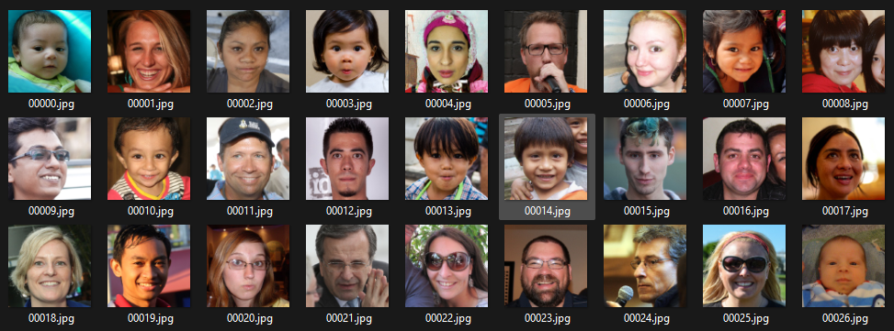
Data
FFHQ: Flickr-Faces-HQ
Source:
https://www.kaggle.com/datasets/rahulbhalley/ffhq-1024x1024

Slide 6
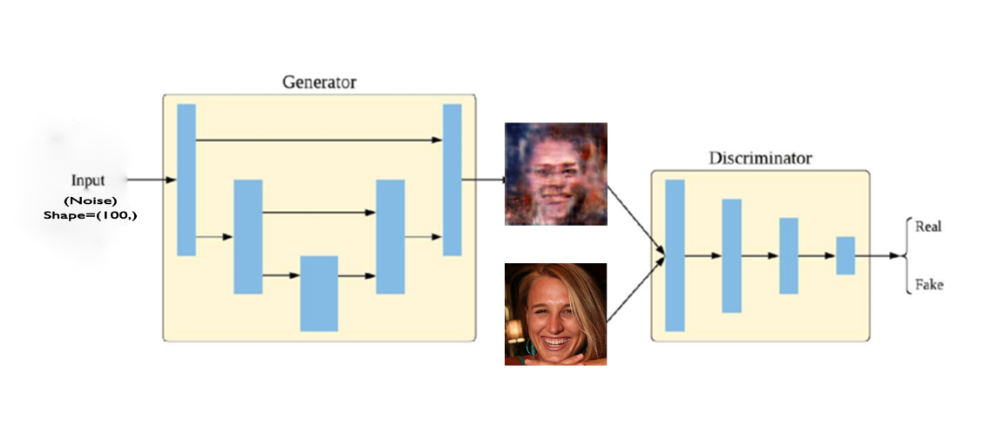
GAN Model

Slide 7
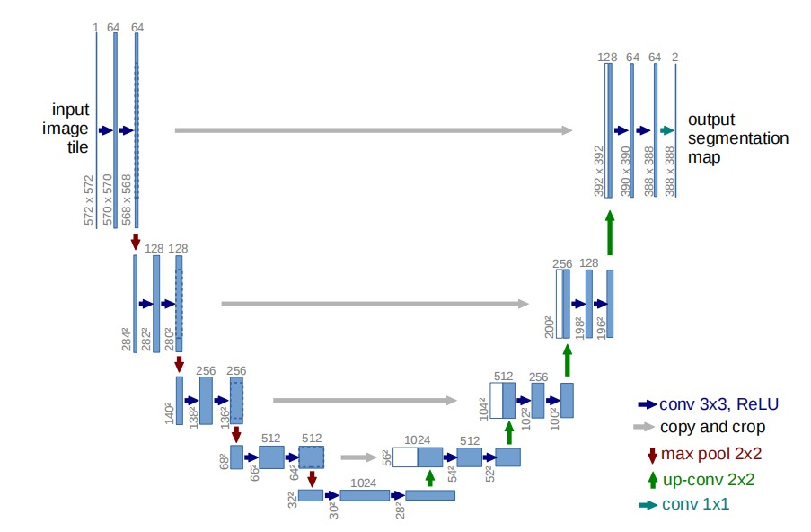
U-Net Architecture
The encoder part in the U-Net performs per -pixel classification and the decoder part give per-pixel decision providing spatial coherent feedback to the generator.
Input dimension is (100,) passed to the generator a U-Net architecture and a few convolutional layers.

Slide 8
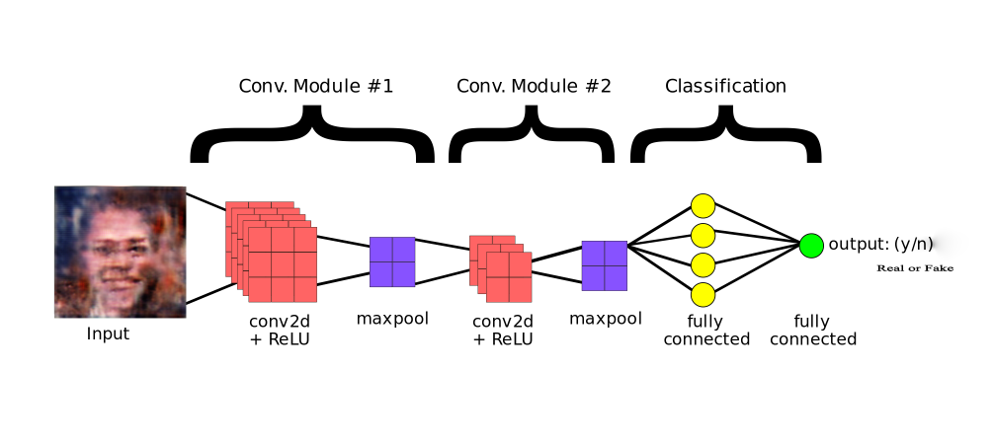
Discriminator

Slide 9

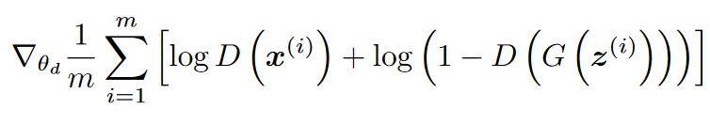
Loss Function
Generator Loss:
Discriminator Loss:

Slide 10
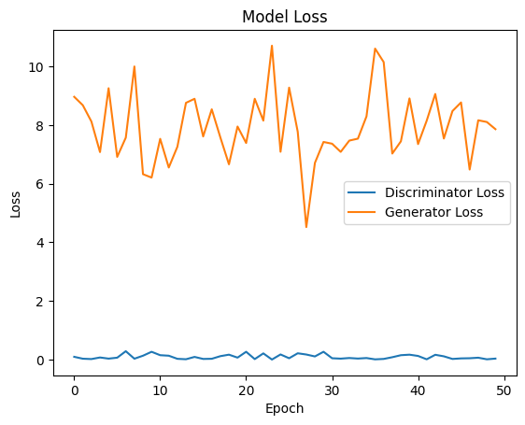
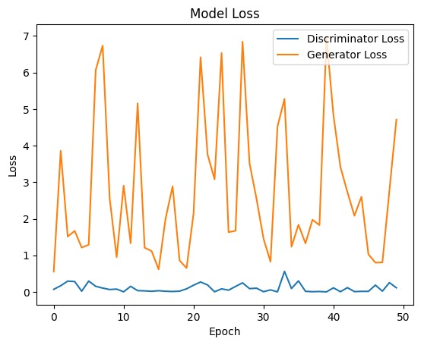
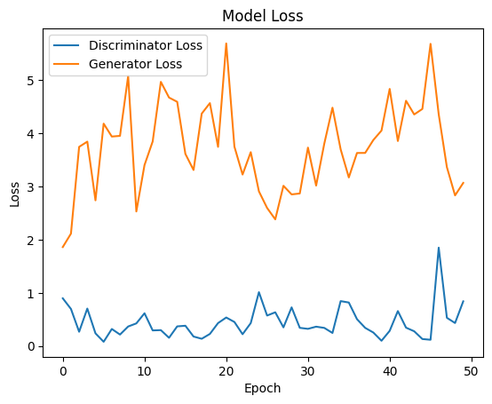
Model Loss
Simple GAN
U-Net GAN
U-Net GAN with CutMix Augumentation

Slide 11
Evaluation
 | SSIM | FID
Simple GAN | 0.52511 | 8331
U-Net GAN | 0.58723 | 8231
U-Net GAN with CutMix Augumentation | 0.5299 | 9474

Slide 12
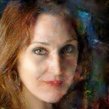
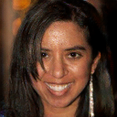
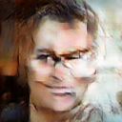
Results
Simple GAN
U-Net GAN
U-Net GAN CutMix Augumentation

Slide 13
References
[1]. E. Schönfeld, B. Schiele and A. Khoreva, "A U-Net Based Discriminator for Generative Adversarial Networks," 2020 IEEE/CVF Conference on Computer Vision and Pattern Recognition (CVPR), Seattle, WA, USA, 2020, pp. 8204-8213, doi: 10.1109/CVPR42600.2020.00823.
[2]. Y. Wang, H. Laria, J. van de Weijer, L. Lopez-Fuentes and B. Raducanu, "TransferI2I: Transfer Learning for Image-to-Image Translation from Small Datasets," 2021 IEEE/CVF International Conference on Computer Vision (ICCV), Montreal, QC, Canada, 2021, pp. 13990-13999, doi: 10.1109/ICCV48922.2021.01375.
[3]. A. Al-qerem, Y. S. Alsalman and K. Mansour, "Image Generation Using Different Models Of Generative Adversarial Network," 2019 International Arab Conference on Information Technology (ACIT), Al Ain, United Arab Emirates, 2019, pp. 241-245, doi: 10.1109/ACIT47987.2019.8991120.
[4] https://keras.io/examples/vision/cutmix/
[5] https://www.tensorflow.org/tutorials/generative/pix2pix

Slide 14
THANK YOU

