Slide 1

Business Development New Ice Cream shop venue
Raghunath Nair
IBM

Slide 2
Introduction
A Business development consultant has been tasked to make recommendations to a Venture Capitalist on opening a new Ice Cream shop in Bangalore.
The client would like a neighbourhood with other Indian Restaurants, but a location having not much competition in the area
The project provides an exploratory data analysis and visualizations to eventually come to a recommended location(s).

Slide 3
Data
The data to be used for this project consists the Foursquare location data for the City of Bangalore. More precisely the dataset would use the following features for exploratory data analysis and necessary machine learning involved.
Neighbourhood, Neighbourhood Latitude, Neighbourhood Longitude, Venue, Venue Latitude, Venue Longitude, Venue Categorys

Slide 4
Methodology
- Get Neighbourhoods in Bangalore
Beautiful Soup is a Python library for pulling data out of HTML and XML files; this has been used for extracting the list of neighbourhoods in Bangalore
- Get coordinates for each neighbourhood
Use GEOPY library to get the latitude and longitude values of the above neighbourhoods in Bangalore City
- Visualize using Folium
It makes sense to visualize the datasets at each stage of the data wrangling as it could stimulate new ideas and provide different perspectives. Then we create a map of Bangalore using latitude and longitude values

Slide 5
Methodology
Top 10 most venue categories: Use the foursquare APIs to get the nearest X venues and venue categories, which will be used for clustering the neighbourhoods. Since there are so many venue categories, only Top 10 were chosen for this exercise
Optimal number of clusters
The optimal number of clusters is found out by the silhouette score whose value is a measure of how similar an object is to its own cluster (cohesion) compared to other clusters (separation). The silhouette ranges from −1 to +1, where a high value indicates that the object is well matched to its own cluster and poorly matched to neighbouring clusters.
K-means clustering
The above Bangalore neighbourhoods and venue data is trained using K-means Clustering Algorithm to get the desired clusters to base the analysis on. K-means was chosen since the variables(categories in this case) are large, the K-Means most of the times is computationally faster.
Narrowing Down
Subsequently we narrow down the cluster step-by-step to just a few points based on certain conditions like, the venue should have restaurants and clothing stores, but not many ice cream parlours and desserts in its vicinity or as the most common venue category

Slide 6
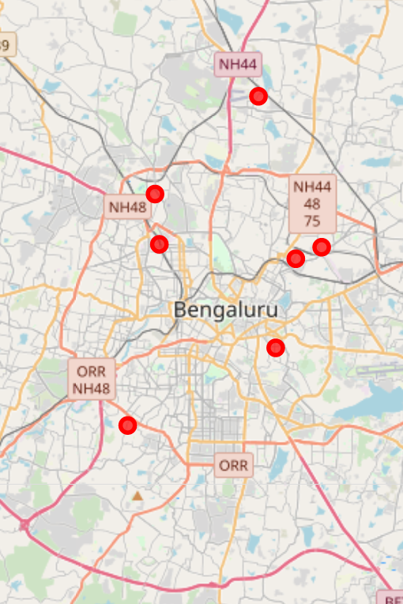
Results
To find an Ice cream storefront site accessible from main roads, with easy access, and with sufficient customer parking, we need to look for locations near businesses, like children’s clothing stores or Indian restaurants.
To narrow down our search and visualize at each step helps the Stakeholders to make business decisions as per company strategy
On applying the filter conditions we can see that the target locations meeting the required conditions were narrowed down to just 8

Slide 7

Discussion
From the exploratory analysis, clustering and filtration process based on venue categories, we can see that there are lots of neighbourhoods which have Restaurants among the top 10 venues.
However we found from the above exercise that localities where we have Restaurants and clothing Stores as most common venues, BUT which do not have ice cream shops or desserts or juice bars are very few.
This entire process provides interesting insights into the problem allowing stake holders to make easier decision making which are aligned to the business strategy

Slide 8
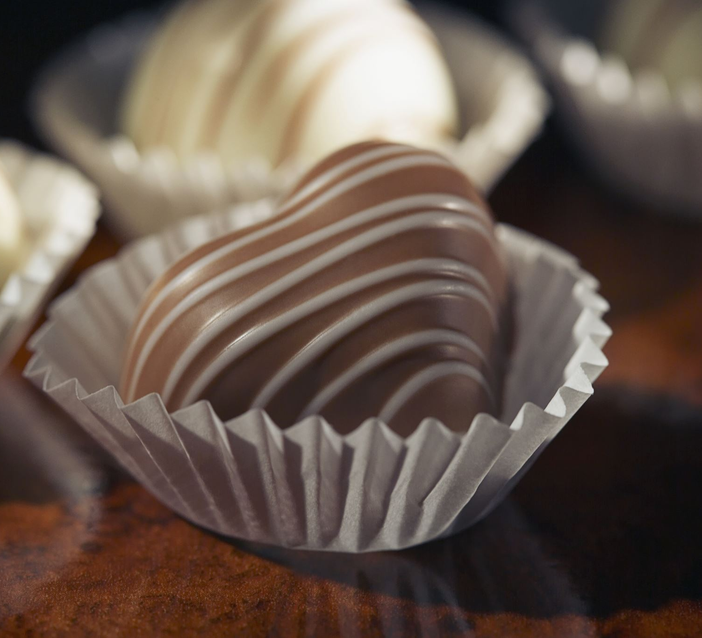
Conclusion
A possible recommendation could bee that - since Jakkur is emerging as an upcoming residential property market and not reached full potential, this could possibly be a good candidate for opening an Ice cream shop, and it also meets all the necessary conditions.

Slide 9

Reference
https://github.com/raghunath-nair/Coursera_capstone_W4

