Slide 1
Group 9
Assignment - 1

Slide 2
Group 9 - Our solution
Kinematic point: Turn towards goal, go at max
velocity and change final velocity. Is optimal (or
close to) for most environments.
Differential drive: Turn-on-spot strategy. Use
maximum velocity for rest. Is not optimal (but
close)
Dynamic point: Create a dubins path between
critical points in the RRT. Check if path collides.
Is not optimal (but still fast!). Points acceleration
towards center (while turning), otherwise along
velocity
Kinematic car: Basically the same strategy as
for dynamic point but here no acceleration.
Pathfinding and collision avoidance
● Implemented RRT and RRT*
● Greedy solution for a better path (
closest node get to goal, can remove
nodes)
● RRT is biased towards goal (prob. of goal
being sampled 0.2)
● We don’t get an optimal path every time
but it requires very little computation and a
low number of nodes (500-1500)
● Since the RRT is small we can perform a
complete point-in-polygon and segment
intersection for every node,edge in graph
● We furthermore do collision checks for the
tangents in our Dubins paths

Slide 3
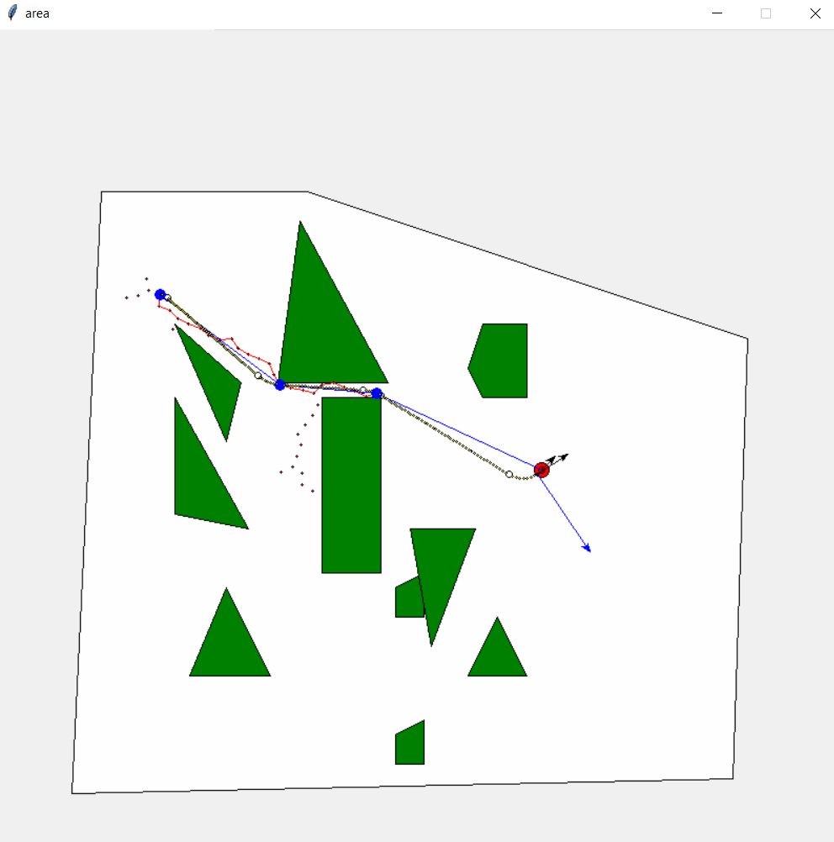
Dynamic Point – P12

Slide 4
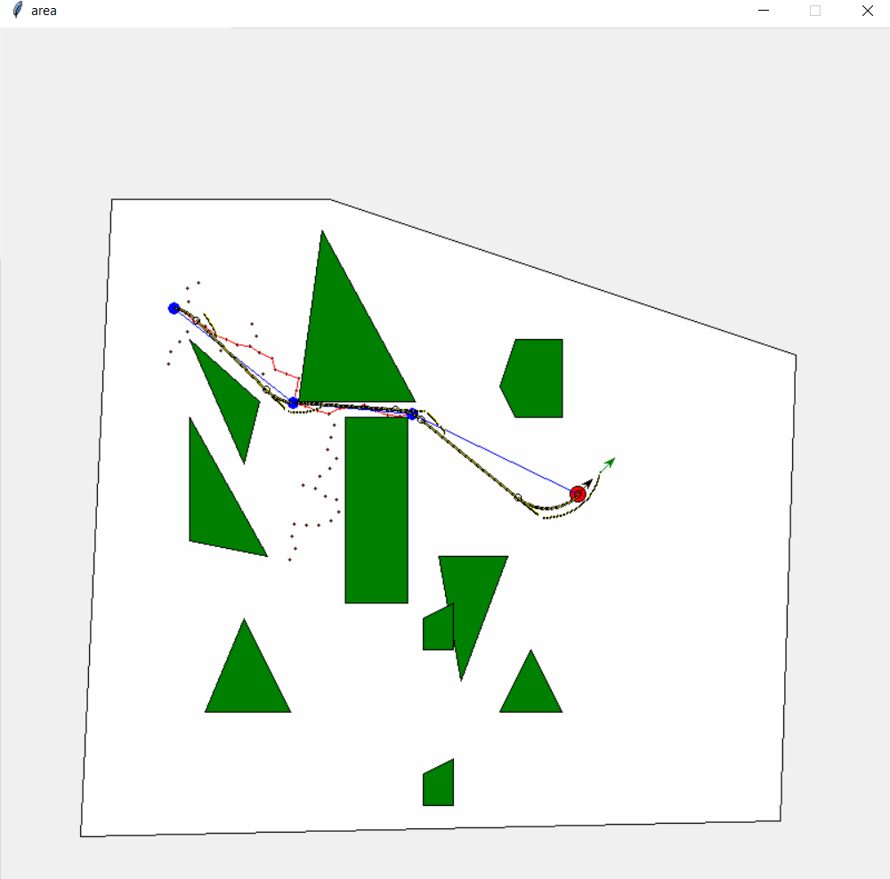
Kinematic Car – P12

Slide 5
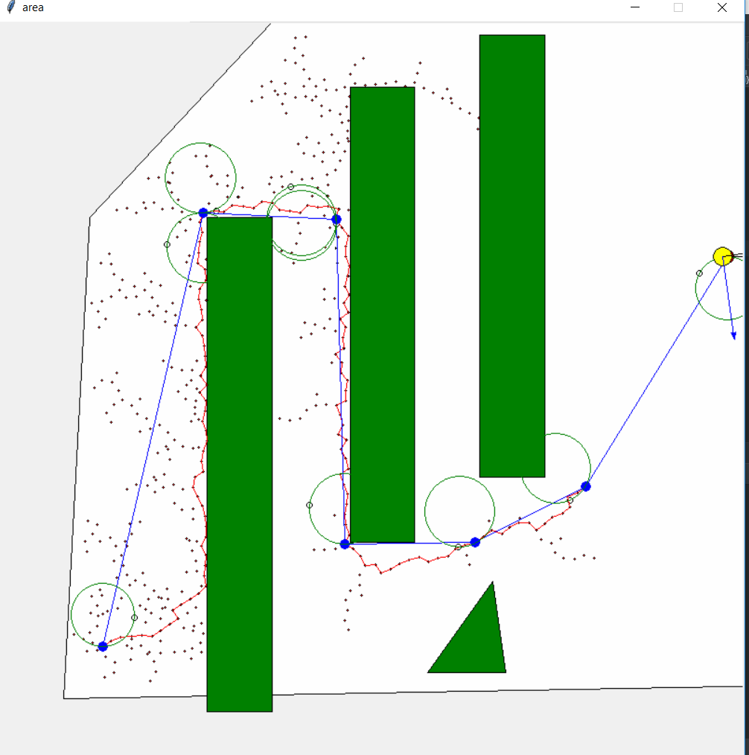
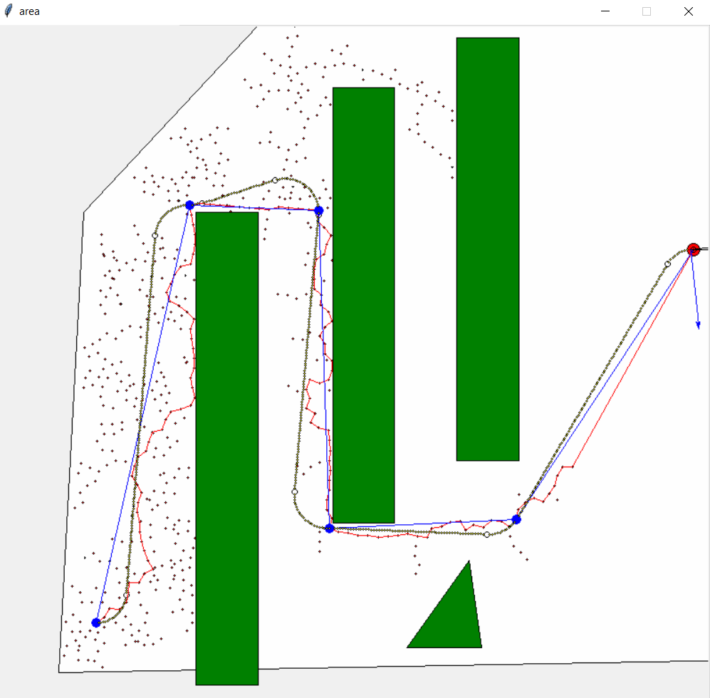
Dynamic Point – P13

Slide 6
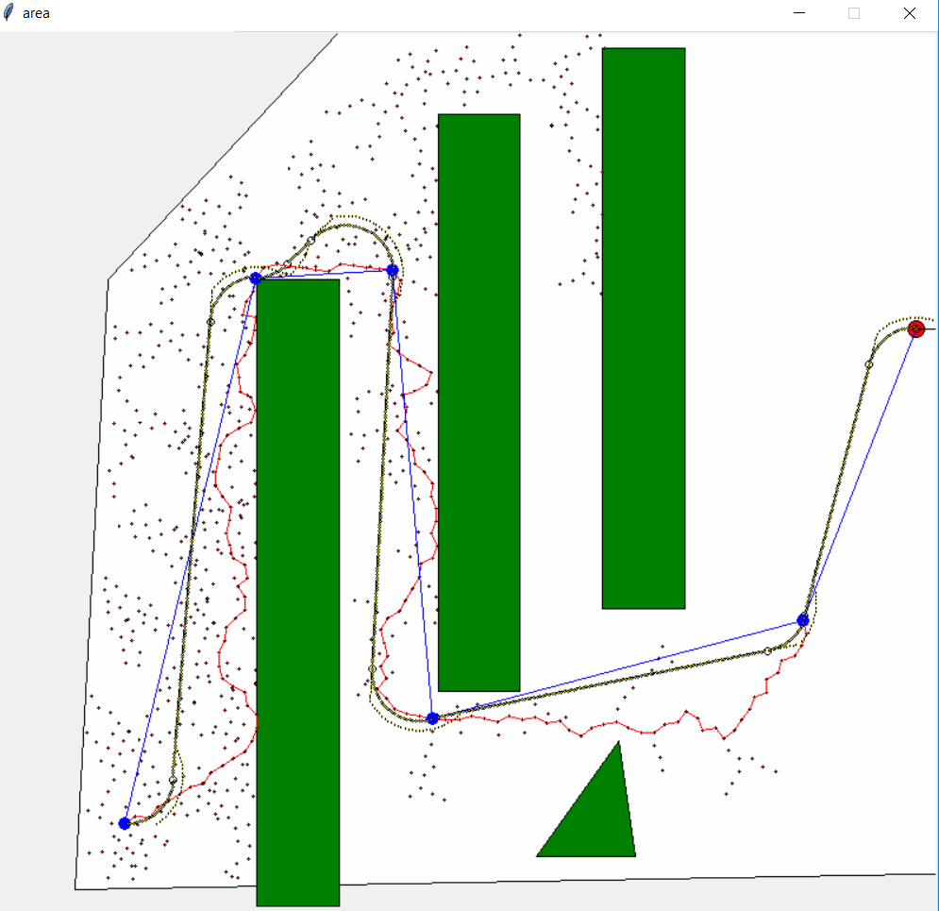
Kinematic Car – P13

