Slide 1
Setup Kubernetes
Local Environment
Minikube (Singlenode)
MicroK8s (SinglenodeProdgrade)
Kubeadm (Multinode)
Cloud
GCP
AWS
Microsoft Azure
Practice
Online CLI tutorials.

Slide 2
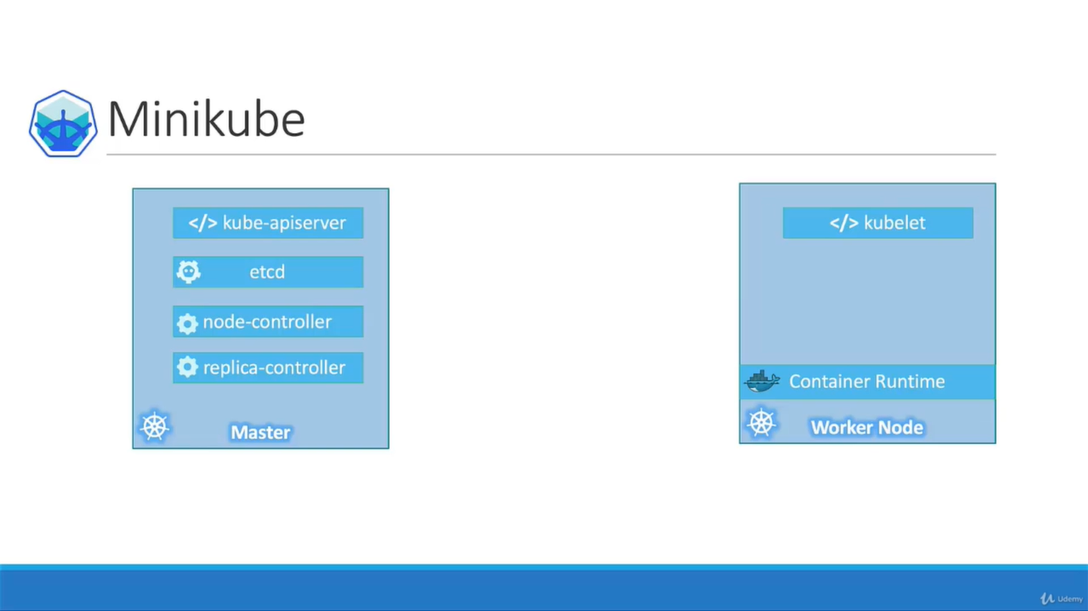

Slide 3
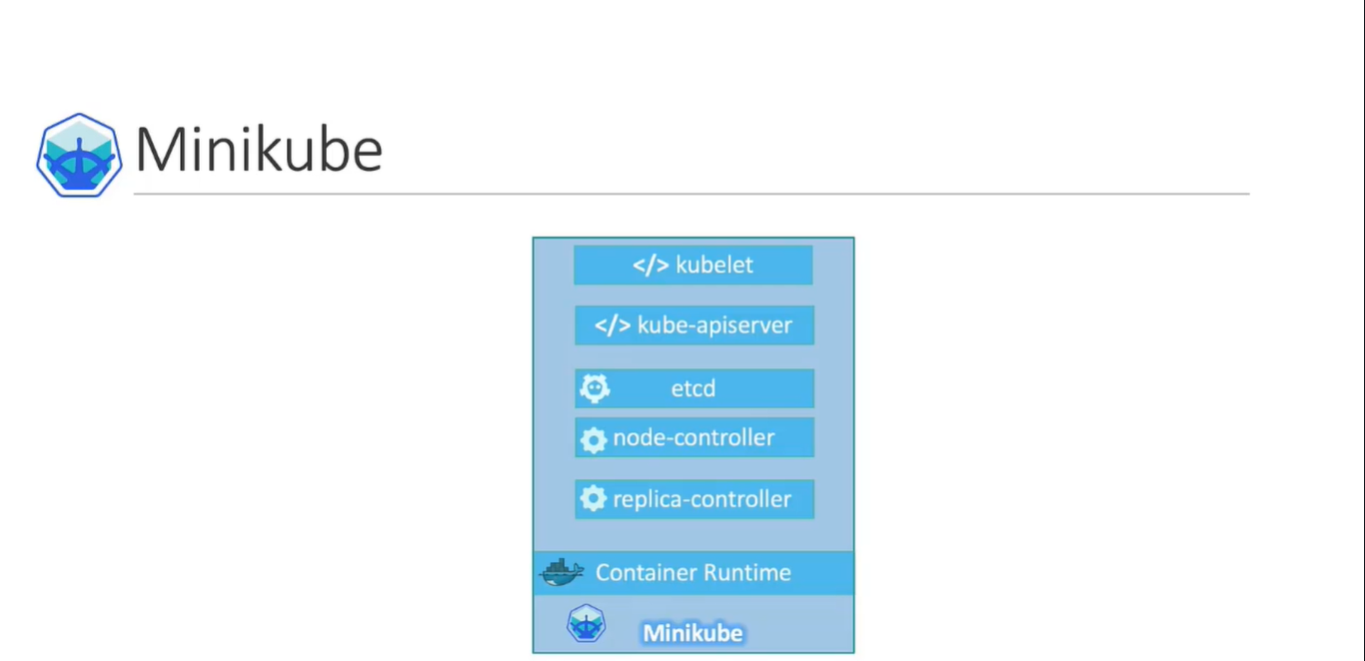

Slide 4
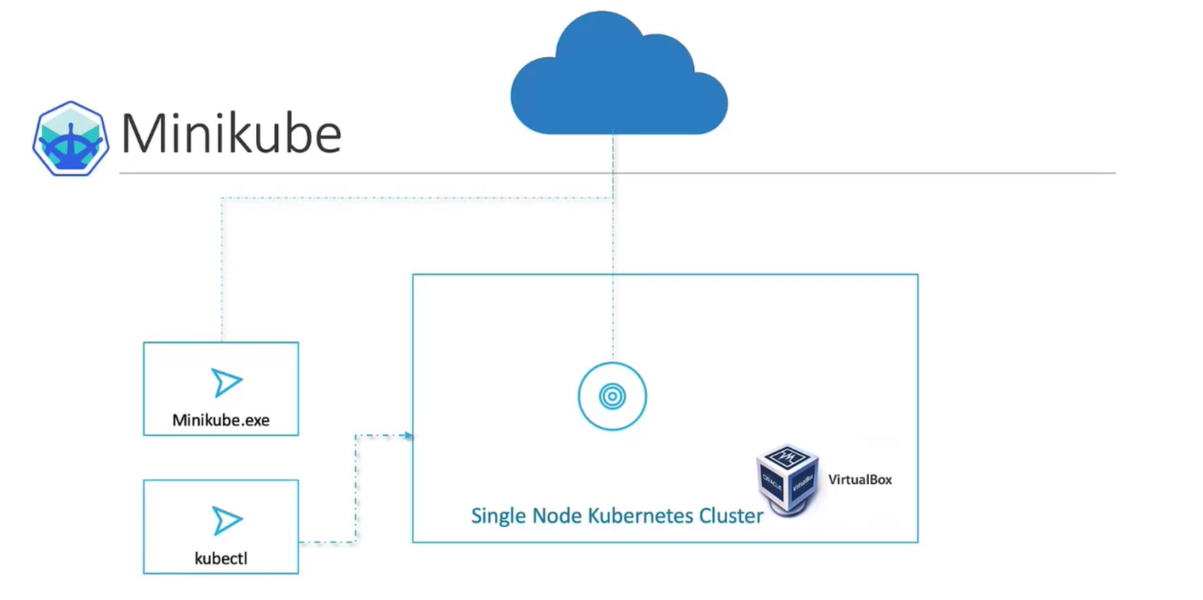
Windows OS
HyperV / VirtualBox
Linux
KVM / VirtualBox
The 3 components required
Kubectl
Minikube.exe
Hypervisor

Slide 5
Quiz
Question 1:Which of the below is an option to run Kubernetes in a Local Environment?
kubectl
kube-server
minikube
play-with-k8s.com

Slide 6
Quiz
Question 2:Which of the below is an instant way of setting up a permanent kubernetes cluster on the cloud?
kubeadm tool
minikube
Google Container Engine
Play-with-k8s.com

Slide 7
Quiz
Question 3:Which of the below solution is used for setting up a multi-node Kubernetes cluster in a local environment?
minikube
kubeadm
GCE
Play-with-k8s.com

Slide 8
Reference
The upcoming demo is completely optional, unless you want to setup a local environment on your laptop. Our hands-on labs will be sufficient for you to practice.
Some links used in the upcoming demo may have changed. Please find the latest links to the documentation topics below:
Install MiniKube: https://kubernetes.io/docs/tasks/tools/install-minikube/
VirtualBox: https://www.virtualbox.org/wiki/Downloads
MiniKube Download page for Windows: https://github.com/kubernetes/minikube/releases
While using Minikube with Virtualization technologies, specify the --vm-driver option like this:
minikube start --vm-driver=<driver_name>
More about it here: https://kubernetes.io/docs/setup/learning-environment/minikube/#specifying-the-vm-driver

Slide 9
Lab
https://kodekloud.com/p/public-labs?scenario=kubernetes-for-beginners-basiccommands-test

