Slide 1
Nagios

Slide 2

Introduction
A key measurement tool for actively monitoring availability of devices and services.
Possible the most used open source network monitoring software.
Has a web interface.
  Uses CGIs written in C for faster response and scalability.
Can support up to thousands of devices and services.

Slide 3
Installation
In Debian/Ubuntu
# apt-get install nagios3
Files are installed here:
/etc/nagios3
/etc/nagios3/conf.d
/etc/nagios-plugins/conf
/usr/share/nagios3/htdocs/images/logos
/usr/sbin/nagios3
/usr/sbin/nagios3stats
Nagios web interface is here:
    http://localhost/nagios3/

Slide 4
Nagios Web Interface
We’ll demonstrate this now…

Slide 5
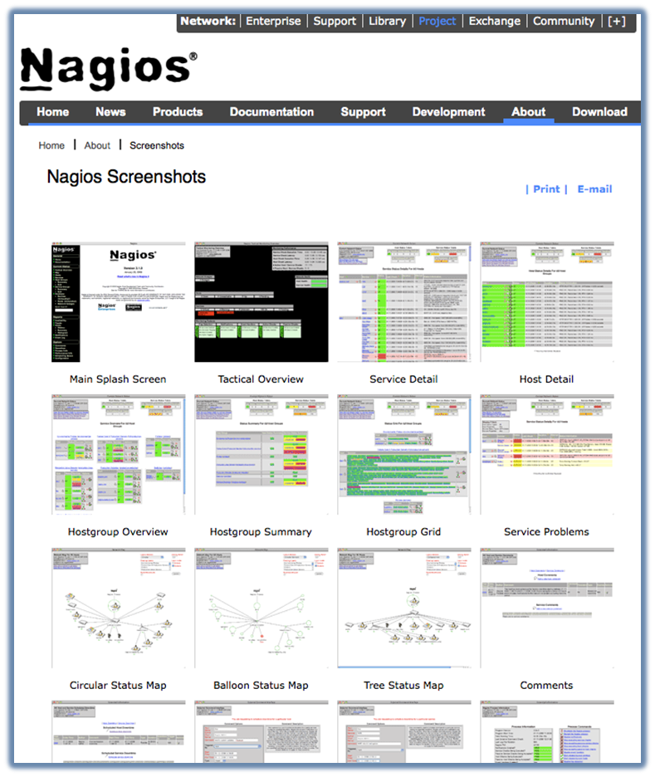
More sample screenshots
Many more sample Nagios screenshots available here:
http://www.nagios.org/about/screenshots

Slide 6
Features
Verification of availability is delegated to plugins:
  The product's architecture is simple enough that writing new plugins is fairly easy in the language of your choice.
  There are many, many plugins available.
Nagios uses parallel checking and forking.
  Version 3 of Nagios does this better.

Slide 7
Features cont.
Has intelligent checking capabilities. Attempts to distribute the server load of running Nagios (for larger sites) and the load placed on devices being checked.
Configuration is done in simple, plain text files, but that can contain much detail and are based on templates.
Nagios reads it's configuration from an entire directory. You decide how to define individual files.

Slide 8
Features cont.
Utilizes topology to determine dependencies.
  Nagios differentiates between what is down vs. what is not available. This way it avoids running unnecessary checks.
Nagios allows you to define how you send notifications based on combinations of:
  Contacts and lists of contacts
  Devices and groups of devices
  Services and groups of services
  Defined hours by persons or groups.
  The state of a service.

Slide 9
The concept of “parents”
Nodes can have parents:
  For example, the parent of a PC connected to a switch would be the switch.
  This allows us to specify the network dependencies that exist between machines, switches, routers, etc.
  This avoids having Nagios send alarms when a parent does not respond.
  A node can have multiple parents.

Slide 10
Network viewpoint concept
Where you locate your Nagios server will determine your point of view of the network.
Nagios allows for parallel Nagios boxes that
run at other locations on a network.
Often it makes sense to place your Nagios server nearer the border of your network vs.
in the core.

Slide 11
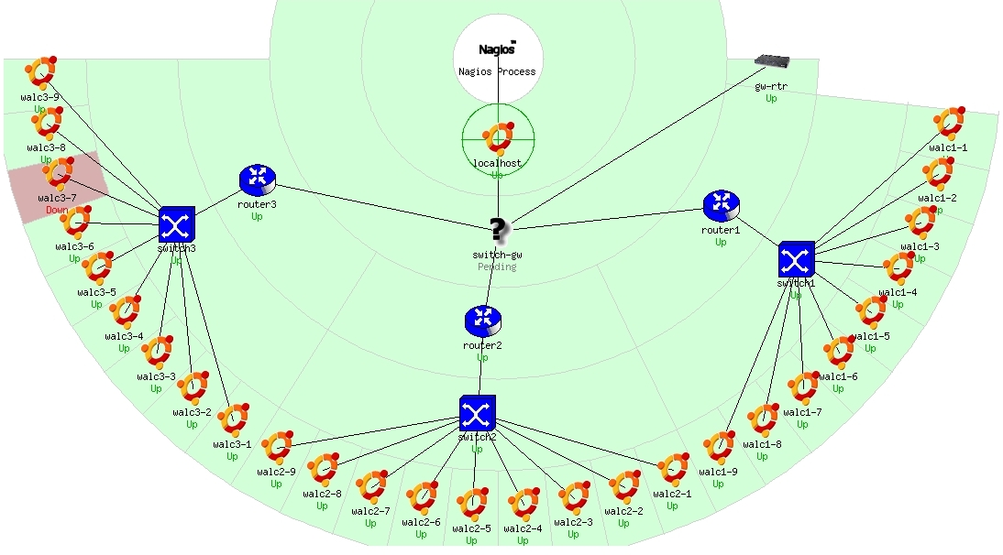
Network viewpoint

Slide 12
Configuration Files
Located in /etc/nagios3/
Important files include:
  cgi.cfg Controls the web interface and
  security options.
  commands.cfg The commands that Nagios uses
  for notifications.
  nagios.cfg Main configuration file.
  conf.d/* All other configuration goes here!

Slide 13
Configuration files continued
Under conf.d/* (sample only)
contacts_nagios3.cfg users and groups
generic-host_nagios2.cfg default host template‏
generic-service_nagios2.cfg default service template
hostgroups_nagios2.cfg groups of nodes
services_nagios2.cfg what services to check
timeperiods_nagios2.cfg when to check and who
to notifiy

Slide 14
Configuration files continued
Under conf.d some other possible configfiles:
host-gateway.cfg Default route definition
extinfo.cfg Additional node information
servicegroups.cfig Groups of nodes and services
localhost.cfg Define the Nagios server itself
pcs.cfg Sample definition of PCs (hosts)
switches.cfg Definitions of switches (hosts)
routers.cfg Definitions of routers (hosts)

Slide 15
Pre-installed plugins in Ubuntu
check_bgpstate check_hpjd check_mailq check_overcr
check_ssmtp check_breeze check_http check_mrtg
check_pgsql check_swap check_by_ssh check_icmp
check_mrtgtraf check_ping check_tcp check_clamd
check_ide_smart check_mysql check_pop check_time
check_cluster check_ifoperstatus check_mysql_query
check_procs check_udp check_dhcp check_ifstatus
check_nagios check_radius check_ups check_dig
check_imap check_nntp check_real check_users
check_disk check_ircd check_nntps check_rpc
check_wave check_disk_smb check_jabber check_nt
check_sensors check_dns check_ldap check_ntp check_spop
check_simap check_dummy check_ldaps check_ntp_peer
check_smtp check_file_age check_linux_raid check_ntp_time
check_snmp check_flexlm check_load check_nwstat

Slide 16
Nodes and services configuration
Based on templates
  This saves lots of time avoiding repetition
  Similar to Object Oriented programming
Create default templates with default parameters for a:
  generic node
  generic service
  generic contact

Slide 17
Generic node template
define host{
name generic-host
notifications_enabled 1
event_handler_enabled 1
flap_detection_enabled 1
process_perf_data 1
retain_status_information 1
retain_nonstatus_information 1
check_command check-host-alive
max_check_attempts 5
notification_interval 60
notification_period 24x7
notification_options d,r
contact_groups nobody
register 0
}

Slide 18
Individual node configuration
define host{
use generic-host
host_name switch1
alias Core_switches
address 192.168.1.2
parents router1
contact_groups switch_group
}

Slide 19
Generic service configuration
define service{
name generic-service
active_checks_enabled 1
passive_checks_enabled 1
parallelize_check 1
obsess_over_service 1
check_freshness 0
notifications_enabled 1
event_handler_enabled 1
flap_detection_enabled 1
process_perf_data 1
retain_status_information 1
retain_nonstatus_information 1
is_volatile 0
check_period 24x7
max_check_attempts 5
normal_check_interval 5
retry_check_interval 1
notification_interval 60
notification_period 24x7
notification_options c,r
register 0
}

Slide 20
Individual service configuration
define service{
host_name switch1
use generic-service
service_description PING
check_command check-host-alive
max_check_attempts 5
normal_check_interval 5
notification_options c,r,f
contact_groups switch-group
}

Slide 21
Beeper and sms messages
It's important to integrate Nagios with something available outside of work
  Problems occur after hours... (unfair, but true)
A critical item to remember: an SMS or message system should be independent from your network.
  You can utilize a modem and a telephone line
  Packages like sendpage, qpage or gnokii can help.

Slide 22
References
Nagios web site
http://www.nagios.org/
Nagios plugins site
http://sourceforge.net/projects/nagiosplug/
Nagios System and Network Monitoring, by Wolfgang Barth. Good book about Nagios.
Unofficial Nagios plugin site
http://www.nagiosexchange.org/
A Debian tutorial on Nagios
http://www.debianhelp.co.uk/nagios.htm
Commercial Nagios support
http://www.nagios.com/

