Slide 1
Automated Computer Management with Ansible
Raghu

Slide 2
What is Ansible?
Simple and easy IT automation
Push model via OpenSSH, agentless
Provisioning
PXE booting and kickstarting bare-metal servers or VMs, or creating virtual or cloud instances from templates
Configuration management
Idempotent server state definitions
Application deployment
One-command standard deployments to update applications across many machines
Continuous delivery
Require sequential success of multiple processes
Security automation
Automate and standardize threat-scanning and firewall updates
Orchestration
Define how multiple configurations interact and ensure the disparate pieces can be managed as a whole
https://docs.ansible.com/ansible/latest/index.html
Notes:
Ansible is an IT automation tool. It can configure systems, deploy software, and orchestrate more advanced IT tasks such as continuous deployments or zero downtime rolling updates.
Ansible’s main goals are simplicity and ease-of-use. It also has a strong focus on security and reliability, featuring a minimum of moving parts, usage of OpenSSH for transport (with other transports and pull modes as alternatives), and a language that is designed around auditability by humans–even those not familiar with the program.

Slide 3
How does Ansible work?
Agentless
Tasks are executed from your machine
Automated
Reliable and less error prone
Playbooks
Configuration/Installation/Deployment in a single YAML file, doubles as notes
Inventories
Tasks can be executed on groups of machines
Module
Atomic task e.g. Copy file
Task
Uses a module with arguments
Play
A series of tasks with designated hosts and user
Playbook
A series of plays
https://www.ansible.com/overview/how-ansible-works

Slide 4
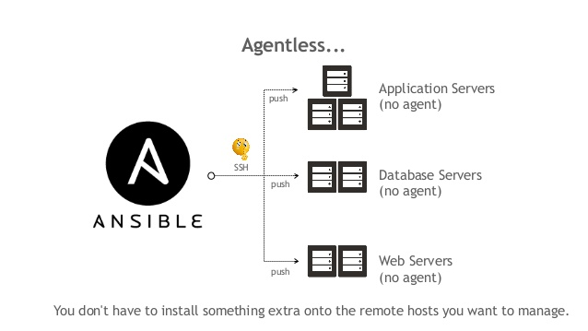
How does Ansible work? – Agentless
on
your machine
https://www.slideshare.net/DonghuKIM2/ansible-with-oci-221441463
https://www.ansible.com/overview/how-ansible-works

Slide 5
How does Ansible work? – Modules
Module examples
copy – copy files from control node to target
user – manage users and passwords
package - install, update, remove tools using target package manager
service – manage target system services using target init system
firewalld – manage firewall configuration
file – set permissions and ownership
lineinfile – manage single lines on existing files
command – allows for arbitrary commands, best practice is to avoid this
> ansible outland.fnal.gov -m ping
ansible – command line tool
outland.fnal.gov – remote hostname
-m – module flag
ping – built-in Ansible module that does exactly what it says
https://docs.ansible.com/ansible/latest/user_guide/modules_intro.html

Slide 6
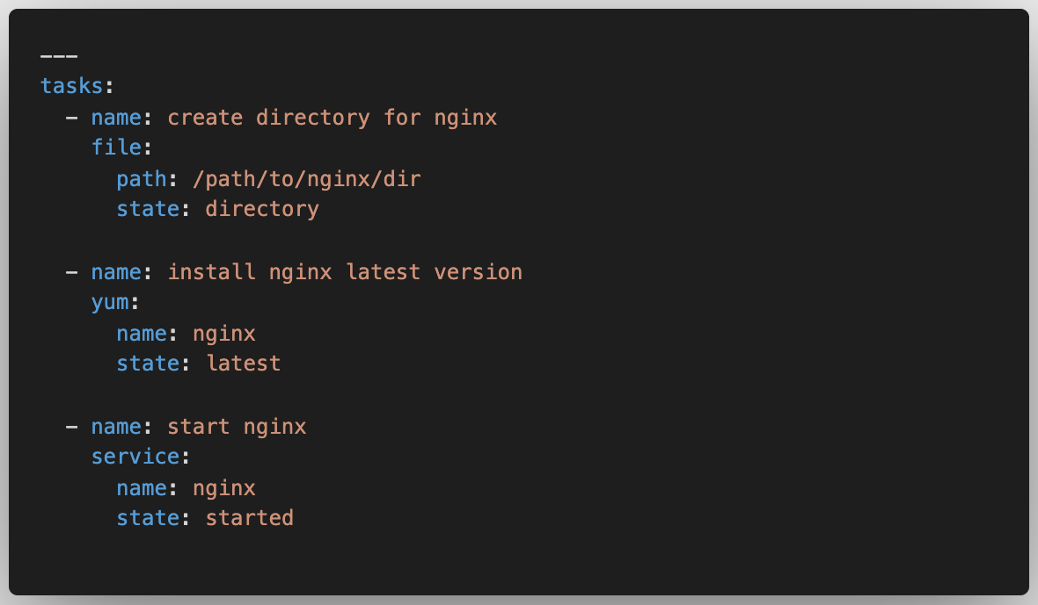
How does Ansible work? – Tasks
Tasks are modules with arguments.
Ansible allows users to create predefined series of tasks in YAML files.
https://docs.ansible.com/ansible/latest/user_guide/index.html#writing-tasks-plays-and-playbooks

Slide 7
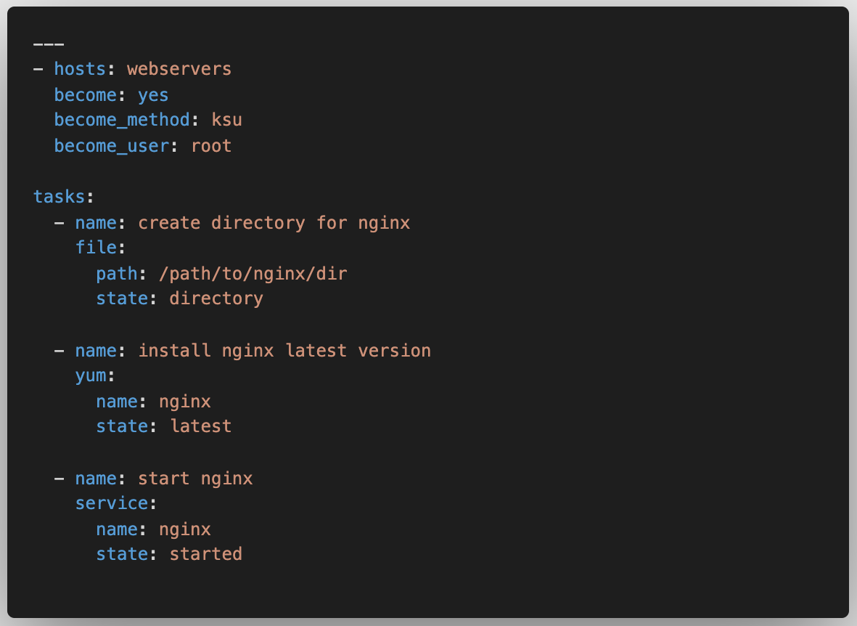
How does Ansible work? – Plays
Plays are a series of tasks with a designated hosts and user.
Ansible allows users to create predefined plays in YAML files.
https://docs.ansible.com/ansible/latest/user_guide/index.html#writing-tasks-plays-and-playbooks

Slide 8
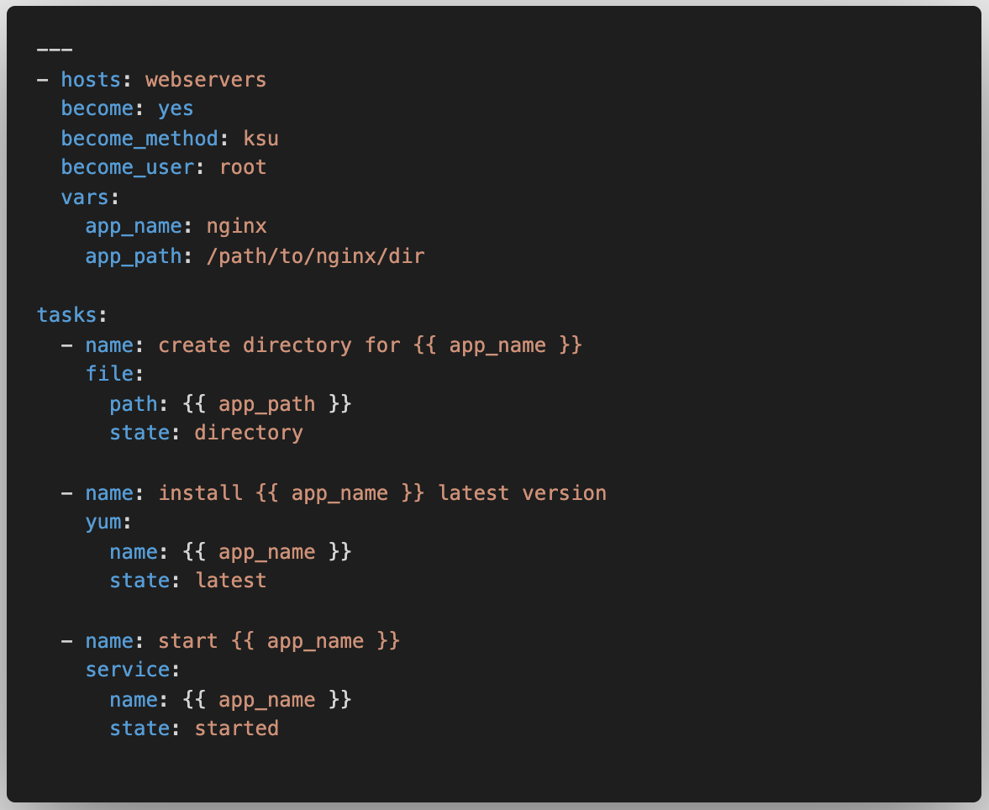
How does Ansible work? – Variables
Variables can help prevent typos and make updates simple.
It’s clear that if we can substitute the variables this play is a generic solution for installing and starting a service.
https://docs.ansible.com/ansible/latest/user_guide/playbooks_variables.html

Slide 9
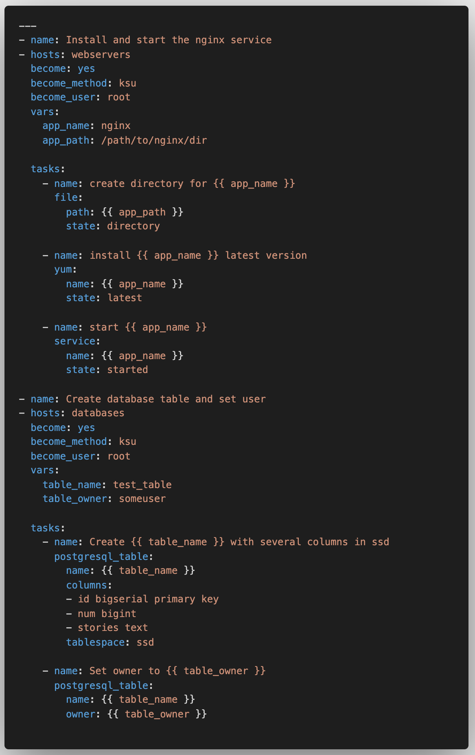
How does Ansible work? – Playbook
Playbooks define how, in which order, on which machines, and what modules should be executed.
Now we are orchestrating module execution!
https://docs.ansible.com/ansible/latest/user_guide/playbooks_intro.html

Slide 10
How does Ansible work? – Playbook
Playbooks define how, in which order, on which machines, and what modules should be executed.
Now we are orchestrating module execution!
What is this magic!?
”webservers” and “databases” are are inventories of remote hosts.
https://docs.ansible.com/ansible/latest/user_guide/playbooks_intro.html

Slide 11
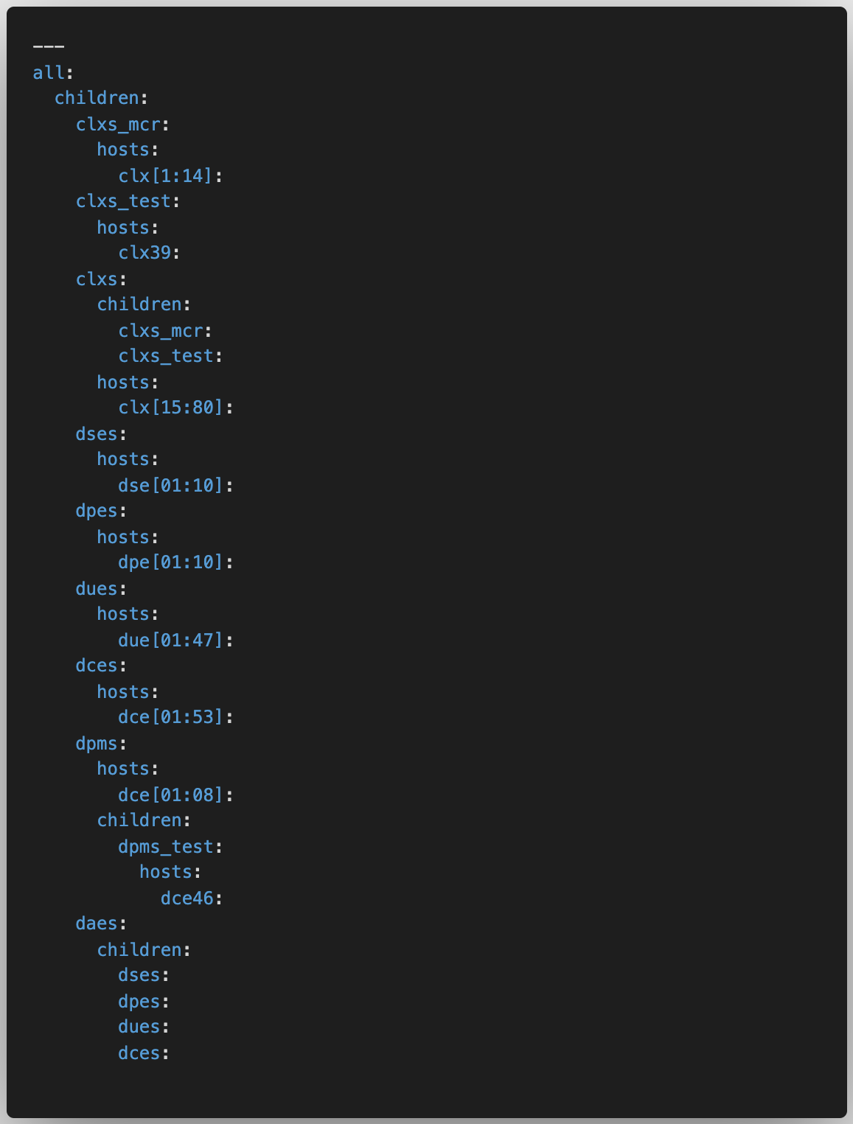
How does Ansible work? – Inventory
Groups allow for aliasing lists of targets
Hosts can be in multiple groups
Hosts with a common naming scheme can be added using the range syntax
This syntax also allows for a stride e.g. clx[01:80:2] odd CLXs
Ansible command line allows for pattern matching and sub-selection from inventory
Multiple hosts/groups – dses:dpes
Exclude – daes:!dpms
Intersection – dces:&dpms_test
> ansible-playbook test-playbook.yaml --limit ‘all:!clxs_test:!dpms_test’
https://docs.ansible.com/ansible/latest/network/getting_started/first_inventory.html

Slide 12
How does Ansible work? – Ad-hoc commands
“Playbooks seem cumbersome for simple tasks”
Ad-hoc commands allow basic commands using Ansible inventories.
> ansible daes -a “/sbin/shutdown”
Modules can be used in conjunction with ad-hoc commands.
> ansible daes –m user –a “name=beau state=absent”
https://docs.ansible.com/ansible/latest/user_guide/intro_adhoc.html

Slide 13
Ansible Galaxy
Hosted shared Ansible content at https://galaxy.ansible.com/
Can be a useful reference to see how common problems are solved.

Slide 14

Use Case
Education Payroll Limited manages payroll services for New Zealand’s 2,500 schools. To replace complex, time-consuming manual processing for 14,000 submissions every two weeks, the organization created a digital payroll application, called EdPay. Working with local partner Deloitte New Zealand, Education Payroll used Red Hat OpenShift and Red Hat Ansible Automation Platform to create a reliable, scalable foundation for EdPay. An accessible, efficient experience for school administrators and principals, EdPay now supports near real-time status information and zero-downtime updates to enhance available features and capabilities

Slide 15
Use cases:
Provisioning: Provisioning is creating new infrastructure. Ansible allows for application management, deployment, orchestration, and configuration management.
Continuous Delivery: Ansible provides a simpler way to automatically deploy applications. All required services for a deployment can be configured from a single system. Continuous Integration (CI) tool can be used to run Ansible playbook which can be used to test and automatically deploy the application to production if tests are passed.
Application Deployment: Ansible provides a simpler way to deploy applications across the infrastructure. Deployment of multi-tier applications can be simplified and the infrastructure can be easily changed over time.
Ansible for Cloud Computing: Ansible makes it easy to provision instances across all cloud providers. Ansible contains multiple modules and allows to manage of large cloud infrastructure across the public-private and hybrid cloud.
Ansible for Security and Compliance: You can define security policies in Ansible which will automate security policy across all machines in the network. Security roles once configured in an Ansible node will be embedded across all machines in the network automatically.

