Slide 1
YAML
Introduction

Slide 2
If you are familiar with
XML
JSON
YAML can easily pick it up
If not this briefing will help

Slide 3

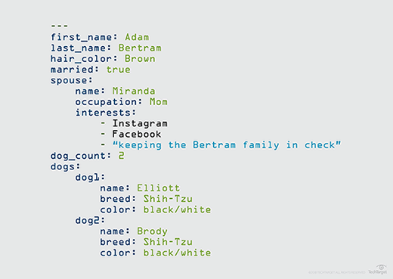
Sample

Slide 4
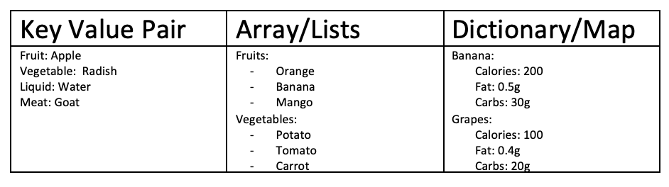
YAML
Key value pair
Array/Lists
Dictionary/Map

Slide 5
Dictionary/Map
Banana
calories: 200
fat: 0.5g
carbs: 30g
Banana
calories: 200
fat: 0.5g
carbs: 30g
Note: Equal number of spaces is key here or it will not make any sense

Slide 6
YAML - ADVANCED
Fruits:
- Banana:
calories: 200
fat: 0.5g
carbs: 30g
- Grapes
calories: 200
fat: 0.5g
carbs: 30g

Slide 7
DICTIONARY/LIST/LIST OF DICTIONARIES
CAR
Color
Model
Name
Year
Transmission
Price
Color: Blue
Model: Maruti
Name: Alto
Year: 2020
Transmission: Manual
Price: Rs.5,00,000

Slide 8
List of Strings..
CAR with multiple colors
List (of strings)
- White Alto
- Marine Alto
- Black Alto

Slide 9
List of Dictorinaries.
Color: White
Model: Maruti
Name: Alto
Year: 2020
Transmission: Manual
Price: Rs.5,00,000
Color: Marine
Model: Maruti
Name: Alto
Year: 2020
Transmission: Manual
Price: Rs.5,00,000
Color: Black
Model: Maruti
Name: Alto
Year: 2020
Transmission: Manual
Price: Rs.5,00,000

Slide 10
Dictionary / Map
Banana
calories: 200
fat: 0.5g
carbs: 30g
Banana
calories: 200
carbs: 30g
fat: 0.5g
Dictionary – Unordered
The above are same

Slide 11
Array / List
Fruits:
- orange
- apple
- banana
Fruits:
- apple
- orange
- banana
List – Ordered
The above are not same
And # are comments

Slide 12
List of example
Fruits:
- Apple
- Banana
- Orange
Vegetables:
- Carrot
- Tomato
- Cucumber
employee:
name: jacob
sex: male
age: 30
title: systems engineer
Employee:
Name: Jacob
Sex: Male
Age: 30
Title: Systems Engineer
Projects:
- Automation
- Support

Slide 13
List of dictionaries
Employee:
Name: Jacob
Sex: Male
Age: 30
Title: Systems Engineer
Projects:
- Automation
- Support
Payslips:
- Month: June
Wage: 4000
- Month: July
Wage: 4500
- Month: August
Wage: 4000

