Slide 1

Internet Of Things (IoT) Part 2
Raghu Prasad
9845547471
www.kaushalya.tech
FB : https://www.facebook.com/raghuprasadkonandur/
Skill Up-Skill Re-Skill
Excellence in action

Slide 2
Introduction
Raghu Prasad – BE, MS
Total of 23 years of experience
7 years as a lecturer in an Engineering College
16 Years into IT
Worked with companies like CISCO,CSC,ICICI,First Apex – NTT Data
Currently into Corporate training and consultancy
Worked with corporates and public sector
Service Offerings – In person/On-line/Corporate/Academic Institutes
Technologies – Java,Python,Web technologies,Java Script technologies (MEAN stack),IOT,Test Automation,Machine Learning,Artificial Intelligence,ERP
Customers – L & T,NextGen,Incarnus,BGS-IT,Sindhi College

Slide 3
Topics
Communication protocols – Deep dive
Cloud Computing
IoT Platforms
IoT Consortiums

Slide 4
Communication Protocol – MQTT – Deepdive
What is MQTT?
MQTT stands for MQ Telemetry Transport. It is a publish/subscribe, extremely simple and lightweight messaging protocol, designed for constrained devices and low-bandwidth, high-latency or unreliable networks. The design principles are to minimise network bandwidth and device resource requirements whilst also attempting to ensure reliability and some degree of assurance of delivery. These principles also turn out to make the protocol ideal of the emerging “machine-to-machine” (M2M) or “Internet of Things” world of connected devices, and for mobile applications where bandwidth and battery power are at a premium.
Who invented MQTT?
MQTT was invented by Dr Andy Stanford-Clark of IBM, and Arlen Nipper of Arcom (now Eurotech), in 1999.
Where is MQTT in use?
MQTT has been widely implemented across a variety of industries since 1999.
Is MQTT a standard?
As of March 2013, MQTT is in the process of undergoing standardisation at OASIS.
The protocol specification has been openly published with a royalty-free license for many years, and companies such as Eurotech (formerly known as Arcom) have implemented the protocol in their products.
In November 2011 IBM and Eurotech announced their joint participation in the Eclipse M2M Industry Working Group and donation of MQTT code to the proposed Eclipse Paho project.

Slide 5
Communication Protocol – MQTT – Deepdive
How does MQTT relate to SCADA protocol and MQIsdp?
The “SCADA protocol” and the “MQ Integrator SCADA Device Protocol” (MQIsdp) are both old names for what is now known as the MQ Telemetry Transport (MQTT). The protocol has also been known as “WebSphere MQTT” (WMQTT), though that name is also no longer used.
What is WebSphere MQ Telemetry?
This is a product from IBM which implements the MQTT protocol in a very scalable manner and which interoperates directly with the WebSphere MQ family of products.
Are there standard ports for MQTT to use?
Yes. TCP/IP port 1883 is reserved with IANA for use with MQTT. TCP/IP port 8883 is also registered, for using MQTT over SSL.
Does MQTT support security?
You can pass a user name and password with an MQTT packet in V3.1 of the protocol. Encryption across the network can be handled with SSL, independently of the MQTT protocol itself (it is worth noting that SSL is not the lightest of protocols, and does add significant network overhead). Additional security can be added by an application encrypting data that it sends and receives, but this is not something built-in to the protocol, in order to keep it simple and lightweight.
Notable MQTT projects
http://mqtt.org/projects

Slide 6
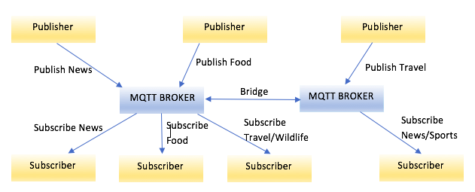
MQTT – Terminologies
Terminology

Slide 7
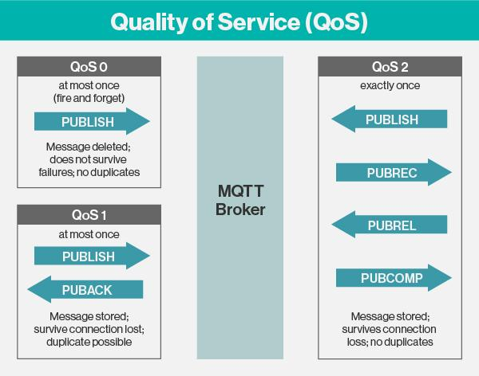
MQTT – Terminologies
Terminology

Slide 8
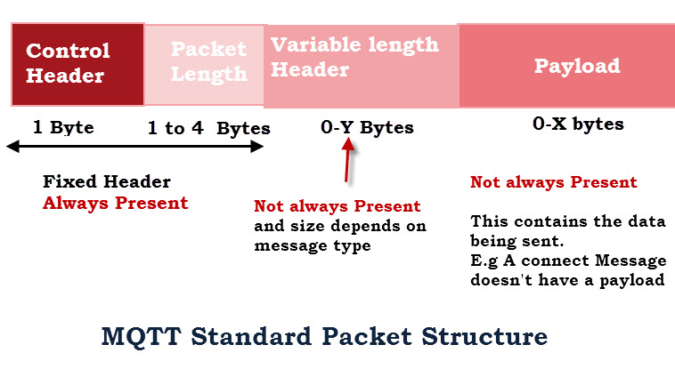
MQTT – Terminologies
Terminology (http://www.steves-internet-guide.com/mqtt-protocol-messages-overview/)

Slide 9
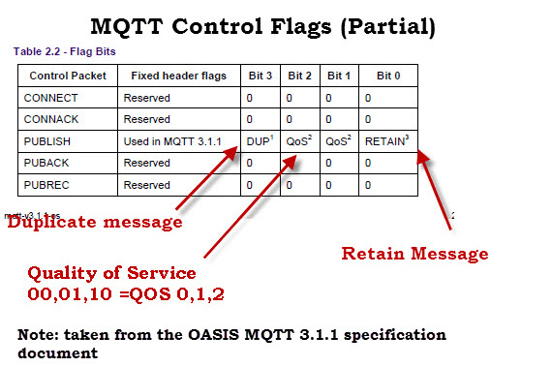
MQTT – Terminologies
Terminology

Slide 10
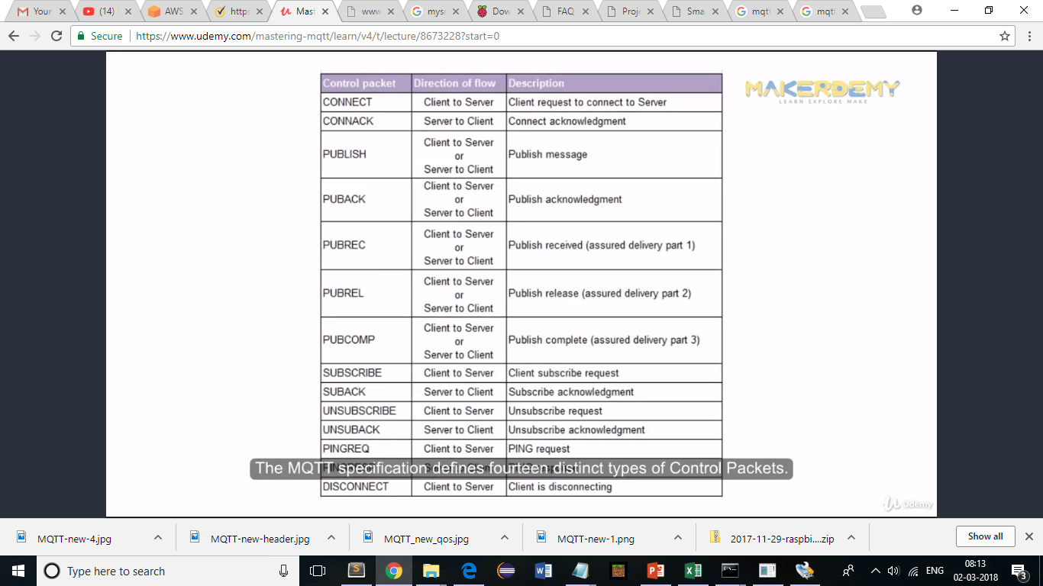
MQTT – Terminologies
Terminology

Slide 11
MQTT - Demo
Broker
M2M Eclipse(m2m.eclipse.org)
Mosquitto (https://mosquitto.org/)
Mosquitto installed on the laptop
Client
MQTT.fx (Web client)
MyMQTT (Android client)
MQTTLens(Chrome Extension)

Slide 12
MQTT – Demo – Scenario 1
Broker – Mosquitto installed on system
Client - Mosquitto installed on system (Publisher and Subscriber)
Steps
Download mosquitto (https://mosquitto.org/download/)
Install mosquito
Start mosquitto as a windows service
Publish and Subscribe

Slide 13
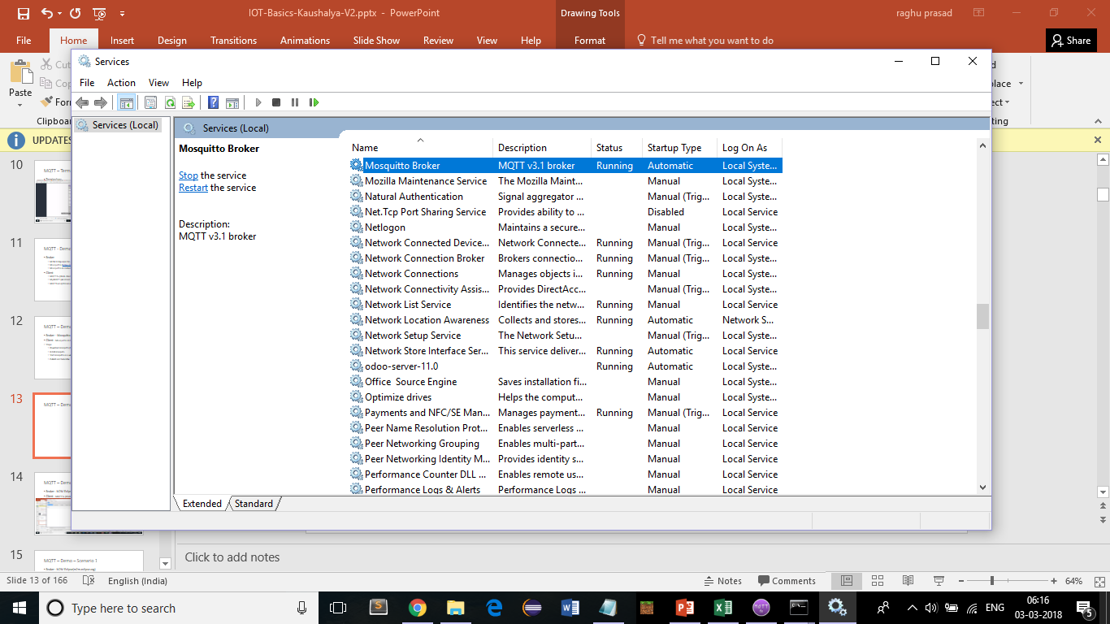
MQTT – Demo – Scenario 1

Slide 14
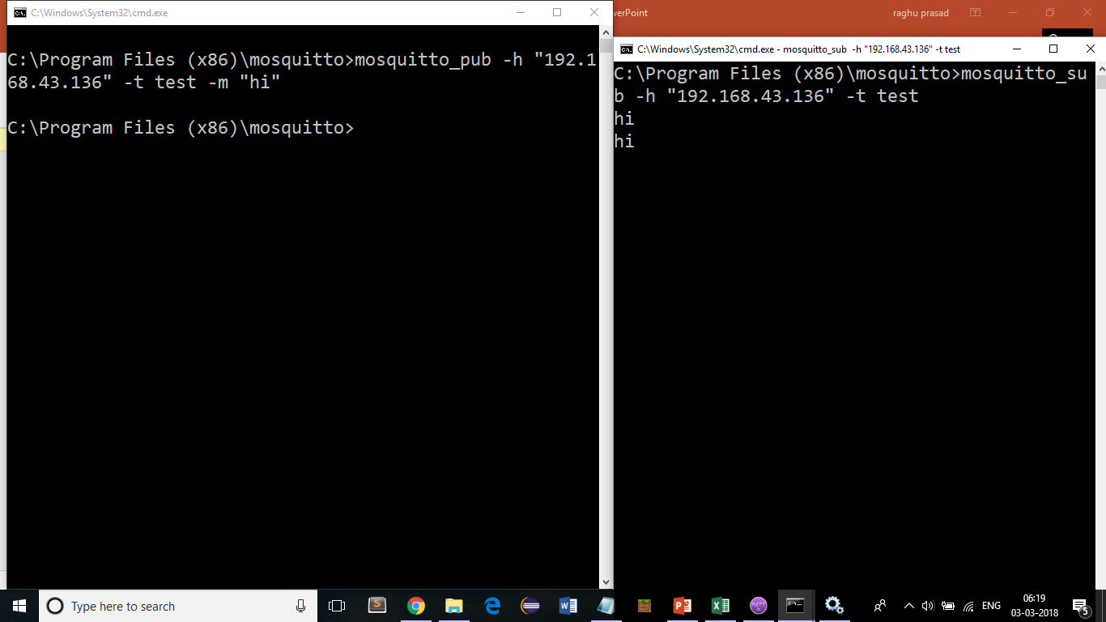
MQTT – Demo – Scenario 1

Slide 15
MQTT – Demo – Scenario 1
To check running of mosquitto on port 1883
netstat -an | findstr 1883
Publish message
mosquitto_pub -h "192.168.43.136" -t test -m "hi"
Subscribe to message
mosquitto_sub -h "192.168.43.136" -t test

Slide 16
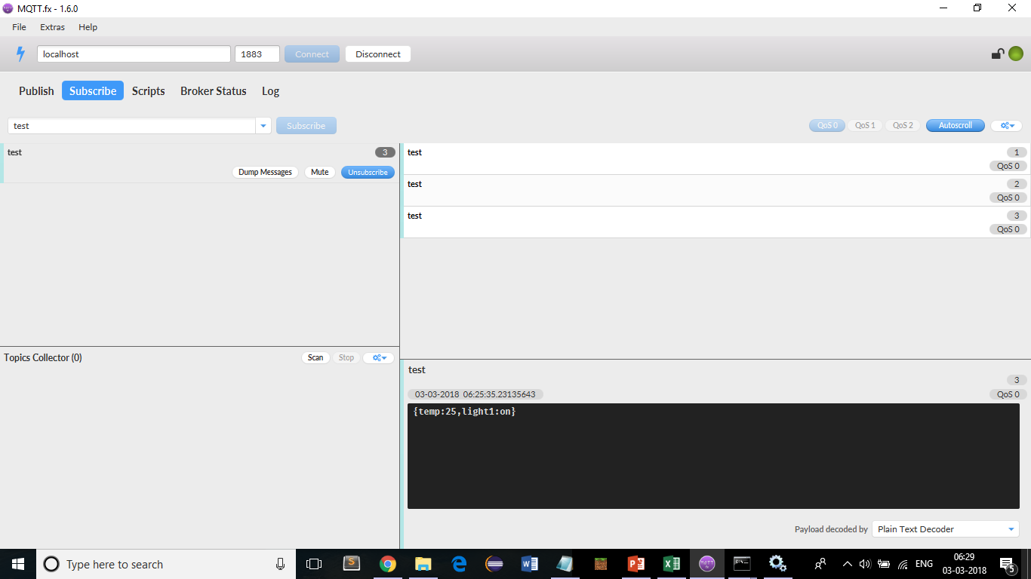
MQTT – Demo – Scenario 2
Broker – Mosquitto on local system
Client - MQTT.fx (Web client) (Download - http://mqttfx.jensd.de/index.php/download http://mqttfx.jensd.de/index.php/download

Slide 17
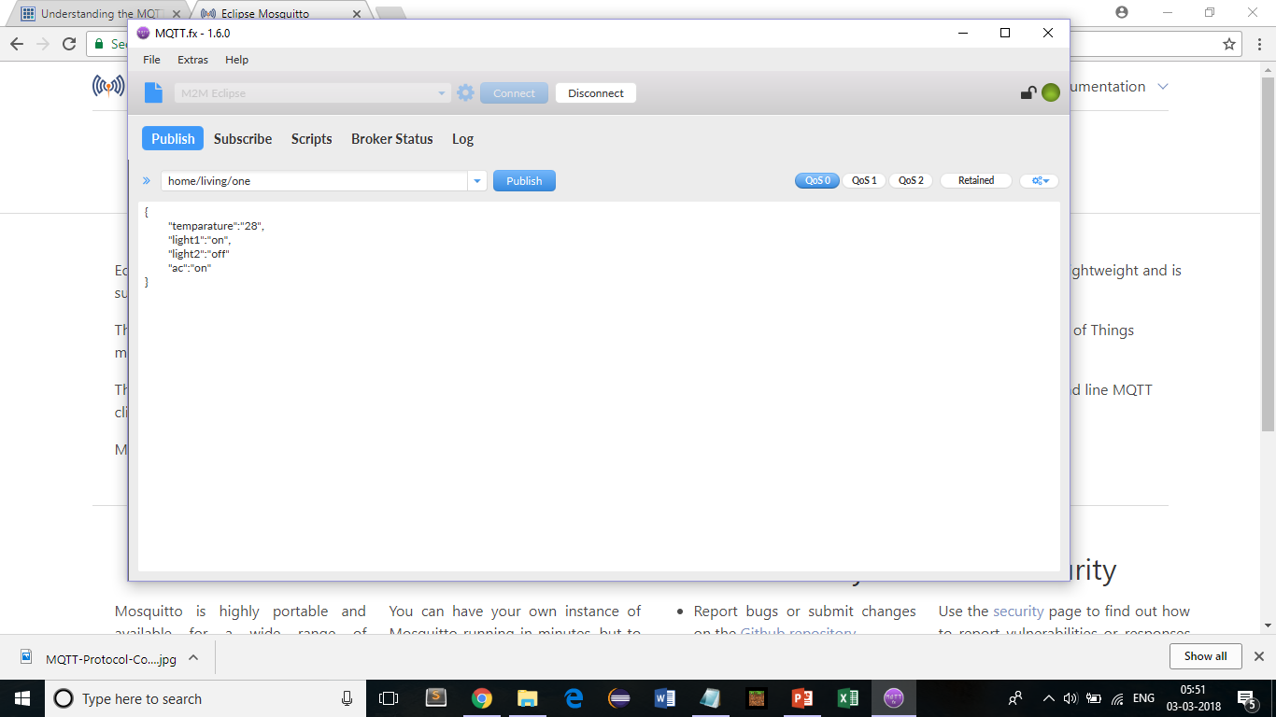
MQTT – Demo – Scenario 3
Broker – Mosquitto on local system
Client –MyMQTT (Android App)

Slide 18
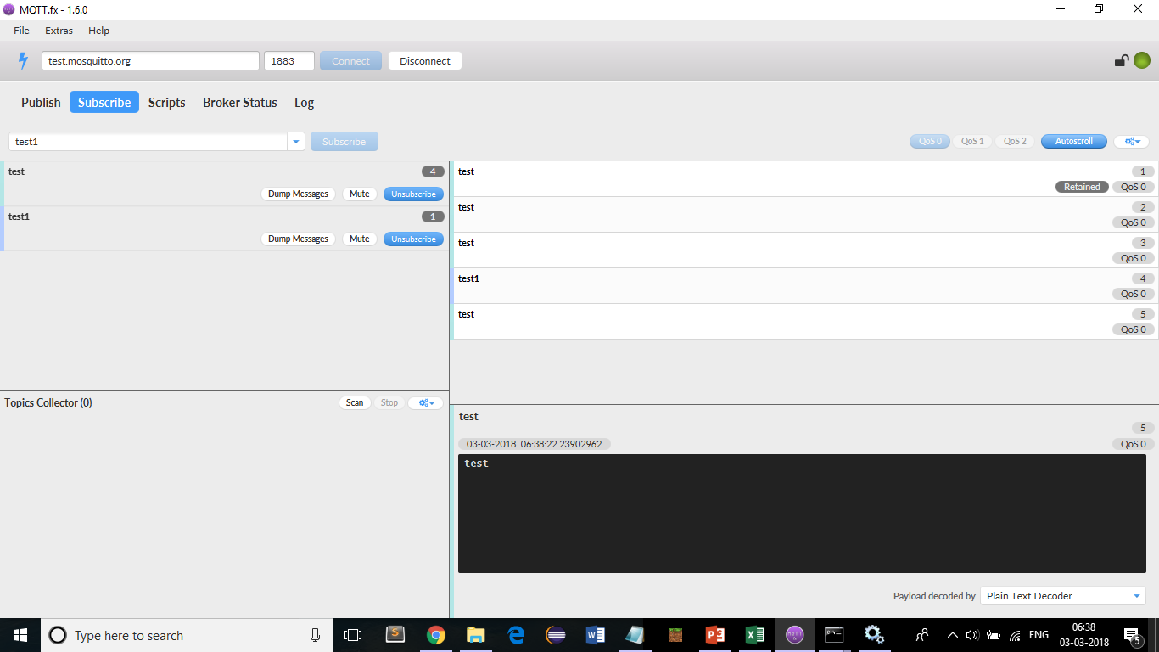
MQTT – Demo – Scenario 4
Broker - http://test.mosquitto.org/
Client - MQTT.fx (Web client) (usage of # and +)

Slide 19
Raspberry pi
https://www.raspberrypi.org/
The Raspberry Pi is a series of small single-board computers developed in the United Kingdom by the Raspberry Pi Foundation to promote the teaching of basic computer science in schools and in developing countries.The original model became far more popular than anticipated,selling outside its target market for uses such as robotics. It does not include peripherals (such as keyboards, mice and cases). However, some accessories have been included in several official and unofficial bundles.
According to the Raspberry Pi Foundation, over 5 million Raspberry Pis were sold by February 2015, making it the best-selling British computer.By November 2016 they had sold 11 million units and 12.5m by March 2017, making it the third best-selling "general purpose computer".In July 2017, sales reached nearly 15 million.

Slide 20
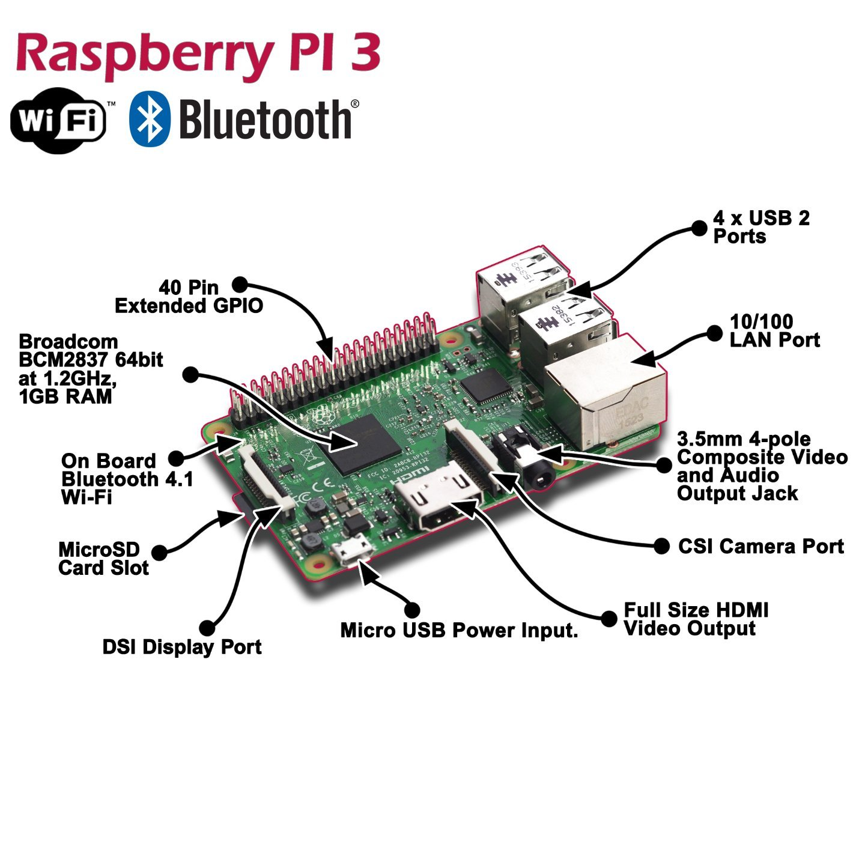
Raspberry pi

Slide 21
Raspberry pi programs
1. Measure temperature and humidity – DTH11
https://www.thegeekpub.com/236867/using-the-dht11-temperature-sensor-with-the-raspberry-pi/
import Adafruit_DHT
import time
DHT_SENSOR = Adafruit_DHT.DHT11
DHT_PIN = 4
while True:
humidity, temperature = Adafruit_DHT.read(DHT_SENSOR, DHT_PIN)
if humidity is not None and temperature is not None:
print("Temp={0:0.1f}C Humidity={1:0.1f}%".format(temperature, humidity))
else:
print("Sensor failure. Check wiring.");
time.sleep(3);

Slide 22
Projects on Raspberry pi
http://www.trustedreviews.com/opinion/best-raspberry-pi-projects-pi-3-pi-zero-2949390
An Amazon Alexa-powered dash cam
An electric skateboard
A disposable GIF camera
An electronic chess board
A Kodi media centre
A DIY NES Classic Mini
A digital DJ system
Automated entrance music
A robot arm
Multiroom audio for under £100
A walkie-talkie
A film-to-digital transfer system
A tiny retro games console
A magic mirror
A mini retro Macintosh Read more at http://www.trustedreviews.com/opinion/best-raspberry-pi-projects-pi-3-pi-zero-2949390#WlFlr3fl5UFfl88j.99

Slide 23
Cloud Computing
Cloud computing is an information technology paradigm that enables access to shared pools of configurable system resources and higher-level services that can be rapidly provisioned with minimal management effort, often over the Internet
In other words it is use of remote servers on the internet to store, manage and process data rather than a local server or your personal computer.
Cloud computing relies on sharing of resources to achieve coherence and economies of scale, similar to a public utility.

Slide 24
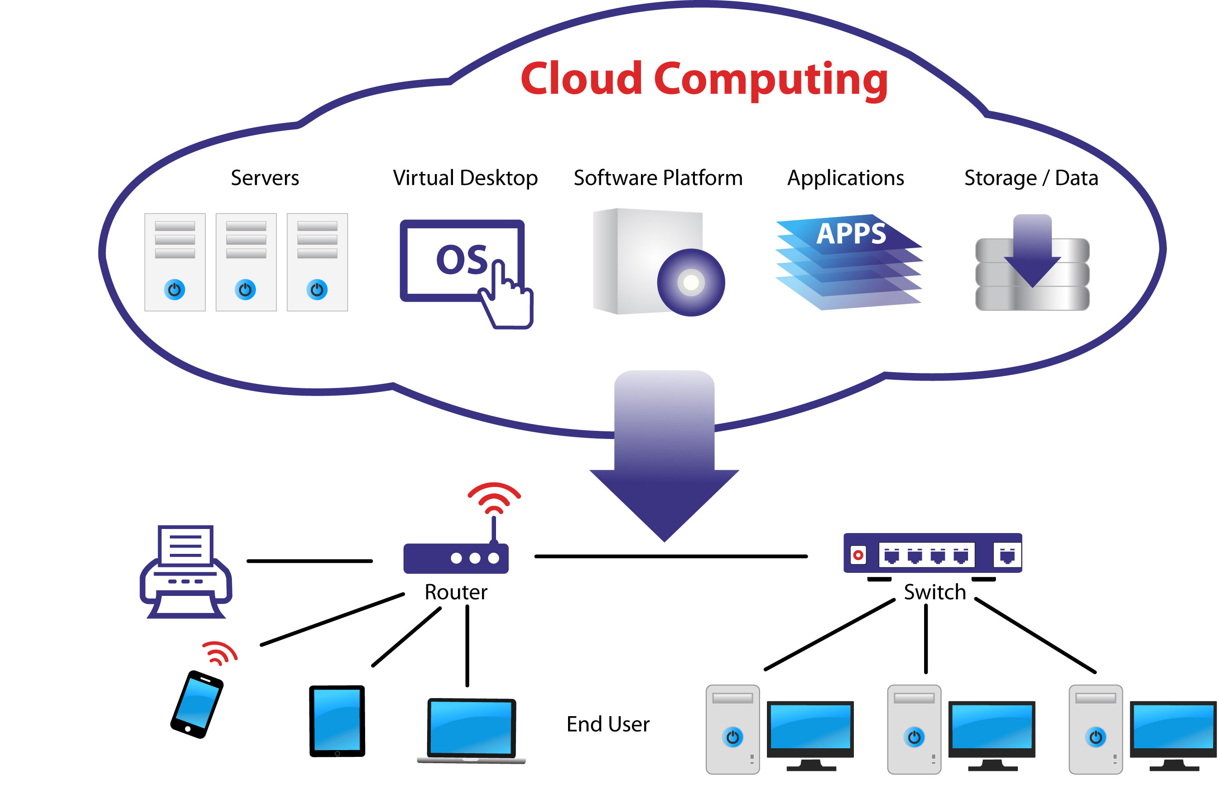
Cloud Computing

Slide 25
Cloud Models
Cloud Models is of two types namely
Service Models
Infrastructure As A Service (IaaS )
Platform As A Service (PaaS)
Software As A Service (SaaS)
Deployment Models
Public Cloud
Community Cloud
Hybrid Cloud
Private Cloud

Slide 26
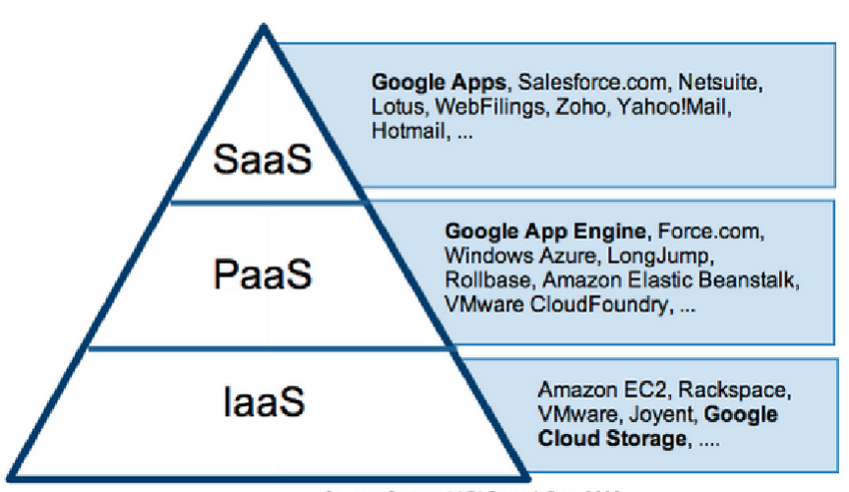
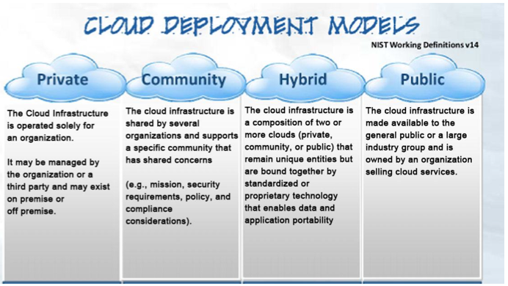
Cloud Models

Slide 27
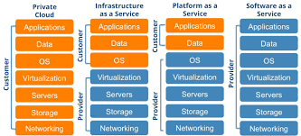
Cloud Models

Slide 28
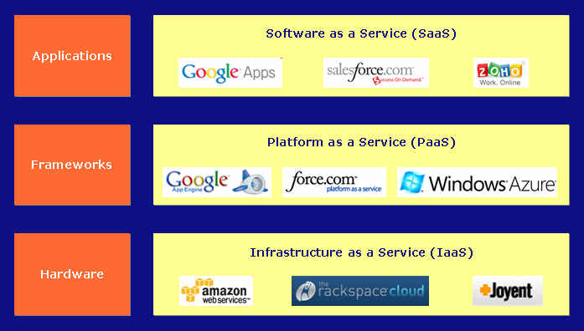
Cloud Models

Slide 29
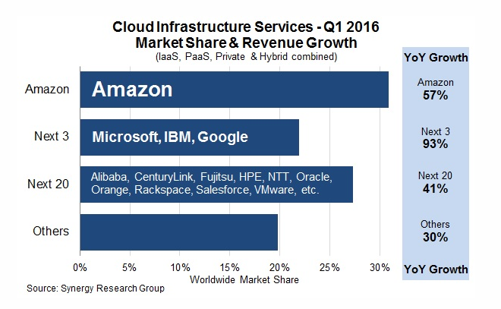
Cloud Market share

Slide 30
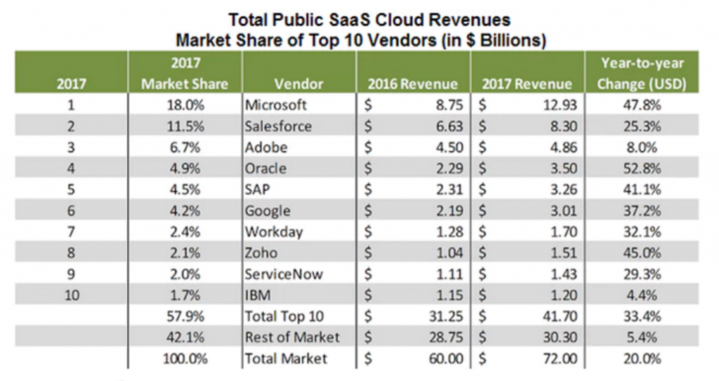
Cloud Market share - SaaS

