Slide 1
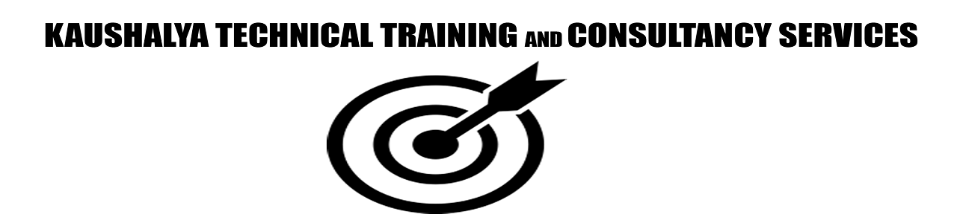
Internet Of Things (IoT) Unit 4 – Data Analytics and Supporting Services Part -2
Raghu Prasad
9845547471
www.kaushalya.tech

Slide 2
Topics
Hadoop
Apache – Spark
Apache – Kafka
AWS – IoT
Python - Django

Slide 3
Hadoop
Apache Hadoop is a collection of open-source software utilities that facilitates using a network of many computers to solve problems involving massive amounts of data and computation. It provides a software framework for distributed storage and processing of big data using the MapReduce programming model. Hadoop was originally designed for computer clusters built from commodity hardware, which is still the common use.[3] It has since also found use on clusters of higher-end hardware.[4][5] All the modules in Hadoop are designed with a fundamental assumption that hardware failures are common occurrences and should be automatically handled by the framework.[6]
https://www.youtube.com/watch?v=aReuLtY0YMI

Slide 4
Hadoop
The core of Apache Hadoop consists of a storage part, known as Hadoop Distributed File System (HDFS), and a processing part which is a MapReduce programming model. Hadoop splits files into large blocks and distributes them across nodes in a cluster. It then transfers packaged code into nodes to process the data in parallel. This approach takes advantage of data locality,[7] where nodes manipulate the data they have access to. This allows the dataset to be processed faster and more efficiently than it would be in a more conventional supercomputer architecture that relies on a parallel file system where computation and data are distributed via high-speed networking

Slide 5
Hadoop
The base Apache Hadoop framework is composed of the following modules:
Hadoop Common – contains libraries and utilities needed by other Hadoop modules;
Hadoop Distributed File System (HDFS) – a distributed file-system that stores data on commodity machines, providing very high aggregate bandwidth across the cluster;
Hadoop YARN – (introduced in 2012) a platform responsible for managing computing resources in clusters and using them for scheduling users' applications;^{[10][11]}
Hadoop MapReduce – an implementation of the MapReduce programming model for large-scale data processing.
Hadoop Ozone – (introduced in 2020) An object store for Hadoop
https://data-flair.training/blogs/hadoop-ecosystem-components/

Slide 6
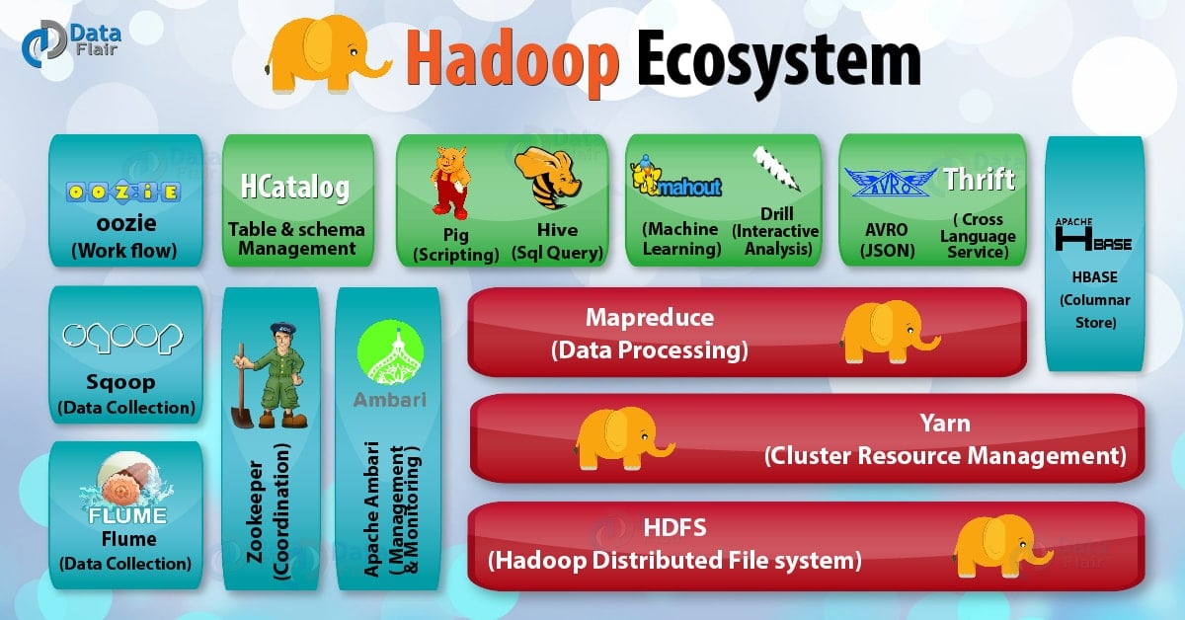
Hadoop

Slide 7
Apache - Spark
Apache Spark is an open-source unified analytics engine for large-scale data processing. Spark provides an interface for programming clusters with implicit data parallelism and fault tolerance. Originally developed at the University of California, Berkeley's AMPLab, the Spark codebase was later donated to the Apache Software Foundation, which has maintained it since.
https://towardsdatascience.com/a-beginners-guide-to-apache-spark-ff301cb4cd92
https://www.youtube.com/watch?v=OlYKyZvN2FA
https://www.youtube.com/watch?v=2PVzOHA3ktE&t=326s

Slide 8
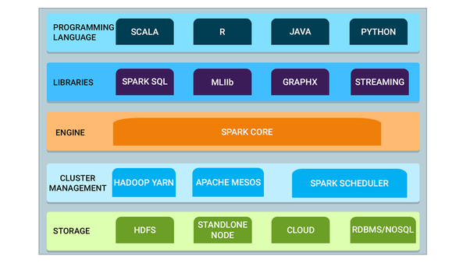
Apache - Spark

Slide 9
Apache - Kafka
Apache Kafka is a distributed event store and stream-processing platform. It is an open-source system developed by the Apache Software Foundation written in Java and Scala.
The project aims to provide a unified, high-throughput, low-latency platform for handling real-time data feeds. Kafka can connect to external systems (for data import/export) via Kafka Connect, and provides the Kafka Streams libraries for stream processing applications.
Kafka uses a binary TCP-based protocol that is optimized for efficiency and relies on a "message set" abstraction that naturally groups messages together to reduce the overhead of the network roundtrip.
https://www.youtube.com/watch?v=aj9CDZm0Glc

Slide 10
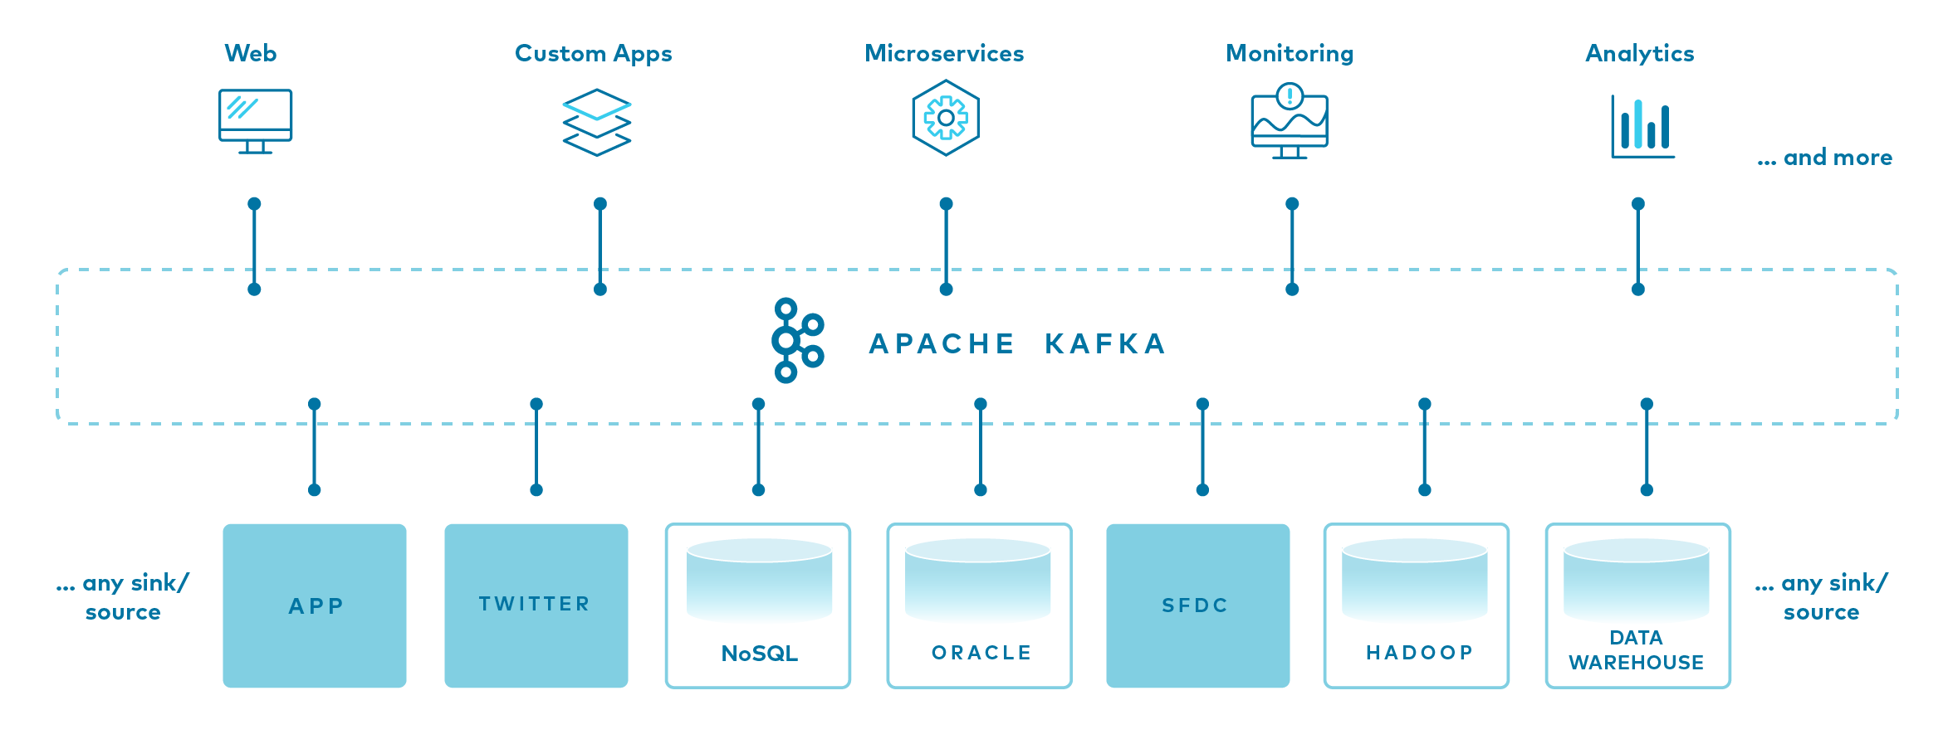
Apache - Kafka

Slide 11
Apache - Kafka
Kafka was originally developed at LinkedIn, and was subsequently open sourced in early 2011. Jay Kreps, Neha Narkhede and Jun Rao helped co-create Kafka.^{[4]} Graduation from the Apache Incubator occurred on 23 October 2012.^{[5]} Jay Kreps chose to name the software after the author Franz Kafka because it is "a system optimized for writing", and he liked Kafka's work.[
^{Applications}
Apache Kafka is based on the commit log, and it allows users to subscribe to it and publish data to any number of systems or real-time applications. Example applications include managing passenger and driver matching at Uber, providing real-time analytics and predictive maintenance for British Gas smart home, and performing numerous real-time services across all of LinkedIn.

Slide 12
Apache - Kafka
There are five major APIs in Kafka:
Producer API – Permits an application to publish streams of records.
Consumer API – Permits an application to subscribe to topics and processes streams of records.
Connector API – Executes the reusable producer and consumer APIs that can link the topics to the existing applications.
Streams API – This API converts the input streams to output and produces the result.
Admin API – Used to manage Kafka topics, brokers, and other Kafka objects.
https://developer.confluent.io/what-is-apache-kafka/

Slide 13
AWS-IoT
AWS offers Internet of Things (IoT) services and solutions to connect and manage billions of devices. Collect, store, and analyze IoT data for industrial, consumer, commercial, and automotive workloads.
How AWS-IoT helps
Accelerate innovation with the most complete set of IoT services
Secure your IoT applications from the cloud to the edge
Build intelligent IoT solutions with superior AI and ML integration
Scale easily and reliably
https://aws.amazon.com/iot/

Slide 14
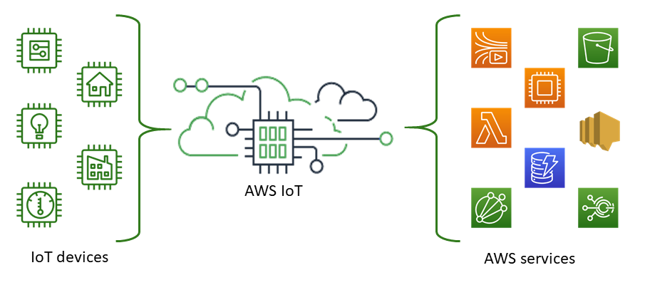
AWS-IoT

Slide 15
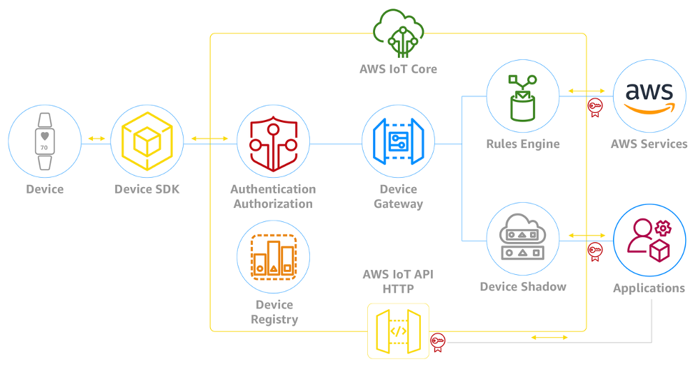
AWS-IoT

Slide 16
AWS-IoT

Slide 17
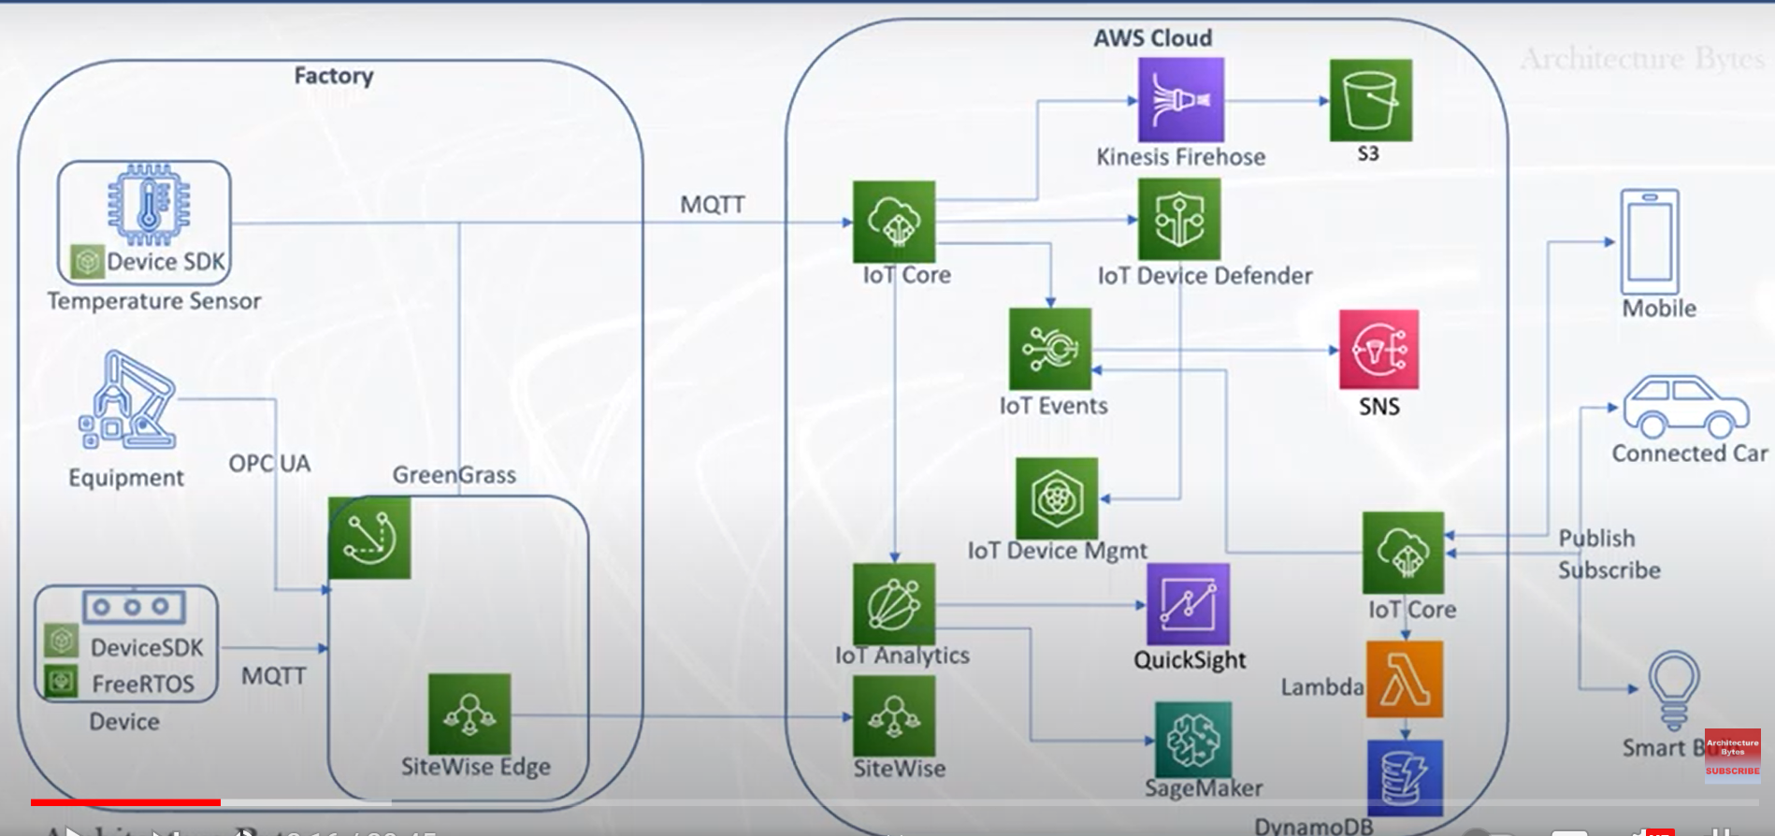
AWS-IoT-Use Case

Slide 18
Python - Django
Django (/ˈdʒæŋɡoʊ/ JANG-goh; sometimes stylized as django)^{[6]} is a free and open-source, Python-based web framework that follows the model–template–views (MTV) architectural pattern.^{[7][8]} It is maintained by the Django Software Foundation (DSF), an independent organization established in the US as a 501(c)(3) non-profit.
Django's primary goal is to ease the creation of complex, database-driven websites. The framework emphasizes reusability and "pluggability" of components, less code, low coupling, rapid development, and the principle of don't repeat yourself.^{[9]} Python is used throughout, even for settings, files, and data models. Django also provides an optional administrative create, read, update and delete interface that is generated dynamically through introspection and configured via admin models.

Slide 19
Python - Django
Some well-known sites that use Django include Instagram,^{[10]} Mozilla,^{[11]} Disqus,^{[12]} Bitbucket,^{[13]} Nextdoor^{[14]} and Clubhouse.^{[15]}

Slide 20
Thank You
Raghu Prasad
9845547471
www.kaushalya.tech

