Slide 1

Internet Of Things (IoT) Unit 4 – Data Analytics and Supporting Services – Part 1
Raghu Prasad
9845547471
www.kaushalya.tech

Slide 2
Topics
Data Analytics
Structured Vs Un-Structured Data
Data in Motion Vs Data in Rest
Role of Machine Learning
No-SQL Database
Big Data

Slide 3
Data Analytics
Data analytics (DA) is the process of examining data sets in order to find trends and draw conclusions about the information they contain. Increasingly, data analytics is done with the aid of specialized systems and software.
Data analytics technologies and techniques are widely used in commercial industries to enable organizations to make more-informed business decisions. Scientists and researchers also use analytics tools to verify or disprove scientific models, theories and hypotheses.

Slide 4
Data Analytics
As a term, data analytics predominantly refers to an assortment of applications, from basic business intelligence (BI), reporting and online analytical processing (OLAP) to various forms of advanced analytics.
In that sense, it's similar in nature to business analytics, another umbrella term for approaches to analyzing data. The difference is that the latter is oriented to business uses, while data analytics has a broader focus. The expansive view of the term isn't universal, though: In some cases, people use data analytics specifically to mean advanced analytics, treating BI as a separate category.

Slide 5
Data Analytics
Data analytics initiatives can help businesses increase revenue, improve operational efficiency, optimize marketing campaigns and bolster customer service efforts.
Analytics also enable organizations to respond quickly to emerging market trends and gain a competitive edge over business rivals.
The ultimate goal of data analytics, however, is boosting business performance. Depending on the particular application, the data that's analyzed can consist of either historical records or new information that has been processed for real-time analytics. In addition, it can come from a mix of internal systems and external data sources.

Slide 6
Types of Data Analytics applications
At a high level, data analytics methodologies include exploratory data analysis (EDA) and confirmatory data analysis (CDA)
EDA aims to find patterns and relationships in data, while CDA applies statistical techniques to determine whether hypotheses about a data set are true or false.
EDA is often compared to detective work, while CDA is akin to the work of a judge or jury during a court trial -- a distinction first drawn by statistician John W. Tukey in his 1977 book Exploratory Data Analysis.

Slide 7
Types of Data Analytics applications
Data analytics can also be separated into quantitative data analysis and qualitative data analysis.
The former involves the analysis of numerical data with quantifiable variables. These variables can be compared or measured statistically.
The qualitative approach is more interpretive -- it focuses on understanding the content of non-numerical data like text, images, audio and video, as well as common phrases, themes and points of view.

Slide 8
Types of Data Analytics applications
At the application level, BI and reporting provide business executives and corporate workers with actionable information about key performance indicators, business operations, customers and more.
In the past, data queries and reports typically were created for end users by BI developers who worked in IT
Now, more organizations use self-service BI tools that let executives, business analysts and operational workers run their own ad hoc queries and build reports themselves.

Slide 9
Types of Data Analytics applications
Advanced types of data analytics include data mining, which involves sorting through large data sets to identify trends, patterns and relationships
Another is predictive analytics, which seeks to predict customer behavior, equipment failures and other future business scenarios and events.
Machine learning can also be used for data analytics, by running automated algorithms to churn through data sets more quickly than data scientists can do via conventional analytical modeling.

Slide 10
Types of Data Analytics applications
Big data analytics applies data mining, predictive analytics and machine learning tools to data sets that can include a mix of structured, unstructured and semistructured data.
Text mining provides a means of analyzing documents, emails and other text-based content.

Slide 11
Data at rest vs Data in motion
Gaining insights from big data is no small task. Having the right technology in place to collect, manage and analyze data for predictive purposes or real-time insight is critical. Different types of data may require different computing platforms to provide meaningful insights. Understanding the difference between data in motion vs. data at rest can help determine the type of technology and processing capabilities required to glean insights from the data.
Data at rest This refers to data that has been collected from various sources and is then analyzed after the event occurs. The point where the data is analyzed and the point where action is taken on it occur at two separate times. For example, a retailer analyzes a previous month’s sales data and uses it to make strategic decisions about the present month’s business activities. The action takes place after the data-creating event has occurred. This data is meaningful to the retailer, and allows them to create marketing campaigns and send customized coupons based on customer purchasing behavior and other variables. While the data provides value, the business impact is dependent on the customer coming back in the store to take advantage of the offers.

Slide 12
Data at rest vs Data in motion
Data in motion The collection process for data in motion is similar to that of data at rest; however, the difference lies in the analytics. In this case, the analytics occur in real-time as the event happens. An example here would be a theme park that uses wristbands to collect data about their guests. These wristbands would constantly record data about the guest’s activities, and the park could use this information to personalize the guest visit with special surprises or suggested activities based on their behavior. This allows the business to customize the guest experience during the visit. Organizations have a tremendous opportunity to improve business results in these scenarios.

Slide 13
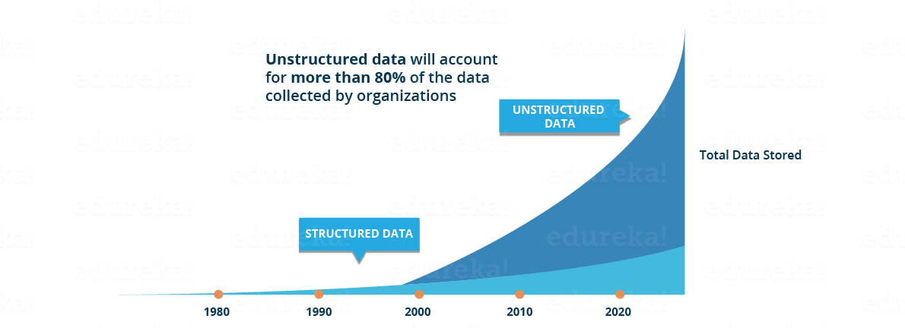
Data Science
Need for data science
https://jeremyronk.wordpress.com/2014/09/01/structured-semi-structured-and-unstructured-data/

Slide 14
Data Science
Need for data science
This data is generated from different sources like financial logs, text files, multimedia forms, sensors, and instruments.
Source - https://www.edureka.co/blog/what-is-data-science/
Simple BI tools are not capable of processing this huge volume and variety of data.
This is why we need more complex and advanced analytical tools and algorithms for processing, analyzing and drawing meaningful insights out of it.
https://www.geeksforgeeks.org/difference-between-structured-semi-structured-and-unstructured-data/
https://www.w3trainingschool.com/structured-semi-structured-unstructured-data

Slide 15
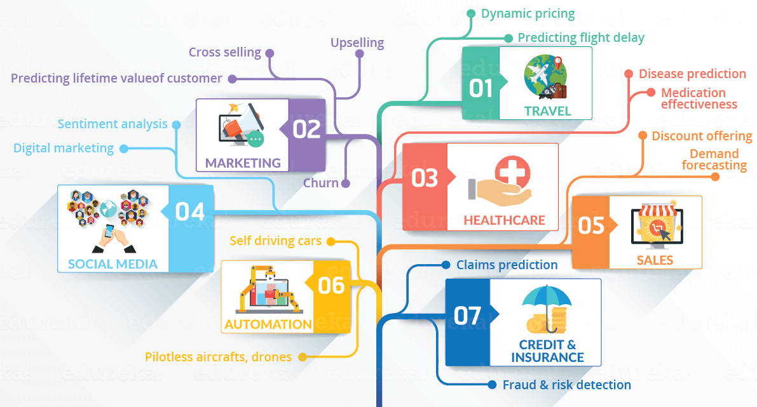
Data Science/Big Data Applications
Domains currently using data science

Slide 16
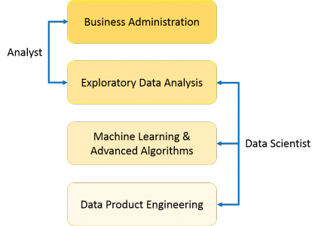
Data Science
What is data science
Data Science is a blend of various tools, algorithms, and machine learning principles with the goal to discover hidden patterns from the raw data, make sense of the data, predicting the future and take business decisions.
Data Analyst,Data Scientist and Data Engineer
https://www.youtube.com/watch?v=q9oAZwhuUy4

Slide 17
Data Science
Predictive causal analytics – If you want a model which can predict the possibilities of a particular event in the future, you need to apply predictive causal analytics.
Example: If you are providing money on credit, then the probability of customers making future credit payments on time is a matter of concern for you. Here, you can build a model which can perform predictive analytics on the payment history of the customer to predict if the future payments will be on time or not.
Prescriptive analytics: If you want a model which has the intelligence of taking its own decisions and the ability to modify it with dynamic parameters, you certainly need prescriptive analytics for it. This relatively new field is all about providing advice. In other terms, it not only predicts but suggests a range of prescribed actions and associated outcomes.
Example for this is Google’s self-driving car which I had discussed earlier too. The data gathered by vehicles can be used to train self-driving cars. You can run algorithms on this data to bring intelligence to it. This will enable your car to take decisions like when to turn, which path to take, when to slow down or speed up.

Slide 18
Data Science
Machine learning for making predictions — If you have transactional data of a finance company and need to build a model to determine the future trend, then machine learning algorithms are the best bet.
This falls under the paradigm of supervised learning. It is called supervised because you already have the data based on which you can train your machines.
For example, a fraud detection model can be trained using a historical record of fraudulent purchases.

Slide 19
Data Science
Machine learning for pattern discovery — If you don’t have the parameters based on which you can make predictions, then you need to find out the hidden patterns within the dataset to be able to make meaningful predictions. This is nothing but the unsupervised model as you don’t have any predefined labels for grouping.
The most common algorithm used for pattern discovery is Clustering. Let’s say you are working in a telephone company and you need to establish a network by putting towers in a region. Then, you can use the clustering technique to find those tower locations which will ensure that all the users receive optimum signal strength.

Slide 20
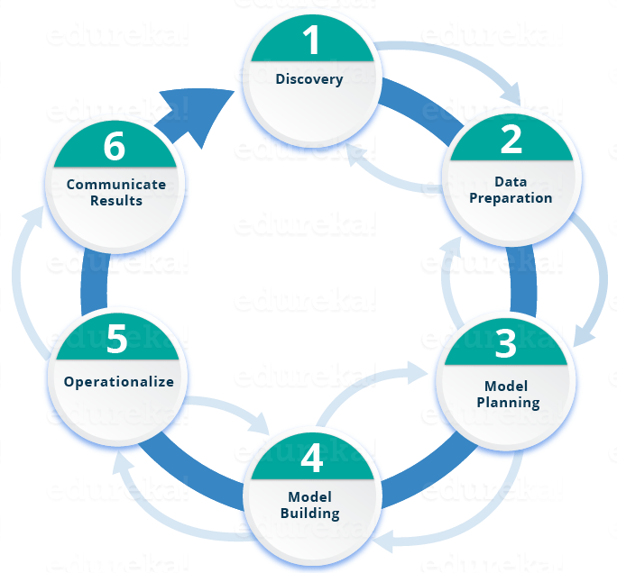
Data Science
Life cycle of data science

Slide 21
What is Artificial Intelligence ?
In computer science, artificial intelligence (AI), sometimes called machine intelligence, is intelligence demonstrated by machines, in contrast to the natural intelligence displayed by humans. Colloquially, the term "artificial intelligence" is often used to describe machines (or computers) that mimic "cognitive" functions that humans associate with the human mind, such as "learning" and "problem solving"

Slide 22
What is Cognitive Computing ?
Cognitive -
Relating to or involving the processes of thinking and reasoning
Cognitive computing (CC) describes technology platforms that, broadly speaking, are based on the scientific disciplines of artificial intelligence and signal processing. These platforms encompass machine learning, reasoning, natural language processing, speech recognition and vision (object recognition), human–computer interaction, dialog and narrative generation, among other technologies

Slide 23
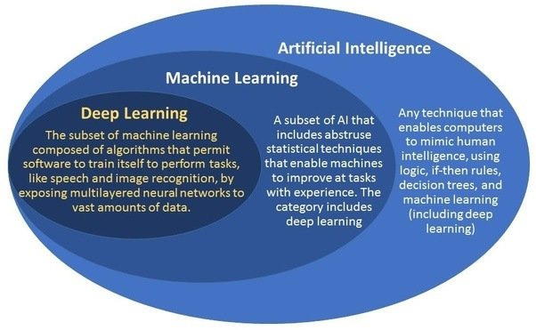
What is AI/ML/DL ?

Slide 24
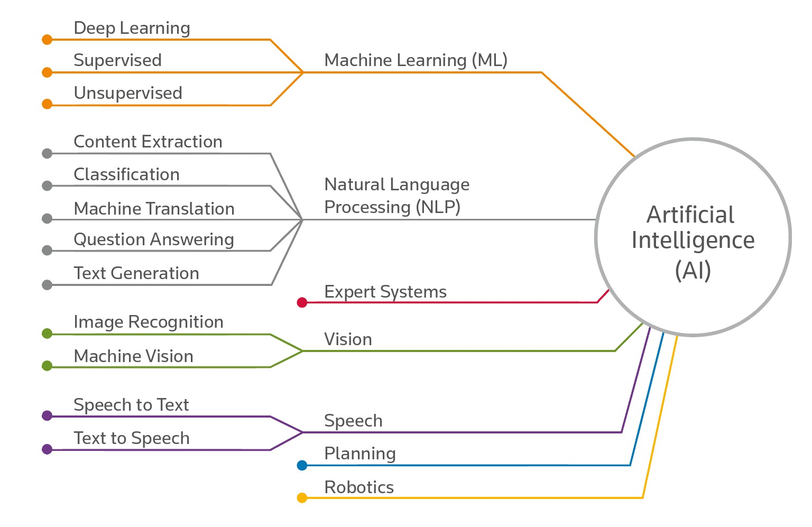
What is Artificial Intelligence ?

Slide 25
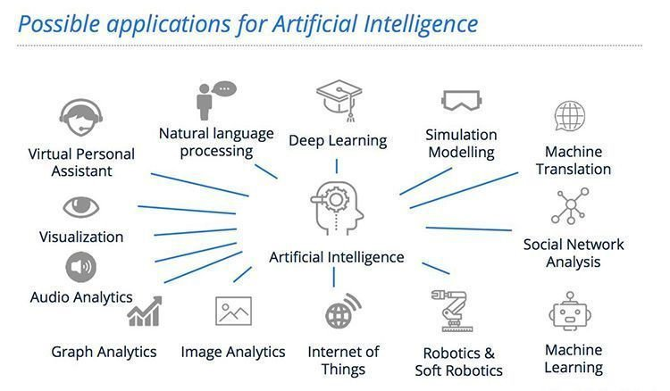
AI – History

Slide 26
No SQL Databases ?
NoSQL databases (aka "not only SQL") are non-tabular databases and store data differently than relational tables. NoSQL databases come in a variety of types based on their data model. The main types are document, key-value, wide-column, and graph. They provide flexible schemas and scale easily with large amounts of data and high user loads.
NoSQL database features
Each NoSQL database has its own unique features. At a high level, many NoSQL databases have the following features:
Flexible schemas
Horizontal scaling
Fast queries due to the data model
Ease of use for developers

Slide 27
No SQL Databases ?
Types of NoSQL databases
Over time, four major types of NoSQL databases emerged: document databases, key-value databases, wide-column stores, and graph databases.
Document databases store data in documents similar to JSON (JavaScript Object Notation) objects. Each document contains pairs of fields and values. The values can typically be a variety of types including things like strings, numbers, booleans, arrays, or objects.
Example of Document Databases - MongoDB, CouchDB, Cloudant
Key-value databases are a simpler type of database where each item contains keys and values.
Examples of Key-Value pair database - Memcached, Redis, Coherence
Wide-column/Tabular stores store data in tables, rows, and dynamic columns.
Examples of Wide-column - Hbase, Big Table, Accumulo
Graph databases store data in nodes and edges. Nodes typically store information about people, places, and things, while edges store information about the relationships between the nodes.
Examples of Graph database - Amazon Neptune, Neo4j

Slide 28
No SQL Databases ?
When should NoSQL be used?
When deciding which database to use, decision-makers typically find one or more of the following factors lead them to selecting a NoSQL database:
Fast-paced Agile development
Storage of structured and semi-structured data
Huge volumes of data
Requirements for scale-out architecture
Modern application paradigms like microservices and real-time streaming
https://www.mongodb.com/nosql-explained
https://www.geeksforgeeks.org/introduction-to-nosql/

Slide 29
Big Data
Big data is exactly what the name suggests, a “big” amount of data. Big Data means a data set that is large in terms of volume and is more complex. Because of the large volume and higher complexity of Big Data, traditional data processing software cannot handle it. Big Data simply means datasets containing a large amount of diverse data, both structured as well as unstructured.
Big Data allows companies to address issues they are facing in their business, and solve these problems effectively using Big Data Analytics. Companies try to identify patterns and draw insights from this sea of data so that it can be acted upon to solve the problem(s) at hand.
Although companies have been collecting a huge amount of data for decades, the concept of Big Data only gained popularity in the early-mid 2000s. Corporations realized the amount of data that was being collected on a daily basis, and the importance of using this data effectively.
https://www.analyticsvidhya.com/blog/2021/05/what-is-big-data-introduction-uses-and-applications/

Slide 30
Big Data
What are the 5 Vs of Big Data?
Doug Laney introduced this concept of 3 Vs of Big Data, viz. Volume, Variety, and Velocity.
Volume refers to the amount of data that is being collected. The data could be structured or unstructured.
Velocity refers to the rate at which data is coming in.
Variety refers to the different kinds of data (data types, formats, etc.) that is coming in for analysis.
Over the last few years, 2 additional Vs of data have also emerged – value and veracity.
Value refers to the usefulness of the collected data.
Veracity refers to the quality of data that is coming in from different sources.
https://www.youtube.com/watch?v=bAyrObl7TYE

Slide 31
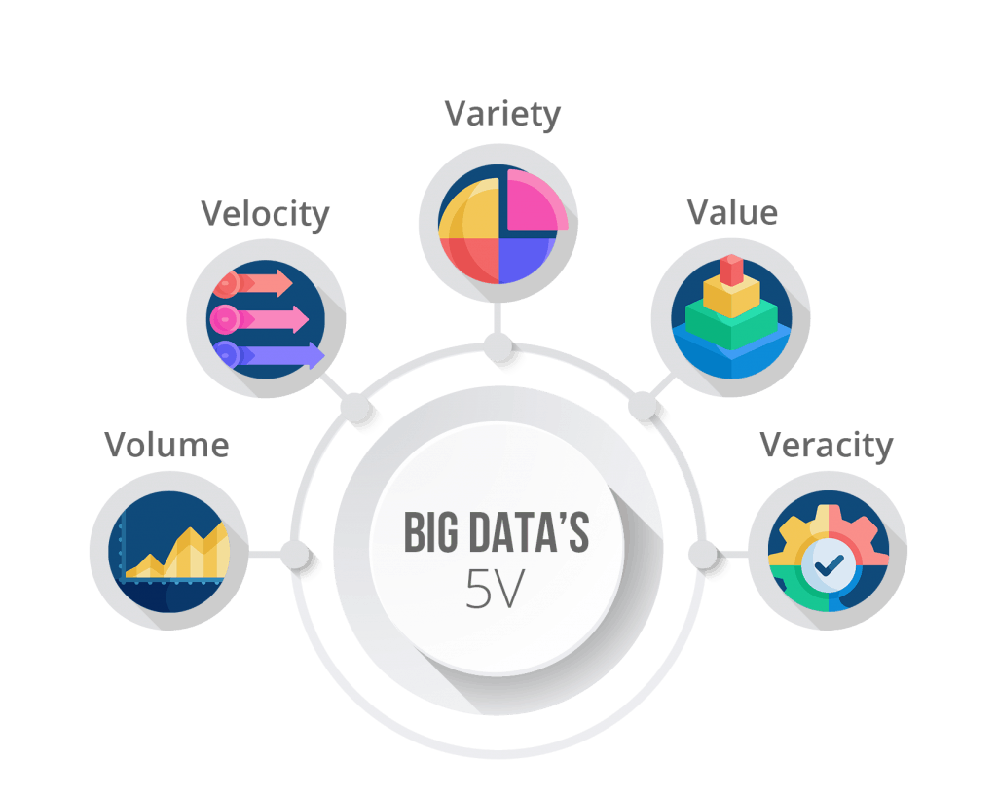
Big Data

Slide 32
Big Data
Applications in the real world
Big Data helps corporations in making better and faster decisions, because they have more information available to solve problems, and have more data to test their hypothesis on.
Customer experience is a major field that has been revolutionized with the advent of Big Data. Companies are collecting more data about their customers and their preferences than ever. This data is being leveraged in a positive way, by giving personalized recommendations and offers to customers, who are more than happy to allow companies to collect this data in return for the personalized services. The recommendations you get on Netflix, or Amazon/Flipkart are a gift of Big Data!

Slide 33
Big Data
Machine Learning is another field that has benefited greatly from the increasing popularity of Big Data. More data means we have larger datasets to train our ML models, and a more trained model (generally) results in a better performance. Also, with the help of Machine Learning, we are now able to automate tasks that were earlier being done manually, all thanks to Big Data.
Demand forecasting has become more accurate with more and more data being collected about customer purchases. This helps companies build forecasting models, that help them forecast future demand, and scale production accordingly. It helps companies, especially those in manufacturing businesses, to reduce the cost of storing unsold inventory in warehouses.
Big data also has extensive use in applications such as product development and fraud detection.

Slide 34
Big Data
How to store and process Big Data?
The volume and velocity of Big Data can be huge, which makes it almost impossible to store it in traditional data warehouses. Although some and sensitive information can be stored on company premises, for most of the data, companies have to opt for cloud storage or Hadoop.
Cloud storage allows businesses to store their data on the internet with the help of a cloud service provider (like Amazon Web Services, Microsoft Azure, or Google Cloud Platform) who takes the responsibility of managing and storing the data. The data can be accessed easily and quickly with an API.
Hadoop also does the same thing, by giving you the ability to store and process large amounts of data at once. Hadoop is an open-source software framework and is free. It allows users to process large datasets across clusters of computers.

Slide 35
Big Data
Challenges
1. Data growth
Managing datasets having terabytes of information can be a big challenge for companies. As datasets grow in size, storing them not only becomes a challenge but also becomes an expensive affair for companies.
To overcome this, companies are now starting to pay attention to data compression and de-duplication. Data compression reduces the number of bits that the data needs, resulting in a reduction in space being consumed. Data de-duplication is the process of making sure duplicate and unwanted data does not reside in our database.

Slide 36
Big Data
2. Data security
Data security is often prioritized quite low in the Big Data workflow, which can backfire at times. With such a large amount of data being collected, security challenges are bound to come up sooner or later.
Mining of sensitive information, fake data generation, and lack of cryptographic protection (encryption) are some of the challenges businesses face when trying to adopt Big Data techniques.
Companies need to understand the importance of data security, and need to prioritize it. To help them, there are professional Big Data consultants nowadays, that help businesses move from traditional data storage and analysis methods to Big Data.

Slide 37
Big Data
3. Data integration
Data is coming in from a lot of different sources (social media applications, emails, customer verification documents, survey forms, etc.). It often becomes a very big operational challenge for companies to combine and reconcile all of this data.
There are several Big Data solution vendors that offer ETL (Extract, Transform, Load) and data integration solutions to companies that are trying to overcome data integration problems. There are also several APIs that have already been built to tackle issues related to data integration.

Slide 38
Big Data
The future of Big Data
The volume of data being produced every day is continuously increasing, with increasing digitization. More and more businesses are starting to shift from traditional data storage and analysis methods to cloud solutions. Companies are starting to realize the importance of data. All of these imply one thing, the future of Big Data looks promising! It will change the way businesses operate, and decisions are made.
Big Data Applications
https://www.youtube.com/watch?v=nogE5tOt3g8&t=637s

Slide 39
Thank You
Raghu Prasad
9845547471
www.kaushalya.tech

