Slide 1
Python
Ramesh V
www.kaushalya.tech
9845547471

Slide 2
Introduction
Raghu Prasad K S – BE, MS, CEO of Kasuhalya Technologies
Total of 24 years of experience
7 years as a lecturer in an Engineering College
17 Years into IT
Worked with companies like CISCO,CSC,ICICI,First Apex – NTT Data
Currently into Corporate training and consultancy
Worked with corporates and public sector
Technologies – Java,Python,AI,ML,Web technologies,Java Script technologies (MEAN stack),IOT,Test Automation – Selenium,Jmeter
CSR Activities
Professional Yoga Trainer and motivational speaker

Slide 3
About Us
Kaushalya Technologies (www.kaushalya.tech) is an educational technology company started by IT Professionals and Academicians.
It has offices in Jakkur and Sahakara Nagara in Bengaluru
Kaushalya Technologies are into IT niche skills training, consultancy and educational application development
We conduct FDP, SDP, Internships for educational institutions.
We conduct Boot camp and niche IT skills training for corporates.

Slide 4
Our Major clients
Educational Institutions
Acharya Institute of Technology, REVA University,Dayanand Sagar University, Nagarjuna Engineering College, Bengaluru
BGSIT- Bellur, Malnad Engineering College-Hassan, NIE-Mysore, MYCEM, Mysore, NIT-Manipur
Sindhi College, SB College of Management, Bengaluru
IT Companies
L & T – Mysore,NextGen-Bengaluru,Philips-Bengaluru,Incarnus-Chennai,Aspire Systems-Chennai, Infidata Technologies – Bengaluru, Edulife- Bengaluru

Slide 5
Course Objectives
Introduce trainees to Python as a generic programming language
Introduce trainees to Object Oriented Programming and its usages
Code as you learn
Build ability to solve a problem by developing necessary algorithms
Bridge the gap between actual skills required for the industry and the current skills possessed by the trainees
Prepare trainees for hackathons and placements

Slide 6
Course Outcome
Trainees are expected to gain theoretical and practical exposure in basics of Python
Hands-on and minds-on Learning
Build a project at the end of the training
Learn soft skills aspects such as being a team player and critical thinking ability
Well prepared to participate in hackathon and campus
Well versed with software development life cycle

Slide 7
Training Methodology
It’s combination of theoretical and practical sessions. We will introduce to a concept and use hands-on session to further strengthen their understanding of the concept.
It’s a 30 hour course
Following assessment methodology would be performed
Pre-assessment test
Attendance and attentiveness in the class
Completion of hands-on session
Completion of assignments
Completion of project
Feedback
Post-assessment test
Softcopy of the course material would be handed over to each student at the end of the course.
Joint certificate by the college and Kaushalya would be issued to the trainees

Slide 8
Python Collections
List is a collection which is ordered and changeable. Allows duplicate members, lists are written with square brackets.
Tuple is a collection which is ordered and unchangeable. Allows duplicate members, tuples are written with round brackets.
Set is a collection which is unordered and un-indexed. No duplicate members, sets are written with curly brackets.
Dictionary is a collection which is unordered, changeable and indexed. No duplicate members, dictionaries are written with curly brackets, and they have keys and values.

Slide 9
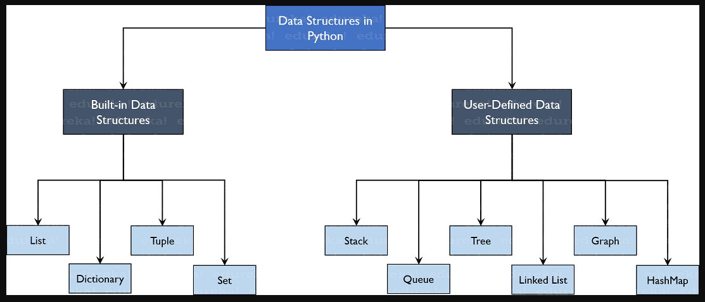
Python Collections – Programs on List, Tuple, Set and Dictionary

Slide 10
Python Collections – Programs on List
List is a collection which is ordered and changeable and are written with square brackets. Allows duplicate members.
#Creating a list
thislist = ["apple", "banana", "cherry"]
print(thislist)
print(type(thislist))
#Access the List items using Index
print(thislist[1])
print(thislist[-1])
#Range of List is specified to get start and end of the list and new list is formed, the search will start at index 2 (included) and end at index 5 (not included)
thislist = ["apple", "banana", "cherry", "orange", "kiwi", "melon", "mango"]
newlist =thislist[2:5]
print(newlist)
#This will return the items from index 0 to index 4. Remember that index 0 is the first item, and index 4 is the fifth item
thislist = ["apple", "banana", "cherry", "orange", "kiwi", "melon", "mango"]
print(thislist[:4])

Slide 11
Python Collections – Programs on List
#This will return the items from index 2 to the end. Remember that index 0 is the first item, and index 2 is the third
thislist = ["apple", "banana", "cherry", "orange", "kiwi", "melon", "mango"]
print(thislist[2:])
#Negative Indexes range in list, -ve indexing means starting from the end of the list index -1. This example returns the items from index -4 (included) to index -1 (excluded)
thislist = ["apple", "banana", "cherry", "orange", "kiwi", "melon", "mango"]
print(thislist[-4:-1])
#Change Item Value, To change the value of a specific item, refer to the index number (here second number/index)
thislist = ["apple", "banana", "cherry"]
thislist[1] = "blackcurrant“
print(thislist)
# To check if Item Exists, use the in keyword, check if "apple" is present in the list
thislist = ["apple", "banana", "cherry"]
if "apple" in thislist:
print("Yes, 'apple' is in the fruits list")
#List Length, use the len() function
thislist = ["apple", "banana", "cherry"]
print(len(thislist))

Slide 12
Python Collections – Programs on List
#add an item to the end of the list, use the append() method
thislist = ["apple", "banana", "cherry"]
thislist.append("orange")
print(thislist)
#add an item at the specified index, use the insert() method, insert at second position (index 1)
thislist = ["apple", "banana", "cherry"]
thislist.insert(1, "orange")
print(thislist)
#several methods to remove items from a list
#1. Use Remove method
thislist = ["apple", "banana", "cherry"]
thislist.remove("banana")
print(thislist)
#2. pop() method removes the specified index, (or the last item if index is not specified)
thislist = ["apple", "banana", "cherry"]
thislist.pop()
print(thislist)

Slide 13
Python Collections – Programs on List
#3. del keyword removes the specified index
thislist = ["apple", "banana", "cherry"]
del thislist[0]
print(thislist)
#4. del keyword can also delete the list completely, this will cause an error because you have succsesfully deleted "thislist".
thislist = ["apple", "banana", "cherry"]
del thislist
print(thislist)
#5. clear() method empties the list
thislist = ["apple", "banana", "cherry"]
thislist.clear()
print(thislist)
#Copy a List Method1
thislist = ["apple", "banana", "cherry"]
mylist = thislist.copy()
print(mylist)
#Copy a List Method2
thislist = ["apple", "banana", "cherry"]
mylist = list(thislist)
print(mylist)

Slide 14
Python Collections – Programs on List
#To Join, or Concatenate, two or more lists in Python
#1. To use the operator + sign
list1 = ["a", "b" , "c"]
list2 = [1, 2, 3]
list3 = list1 + list2
print(list3)
#2. Join two lists by appending all the items from list2 into list1
list1 = ["a", "b" , "c"]
list2 = [1, 2, 3]
for x in list2:
list1.append(x)
print(list1)
#3. use the extend() method, which purpose is to add elements from one list to another list
list1 = ["a", "b" , "c"]
list2 = [1, 2, 3]
list1.extend(list2)
print(list1)

Slide 15
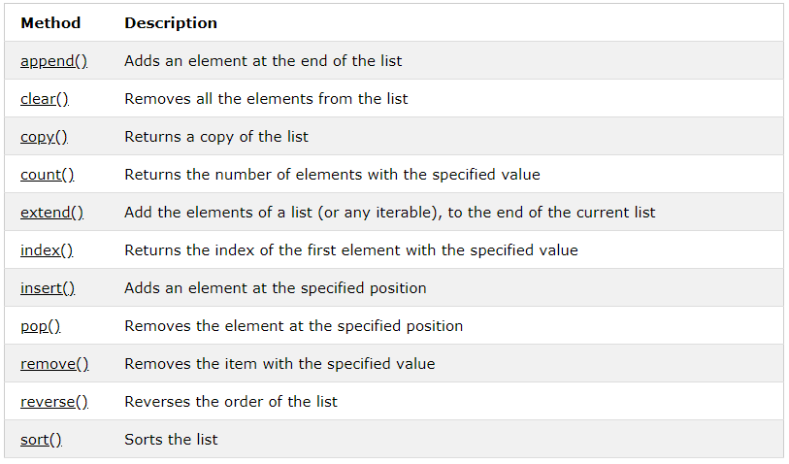
Python Collections – Programs on List
#The list() Constructor: It is also possible to use the list() constructor to make a new list
thislist = list(("apple", "banana", "cherry"))
print(thislist)
LIST METHODS

Slide 16
Python Collections – Programs on Tuples
A Tuple is a collection which is ordered and unchangeable. In Python tuples are written with round brackets.
#Creating a Tuple
thistuple = ("apple", "banana", "cherry")
print(thistuple)
print(type(thistuple))
#Access Tuple Items, by referring to the index number, inside square brackets
thistuple = ("apple", "banana", "cherry")
print(thistuple[1])
#Negative indexing means beginning from the end, -1 refers to the last item, -2 refers to the second last item etc.
thistuple = ("apple", "banana", "cherry")
print(thistuple[-1])
#Range of Indexes, this will return the items from position 2 to 5. The first item is position 0 and item in position 5 is NOT included, first item having Index → 0
thistuple = ("apple", "banana", "cherry", "orange", "kiwi", "melon", "mango")
print(thistuple[2:5])

Slide 17
Python Collections – Programs on Tuples
#Range of Negative Indexes in Tuple, starts from end of the tuple. E.g. below returns items form index -4(included) and index -#1(excluded) and the last item has the index -1
thistuple = ("apple", "banana", "cherry", "orange", "kiwi", "melon", "mango")
print(thistuple[-4:-1])
#Change Tuple Values, as tuples are created its values cannot be changed (immutable). Workaround is convert tuple to list, #change the list and this is converted back to tuple
x = ("apple", "banana", "cherry")
y = list(x)
y[1] = "kiwi"
x = tuple(y)
print(x)
#loop through the tuple items by using a for loop.
thistuple = ("apple", "banana", "cherry")
for x in thistuple:
print(x)
#To determine how many items a tuple has, use the len() method
thistuple = ("apple", "banana", "cherry")
print(len(thistuple))

Slide 18
Python Collections – Programs on Tuples
#To determine if a specified item is present in a tuple use the in keyword
thistuple = ("apple", "banana", "cherry")
if "apple" in thistuple:
print("Yes, 'apple' is in the fruits tuple")
#Add Items, you cannot add items to it. Tuples are unchangeable
thistuple = ("apple", "banana", "cherry")
thistuple[3] = "orange" # This will raise an error
print(thistuple)
#Create Tuple With One Item:, To create a tuple with only one item, add a comma after the item
thistuple = ("apple",)
print(type(thistuple))
#NOT a tuple
thistuple = ("apple")
print(type(thistuple))
#Remove Items, Tuples are unchangeable, so you cannot remove items from it, but you can delete the tuple completely
thistuple = ("apple", "banana", "cherry")
del thistuple
print(thistuple)

Slide 19
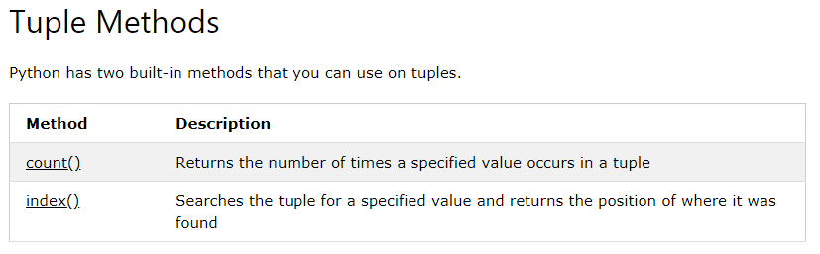
Python Collections – Programs on Tuples
#Join Two Tuples, join two or more tuples you can use the + operator
tuple1 = ("a", "b" , "c")
tuple2 = (1, 2, 3)
tuple3 = tuple1 + tuple2
print(tuple3)
#tuple() Constructor, It is also possible to use the tuple() constructor to make a tuple
thistuple = tuple(("apple", "banana", "cherry"))
print(thistuple)

Slide 20
Python Collections – Programs on Sets
A set is a collection which is unordered and un-indexed. In Python sets are written with curly brackets
#Create a Set, set-list is unordered (can appear in a random order)
thisset = {"apple", "banana", "cherry"}
print(thisset)
#Access Items: You cannot access items in a set by referring to an index, as sets are unordered and the items has no index.
#But you can loop through the set items using a for loop, or check if a specified value is present in a set, by using the in keyword
thisset = {"apple", "banana", "cherry"}
for x in thisset:
print(x)
#Other means to check
thisset = {"apple", "banana", "cherry"}
print("banana" in thisset)
#Change Items, Once a set is created, you cannot change its items, but you can add new items
#Add Items, To add one item to a set use the add() method. To add more than one item to a set use the update() method
thisset = {"apple", "banana", "cherry"}
thisset.add("orange")
print(thisset)
thisset = {"apple", "banana", "cherry"}
thisset.update(["orange", "mango", "grapes"])
print(thisset)

Slide 21
Python Collections – Programs on Sets
#Length of a Set: To determine how many items a set has, use the len() method
thisset = {"apple", "banana", "cherry"}
print(len(thisset))
#Remove Item: remove an item in a set, use the remove(), or the discard() method
thisset = {"apple", "banana", "cherry"}
thisset.remove("banana")
print(thisset)
thisset = {"apple", "banana", "cherry"}
thisset.discard("banana")
print(thisset)
#pop(), method to remove an item, but this method will remove the last item. Sets are unordered, hence will not know what got removed. The return value of the pop() method is the removed item
thisset = {"apple", "banana", "cherry"}
x = thisset.pop()
print(x) #removed item
print(thisset) #the set after removal

Slide 22
Python Collections – Programs on Sets
#Length of a Set: To determine how many items a set has, use the len() method
thisset = {"apple", "banana", "cherry"}
print(len(thisset))
#Remove Item: remove an item in a set, use the remove(), or the discard() method
thisset = {"apple", "banana", "cherry"}
thisset.remove("banana")
print(thisset)
thisset = {"apple", "banana", "cherry"}
thisset.discard("banana")
print(thisset)
#pop(), method to remove an item, but this method will remove the last item. Sets are unordered, hence will not know what got removed. The return value of the pop() method is the removed item
thisset = {"apple", "banana", "cherry"}
x = thisset.pop()
print(x) #removed item
print(thisset) #the set after removal
Sets are unordered, so when using the pop() method, you will not know which item that gets removed

Slide 23
Python Collections – Programs on Sets
#The clear() method empties the set
thisset = {"apple", "banana", "cherry"}
thisset.clear()
print(thisset)
#The del keyword will delete the set completely
thisset = {"apple", "banana", "cherry"}
del thisset
print(thisset) #this will raise an error because the set no longer exists
#Different ways to join two or more sets in Python
#The union() method and update method returns a new set with all items from both sets, Both will exclude any duplicate items
set1 = {"a", "b" , "c"}
set2 = {1, 2, 3}
set3 = set1.union(set2)
print(set3)
set1 = {"a", "b" , "c"}
set2 = {1, 2, 3}
set1.update(set2)
print(set1)

Slide 24
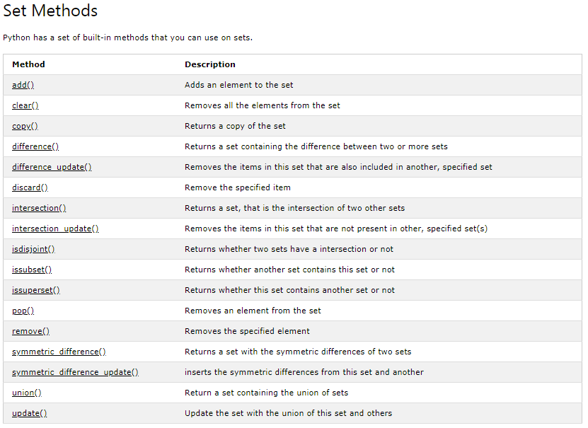
Python Collections – Programs on Sets
#It is also possible to use the set() constructor to make a set, the set list is unordered, result displayed are in a random order
thisset = set(("apple", "banana", "cherry"))
print(thisset).

Slide 25
Python Collections – Programs on Dictionaries
A dictionary is a collection which is unordered, changeable and indexed with curly brackets, and they have keys and values
#Create and print a dictionary:
thisdict = {
"brand": "Ford",
"model": "Mustang",
"year": 1964
}
print(thisdict)
# Accessing Items: the items of a dictionary are accessed by referring to its key name, inside square brackets / using get() method
thisdict = {
"brand": "Ford",
"model": "Mustang",
"year": 1964
}
x = thisdict["model"]
print(x)
thisdict = {
"brand": "Ford",
"model": "Mustang",
"year": 1964
}
x = thisdict.get("model")
print(x)

Slide 26
Python Collections – Programs on Dictionaries
# Change Values: can change the value of a specific item by referring to its key name
thisdict = {
"brand": "Ford",
"model": "Mustang",
"year": 1964
}
thisdict["year"] = 2018
print(thisdict)
# loop through a dictionary by using a for loop
thisdict = {
"brand": "Ford",
"model": "Mustang",
"year": 1964
}
for x in thisdict:
print(x)
#to print all values
thisdict = {
"brand": "Ford",
"model": "Mustang",
"year": 1964
}
for x in thisdict:
print(thisdict[x])
#to print values using values()
thisdict = {
"brand": "Ford",
"model": "Mustang",
"year": 1964
}
for x in thisdict.values():
print(x)
#to print both key & value
thisdict = {
"brand": "Ford",
"model": "Mustang",
"year": 1964
}
for x, y in thisdict.items():
print(x, y)

Slide 27
Python Collections – Programs on Dictionaries
# Check if Key Exists: To determine if a specified key is present in a dictionary use the in keyword
thisdict = {
"brand": "Ford",
"model": "Mustang",
"year": 1964
}
if "model" in thisdict:
print("Yes, 'model' is one of the keys in the thisdict dictionary")
#Dictionary length: To determine how many items (key-value pairs) a dictionary has, use the len() method
thisdict = {
"brand": "Ford",
"model": "Mustang",
"year": 1964
}
print(len(thisdict))
# Adding Items: item to the dictionary is added by using a new index key and assigning a value to it
thisdict = {
"brand": "Ford",
"model": "Mustang",
"year": 1964
}
thisdict["color"] = "red“ print(thisdict)

Slide 28
Python Collections – Programs on Dictionaries
# Removing Items: several methods to remove items from a dictionary
#1 Using pop() method
thisdict = {
"brand": "Ford",
"model": "Mustang",
"year": 1964
}
thisdict.pop("model")
print(thisdict)
#2. popitem() method removes the last inserted item (in versions before 3.7, a random item is removed instead
thisdict = {
"brand": "Ford",
"model": "Mustang",
"year": 1964
}
thisdict.popitem()
print(thisdict)

Slide 29
Python Collections – Programs on Dictionaries
# Removing Items: several methods to remove items from a dictionary
#3. del method: The del keyword removes the item with the specified key name
thisdict = {
"brand": "Ford",
"model": "Mustang",
"year": 1964
}
del thisdict["model"]
print(thisdict)
# 4. The del keyword can also delete the dictionary completely
thisdict = {
"brand": "Ford",
"model": "Mustang",
"year": 1964
}
del thisdict
print(thisdict)
#this will cause an error because "thislist" no longer exists.

Slide 30
Python Collections – Programs on Dictionaries
# Removing Items: several methods to remove items from a dictionary
#3. del method: The del keyword removes the item with the specified key name
thisdict = {
"brand": "Ford",
"model": "Mustang",
"year": 1964
}
del thisdict["model"]
print(thisdict)
# 4. The del keyword can also delete the dictionary completely
thisdict = {
"brand": "Ford",
"model": "Mustang",
"year": 1964
}
del thisdict
print(thisdict)
#this will cause an error because "thislist" no longer exists.
#5. clear method empties the dictionary
thisdict = {
"brand": "Ford",
"model": "Mustang",
"year": 1964
}
thisdict.clear()
print(thisdict)

Slide 31
Python Collections – Programs on Dictionaries
# Copy a Dictionary: You cannot copy a dictionary simply by typing dict2 = dict1, because: dict2 will only be a reference to dict1, #and changes made in dict1 will automatically also be made in dict2. There are ways to make a copy, one way is to use the built-#in Dictionary method copy() and built-in method dict()
thisdict = {
"brand": "Ford",
"model": "Mustang",
"year": 1964
}
mydict = thisdict.copy()
print(mydict)
thisdict = {
"brand": "Ford",
"model": "Mustang",
"year": 1964
}
mydict = dict(thisdict)
print(mydict)

Slide 32
Python Collections – Programs on Dictionaries
# Nested Dictionaries: A dictionary can also contain many dictionaries, this is called nested dictionaries
# Create a dictionary that contain
#three dictionaries
myfamily = {
"child1" : {
"name" : "Emil",
"year" : 2004
},
"child2" : {
"name" : "Tobias",
"year" : 2007
},
"child3" : {
"name" : "Linus",
"year" : 2011
}
}
print(myfamily)
To nest three dictionaries that already exists as dictionaries, Create three dictionaries, than create one dictionary that will contain the other three dictionaries
child1 = {"name" : "Emil",
"year" : 2004
}
child2 = {
"name" : "Tobias",
"year" : 2007
}
child3 = {
"name" : "Linus",
"year" : 2011
}
myfamily = {
"child1" : child1,
"child2" : child2,
"child3" : child3
}
print(myfamily)

Slide 33
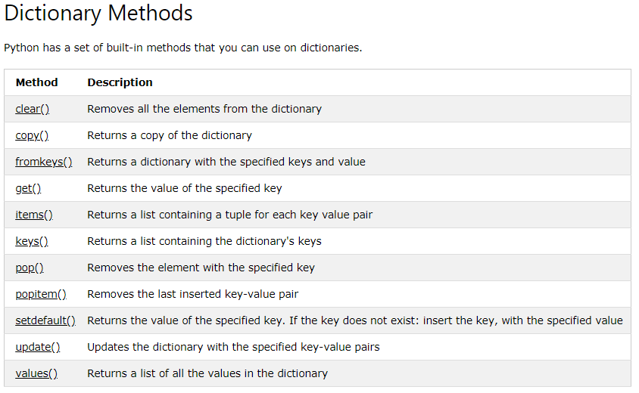
Python Collections – Programs on Dictionaries
# The dict() Constructor, used to make a new dictionary, keywords are not string literals, use of equals rather than colon to assign
thisdict = dict(brand="Ford", model="Mustang", year=1964)
print(thisdict)

Slide 34
Why Us
Kaushalya is built by IT Professions having experience in academia
Our vision is to Skill, Up-Skill and Re-Skill in order to bridge the gap between academia and industry
Training is conducted by experienced IT Professionals
Vendors for major educational institutions and corporates

Slide 35

Thank You

