Slide 1
Python
Raghu Prasad K S
www.kaushalya.tech
9845547471

Slide 2
Introduction
Raghu Prasad K S – BE, MS, CEO of Kasuhalya Technologies
Total of 24 years of experience
7 years as a lecturer in an Engineering College
17 Years into IT
Worked with companies like CISCO,CSC,ICICI,First Apex – NTT Data
Currently into Corporate training and consultancy
Worked with corporates and public sector
Technologies – Java,Python,AI,ML,Web technologies,Java Script technologies (MEAN stack),IOT,Test Automation – Selenium,Jmeter
CSR Activities
Professional Yoga Trainer and motivational speaker

Slide 3
About Us
Kaushalya Technologies (www.kaushalya.tech) is an educational technology company started by IT Professionals and Academicians.
It has offices in Jakkur and Sahakara Nagara in Bengaluru
Kaushalya Technologies are into IT niche skills training, consultancy and educational application development
We conduct FDP, SDP, Internships for educational institutions.
We conduct Boot camp and niche IT skills training for corporates.

Slide 4
Our Major clients
Educational Institutions
Acharya Institute of Technology, REVA University,Dayanand Sagar University, Nagarjuna Engineering College, Bengaluru
BGSIT- Bellur, Malnad Engineering College-Hassan, NIE-Mysore, MYCEM, Mysore, NIT-Manipur
Sindhi College, SB College of Management, Bengaluru
IT Companies
L & T – Mysore,NextGen-Bengaluru,Philips-Bengaluru,Incarnus-Chennai,Aspire Systems-Chennai, Infidata Technologies – Bengaluru, Edulife- Bengaluru

Slide 5
Course Objectives
Introduce trainees to Python as a generic programming language
Introduce trainees to Object Oriented Programming and its usages
Code as you learn
Build ability to solve a problem by developing necessary algorithms
Bridge the gap between actual skills required for the industry and the current skills possessed by the trainees
Prepare trainees for hackathons and placements

Slide 6
Course Outcome
Trainees are expected to gain theoretical and practical exposure in basics of Python
Hands-on and minds-on Learning
Build a project at the end of the training
Learn soft skills aspects such as being a team player and critical thinking ability
Well prepared to participate in hackathon and campus
Well versed with software development life cycle

Slide 7
Training Methodology
It’s combination of theoretical and practical sessions. We will introduce to a concept and use hands-on session to further strengthen their understanding of the concept.
It’s a 60 hour course
Following assessment methodology would be performed
Pre-assessment test
Attendance and attentiveness in the class
Completion of hands-on session
Completion of assignments
Completion of project
Feedback
Post-assessment test
Softcopy of the course material would be handed over to each student at the end of the course.
Joint certificate by the college and Kaushalya would be issued to the trainees

Slide 8
Course Outline
Introduction to Python
Installation of Python and getting started with python
Introduction to IDE and Installation of Anaconda
Building Blocks of Python
Object Orientation
File Operations
GUI
Exception Handling
Database Interaction

Slide 9
Database Interaction – Using Python
Introduction to Database
Python and Database
CRUD – Python Mapping
Database Interactions using Python
Examples refer to Programs under Anaconda File Explorer, 30_Sql

Slide 10
Introduction to Database
Earlier the File Based Systems
Data is stored in files
Each file has a specific format
Programs that use these files depend on knowledge about that format
Limitations Observed in File Based System:
No standards
Data duplication
Data dependence
No way to generate ad hoc queries
No provision for security, recovery, concurrency, etc
What is Database?
One or more large structured sets of persistent data, usually associated with software not only to update and query the
data but also assist in other operations as well
A database is a collection of tables related to each other via columns. For most real-world projects, a database is a must.
SQL (Structured Query Language) to create, access, and manipulate data. We can also make use of normalization to avoid
redundancy of data.

Slide 11
Structured Query Language (SQL)
To perform operations on databases, one should use structured query language.
SQL is a standard language for storing, manipulating and retrieving data in databases.
Irrespective of RDBMS software (like Oracle, MySQL, MS Access, SQLite etc) being used, the syntax of SQL remains the same.
The usage of SQL commands may vary from one RDBMS to the other and there may be little syntactical difference.
Also, when we are using some programming language like Python as a front-end to perform database applications, the way we embed SQL commands inside the program source-code is as per the syntax of respective programming language.
Still, the underlying SQL commands remain the same. Hence, it is essential to understand basic commands of SQL.
There are some clauses like FROM, WHERE, ORDER BY, INNER JOIN etc. that are used with SQL commands, which we will study in a due course.

Slide 12
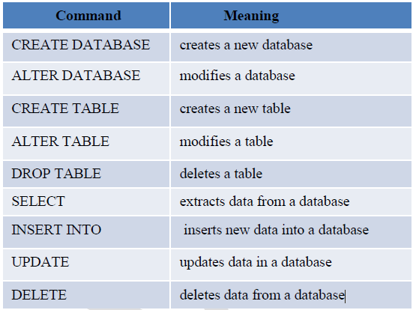
Structured Query Language (SQL)
The following table gives few of the SQL commands.

Slide 13
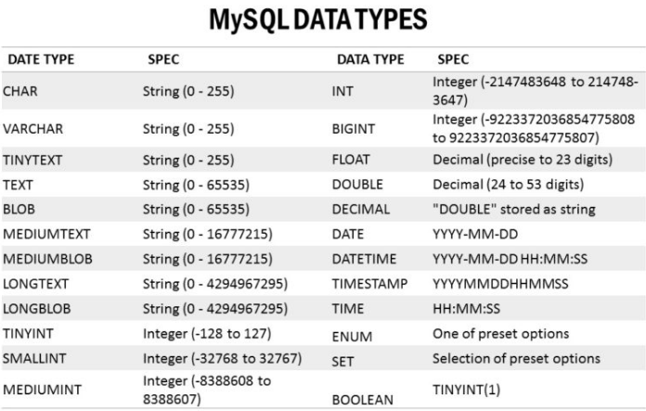
Structured Query Language (SQL)
Every RDBMS has its own way of storing the data in tables. Each of RDBMS uses its own set of data types for the
attribute values to be used as mentioned in the following table

Slide 14
Structured Query Language (SQL)
SQL commands are case-insensitive. But, it is a common practice to write commands and clauses in uppercase alphabets just to differentiate them from table name and attribute names.
Some of the examples to understand the usage of SQL statements –
CREATE TABLE Tracks (title TEXT, plays INTEGER): This command creates a table called as Tracks with the attributes title and plays where title can store data of type TEXT and plays can store data of type INTEGER.
INSERT INTO Tracks (title, plays) VALUES ('My Way', 15): This command inserts one record into the table Tracks where values for the attributes title and plays are My Way and 15 respectively.
SELECT * FROM Tracks: Retrieves all the records from the table Tracks
SELECT * FROM Tracks WHERE title = 'My Way’: Retrieves the records from the table Tracks having the value of attribute title as My Way
SELECT title, plays FROM Tracks ORDER BY title: The values of attributes title and plays are retrieved from the table Tracks with the records ordered in ascending order of title.
UPDATE Tracks SET plays = 16 WHERE title = 'My Way’: To modify the value of any particular attribute in the table, use UPDATE command. Here, the value of attribute plays is assigned to a new value for the record having value of title as My Way.
DELETE FROM Tracks WHERE title = 'My Way‘: A particular record can be deleted from the table using DELETE command. Here, the record with value of attribute title as My Way is deleted from the table Tracks.

Slide 15
Python MySQL - KEYS
Three Kinds of Keys : To build a data model by putting data into multiple linked tables and linking the rows of those tables can be done by using some keys. There are three types of keys used in database model:
A logical key is a key that the “real world” might use to look up a row. It defines the relationship between primary keys and foreign keys. Most of the times, a UNIQUE constraint is added to a logical key. Since the logical key is how we look up a row from the outside world, it makes little sense to allow multiple rows with the same value in the table.
A primary key is usually a number that is assigned automatically by the database. It generally has no meaning outside the program and is only used to link rows from different tables together. When we want to look up a row in a table, usually searching for the row using the primary key is the fastest way to find the row. Since primary keys are integer numbers, they take up very little storage and can be compared or sorted very quickly.
A foreign key is usually a number that points to the primary key of an associated row in a different table.

Slide 16
Introduction to Database
A database system consists of
Data (the database)
Software
Hardware
Users
Database systems allow users (w.r.t data) such as
Store; Update; Retrieve; Organise and Protect
Database Users
End users: Use the database system to achieve some goal
Application developers: Write software to allow end users to interface with the database system
Database Administrator (DBA): Designs & manages the database system
Database systems programmer: Writes the database software itself
Problems with early databases
Navigating the records requires complex programs
There is minimal data independence
No theoretical foundations
(Then, in 1970, E. F. Codd wrote “A Relational Model of Data for Large Shared Databanks” and introduced the
relational model)

Slide 17
Relational Systems
Information is stored as tuples or records in relations or tables
There is a sound mathematical theory of relations
Most modern DBMS are based on the relational model
The Relational model covers 3 areas:
Data structure
Data integrity
Data manipulation
ANSI/SPARC Architecture
ANSI - American National Standards Institute
SPARC - Standards Planning and Requirements Committee
1975 - proposed a framework for DBs
A three-level architecture
Internal level: For systems designers
Conceptual level: For database designers and administrators
External level: For database users

Slide 18
Three Level Architecture
Internal Level: Deals with physical storage of data
Structure of records on disk - files, pages, blocks
Indexes and ordering of records
Used by database system programmers
Internal Schema
RECORD EMP
LENGTH=44
HEADER: BYTE(5)
OFFSET=0
NAME: BYTE(25)
OFFSET=5
SALARY: FULLWORD
OFFSET=30
DEPT: BYTE(10)
OFFSET=34
Conceptual Level: Deals with the organisation of the data as a whole
Abstractions are used to remove unnecessary details of the internal level
Used by DBAs and application programmers
Conceptual Schema
CREATE TABLE
Employee (
Name
VARCHAR(25),
Salary REAL,
Dept_Name
VARCHAR(10))
External Level: Provides a view of the database tailored to a user
Parts of the data may be hidden
Data is presented in a useful form
Used by end users and application programmers
External Schemas
Payroll:
String Name
double Salary
Personnel:
char *Name
char *Department

Slide 19
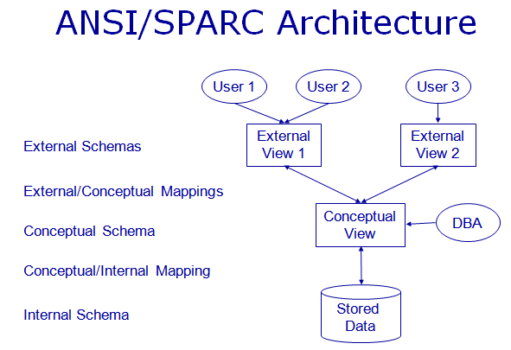
Three Level Architecture Mapping
Mappings translate information from one level to the next
External/Conceptual
Conceptual/Internal
These mappings provide data independence
Physical data independence
Changes to internal level shouldn’t affect conceptual level
Logical data independence
Conceptual level changes shouldn’t affect external levels

Slide 20
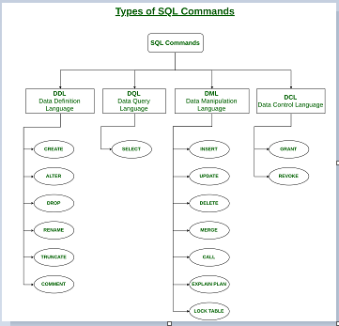
Python and Databases
For database programming, Python supports many database servers:
MySQL, Oracle, PostgreSQL, SQLite, Sybase, Microsoft SQL Server, MSQL, Microsoft Access, and many more.
It also supports Data Query Statements, DDL – Data Definition Language; DQL – Data Query Language; DML – Data Manipulation Language; DCL – Data Control Language
Advantages of Database Programming with Python have the following benefits:
Platform-independent
Faster and more efficient
Portable
Support for relational database systems
Easy to migrate and port database application interfaces
Support for SQL cursors
It handles open and closed connections

Slide 21
Python MySQL
Python can be used in database applications, One of the most popular databases is MySQL available as free download at https://www.mysql.com/downloads/
Python needs a MySQL driver to access the MySQL database that can be installed using the command
python -m pip install mysql-connector
To test if the installation was successful, or if "MySQL Connector" is installed, Python page with the following
content
import mysql.connector
#if this page is executed with no errors, then "mysql.connector" module is installed correctly.
Create Connection
import mysql.connector
mydb = mysql.connector.connect(host="localhost", user="myusername", passwd="mypassword”)
print(mydb)
Output is something like: <mysql.connector.connection.MySQLConnection object ar 0x016645F0>

Slide 22
Python MySQL
Creating a Database:
import mysql.connector
mydb = mysql.connector.connect(host="localhost", user="myusername", passwd="mypassword”)
mycursor = mydb.cursor()
mycursor.execute("CREATE DATABASE mydatabase")
#If this page is executed with no error, you have successfully created a database
Check if Database Exists:
import mysql.connector
mydb = mysql.connector.connect(host="localhost", user="myusername", passwd="mypassword”)
mycursor = mydb.cursor()
mycursor.execute("SHOW DATABASES")
for x in mycursor:
print(x)
A cursor() is like a file handle that we can use to perform operations on the data stored in the database. Calling cursor() is very
similar conceptually to calling open() when dealing with text files using cursor, we commands can be executed on the contents of
database using execute() method

Slide 23
Python MySQL
To Access the Database:
Import mysql.connector
mydb = mysql.connector.connect(host="localhost“, user="myusername", passwd="mypassword",
database="mydatabase”)
#If this page is executed with no error, the database "mydatabase" exists in your system
Creating a Table:
import mysql.connector
mydb = mysql.connector.connect(host="localhost“, user="myusername", passwd="mypassword",
database="mydatabase”)
mycursor = mydb.cursor()
mycursor.execute("CREATE TABLE customers (name VARCHAR(255), address VARCHAR(255))")
#If this page is executed with no error, you have successfully created a table named "customers".

Slide 24
Python MySQL
Check if Table Exists:
import mysql.connector
mydb = mysql.connector.connect(host="localhost", user="myusername", passwd="mypassword",
database="mydatabase”)
mycursor = mydb.cursor()
mycursor.execute("SHOW TABLES")
for x in mycursor:
print(x)
Primary Key
When creating a table, you should also create a column with a unique key for each record. This can be done by
defining a PRIMARY KEY. We use the statement "INT AUTO_INCREMENT PRIMARY KEY" which will insert a unique
number for each record. Starting at 1, and increased by one for each record.

Slide 25
Python MySQL – Primary Key Example
import mysql.connector mydb = mysql.connector.connect(host="localhost", user="yourusername", passwd="yourpassword", database="mydatabase”) mycursor = mydb.cursor() mycursor.execute("CREATE TABLE customers (id INT AUTO_INCREMENT PRIMARY KEY, name VARCHAR(255), address VARCHAR(255))")
If the table already exists, use the ALTER TABLE keyword:
import mysql.connector mydb = mysql.connector.connect(host="localhost", user="yourusername", passwd="yourpassword", database="mydatabase”) mycursor = mydb.cursor() mycursor.execute("ALTER TABLE customers ADD COLUMN id INT AUTO_INCREMENT PRIMARY KEY")

Slide 26
Python MySQL - Insert Into Table
import mysql.connector mydb = mysql.connector.connect( host="localhost", user="yourusername", passwd="yourpassword", database="mydatabase" ) mycursor = mydb.cursor() sql = "INSERT INTO customers (name, address) VALUES (%s, %s)" val = ("John", "Highway 21") mycursor.execute(sql, val) mydb.commit() print(mycursor.rowcount, "record inserted.")

Slide 27
Python MySQL – Insert Multiple Rows
import mysql.connector mydb = mysql.connector.connect( host="localhost", user="yourusername", passwd="yourpassword", database="mydatabase" ) mycursor = mydb.cursor() sql = "INSERT INTO customers (name, address) VALUES (%s, %s)" val = [('Peter', 'Lowstreet 4'), ('Amy', 'Apple st 652'), ('Hannah', 'Mountain 21'), ('Michael', 'Valley 345'), ('Sandy', 'Ocean blvd 2'), ('Betty', 'Green Grass 1'), ('Richard', 'Sky st 331'), ('Susan', 'One way 98'), ('Vicky', 'Yellow Garden 2'), ('Ben', 'Park Lane 38'), ('William', 'Central st 954'), ('Chuck', 'Main Road 989'), ('Viola', 'Sideway 1633‘)] mycursor.executemany(sql, val) mydb.commit() print(mycursor.rowcount, "was inserted.")

Slide 28
Python MySQL - Insert one row, and return the ID
import mysql.connector mydb = mysql.connector.connect( host="localhost", user="yourusername", passwd="yourpassword", database="mydatabase" ) mycursor = mydb.cursor() sql = "INSERT INTO customers (name, address) VALUES (%s, %s)" val = ("Michelle", "Blue Village") mycursor.execute(sql, val) mydb.commit() print("1 record inserted, ID:", mycursor.lastrowid)
A commit command tells the database to finalize the write to the database. A rollback lets us revert changes and get back to a previous state. For committing, you can use commit(), and for rollback, you can use rollback()

Slide 29
Python MySQL - SELECT
import mysql.connector mydb = mysql.connector.connect( host="localhost", user="yourusername", passwd="yourpassword", database="mydatabase" ) mycursor = mydb.cursor() mycursor.execute("SELECT * FROM customers") myresult = mycursor.fetchall() for x in myresult: print(x)
Note: We use the fetchall() method, which fetches all rows from the last executed statement

Slide 30
Python MySQL - Selecting Columns
import mysql.connector mydb = mysql.connector.connect( host="localhost", user="yourusername", passwd="yourpassword", database="mydatabase" ) mycursor = mydb.cursor() mycursor.execute("SELECT name, address FROM customers") myresult = mycursor.fetchall() for x in myresult: print(x)

Slide 31
Python MySQL – SELECT Using the fetchone() Method
import mysql.connector mydb = mysql.connector.connect( host="localhost", user="yourusername", passwd="yourpassword", database="mydatabase" ) mycursor = mydb.cursor() mycursor.execute("SELECT * FROM customers") myresult = mycursor.fetchone() print(myresult)

Slide 32
Python MySQL – Using WHERE (Filter)
import mysql.connector mydb = mysql.connector.connect( host="localhost", user="yourusername", passwd="yourpassword", database="mydatabase" ) mycursor = mydb.cursor() sql = "SELECT * FROM customers WHERE address ='Park Lane 38'" mycursor.execute(sql) myresult = mycursor.fetchall() for x in myresult: print(x)

Slide 33
Python MySQL – Using WHERE (wild character)
import mysql.connector mydb = mysql.connector.connect( host="localhost", user="yourusername", passwd="yourpassword", database="mydatabase" ) mycursor = mydb.cursor() sql = "SELECT * FROM customers WHERE address LIKE '%way%'" mycursor.execute(sql) myresult = mycursor.fetchall() for x in myresult: print(x)

Slide 34
Python MySQL – Prevent SQL Injection
When query values are provided by the user, you should escape the values. This is to prevent SQL injections, which is a common web hacking technique to destroy or misuse your database. The mysql.connector module has methods to escape query values using the placeholder %s method
import mysql.connector mydb = mysql.connector.connect( host="localhost", user="yourusername", passwd="yourpassword", database="mydatabase" ) mycursor = mydb.cursor() sql = "SELECT * FROM customers WHERE address = %s" adr = ("Yellow Garden 2", ) mycursor.execute(sql, adr) myresult = mycursor.fetchall() for x in myresult: print(x)

Slide 35
Python MySQL – Using Order By
Use the ORDER BY statement to sort the result in ascending or descending order. The ORDER BY keyword sorts the result ascending by default. To sort the result in descending order, use the DESC keyword
import mysql.connector mydb = mysql.connector.connect( host="localhost", user="yourusername", passwd="yourpassword", database="mydatabase" ) mycursor = mydb.cursor() sql = "SELECT * FROM customers ORDER BY name" mycursor.execute(sql) myresult = mycursor.fetchall() for x in myresult: print(x)

Slide 36
Python MySQL – Using Order By
Use the ORDER BY statement to sort the result in ascending or descending order. The ORDER BY keyword sorts the result ascending by default. To sort the result in descending order, use the DESC keyword
import mysql.connector mydb = mysql.connector.connect( host="localhost", user="yourusername", passwd="yourpassword", database="mydatabase" ) mycursor = mydb.cursor() sql = "SELECT * FROM customers ORDER BY name" mycursor.execute(sql) myresult = mycursor.fetchall() for x in myresult: print(x)

Slide 37
Python MySQL – Using ORDER BY DESC
Use the ORDER BY statement to sort the result in ascending or descending order. The ORDER BY keyword sorts the result ascending by default. To sort the result in descending order, use the DESC keyword
import mysql.connector mydb = mysql.connector.connect( host="localhost", user="yourusername", passwd="yourpassword", database="mydatabase" ) mycursor = mydb.cursor() sql = "SELECT * FROM customers ORDER BY name DESC" mycursor.execute(sql) myresult = mycursor.fetchall() for x in myresult: print(x)

Slide 38
Python MySQL – Using Delete From
delete records from an existing table by using the "DELETE FROM" statement
import mysql.connector mydb = mysql.connector.connect( host="localhost", user="yourusername", passwd="yourpassword", database="mydatabase" ) mycursor = mydb.cursor() sql = "DELETE FROM customers WHERE address = 'Mountain 21'" mycursor.execute(sql) mydb.commit() print(mycursor.rowcount, "record(s) deleted")

Slide 39
Python MySQL – Using Delete From
import mysql.connector mydb = mysql.connector.connect( host="localhost", user="yourusername", passwd="yourpassword", database="mydatabase" ) mycursor = mydb.cursor() sql = "DELETE FROM customers WHERE address = 'Mountain 21'" mycursor.execute(sql) mydb.commit() print(mycursor.rowcount, "record(s) deleted")
delete records from an existing table by using the "DELETE FROM" statement Notice the statement: mydb.commit(). It is required to make the changes, otherwise no changes are made to the table. The WHERE clause specifies which record(s) that should be deleted. If you omit the WHERE clause, all records will be deleted

Slide 40
Python MySQL – Using Delete Prevent SQL Injection
import mysql.connector mydb = mysql.connector.connect( host="localhost", user="yourusername", passwd="yourpassword", database="mydatabase" ) mycursor = mydb.cursor() sql = "DELETE FROM customers WHERE address = %s" adr = ("Yellow Garden 2", ) mycursor.execute(sql, adr) mydb.commit() print(mycursor.rowcount, "record(s) deleted")
It is considered a good practice to escape the values of any query, also in delete statements. This is to prevent SQL injections, which is a common web hacking technique to destroy or misuse your database. The mysql.connector module uses the placeholder %s to escape values in the delete statement

Slide 41
Python MySQL – Using Drop Table
Delete the table "customers":
import mysql.connector mydb = mysql.connector.connect( host="localhost", user="yourusername", passwd="yourpassword", database="mydatabase" ) mycursor = mydb.cursor() sql = "DROP TABLE customers" mycursor.execute(sql)

Slide 42
Python MySQL – Using Drop Only if Exist
If the the table you want to delete is already deleted, or for any other reason does not exist, you can use the IF EXISTS keyword to avoid getting an error
import mysql.connector mydb = mysql.connector.connect( host="localhost", user="yourusername", passwd="yourpassword", database="mydatabase" ) mycursor = mydb.cursor() sql = "DROP TABLE IF EXISTS customers" mycursor.execute(sql)

Slide 43
Python MySQL – Using Update Table
import mysql.connector mydb = mysql.connector.connect( host="localhost", user="yourusername", passwd="yourpassword", database="mydatabase" ) mycursor = mydb.cursor() sql = "UPDATE customers SET address = 'Canyon 123' WHERE address = 'Valley 345'" mycursor.execute(sql) mydb.commit() print(mycursor.rowcount, "record(s) affected")
Notice the statement: mydb.commit(). It is required to make the changes, otherwise no changes are made to the table. The WHERE clause specifies which record(s) that should be deleted. If you omit the WHERE clause, all records will be deleted

Slide 44
Python MySQL – Using Update Table Prevent SQL Injection
import mysql.connector mydb = mysql.connector.connect( host="localhost", user="yourusername", passwd="yourpassword", database="mydatabase" ) mycursor = mydb.cursor() sql = "UPDATE customers SET address = %s WHERE address = %s" val = ("Valley 345", "Canyon 123") mycursor.execute(sql, val) mydb.commit() print(mycursor.rowcount, "record(s) affected")
It is considered a good practice to escape the values of any query, also in update statements. This is to prevent SQL injections, which is a common web hacking technique to destroy or misuse your database. The mysql.connector module uses the placeholder %s to escape values in the delete statement

Slide 45
Python MySQL – Using LIMIT Start From Another Position
import mysql.connector mydb = mysql.connector.connect( host="localhost", user="yourusername", passwd="yourpassword", database="mydatabase" ) mycursor = mydb.cursor() mycursor.execute("SELECT * FROM customers LIMIT 5 OFFSET 2") myresult = mycursor.fetchall() for x in myresult: print(x)
If you want to return five records, starting from the third record, you can use the "OFFSET" keyword, start from position 3, and return 5 records

Slide 46
Python MySQL – Using Join
import mysql.connector mydb = mysql.connector.connect( host="localhost", user="yourusername", passwd="yourpassword", database="mydatabase" ) mycursor = mydb.cursor() sql = "SELECT \ users.name AS user, \ products.name AS favorite \ FROM users \ INNER JOIN products ON users.fav = products.id" mycursor.execute(sql) myresult = mycursor.fetchall() for x in myresult: print(x)

Slide 47
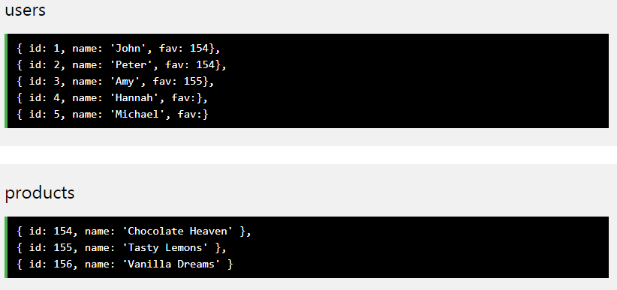
Python MySQL – Using Join
You can combine rows from two or more tables, based on a related column between them, by using a JOIN statement.
Consider you have a "users" table and a "products" table. These two tables can be combined by using users' fav field and products' id field. You can use JOIN instead of INNER JOIN. They will both give you the same result

Slide 48
Python MySQL – Using LEFT JOIN and RIGHT JOIN
In the example above, Hannah, and Michael were excluded from the result, that is because INNER JOIN only shows the records where there is a match. If you want to show all users, even if they do not have a favorite product, use the LEFT JOIN statement:
(Select all users and their favorite product)
sql = "SELECT \ users.name AS user, \ products.name AS favorite \ FROM users \ LEFT JOIN products ON users.fav = products.id"
If you want to return all products, and the users who have them as their favorite, even if no user have them as their favorite, use the RIGHT JOIN statement:
(Select all products, and the user(s) who have them as their favorite)
sql = "SELECT \ users.name AS user, \ products.name AS favorite \ FROM users \ RIGHT JOIN products ON users.fav = products.id"

Slide 49
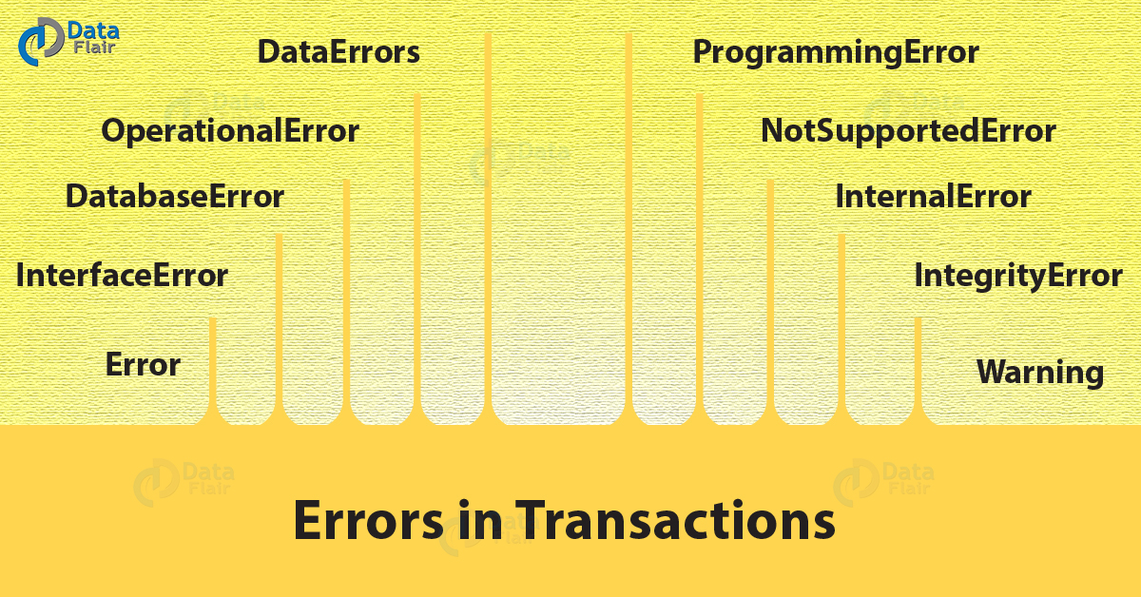
Errors in Transactions
Notes:
Ref: DataFlair

Slide 50
Errors in Transactions
Error: This is the base class for errors and a subclass to StandardError.
InterfaceError: This is a subclass to Error and Python uses it for
errors relating to the module for database access.
DatabaseError: This is a subclass to Error and Python uses it for
database errors.
OperationalError: This is a subclass of DatabaseError. When
Python loses connection to a database, it throws this error. This
may happen when we haven’t selected a database.
DataError: This is a subclass of DatabaseError. Python uses this
When there is an error in the Data.

Slide 51
Errors in Transactions
InternalError: This is a subclass of DatabaseError. Python uses this for errors internal to the module we use for the database access.
IntegrityError: Also a subclass of DatabaseError. Python uses this for cases where there can be damage to relational integrity. This may happen when you try to enter duplicate records in the database.
ProgrammingError: This is a subclass of DatabaseError. Errors like bad table names cause this. This may happen when we try to create a duplicate database.
NotSupportedError: A subclass of DatabaseError. When we attempt to call functionality that it doesn’t support, Python raises this error.
Warning: This is a subclass of StandardError. Python uses for non fatal issues.

Slide 52
Why Us
Kaushalya is built by IT Professions having experience in academia
Our vision is to Skill, Up-Skill and Re-Skill in order to bridge the gap between academia and industry
Training is conducted by experienced IT Professionals
Vendors for major educational institutions and corporates

Slide 53

Thank You

