Slide 1
Python
Ramesh V
www.kaushalya.tech
9845547471

Slide 2
Introduction
Ramesh V – BE, ME, MBA
Total of 16 years of experience
Worked with companies like Hexaware, Cognizant, Siebel, ANZ-OTSS, and etc..
Currently into Training for Academic and Corporate
Technologies – Worked on Java, Python, ML and actively involved in Development and Testing Products and Projects and etc..

Slide 3
About Us
Kaushalya Technologies (www.kaushalya.tech) is an educational technology company started by IT Professionals and Academicians.
It has offices in Jakkur and Sahakara Nagara in Bengaluru
Kaushalya Technologies are into IT niche skills training, consultancy and educational application development
We conduct FDP, SDP, Internships for educational institutions.
We conduct Boot camp and niche IT skills training for corporates.

Slide 4
Our Major clients
Educational Institutions
Acharya Institute of Technology, REVA University,Dayanand Sagar University, Nagarjuna Engineering College, Bengaluru
BGSIT- Bellur, Malnad Engineering College-Hassan, NIE-Mysore, MYCEM, Mysore, NIT-Manipur
Sindhi College, SB College of Management, Bengaluru
IT Companies
L & T – Mysore,NextGen-Bengaluru,Philips-Bengaluru,Incarnus-Chennai,Aspire Systems-Chennai, Infidata Technologies – Bengaluru, Edulife- Bengaluru

Slide 5
Course Objectives
Introduce trainees to Python as a generic programming language
Introduce trainees to Object Oriented Programming and its usages
Code as you learn
Build ability to solve a problem by developing necessary algorithms
Bridge the gap between actual skills required for the industry and the current skills possessed by the trainees
Prepare trainees for hackathons and placements

Slide 6
Course Outcome
Trainees are expected to gain theoretical and practical exposure in basics of Python
Hands-on and minds-on Learning
Build a project at the end of the training
Learn soft skills aspects such as being a team player and critical thinking ability
Well prepared to participate in hackathon and campus
Well versed with software development life cycle

Slide 7
Training Methodology
It’s combination of theoretical and practical sessions. We will introduce to a concept and use hands-on session to further strengthen their understanding of the concept.
It’s a 30 hour course
Following assessment methodology would be performed
Pre-assessment test
Attendance and attentiveness in the class
Completion of hands-on session
Completion of assignments
Completion of project
Feedback
Post-assessment test
Softcopy of the course material would be handed over to each student at the end of the course.
Joint certificate by the college and Kaushalya would be issued to the trainees

Slide 8
Course Outline
Introduction to Python
Installation of Python and getting started with python
Introduction to IDE and Installation of Anaconda
Building Blocks of Python
Object Orientation
File Management Operations
GUI
Exception Handling
Database Interaction

Slide 9
File Management / Operations – Using Python
Introduction to File Management
File Management Options for Python
Python and File Operations
Examples refer to Programs under Anaconda File Explorer, 15-FileManagement

Slide 10
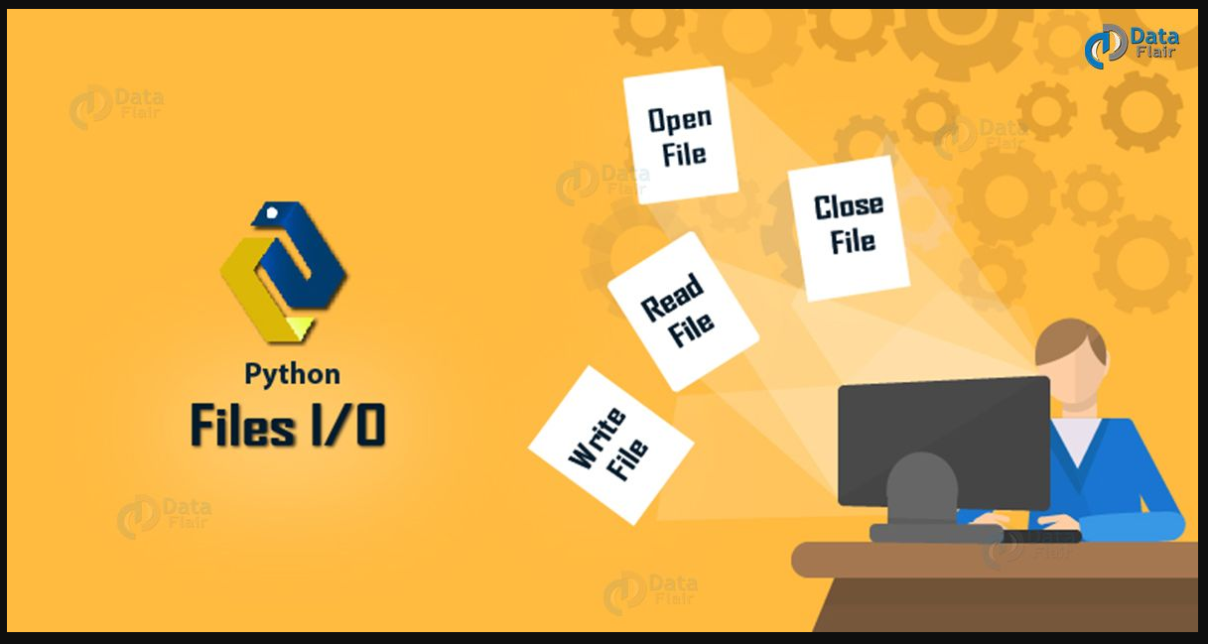
Introduction to File Management
File Management happens to be an important aspect of any application
Python provides several functions working with files CRUD (Create, Read, Update, and Delete)

Slide 11
Introduction to File Management
A file is a location on disk that stores related information and has a name
A hard-disk is non-volatile, and we use files to organize our data in different directories on a hard-disk.
The RAM (Random Access Memory) is volatile; it holds data only as long as it is up. So, we use files to store data permanently. To read from or write to a file, we must first open it. And then when we’re done with it, we should close it to free up the resources it holds (Open, Read/Write, Close)
The key function for working with files in Python is the open() function and need to “import os” library
The open() function takes two parameters; filename, and mode, In addition you can specify if the file should be handled as binary or text mode
"t" - Text - Default value. Text mode
"b" - Binary - Binary mode (e.g. images)

Slide 12
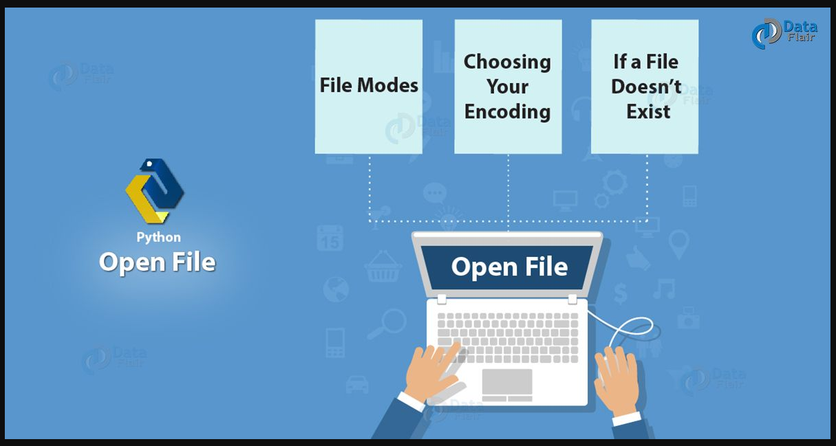
Introduction to File Management

Slide 13
File Management Options for Python
Access Modes Description
r Opens a file for reading only.
rb Opens a file for reading only in binary format.
r+ Opens a file for both reading and writing.
rb+ Opens a file for both reading and writing in binary format.
w Opens a file for writing only.
wb Opens a file for writing only in binary format.
w+ Opens a file for both writing and reading.
wb+ Opens a file for both writing and reading in binary format.
a Opens a file for appending.
ab Opens a file for appending in binary format.
a+ Opens a file for both appending and reading.
ab+ Opens a file for both appending and reading in binary format.

Slide 14
File Management Options for Python
Mode Description
'r' Open a file for reading. (default)
'w' Open a file for writing. Creates a new file if it does not exist or
truncates the file if it exists.
'x' Open a file for exclusive creation. If the file already exists, the
operation fails.
'a' Open for appending at the end of the file without truncating it. Creates a
new file if it does not exist.
't' Open in text mode. (default)
'b' Open in binary mode.
'+' Open a file for updating (reading and writing)

Slide 15
Python and File Operations
Syntax
To open a file for reading it is enough to specify the name of the file
1/ f = open("demofile.txt")
2/ f = open("demofile.txt", "rt")
3/ f = open (“<<filepath>>\demofile.txt")
4/ f = open(“<<filepath>>\demofile.txt", "rt")
Both 1, 2, 3 and 4 are same as "r" for read, and "t" for text are the default values,
you do not need to specify them and also ensure the file exists, or else you will get
an error

Slide 16
Python and File Operations
Open a File on the Server
Assume a file under demofile.txt contents are:
Hello! Welcome to demofile.txt
This file is for testing purposes.
Good Luck!
To open the file, use the built-in open() function.
The open() function returns a file object, which has a read() method for reading the content of the file
f = open("demofile.txt", "r") print(f.read())
Read Only Parts of the File
By default the read() method returns the whole text, but you can also specify how many characters you want to
return (below code return 5 characters of the file
f = open("demofile.txt", "r") print(f.read(5))

Slide 17
Python and File Operations
Read Lines
You can return one line by using the readline() method:
#Read one line of the file
f = open("demofile.txt", "r") print(f.readline())
#By calling readline() two times, you can read the two first lines
f = open("demofile.txt", "r") print(f.readline()) print(f.readline())
#use try and finally
try:
f=open('To do.txt')
print("Before")
print(1/0)
finally:
f.close()
The try block lets you test a block of code for errors.
The except block lets you handle the error.
The finally block lets you execute code, regardless of the result of the try- and except blocks

Slide 18
Python and File Operations
By looping through the lines of the file, you can read the whole file, line by line:
f = open("demofile.txt", "r") for x in f: print(x)
Close Files
It is a good practice to always close the file when you are done with it.
f = open("demofile.txt", "r") print(f.readline()) f.close()
Note: You should always close your files, in some cases, due to buffering, changes made to a file may not show until
you close the file.

Slide 19
Python and File Operations
Write to an Existing File
To write to an existing file, you must add a parameter to the open() function:
"a" - Append - will append to the end of the file
"w" - Write - will overwrite any existing content
Open the file "demofile2.txt" and append content to the file:
f = open("demofile2.txt", "a") f.write("Now the file has more content!") f.close()
#open and read the file after the appending:
f = open("demofile2.txt", "r") print(f.read())
Open the file "demofile3.txt" and overwrite the content:
f = open("demofile3.txt", "w") f.write("Woops! I have deleted the content!") f.close()
#open and read the file after the appending:
f = open("demofile3.txt", "r") print(f.read())
Note: the "w" method will overwrite the entire file

Slide 20
Python and File Operations
Create a New File
To create a new file in Python, use the open() method, with one of the following parameters:
"x" - Create - will create a file, returns an error if the file exist
"a" - Append - will create a file if the specified file does not exist
"w" - Write - will create a file if the specified file does not exist
f = open("myfile.txt", "x")
f = open("myfile.txt", "w")
Delete a File
To delete a file, you must import the OS module, and run its os.remove() function:
#Remove the file demofile.txt
import os os.remove("demofile.txt")

Slide 21
Python and File Operations
Check if File exist
To avoid getting an error, you might want to check if the file exists before you try to delete it:
#Check if file exists, then delete it:
import os
if os.path.exists("demofile.txt"): os.remove("demofile.txt")
else: print("The file does not exist")
Delete Folder
To delete an entire folder, use the os.rmdir() method:
#Remove the folder "myfolder":
import os
os.rmdir("myfolder")
Note: You can only remove empty folders.

Slide 22
Python and File Operations
File Iterate:
The file object has an inbuilt iterate. The following program reads the given file line by line until
StopIteration is raised, i.e. the end of the file is reached.
f=open("myfiledemo.txt","r")
while True:
try:
line=next(f)
print (line)
except StopIteration:
break
f.close()

Slide 23
Python and File Operations
#seek() method : To read or write at a specific position, use the seek() function to
set the current read/write position.
f.seek(offset, from)
Here, the from parameter takes the following values:
0 : offset calculated from the beginning
1 : offset calculated from the current position
2 : offset calculated from the end
file.tell() - Returns the file's current position
f=open("myfiledemo.txt","r+")
f.seek(6,0)
currposition = f.tell()
print('current position',currposition)
lines=f.readlines()
for line in lines:
print(line)
print('position after every line', f.tell())
f.close()
f=open("myfile.txt","r+")
f.seek(6,0)
content=f.read()
print(content)
f.close()

Slide 24
Why Us
Kaushalya is built by IT Professions having experience in academia
Our vision is to Skill, Up-Skill and Re-Skill in order to bridge the gap between academia and industry
Training is conducted by experienced IT Professionals
Vendors for major educational institutions and corporates

Slide 25

Thank You

