Slide 1
Python
Ramesh V
www.kaushalya.tech
9845547471

Slide 2
Introduction
Ramesh V – BE, ME, MBA
Total of 16 years of experience
Worked with companies like Hexaware, Cognizant, Siebel, ANZ-OTSS, and etc..
Currently into Training for Academic and Corporate
Technologies – Worked on Java, Python, ML and actively involved in Development and Testing Products and Projects and etc..

Slide 3
About Us
Kaushalya Technologies (www.kaushalya.tech) is an educational technology company started by IT Professionals and Academicians.
It has offices in Jakkur and Sahakara Nagara in Bengaluru
Kaushalya Technologies are into IT niche skills training, consultancy and educational application development
We conduct FDP, SDP, Internships for educational institutions.
We conduct Boot camp and niche IT skills training for corporates.

Slide 4
Our Major clients
Educational Institutions
Acharya Institute of Technology, REVA University,Dayanand Sagar University, Nagarjuna Engineering College, Bengaluru
BGSIT- Bellur, Malnad Engineering College-Hassan, NIE-Mysore, MYCEM, Mysore, NIT-Manipur
Sindhi College, SB College of Management, Bengaluru
IT Companies
L & T – Mysore,NextGen-Bengaluru,Philips-Bengaluru,Incarnus-Chennai,Aspire Systems-Chennai, Infidata Technologies – Bengaluru, Edulife- Bengaluru

Slide 5
Course Objectives
Introduce trainees to Python as a generic programming language
Introduce trainees to Object Oriented Programming and its usages
Code as you learn
Build ability to solve a problem by developing necessary algorithms
Bridge the gap between actual skills required for the industry and the current skills possessed by the trainees
Prepare trainees for hackathons and placements

Slide 6
Course Outcome
Trainees are expected to gain theoretical and practical exposure in basics of Python
Hands-on and minds-on Learning
Build a project at the end of the training
Learn soft skills aspects such as being a team player and critical thinking ability
Well prepared to participate in hackathon and campus
Well versed with software development life cycle

Slide 7
Training Methodology
It’s combination of theoretical and practical sessions. We will introduce to a concept and use hands-on session to further strengthen their understanding of the concept.
It’s a 30 hour course
Following assessment methodology would be performed
Pre-assessment test
Attendance and attentiveness in the class
Completion of hands-on session
Completion of assignments
Completion of project
Feedback
Post-assessment test
Softcopy of the course material would be handed over to each student at the end of the course.
Joint certificate by the college and Kaushalya would be issued to the trainees

Slide 8
Course Outline
Introduction to Python
Installation of Python and getting started with python
Introduction to IDE and Installation of Anaconda
Building Blocks of Python
Object Orientation
File Management Operations
GUI
Exception Handling
Database Interaction

Slide 9
Exception Handling
Introduction to Exceptions
Python Exception Handling
Try Except Finally Block
Assertions
Defining Your Own Exceptions

Slide 10
Introduction to Exceptions
To simplify programming and make applications more robust.
What does robust mean?
In a language without exception handling When an exception occurs, control goes to the
operating system, where a message is displayed and the program is terminated
In a language with exception handling When an exception occurs, control goes to the operating
system, where a message is displayed and the program is terminated
Objective is:
to explore Python Exception Handling
discuss try/except blocks, finally block, and raise block
learn how to define your own python exception

Slide 11
Introduction to Exceptions
Exception handling is the process of responding to exceptions when a computer program runs.
An exception occurs when an unexpected event happens that requires special processing. Examples include a user providing abnormal input, a file system error being encountered when trying to read or write a file, or a program attempting to divide by zero.
Exception handling attempts to gracefully handle these situations so that a program (or worse, an entire system) does not crash. Exception handling can be performed at both the software (as part of the program itself) and hardware levels (using mechanisms built into the design of the CPU)

Slide 12
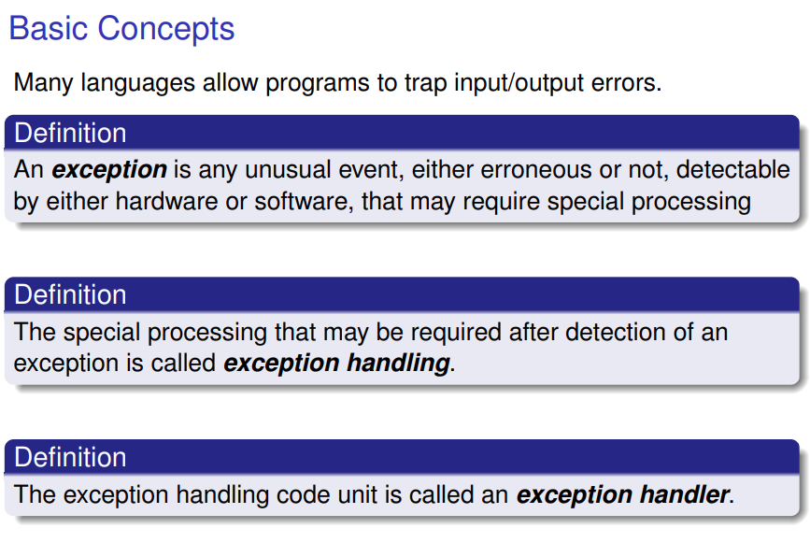
Introduction to Exceptions

Slide 13
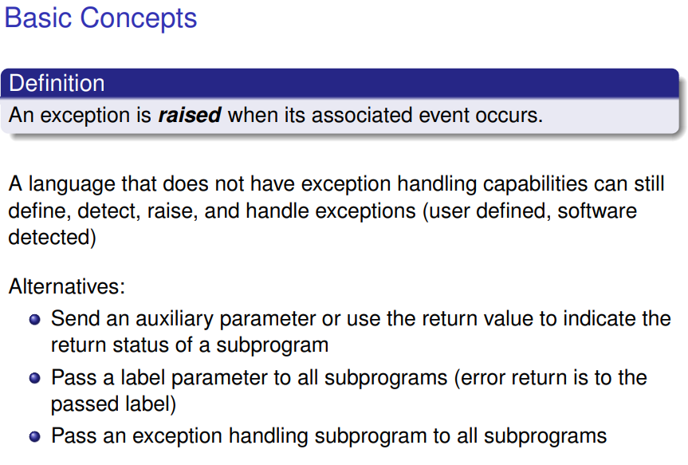
Introduction to Exceptions

Slide 14
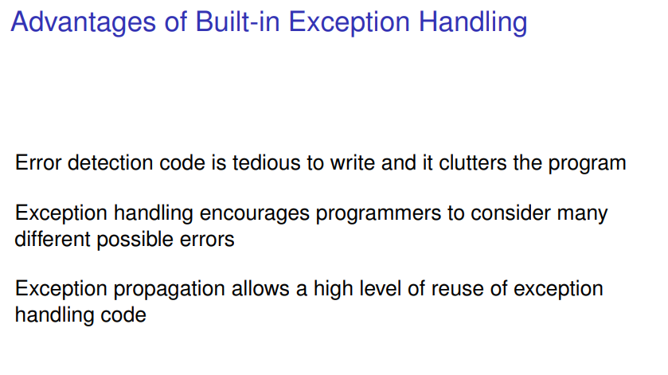
Introduction to Exceptions

Slide 15
Introduction to Exceptions

Slide 16
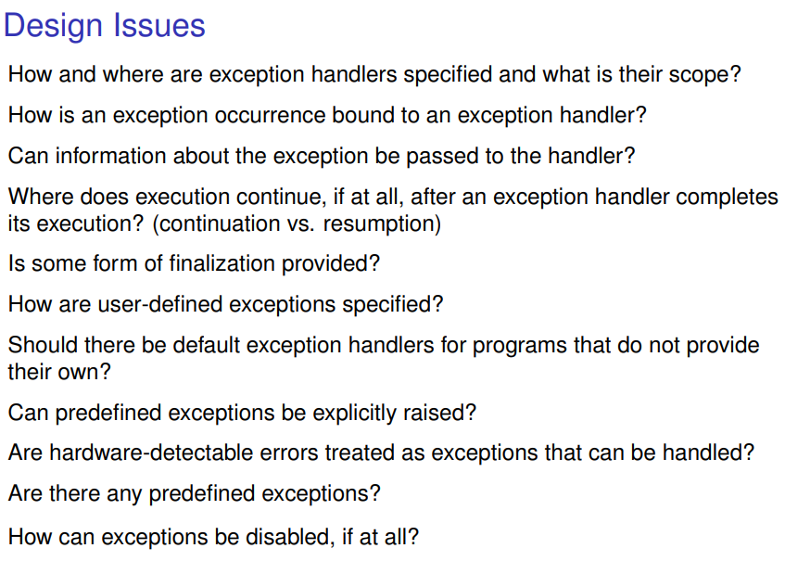
Introduction to Exceptions

Slide 17
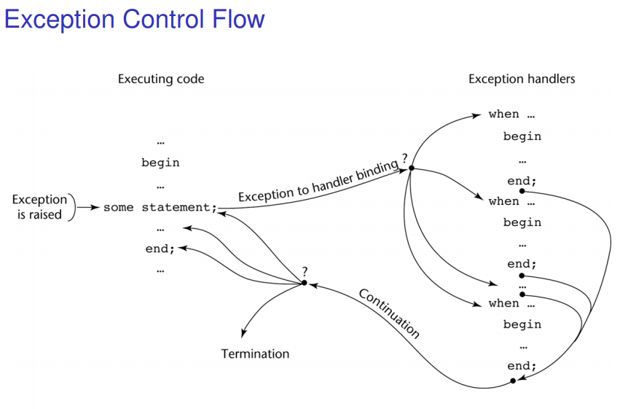
Introduction to Exceptions

Slide 18
Python Exception Handling
Exception Handling
When an error occurs, or exception as we call it, Python will normally stop and
generate an error message. These exceptions can be handled using the try
Statement
The try block lets you test a block of code for errors.
The except block lets you handle the error.
The finally block lets you execute code, regardless of the result of the try- and except blocks
#The try block will generate an exception, because x is not defined
try: print(x)
except: print("An exception occurred")

Slide 19
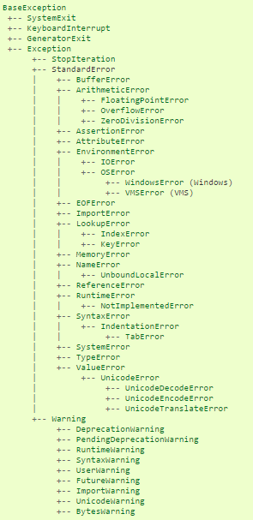
Python Exception Handling Hierarchy

Slide 20
Python Exception Handling - Many Exceptions
You can define as many exception blocks as you want, e.g. if you want to execute a
special block of code for a special kind of error
#The try block will generate a NameError, because x is not defined:
try:
print(x)
except NameError:
print("Variable x is not defined")
except:
print("Something else went wrong")
Output → Variable x is not defined

Slide 21
Python Exception Handling
Else
You can use the else keyword to define a block of code to be executed if no errors were raised:
#The try block does not raise any errors, so the else block is executed:
try:
print("Hello")
except:
print("Something went wrong")
else:
print("Nothing went wrong")

Slide 22
Python Exception Handling
Finally
The finally block, if specified, will be executed regardless if the try block raises an error or not
#The finally block gets executed no matter if the try block raises any errors or not:
try:
print(x)
except:
print("Something went wrong")
finally:
print("The 'try except' is finished")

Slide 23
Python Exception Handling - Raise an exception
As a Python developer you can choose to throw an exception if a condition occurs.
To throw (or raise) an exception, use the raise keyword.
Raise an error and stop the program if x is lower than 0:
x = -1
if x < 0:
raise Exception("Sorry, no numbers below zero")
Output:
Traceback (most recent call last): File “*.py", line 4, in <module> raise Exception("Sorry, no numbers below zero") Exception: Sorry, no numbers below zero

Slide 24
Python Exception Handling - Raise an exception
The raise keyword is used to raise an exception. You can define what kind of error
to raise, and the text to print to the user.
Raise a TypeError if x is not an integer:
x = "hello“
if not type(x) is int:
raise TypeError("Only integers are allowed")
Output:
Traceback (most recent call last):
File "demo_ref_keyword_raise2.py", line 4, in <module>
raise TypeError("Only integers are allowed")
TypeError: Only integers are allowed

Slide 25
Python Exception Handling - Assertion
An assertion is actually a sanity-check for your cynical, paranoid soul. It takes an expression as an argument and
raises a python exception if the expression has a False Boolean value. Otherwise, it performs a No-operation (NOP).
try:
print(1)
assert 2+2==4
print(2)
assert 1+2==4
print(3)
except:
print("An assert failed.")
raise
finally:
print("Okay")
print("Bye")
You may optionally provide a second argument to give out some extra information about the problem.
assert False,"That's a problem"
Traceback (most recent call last):
File “<pyshell#173>”, line 1, in <module> assert False,”That’s a problem”
AssertionError: That’s a problem
1
2
An assert failed.
Okay
Bye
This is because when we ‘raise’ an exception, we aren’t provisioning a handle for it. We can use assertions to check for valid input and output to functions

Slide 26
Python Exception Handling - Own Exceptions
We derive a new class from the Exception class and call it like any other exception.
class MyError(Exception):
print("This is a problem")
raise MyError("MyError happened")
Output:
Traceback (most recent call last):
File “<pyshell#179>”, line 1, in <module>
raise MyError(“MyError happened”)
MyError: MyError happened

Slide 27
Why Us
Kaushalya is built by IT Professions having experience in academia
Our vision is to Skill, Up-Skill and Re-Skill in order to bridge the gap between academia and industry
Training is conducted by experienced IT Professionals
Vendors for major educational institutions and corporates

Slide 28

Thank You

