Slide 1
Python
Ramesh V
www.kaushalya.tech
9845547471

Slide 2
Introduction
Ramesh V – BE, ME, MBA
Total of 16 years of experience
Worked with companies like Hexaware, Cognizant, Siebel, ANZ-OTSS, and etc..
Currently into Training for Academic and Corporate
Technologies – Worked on Java, Python, ML and actively involved in Development and Testing Products and Projects etc..

Slide 3
About Us
Kaushalya Technologies (www.kaushalya.tech) is an educational technology company started by IT Professionals and Academicians.
It has offices in Jakkur and Sahakara Nagara in Bengaluru
Kaushalya Technologies are into IT niche skills training, consultancy and educational application development
We conduct FDP, SDP, Internships for educational institutions.
We conduct Boot camp and niche IT skills training for corporates.

Slide 4
Our Major clients
Educational Institutions
Acharya Institute of Technology, REVA University,Dayanand Sagar University, Nagarjuna Engineering College, Bengaluru
BGSIT- Bellur, Malnad Engineering College-Hassan, NIE-Mysore, MYCEM, Mysore, NIT-Manipur
Sindhi College, SB College of Management, Bengaluru
IT Companies
L & T – Mysore,NextGen-Bengaluru,Philips-Bengaluru,Incarnus-Chennai,Aspire Systems-Chennai, Infidata Technologies – Bengaluru, Edulife- Bengaluru

Slide 5
Course Objectives
Introduce trainees to Python as a generic programming language
Introduce trainees to Object Oriented Programming and its usages
Code as you learn
Build ability to solve a problem by developing necessary algorithms
Bridge the gap between actual skills required for the industry and the current skills possessed by the trainees
Prepare trainees for hackathons and placements

Slide 6
Course Outcome
Trainees are expected to gain theoretical and practical exposure in basics of Python
Hands-on and minds-on Learning
Build a project at the end of the training
Learn soft skills aspects such as being a team player and critical thinking ability
Well prepared to participate in hackathon and campus
Well versed with software development life cycle

Slide 7
Training Methodology
It’s combination of theoretical and practical sessions. We will introduce to a concept and use hands-on session to further strengthen their understanding of the concept.
It’s a 30 hour course
Following assessment methodology would be performed
Pre-assessment test
Attendance and attentiveness in the class
Completion of hands-on session
Completion of assignments
Completion of project
Feedback
Post-assessment test
Softcopy of the course material would be handed over to each student at the end of the course.
Joint certificate by the college and Kaushalya would be issued to the trainees

Slide 8
Course Outline
Introduction to Python
Installation of Python and getting started with python
Introduction to IDE and Installation of Anaconda
Building Blocks of Python
Object Orientation
File Operations
GUI
Exception Handling
Database Interaction
Error and Exception
Python Inheritance Method Overload & Method Override

Slide 9
Python Inheritance Method Overload & Method Override
Inheritance in Python
Python Inheritance Syntax
Types of Inheritance in Python
Python Inheritance Super Function - Super()
Python Method Overriding
Python Method Overloading
Python Operator Overloading
Python Magic Methods

Slide 10
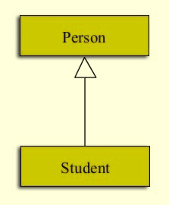
Inheritance in Python
A universal fact that every student is a person. To depict this relationship, we take an illustration.
The relationship from person to a student is termed ‘Specialization’. Conversely, every student is a person, this is called ‘Generalization’. In this representation, we use an arrow towards the base class as a UML (Unified Modeling Language) convention.
Here, Person can be called any of the following:
Super Class
Parent Class
Base Class
Likewise, Student here is:
Sub Class
Child Class
Derived Class

Slide 11
Python Inheritance Syntax
To make a class inherit from another, we apply the name of the base class in parentheses to the derived class definition.
class Person:
pass
class Student(Person):
pass
issubclass(Student,Person)
Output
True
In the above example class Student inherits from class Person.
As we focus on the python syntax, we use the ‘pass’ statement in the bodies of the classes. Also, we use the function issubclass() to confirm that student is a subclass of person.

Slide 12
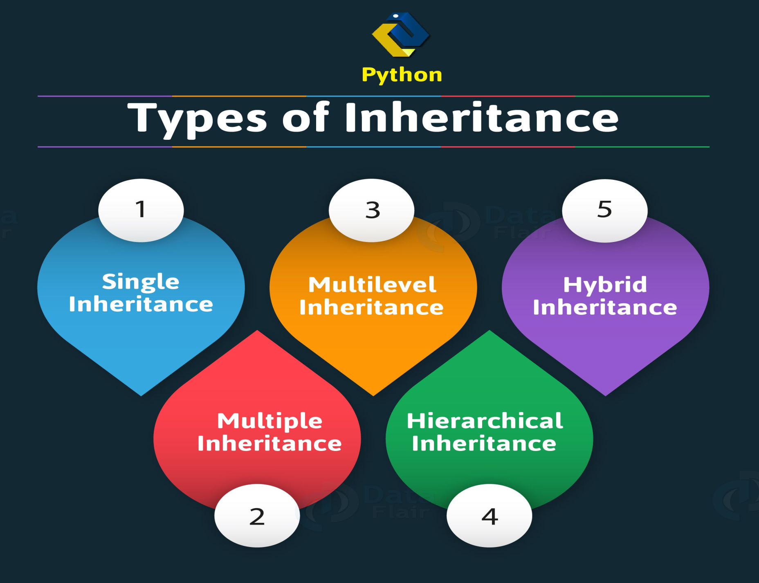
Types of Inheritance in Python

Slide 13
Types of Inheritance in Python
Single Inheritance in Python
A single Python inheritance is when a single class inherits from a class.
x=0
class fruit:
def __init__(self):
global x
x+=1
print("I'm a fruit")
class citrus(fruit):
def __init__(self):
super().__init__()
global x
x+=2
print("I'm citrus")
x
lime=citrus()
Output is
I’m a fruit
I’m citrus
x
Output is
3

Slide 14
Types of Inheritance in Python
b. Python Multiple Inheritance
Multiple Python inheritance are when a class inherits from multiple base classes.
class Color:
pass
class Fruit:
pass
class Orange(Color,Fruit):
pass
issubclass(Orange,Color) and issubclass(Orange,Fruit)
Output is → True

Slide 15
Types of Inheritance in Python
c. Multilevel Inheritance in Python
When one class inherits from another, which in turn inherits from another, it is multilevel python inheritance.
class A:
x=1
class B(A):
pass
class C(B):
pass
cobj=C()
To fetch x value call → cobj.x
Output is: 1

Slide 16
Types of Inheritance in Python
d. Hierarchical Inheritance in Python
When more than one class inherits from a class, it is hierarchical Python inheritance.
class A:
pass
class B(A):
pass
class C(A):
pass
issubclass(B,A) and issubclass(C,A)
Output is → True

Slide 17
Types of Inheritance in Python
e. Hybrid Inheritance in Python
Hybrid Python inheritance is a combination of any two kinds of inheritance.
class A:
x=1
class B(A):
pass
class C(A):
pass
class D(B,C):
pass
dobj=D()
dobj.x
Output is --> 1

Slide 18
Python Inheritance Super Function – Super()
With inheritance, the super() function in python actually comes in quite handy. It allows us to call a method from the parent class.
class Vehicle:
def start(self):
print("Starting engine")
def stop(self):
print("Stopping engine")
class TwoWheeler(Vehicle):
def say(self):
super().start()
print("I have two wheels")
super().stop()
Pulsar=TwoWheeler()
Let us call Pulsar.say()
Output is as below:
Starting engine
I have two wheels
Stopping engine

Slide 19
Python Override Method
A subclass may change the functionality of a Python method in the super class. It does so by redefining it. This is termed python method overriding. Example as below.
class A:
def sayhi(self):
print("I'm in A")
class B(A):
def sayhi(self):
print("I'm in B")
bobj=B()
Perform the function as below:
bobj.sayhi()
The output is:
I’m in B

Slide 20
Python Method Overloading
Like other object languages (for example method overloading in C++ or Java) do, python does not supports method overloading. We may overload the methods but can only use the latest defined method.
# First product method.
# Takes two argument and print their
# product
def product(a, b):
p = a * b
print(p)
# Second product method
# Takes three argument and print their
# product
def product(a, b, c):
p = a * b*c
print(p)
# Uncomment the below line shows an error
# product(4, 5)
# This line will call the second product method
product(4, 5, 5)
Output: 100
(Python keeps only the latest definition of a method you declare to it)

Slide 21
Python Method Overloading
However we may use other implementation in python to make the same function work differently i.e. as per the arguments.
# Function to take multiple arguments
def add(datatype, *args):
if datatype =='int':
answer = 0
if datatype =='str':
answer =''
for x in args:
answer = answer + x
print(answer)
# Integer
add('int', 5, 6) → 11
# String
add('str', 'Hi ', 'Geeks') → Hi Geeks

Slide 22
Python Operator Overloading
Operator-Overloading → giving extended meaning beyond their predefined operational meaning.
For example: operator +
is used to add two integers
join two strings
merge two lists
It is achievable because ‘+’ operator is overloaded by int class and str class. The same built-in operator or function shows different behavior for objects of different classes, this is called Operator Overloading.
In the programming world, operator overloading is also called Operator Ad-hoc Polymorphism.
Indeed, it is a case of Polymorphism where different operators have different implementations based on their arguments. This is either defined by the programmer, by the programming language, or both.

Slide 23
Python Operator Overloading
# Python program to show use of
# + operator for different purposes.
print(1 + 2)
# concatenate two strings
print("Geeks"+"For")
# Product two numbers
print(3 * 4)
# Repeat the String
print("Geeks"*4)
Output:
3
GeeksFor
12
GeeksGeeksGeeksGeeks

Slide 24
Python Magic Methods
Magic methods in Python are the special methods which add "magic" to your class. Magic methods are not meant to be invoked directly by you, but the invocation happens internally from the class on a certain action. For example, when you add two numbers using the + operator, internally, the __add__() method will be called.
#Python Program illustrate how to overload an binary + operator
class A:
def __init__(self, a):
self.a = a
# adding two objects
def __add__(self, o):
return self.a + o.a
ob1 = A(1)
ob2 = A(2)
ob3 = A("Geeks")
ob4 = A("For")
print(ob1 + ob2)
print(ob3 + ob4)
Output :
3
GeeksFor

Slide 25
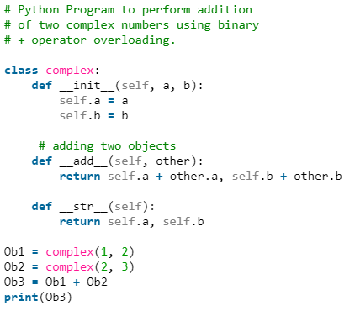
Python Magic Methods
Code 2:
Output:
(3, 5)

Slide 26
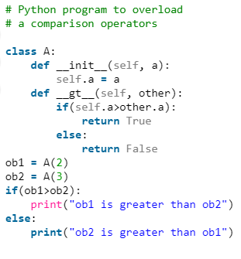
Python Magic Methods
Overloading comparison operators in Python :
Output:
ob2 is greater than ob1

Slide 27
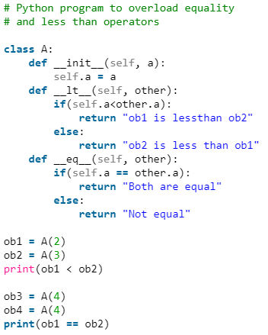
Python Magic Methods
Overloading equality and less than operators :
Output :
ob1 is lessthan ob2
Not equal

Slide 28
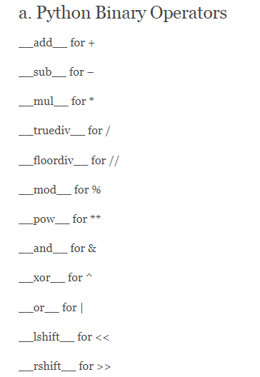
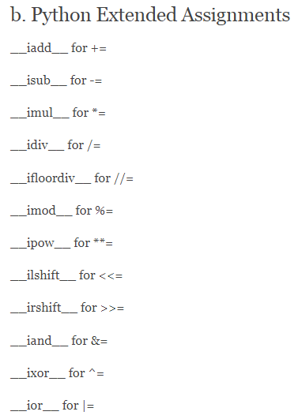
Python Magic Methods

Slide 29
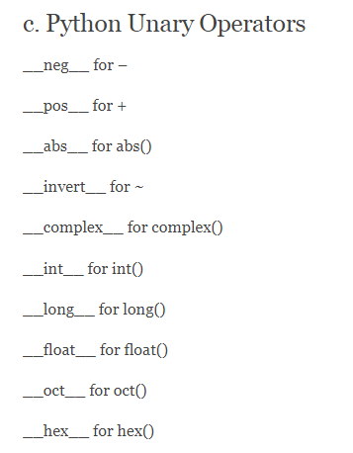
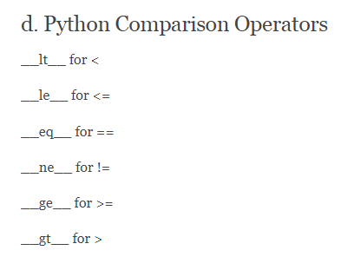
Python Magic Methods

Slide 30
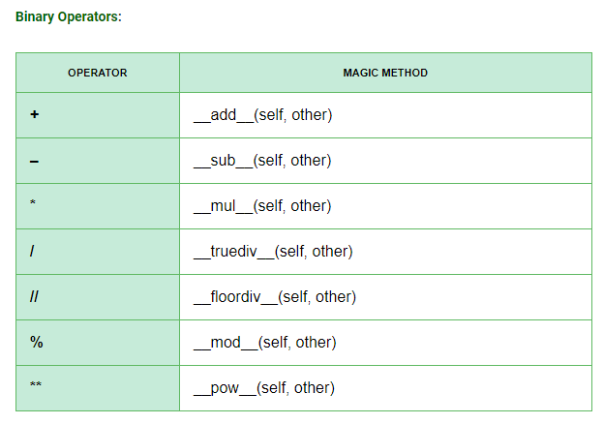
Python Magic Methods

Slide 31
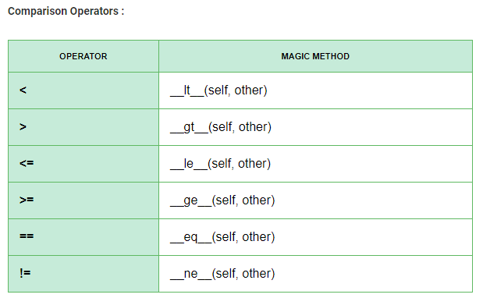
Python Magic Methods

Slide 32
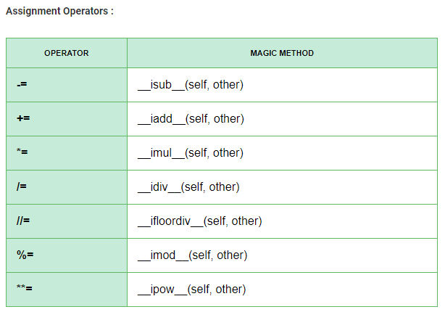
Python Magic Methods

Slide 33
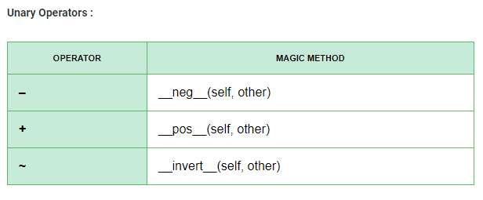
Python Magic Methods

Slide 34
Why Us
Kaushalya is built by IT Professions having experience in academia
Our vision is to Skill, Up-Skill and Re-Skill in order to bridge the gap between academia and industry
Training is conducted by experienced IT Professionals
Vendors for major educational institutions and corporates

Slide 35

Thank You

