Slide 1

Crash course on Fullstack Web Application Development using Angular,Spring Boot and MySQL
Raghu Prasad K S
CEO
www.kaushalya.tech
9845547471

Slide 2
Introduction
Raghu Prasad – BE, MS
Total of 24 years of experience
7 years as a lecturer in Engineering College
17 Years into IT
Worked with companies like CISCO,CSC,ICICI,First Apex – NTT Data
Started Kaushalya Technologies an EduTechnology company in 2017
Currently into Corporate training,consultancy and application development
Worked with corporates and public sector
Technologies – Java,Python,Data Sciences,Web technologies,Java Script technologies (MEAN stack),IOT,Test Automation – Selenium,JMeter

Slide 3
Course Outline
Introduction to Fullstack Web Application Develoment
Technologies related to Fullstack web application
Demonstration of Fullstack Web Application

Slide 4
Course Objective
Learn and explore Fullstack application development using Java and Angular
Learn by coding
Develop end to end module of a full web application development

Slide 5
Fullstack Web Application Development
Full stack development: It refers to the development of both front end(client side) and back end(server side) portions of web application.
Full stack web Developers: Full stack web developers have the ability to design complete web application and websites. They work on the frontend, backend, database and debugging of web application or websites.

Slide 6
Technologies related to fullstack development
Front end: It is the visible part of website or web application which is responsible for user experience. The user directly interacts with the front end portion of the web application or website.
Languages – HTML/CSS/Java Script/AJAX
Frameworks and Libraries – Angular,React,Bootstrap,Jquery,SAAS
Back end: It refers to the server-side development of web application or website with a primary focus on how the website works. It is responsible for managing the database through queries and APIs by client-side commands
Languages – PHP/C++/Java/Python/JavaScript-Node.js
Frameworks and Libraries – Express,Django,Rails,Laravel,Spring
Database – Oracle,MySQL,MongoDB,MSSQL,PostgreSQL

Slide 7
Technologies related to fullstack development
Popular Stacks
MEAN (Mongo,Express,Angular,Node)
MERN (Mongo,Express,React,Node)
Django (Django,Python,MySQL)
Rails or Ruby on Rails (Ruby,PHP,MySQL)
LAMP (Linux,Apache,MySQL,PHP)
Hybrid Stacks
Angular,Java,Spring
React,Java,Spring
Angular,Python,Django

Slide 8
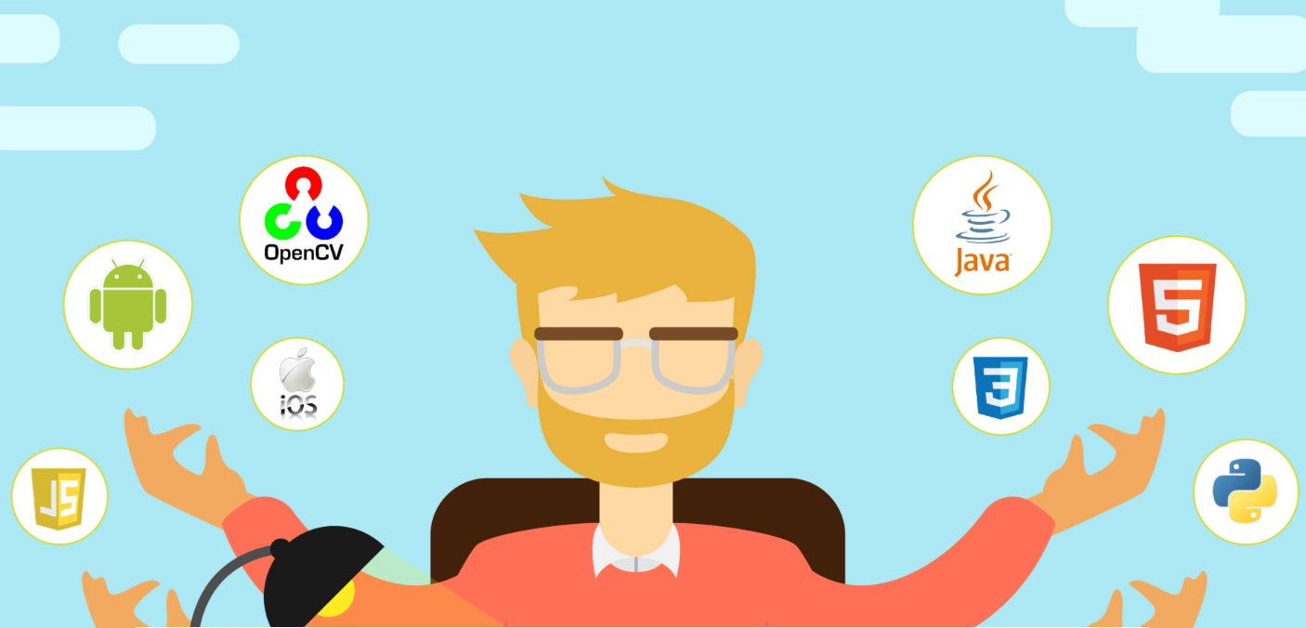
Fullstack Developer

Slide 9
Key skills of a full stack developer
Understand customer need and develop a use case
Convert use case into wire frame and user interface
Understand and implement responsive webdesign
Develop front end code
Understand project architecture and implement relevant design pattern.
Develop web services for backend integration
Understand the mechanism of interfacing with third party softwares
Such as ERP,payment gateway,etc
Develop backend code and interface with database (RDBMS,NoSQL,ORM)
Unit and integration testing

Slide 10
Web Application Architecture
The web application architecture describes the interactions between applications, databases, and middleware systems on the web. It ensures that multiple applications work simultaneously.
Service Oriented Architecture (SOA)
Model View Controller (MVC)
Single Page Applications (SPA)
Microservices
Serverless Architecture

Slide 11
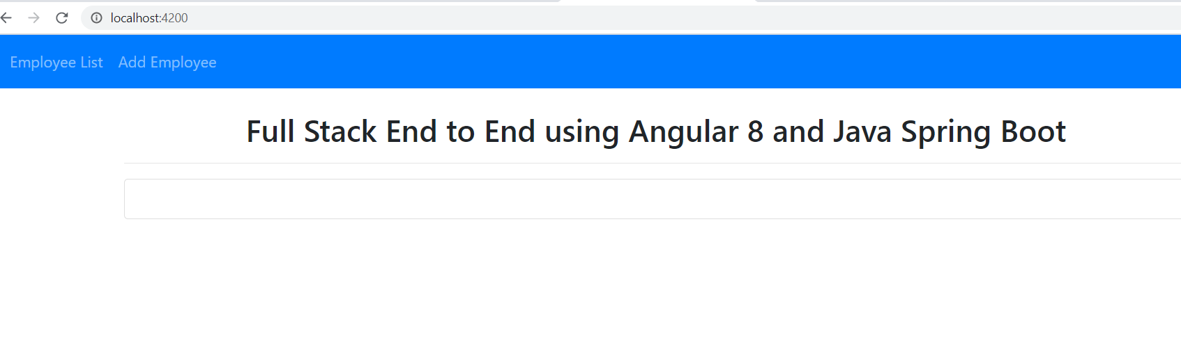
Employee Registration – Home Page

Slide 12
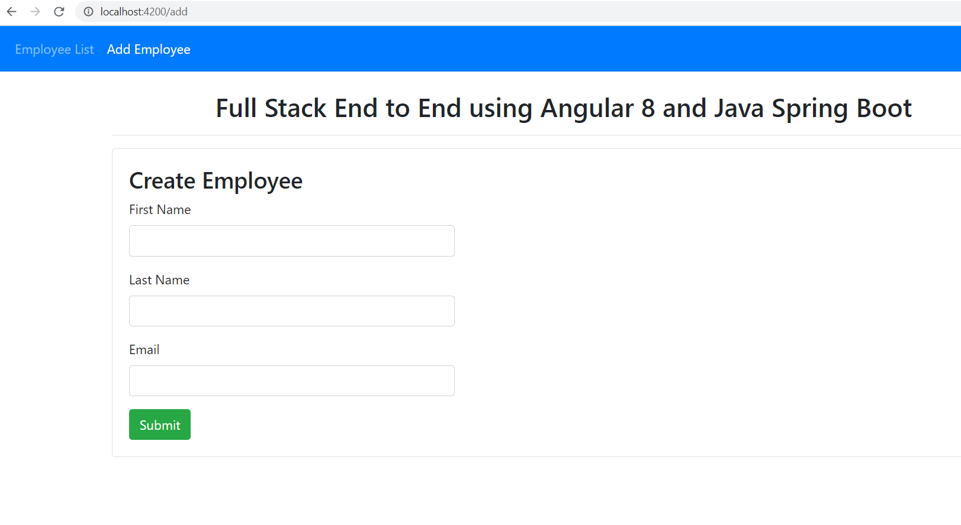
Employee Registration – Add Employee

Slide 13
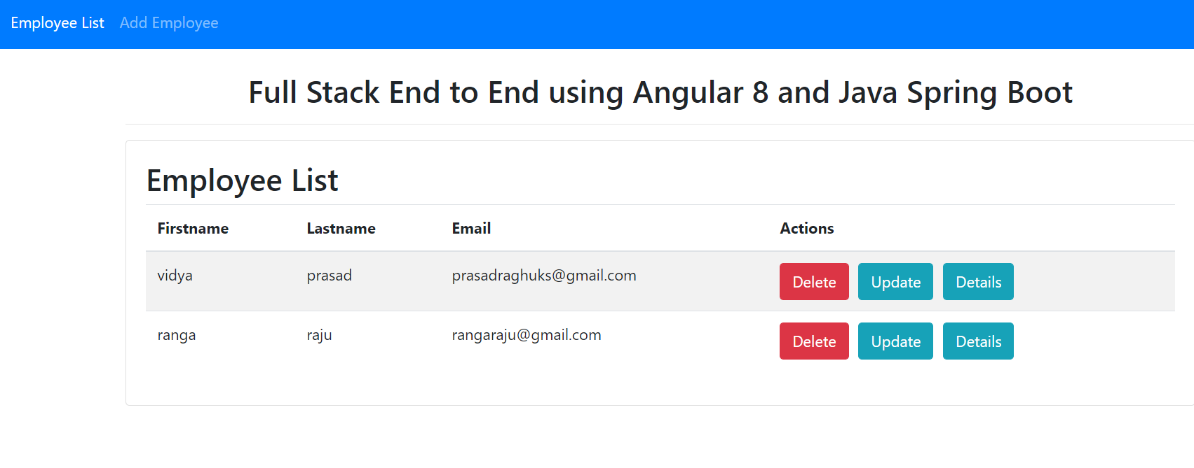
Employee Registration – List Employee

Slide 14
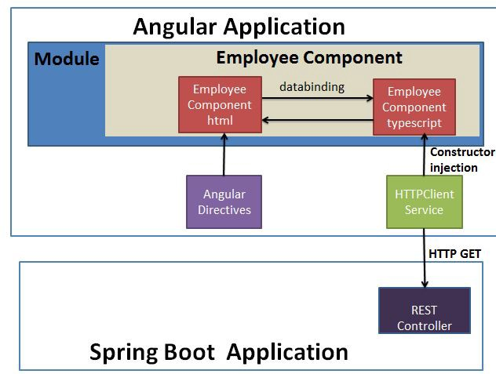
Architecture

Slide 15
Steps for Development
1. Create backend application using Spring Boot
Use https://start.spring.io/ to create project structure
Download the project structure and import as maven project
Create Download the project structure and import as maven project
Create employee entity
Create Employee Rest Controller
Create Service End points for CRUD operation
Test backend using Postman

Slide 16
Steps for Development
2. Create frontend application using Angular 8
Create angular project using Angular CLI
Create following components
create-employee
employee-details
employee-list
update-employee
Create model
Employees
Create service
Employeeservice
End to end testing
Reference - https://www.javaguides.net/2019/06/spring-boot-angular-8-crud-part-1-develop-springboot-crud-rest-apis.html

Slide 17
Happy Coding
Thanks
Visit – www.kaushalya.tech
9845547471

