Slide 1
Spring and Spring Boot
Raghu Prasad K S
www.kaushalya.tech
9845547471

Slide 2
Introduction
Raghu Prasad – BE, MS
Total of 24 years of experience
7 years as a lecturer in Engineering College
17 Years into IT
Worked with companies like CISCO, CSC, ICICI, First Apex – NTT Data
Started Kaushalya Technologies an EduTechnology company in 2017
Currently into Corporate training, consultancy and application development
Worked with corporates and public sector
Technologies – Java, Python, DataSciences, Web Technologies, Java Script technologies (MEAN stack), IOT, Test Automation – Selenium, JMeter

Slide 3
Course Outline
Introduction to Spring
IOC and Dependency Injection
Advantages
Introduction to Spring Boot

Slide 4
Course Objectives
Learn and explore Spring and Spring Boot
Learn by coding
Understand XML based configuration
Understand Annotation based configuration

Slide 5
Introduction to Spring
Spring is a lightweight framework. It can be thought of as a framework of frameworks because it provides support to various frameworks such as Struts, Hibernate, Tapestry, EJB, JSF etc. The framework, in broader sense, can be defined as a structure where we find solution of the various technical problems.
The Spring framework comprises several modules such as IOC, AOP, DAO, Context, ORM, WEB MVC etc.

Slide 6
Inversion Of Control (IOC) and Dependency Injection
These are the design patterns that are used to remove dependency from the programming code. They make the code easier to test and maintain.
class Employee{
Address address;
Employee(){
address=new Address(); } }
In such case, there is dependency between the Employee and Address (tight coupling). In the Inversion of Control scenario, we do this something like this:

Slide 7
Inversion Of Control (IOC) and Dependency Injection
class Employee{
Address address;
Employee(Address address){
this.address=address; } }
Thus, IOC makes the code loosely coupled. In such case, there is no need to modify the code if our logic is moved to new environment.
In Spring framework, IOC container is responsible to inject the dependency. We provide metadata to the IOC container either by XML file or annotation.

Slide 8
Inversion Of Control (IOC) and Dependency Injection
Advantage of Dependency Injection
makes the code loosely coupled so easy to maintain
makes the code easy to test

Slide 9
Advantages of Spring Framework
1) Predefined Templates
Spring framework provides templates for JDBC, Hibernate, JPA etc. technologies. So there is no need to write too much code. It hides the basic steps of these technologies.
Let's take the example of JdbcTemplate, you don't need to write the code for exception handling, creating connection, creating statement, committing transaction, closing connection etc. You need to write the code of executing query only. Thus, it save a lot of JDBC code.
2) Loose Coupling
The Spring applications are loosely coupled because of dependency injection.

Slide 10
Advantages of Spring Framework
3) Easy to test
The Dependency Injection makes easier to test the application. The EJB or Struts application require server to run the application but Spring framework doesn't require server.
4) Lightweight
Spring framework is lightweight because of its POJO implementation. The Spring Framework doesn't force the programmer to inherit any class or implement any interface. That is why it is said non-invasive.
5) Fast Development
The Dependency Injection feature of Spring Framework and it support to various frameworks makes the easy development of JavaEE application.

Slide 11
Advantages of Spring Framework
6) Powerful abstraction
It provides powerful abstraction to JavaEE specifications such as JMS, JDBC, JPA and JTA.
7) Declarative support
It provides declarative support for caching, validation, transactions and formatting.

Slide 12
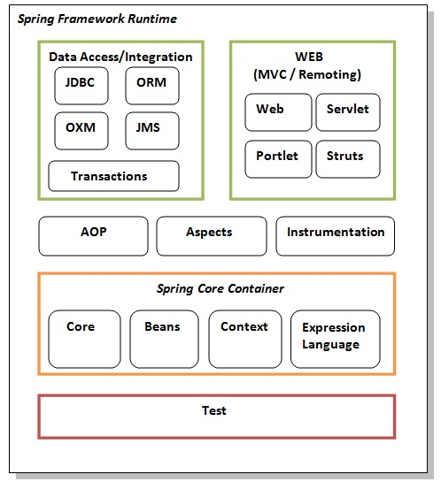
Spring Modules

Slide 13
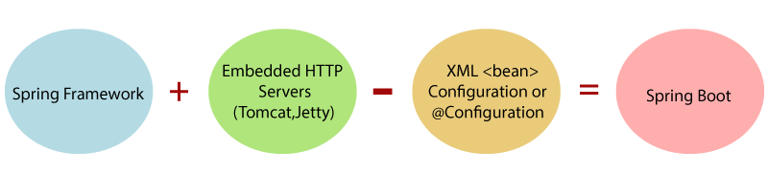
Spring Boot
Spring Boot is a Spring module that provides the RAD (Rapid Application Development) feature to the Spring framework.
Our Spring Boot Tutorial includes all topics of Spring Boot such, as features, project, maven project, starter project wizard, Spring Initializr, CLI, applications, annotations, dependency management, properties, starters, Actuator, JPA, JDBC, etc.

Slide 14
Spring Boot
Why should we use Spring Boot Framework?
We should use Spring Boot Framework because:
The dependency injection approach is used in Spring Boot.
It contains powerful database transaction management capabilities.
It simplifies integration with other Java frameworks like JPA/Hibernate ORM, Struts, etc.
It reduces the cost and development time of the application.

Slide 15
Spring Boot
Other Projects
Spring Data: It simplifies data access from the relational and NoSQL databases.
Spring Batch: It provides powerful batch processing.
Spring Security: It is a security framework that provides robust security to applications.
Spring Social: It supports integration with social networking like LinkedIn.
Spring Integration: It is an implementation of Enterprise Integration Patterns. It facilitates integration with other enterprise applications using lightweight messaging and declarative adapters.

Slide 16
Spring Boot
Other Projects
Spring Data: It simplifies data access from the relational and NoSQL databases.
Spring Batch: It provides powerful batch processing.
Spring Security: It is a security framework that provides robust security to applications.
Spring Social: It supports integration with social networking like LinkedIn.
Spring Integration: It is an implementation of Enterprise Integration Patterns. It facilitates integration with other enterprise applications using lightweight messaging and declarative adapters.

Slide 17
Spring Boot
Advantages of Spring Boot
It creates stand-alone Spring applications that can be started using Java -jar.
It tests web applications easily with the help of different Embedded HTTP servers such as Tomcat, Jetty, etc. We don't need to deploy WAR files.
It provides opinionated 'starter' POMs to simplify our Maven configuration.
It provides production-ready features such as metrics, health checks, and externalized configuration.
There is no requirement for XML configuration.
It offers a CLI tool for developing and testing the Spring Boot application.
It offers the number of plug-ins.
It also minimizes writing multiple boilerplate codes (the code that has to be included in many places with little or no alteration), XML configuration, and annotations.
It increases productivity and reduces development time.

Slide 18
Spring Boot
Limitations of Spring Boot
Spring Boot can use dependencies that are not going to be used in the application. These dependencies increase the size of the application.
Goals of Spring Boot
The main goal of Spring Boot is to reduce development, unit test, and integration test time.
Provides Opinionated Development approach
Avoids defining more Annotation Configuration
Avoids writing lots of import statements
Avoids XML Configuration.
By providing or avoiding the above points, Spring Boot Framework reduces Development time, Developer Effort, and increases productivity.

Slide 19
Q&A Session
Thanks
Visit – www.kaushalya.tech
9845547471

