Slide 1
Spring
Raghu Prasad K S
www.kaushalya.tech
9845547471

Slide 2
Introduction
Raghu Prasad – BE, MS
Total of 24 years of experience
7 years as a lecturer in Engineering College
17 Years into IT
Worked with companies like CISCO, CSC, ICICI, First Apex – NTT Data
Started Kaushalya Technologies an EduTechnology company in 2017
Currently into Corporate training, consultancy and application development
Worked with corporates and public sector
Technologies – Java, Python, DataSciences, Web Technologies, Java Script technologies (MEAN stack), IOT, Test Automation – Selenium, JMeter

Slide 3
Course Outline
Introduction to Spring
IOC and Dependency Injection
Advantages

Slide 4
Course Objectives
Learn and explore Spring
Learn by coding
Understand XML based configuration
Understand Annotation based configuration

Slide 5
Introduction to Spring
Spring is a lightweight framework. It can be thought of as a framework of frameworks because it provides support to various frameworks such as Struts, Hibernate, Tapestry, EJB, JSF etc. The framework, in broader sense, can be defined as a structure where we find solution of the various technical problems.
The Spring framework comprises several modules such as IOC, AOP, DAO, Context, ORM, WEB MVC etc.

Slide 6
Inversion Of Control (IOC) and Dependency Injection
These are the design patterns that are used to remove dependency from the programming code. They make the code easier to test and maintain.
class Employee{
Address address;
Employee(){
address=new Address(); } }
In such case, there is dependency between the Employee and Address (tight coupling). In the Inversion of Control scenario, we do this something like this:

Slide 7
Inversion Of Control (IOC) and Dependency Injection
class Employee{
Address address;
Employee(Address address){
this.address=address; } }
Thus, IOC makes the code loosely coupled. In such case, there is no need to modify the code if our logic is moved to new environment.
In Spring framework, IOC container is responsible to inject the dependency. We provide metadata to the IOC container either by XML file or annotation.

Slide 8
Inversion Of Control (IOC) and Dependency Injection
Advantage of Dependency Injection
makes the code loosely coupled so easy to maintain
makes the code easy to test

Slide 9
Advantages of Spring Framework
1) Predefined Templates
Spring framework provides templates for JDBC, Hibernate, JPA etc. technologies. So there is no need to write too much code. It hides the basic steps of these technologies.
Let's take the example of JdbcTemplate, you don't need to write the code for exception handling, creating connection, creating statement, committing transaction, closing connection etc. You need to write the code of executing query only. Thus, it save a lot of JDBC code.
2) Loose Coupling
The Spring applications are loosely coupled because of dependency injection.

Slide 10
Advantages of Spring Framework
3) Easy to test
The Dependency Injection makes easier to test the application. The EJB or Struts application require server to run the application but Spring framework doesn't require server.
4) Lightweight
Spring framework is lightweight because of its POJO implementation. The Spring Framework doesn't force the programmer to inherit any class or implement any interface. That is why it is said non-invasive.
5) Fast Development
The Dependency Injection feature of Spring Framework and it support to various frameworks makes the easy development of JavaEE application.

Slide 11
Advantages of Spring Framework
6) Powerful abstraction
It provides powerful abstraction to JavaEE specifications such as JMS, JDBC, JPA and JTA.
7) Declarative support
It provides declarative support for caching, validation, transactions and formatting.

Slide 12
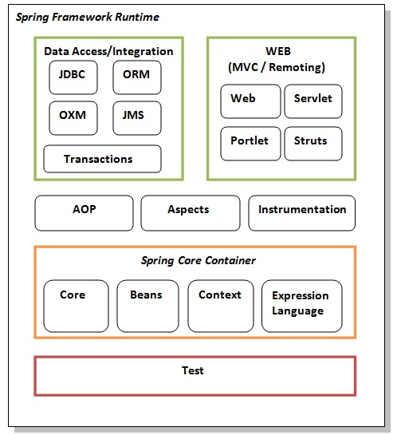
Spring Modules

Slide 13
Q&A Session
Thanks
Visit – www.kaushalya.tech
9845547471

